Slide 1
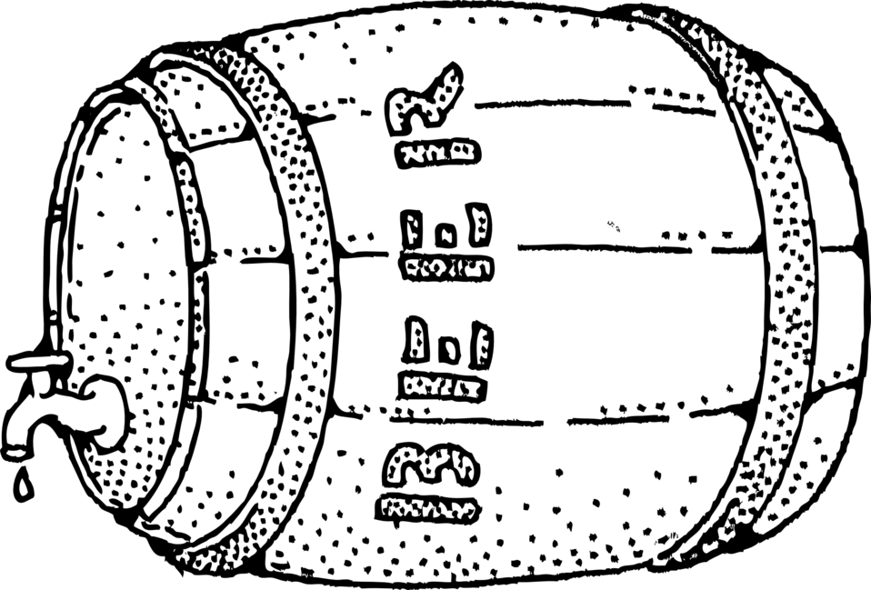
The Effects of Alcohol in the CNMI, Including the U.S.
MY ENGLISH RESEARCH PORTFOLIO
By Mariah Santos
Northern Marianas College

Slide 2
PROJECT:
SECTION I: PREPARATION OF DOCUMENTS
Brainstorm
Proposal
Outline
Reading Notes (Annotated Bibliography)
Schedule & Log
Required Draft

Slide 3
Brainstorm:
The purpose of a brainstorm is to help the writer organize and list the ideas of the topic they are writing about.

Slide 4
Brainstorm:
Choosing a Topic:
Reflecting on 2
Potential Topics:
Anchor Babies in CNMI
The Effects of Alcohol in CNMI
Criteria
Sources Availability
Interest
Time Limitations
TOPIC 2:
TOPIC 1:

Slide 5
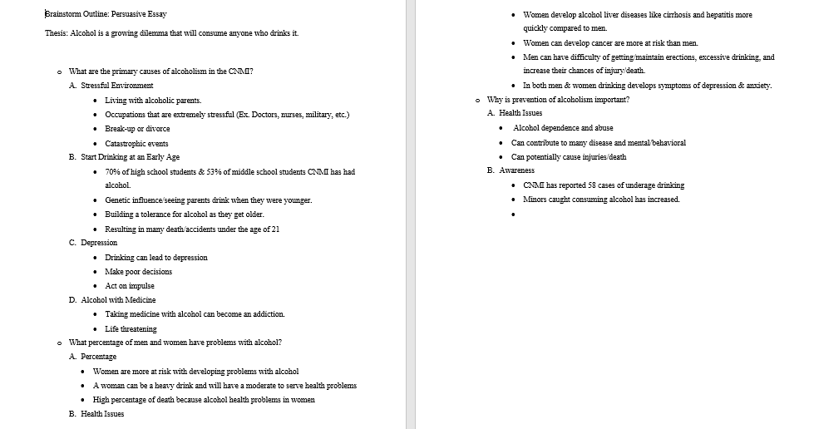
Sample Brainstorm:
Can the sources be easy to locate?
Can I achieve my goal on time?
Is it short term or long term step?
Problems & Benefits?
Is it something I Can build upon or publish?
Does it require any special skills or contacts?
What sort of research methods are used?
Does it need outside help and is it dependable?
Does it meet my time limit to conduct literature review, study and write up?
Is it valuable to others?

Slide 6
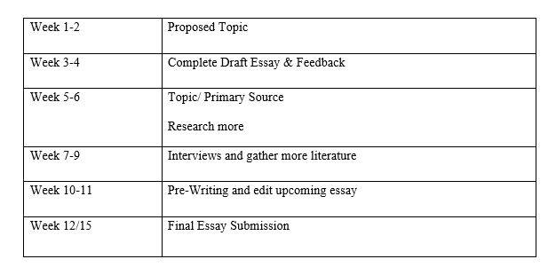
Research Proposal
My Research Proposal
Introduction
Literature Review
Research Question
Research Methodology
References
Tentative Schedule
Introduction: Importance of chosen topic: The third leading cause of death is alcohol. Many people are unaware of the potential dangers they have face when consuming alcohol.
Research Question: What are the primary causes of alcoholism in the CNMI? What percentage of men and women have problems with alcohol? What harmful effect does alcohol have on a person? Why is alcohol prevention importance?
Literature Review: Purpose is explaining how alcohol abuse affects people’s health with detailed information.
Research, Methodology, references, & schedule will be included in proposal.

Slide 7
Portfolio Outline:
INTRODUCTION
General Thesis
Importance
Detailed Thesis
BODY PARAGRAPH 1
Topic Sentence
Support
APA Quote
Transition Sentence
BODY PARAGRAPH 2
Topic Sentence
Support
Paraphrase
Transition Sentence
BODY PARAGRAPH 3
Topic Sentence
Concluding Sentence
CONCLUSION
Topic Sentence
Summary Statement
Concluding Statement

Slide 8
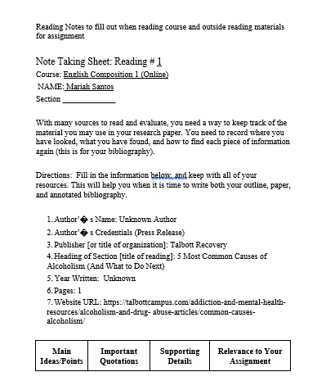
Reading Notes:
Reading Notes contain information about the effects of alcohol. It’s an organizational tool to help organize quotations, terms, and important points that the reader may want to include.

Slide 9
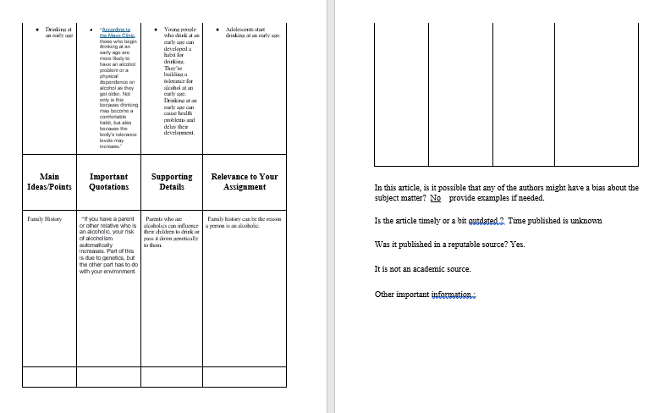
Reading Notes:
Quick Note/ Quotation

Slide 10
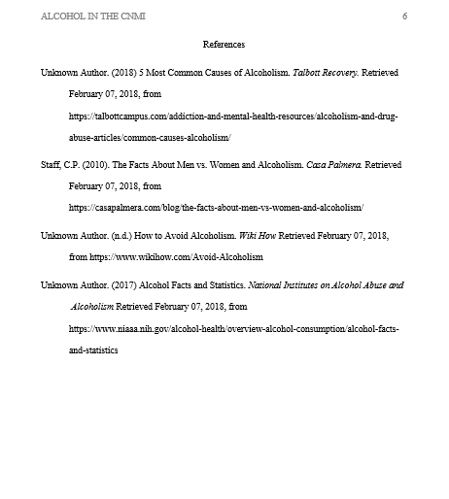
Reading Notes
APA
Unknown Author. (2018) 5 Most Common Causes of Alcoholism. Talbott Recovery. Retrieved February 07, 2018.

Slide 11
Schedule & Log
Updated Research & Writing Process throughout the project.

Slide 12
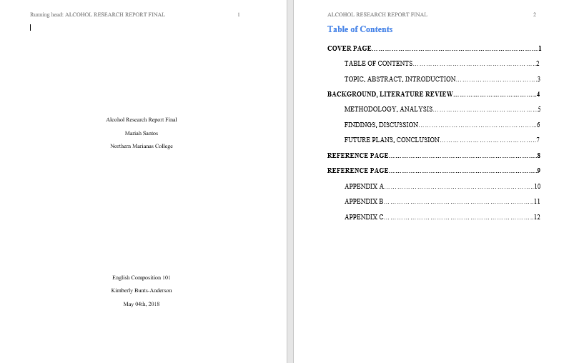
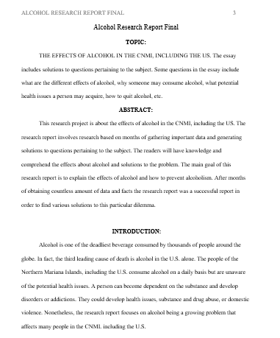
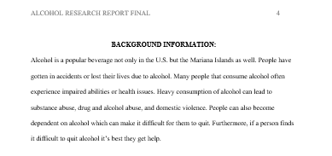
Research Proposal Draft In Sections
Section 1
Cover Page
Table of Contents
Abstract
Introduction of the topic
Background of the topic
Reasons for topic
Support for topic choice and your research questions

Slide 13
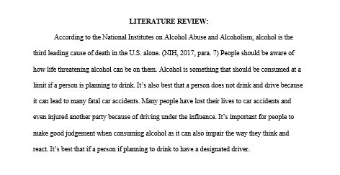
Research Proposal Draft In Sections
Section II
Literature Review

Slide 14
Research Proposal Draft In Sections
How old were you when you first started drinking?
What is the reason you started drinking?
Do you still consume alcohol up till now?
How often do you drink?
What type of alcohol do you consume?
When you were younger did your parents drink around you?
Have you ever taken alcohol with another substance?
Did you ever experience any health issues? If yes, please write the complications.
How many cans of alcohol can you drink a night?
Have you ever tried to quit drinking?
How did you stop drinking?
Is alcohol a habit for you?
In your opinion, how should we prevent alcoholism in the CNMI?
Section II
The organization of literature review & research questions
Support
Clear & short to the point information on how it was chosen

Slide 15
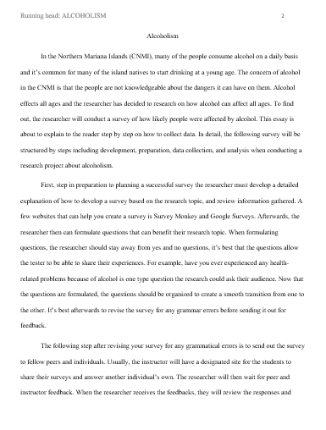
Research Proposal Draft In Sections
Section III
In this section, various amount of research was collected about alcohol. Countless time and effort was spent to gather various types of data and facts for this research project. A survey was created in order to obtain data about alcohol and gain knowledge of people's experience and opinions of the subject. A process essay was completed and it obtains details of how the survey was completed and how the information gathered was useful to the research report. The readers will understand how to generate questions, gather data, and relate the information gathered to the research report. In addition, a letter containing questions was developed in order to obtain expert opinion of the subject. An expository essay was completed and it contains the questionnaire and answers from the expert.

Slide 16
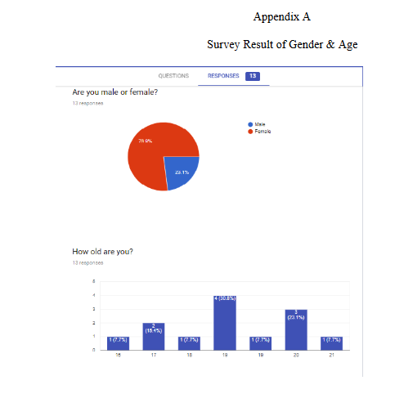
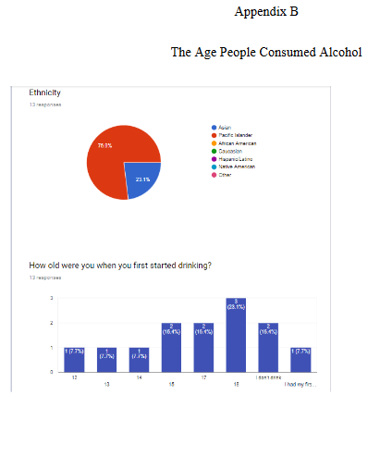
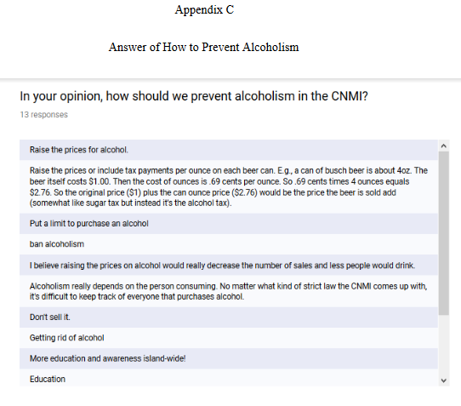
Research Proposal Draft In Sections
Section IV

Slide 17
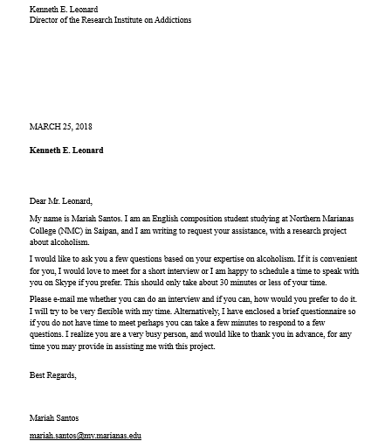
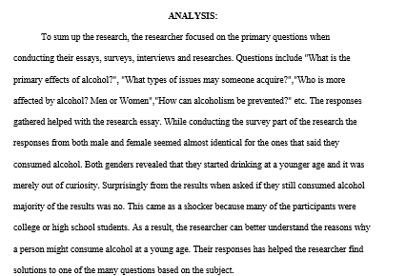
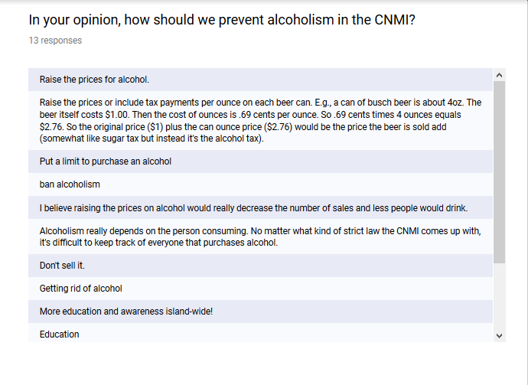
Research Proposal Draft In Sections
Section V
Analysis, letter to experts, surveys, responses, etc.

Slide 18
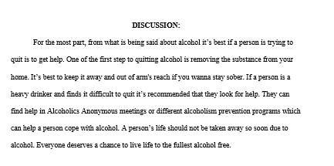
Research Proposal Draft In Sections
Section VI
For the most part, from what is being said about alcohol it’s best if a person is trying to quit is to get help. One of the first step to quitting alcohol is removing the substance from your home. It’s best to keep it away and out of arm's reach if you wanna stay sober. If a person is a heavy drinker and finds it difficult to quit it’s recommended that they look for help. They can find help in Alcoholics Anonymous meetings or different alcoholism prevention programs which can help a person cope with alcohol. A person’s life should not be taken away so soon due to alcohol. Everyone deserves a chance to live life to the fullest alcohol free.

Slide 19
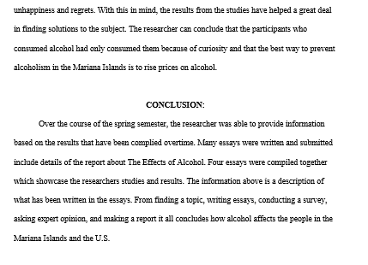
Research Proposal Draft In Sections
Section VII
Over the course of the spring semester, the researcher was able to provide information based on the results that have been complied overtime. Many essays were written and submitted include details of the report about The Effects of Alcohol. Four essays were compiled together which showcase the researchers studies and results. The information above is a description of what has been written in the essays. From finding a topic, writing essays, conducting a survey, asking expert opinion, and making a report it all concludes how alcohol affects the people in the Mariana Islands and the U.S.

Slide 20
My English Research Portfolio
Hypothesis:
Research Portfolio
Cover page
Table of Contents
Abstract
Introduction
Background
Methodology
Studies
-Participants
-Results
Analysis & Findings
Discussions
-Future Suggestions
Conclusion
References
Appendices
-Appendix A-C

Slide 21
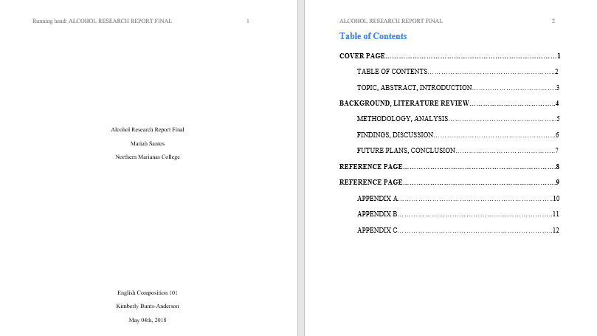
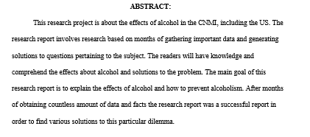
Cover Page, Table of Contents, & Abstract

Slide 22
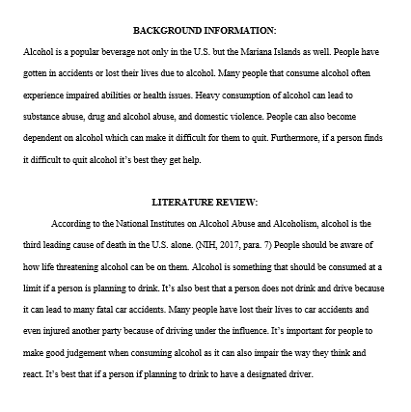
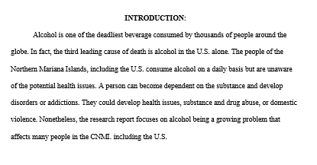
Introduction, Background, & Literature Review

Slide 23
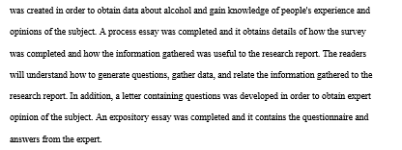
Methodology

Slide 24
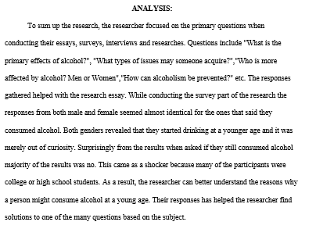
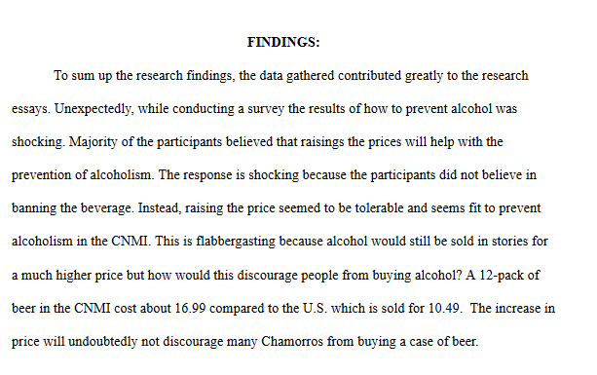
Studies, Participants, Results, & Analysis

Slide 25
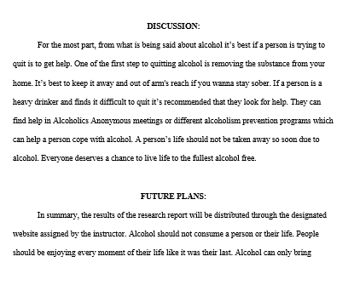
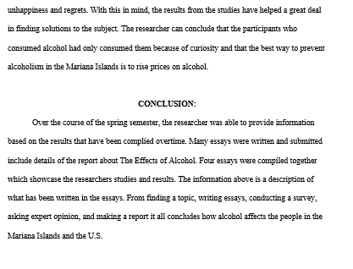
Discussion, Future Suggestions, & Conclusion

Slide 26
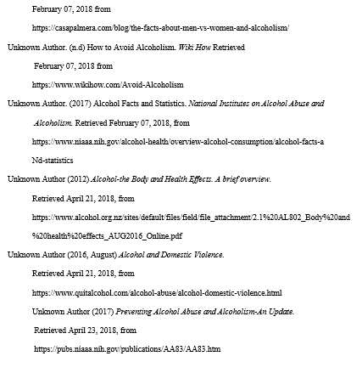
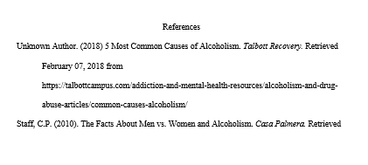
Apa References List

Slide 27
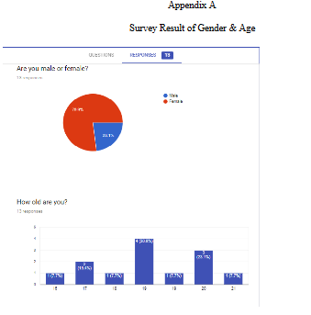
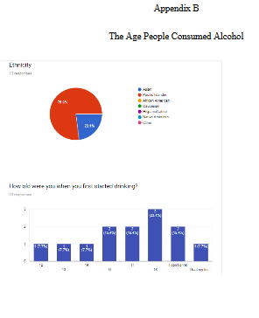
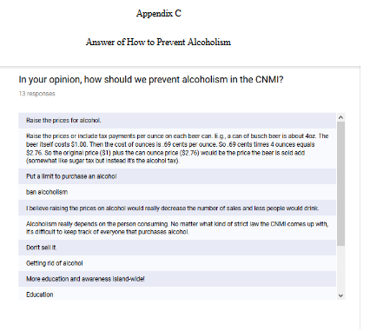
Appendix A-C

Slide 28
The End

