Slide 1
Final 30 Day Challenge
Megan Hemley
BE111-ON01

Slide 2
What was my 30 Day Challenge?
My 30 Day challenge was to quit eating chips. This is because while I was growing up chips were always my go-to snack, especially Flamin’ Hot Cheetos. I would eat it almost every day. I used this challenge to motivate me to finally give up chips completely because I have enough “junk food” in my life, such as Oreos, Ramen Noodles (or soba in general), canned foods, etc.

Slide 3
How did I keep track of my challenge?
I kept track of my challenge by keeping a journal of it every day. It helped me feel like I was really in school with the way I had to write. I also drew in my journal when I felt like it which made me enjoy keeping a journal even more.

Slide 4
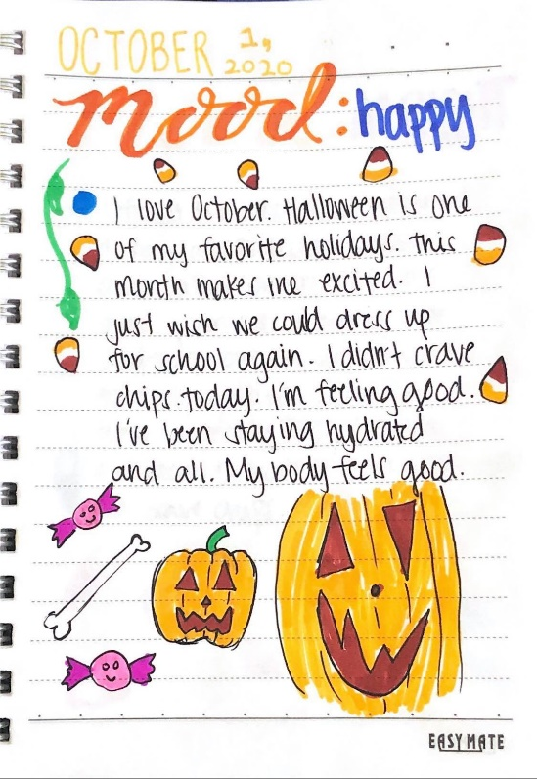
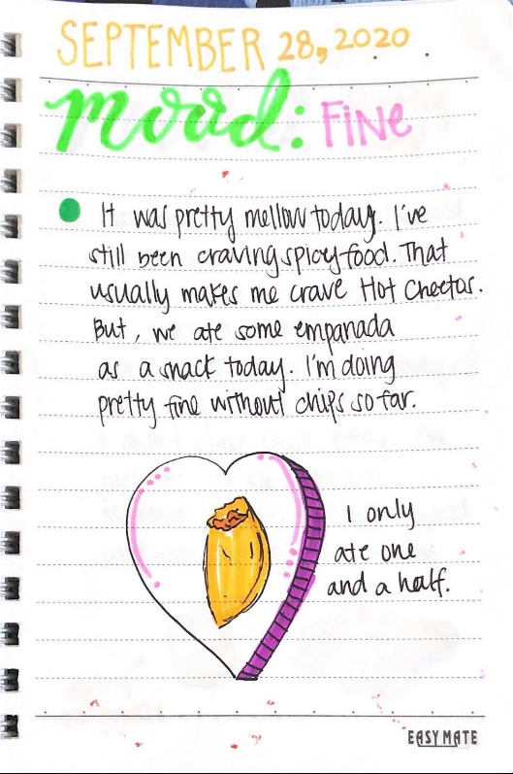
Two of my favorite pages from my journal
Click on this link to see all 31 of my journal day logs:
https://nmcstudentwork.weebly.com/coll-suc-on-fall-2020-mhemley.html

Slide 5
What did I record throughout my challenge?
I decided to record my mood throughout my challenge because I read that your diet can affect your mood, sometimes even making you depressed (Nutritional psychiatry…). I also mentioned my generalized water intake almost every day.

Slide 6
What were some obstacles?
I got into a big situation with one of my close friends over something silly. This caused my mood to go down for a bit. I didn't want to do much the first two days after this happened except school work.
I was with my godsisters most of the ending days of October. They kept trying to give me chips. At first, it was really tempting to eat because they kept trying to feed me it. I did reject though which made me feel like I was progressing.
I got my wisdom tooth pulled out. My water consumption went down and I barely ate for the first three days. I mainly lived off of jello, water, and some soups.

Slide 7
My progress
When the project first started I had just quit eating chips completely for the first time. My mood started off low with “okays”. As the project continued, my mood got higher which meant I got happier and happier. I’ve stopped craving chips and feeling the urge to buy them when I see it. I started drinking more water than I did before. I lost weight too that I didn’t think I would. I’m much happier not eating chips. I can see the progress in my mood changes and the way I feel about myself. My water intake is also increasing and it’s always good being hydrated.

Slide 8
Works Cited:
Selhub, Eva. “Nutritional psychiatry: Your brain on food.” Published 16 November 2015. Last updated 26 March 2020. Harvard Health Publishing. Accessed 25 November 2020. https://www.health.harvard.edu/blog/nutritional-psychiatry-your-brain-on-food-201511168626#:~:text=In%20addition%20to%20worsening%20your,It%20makes%20sense.

