Slide 1
30 days challenge:
Task Management
Billie Jen Lizama
BE 111-10

Slide 2
Why?
I chose to do this 30 Day challenge to see if it really helps me stop my procrastination. I always put my school work as a “priority” but I still tend to procrastinate. So I chose this challenge to see if I can accomplish all my work in time.

Slide 3
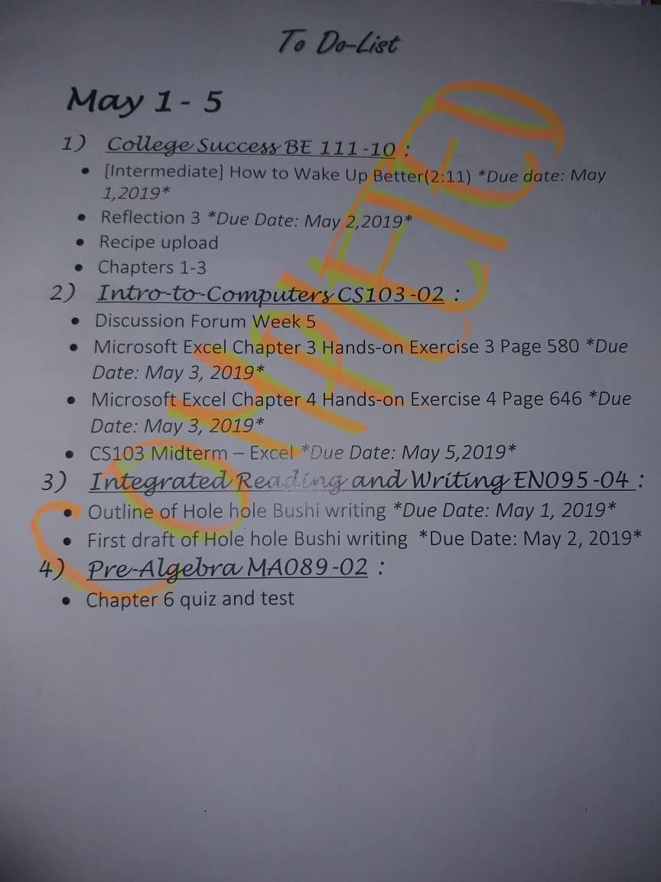
Week 1: May 1-5
I completed all my task for this week. I did most of my assignment advanced for this week.

Slide 4
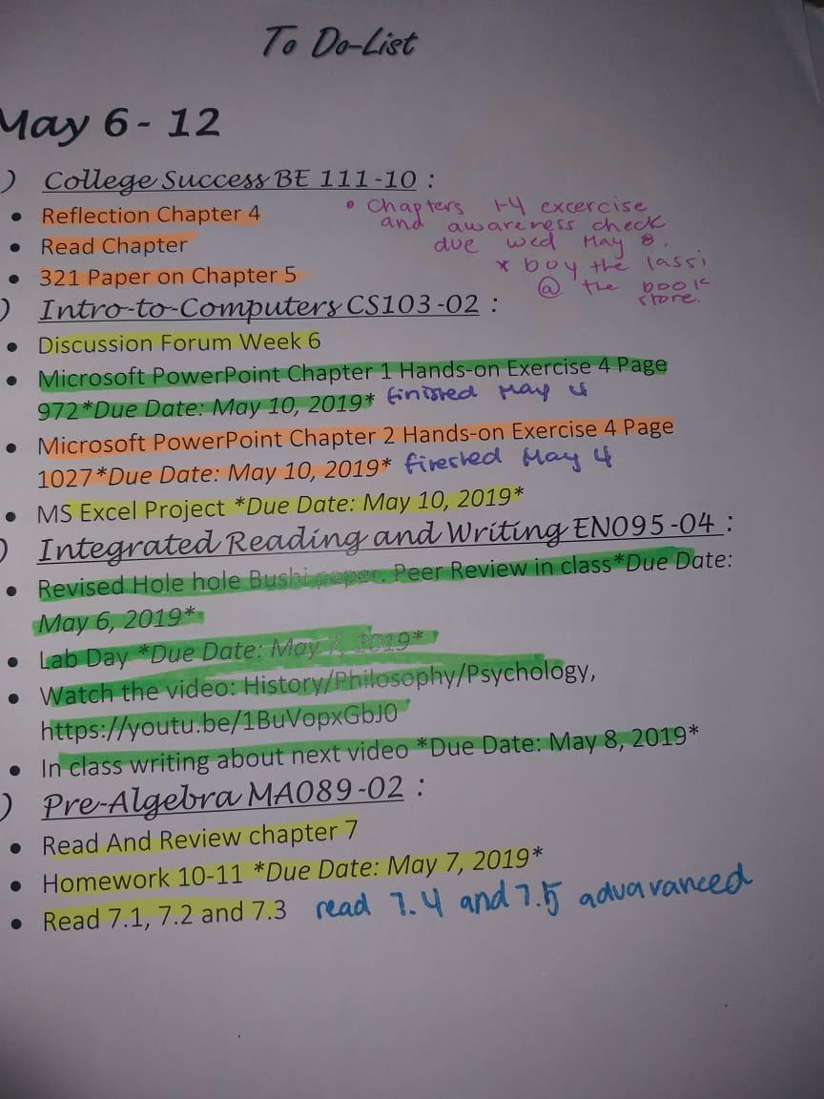
Week 2: May 6-12
For week 2, I can say that this was the most tasks I needed to complete. I had total of 17 task to complete in one week. I had an excel project. I did that assignment first because it was the heaviest graded one.

Slide 5
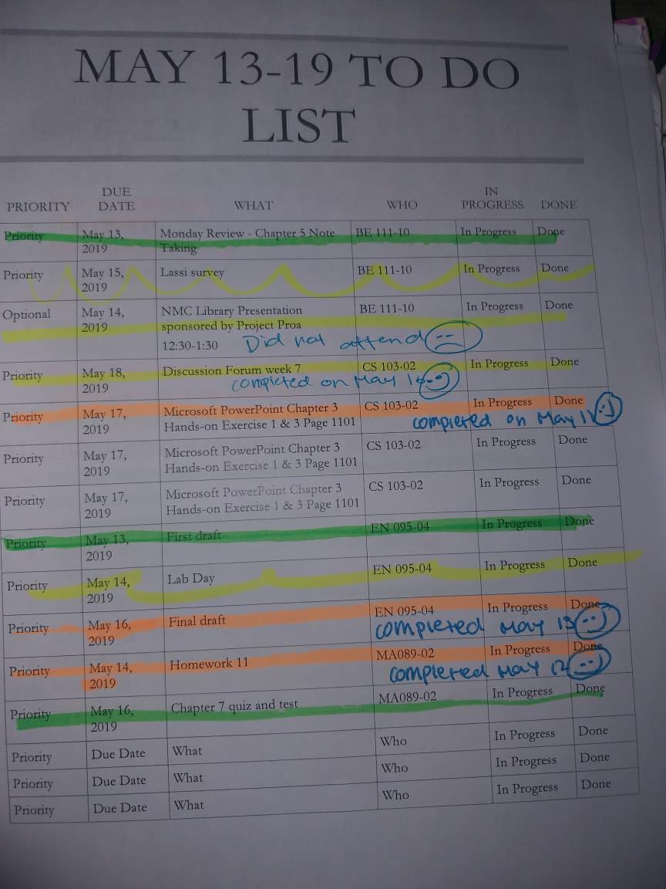
Week 3: May 13-19
For this assignment week, I completed most of them in advanced as well. For this week I had a quiz and a test for MA089.

Slide 6
Week 4&5: May 20-26/ 27-31
For week 4 and 5, I did not make a to-do list. Reason is because I did not have a lot to work on. For my Computer class, I had a final exam. Just waiting for it to be graded to see the results. I had a quiz for my college success class. And for my Math class, I also had a quiz and a test. For week 4&5 all I did was mostly studying.

Slide 7
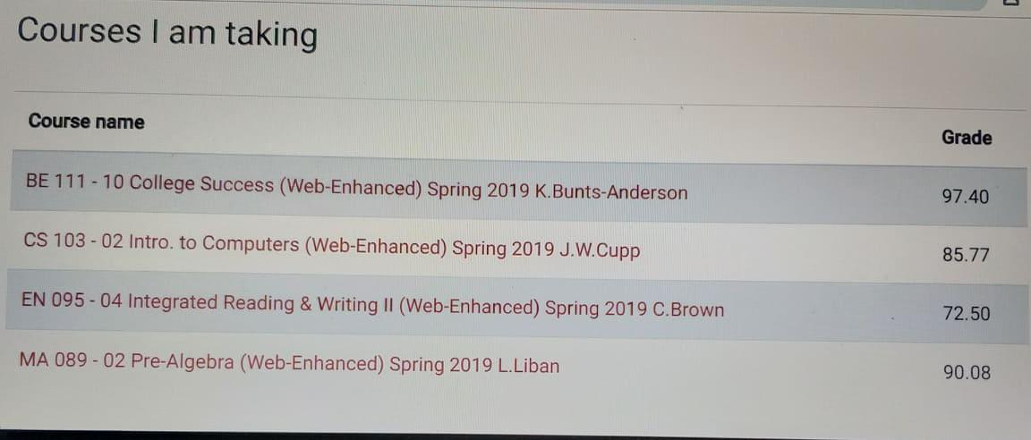
Conclusion…
In conclusion, I personally think that this challenge helped me alot. One thing I forgot to do was take a before and after picture of my grades before and after I started this challenge. The picture on the left is my grade as of right now. This challenge help me because I had a lot of assingent overall for the month of May. Not only I did this assignment for this class, I also did it for my grades in general. It safe to say that I did not procrastinate at all. I will apply this challenge and teach this challenge in the future.

