Slide 1
EN 202 Research Project E-Portfolio
:Saipan-Korean Residents' Typhoon Soudelor Preparedness
Yeji Lee | EN 202 01 | Instructor Kimberly Bunts-Anderson

Slide 2
Project: Saipan-Korean Residents' Typhoon Soudelor Preparedness
Section One
Preparation Documents
Brainstorm
Proposal
Outline
Reading Notes
Schedule
Final Research Draft
Reflection

Slide 3
Brainstorm
Saipan Residents
Ethnic group
Gender
Level of Disaster Preparedness
Before Soudelor
During Soudelor
Awareness of Disaster Prep. Procedures
Local government
FEMA
Age
Other responsible agencies
After Soudelor
Individual’s Preparedness for
Typhoon
Soudelor

Slide 4
Proposal: Outline
Cover Page
Abstract
Introduction
Thesis
Body Paragraph 1
Importance of understanding citizens’ preparedness before the event
Body Paragraph 2
A structurally scheduled research plan
Body Paragraph 3
An effective data collecting method
Conclusion
References
Appendix

Slide 5
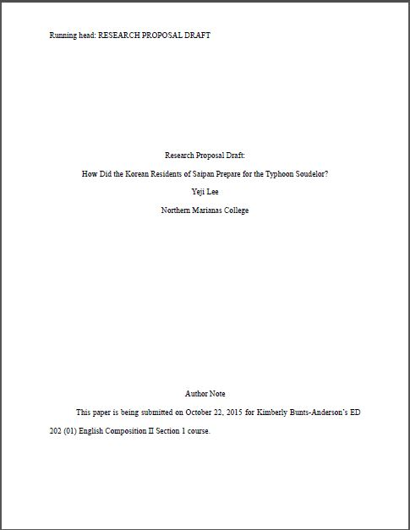
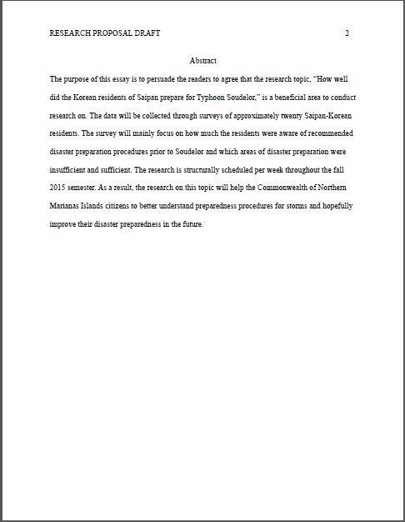
Proposal: Draft

Slide 6
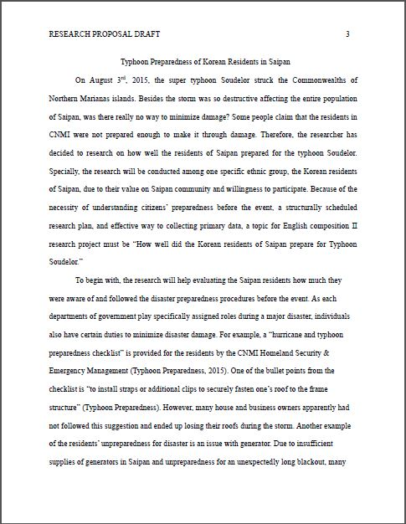
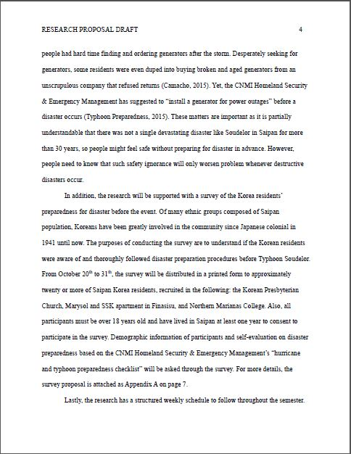
Proposal: Draft

Slide 7
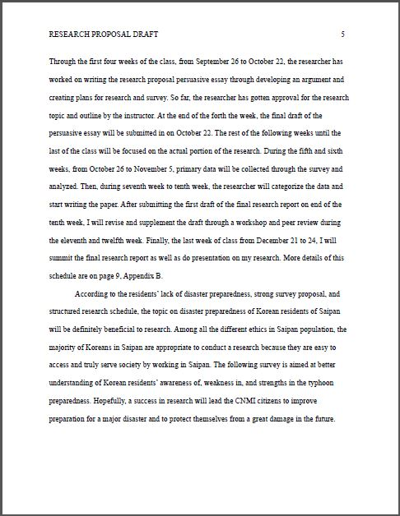
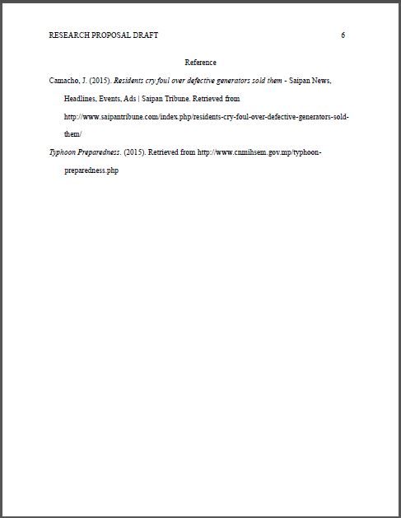
Proposal: Draft

Slide 8
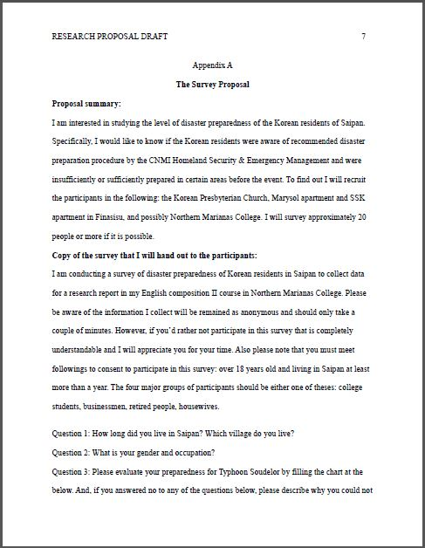
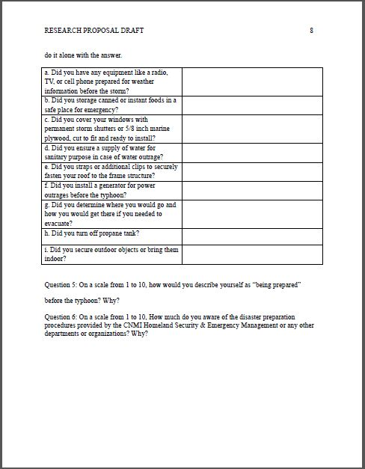
Proposal: Draft

Slide 9
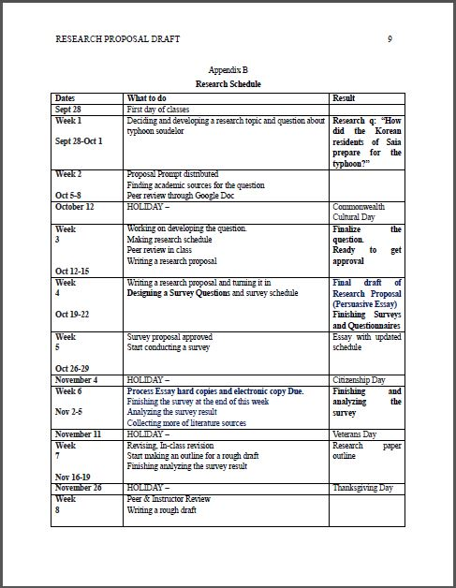
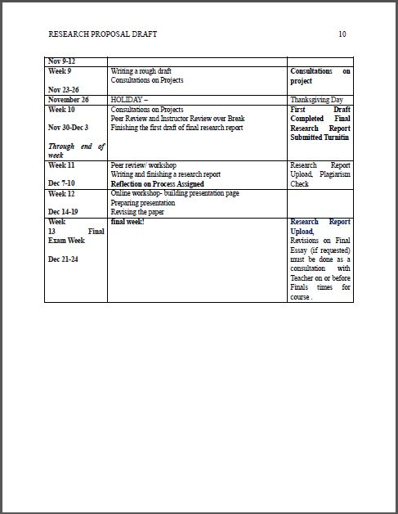
Proposal: Draft

Slide 10
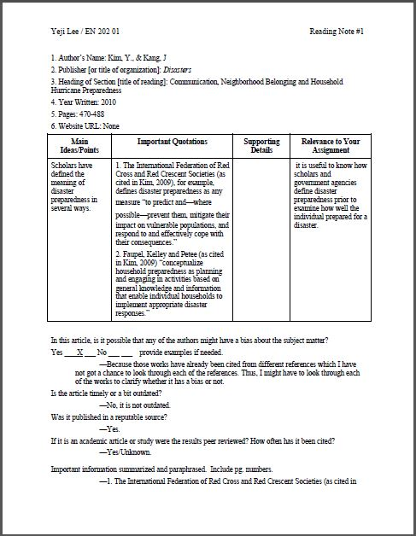
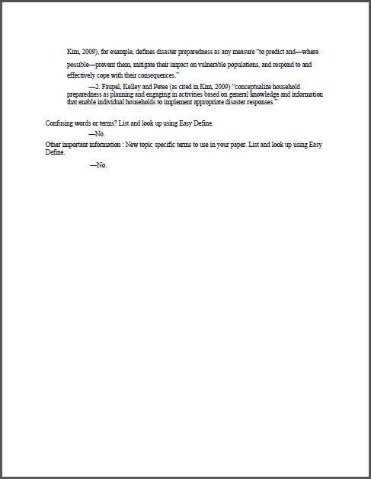
Reading Notes

Slide 11
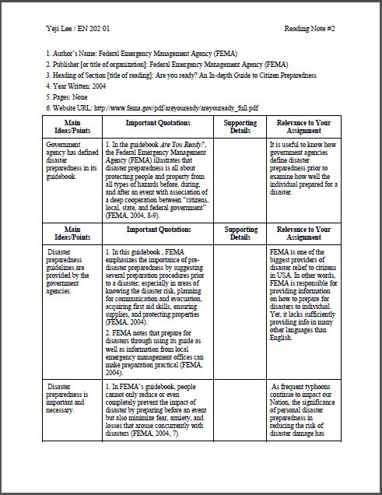
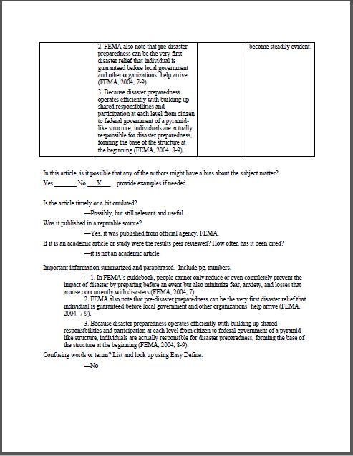
Reading Notes

Slide 12
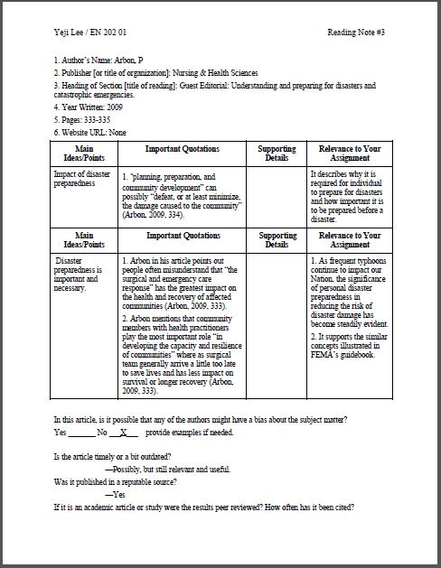
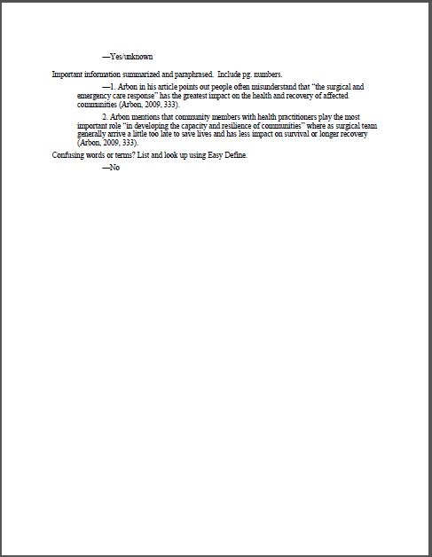
Reading Notes

Slide 13
Project Schedule
Week 1 (Sept 28-Oct 1) | -Developing a research topic and questions regarding Typhoon Soudelor
Week 2 (Oct 5-8) | -Finding literatures
Week 3 (Oct 12-15) | -Developing primary research questions, topic, & schedule
Week 4 (Oct 19-22) | -Writing survey proposal -Designing survey questions and surveying schedule
Week 5 (Oct 26-2) | -Getting instructor's approval for survey proposal -Conducting pilot surveys
Week 6 (Nov 2-5) | -Conducting surveys
Week 7 (Nov 16-19) | -Concluding survey collecting -Analyzing survey results -Outlining the final report
Week 8 (Nov 9-12) | -Writing rough draft of final report with the survey results
Week 9 (Nov 23-26) | -Consultation with instructor -Writing rough draft of final report
Week 10 ~12 (Nov 30-Dec 19) | -Editing & revising final report
Week 13 (Dec 21-24) | -Final report draft submission -Presentation on final report

Slide 14
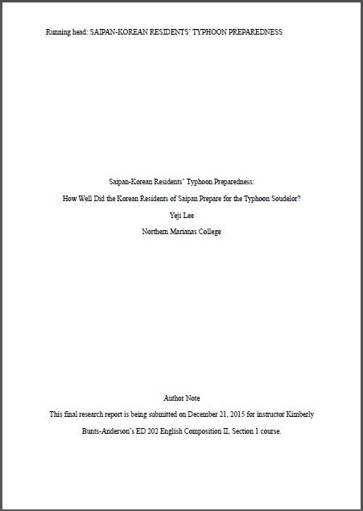
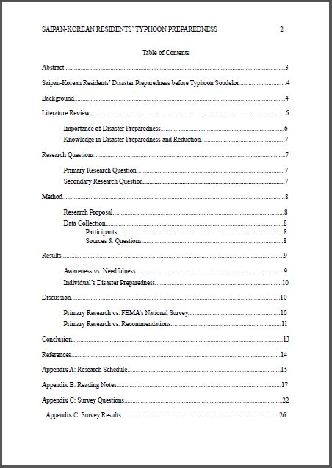
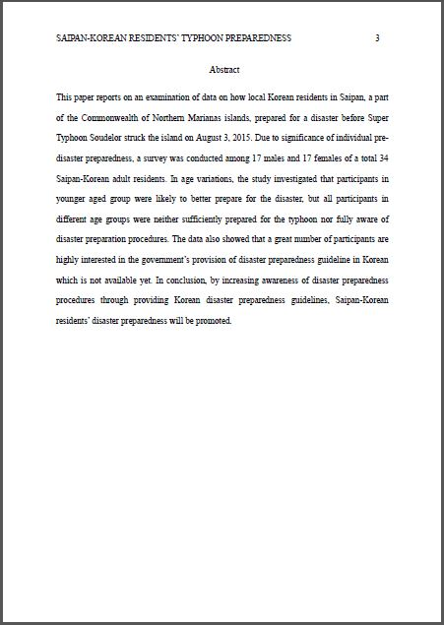
Final Research Report Draft

Slide 15
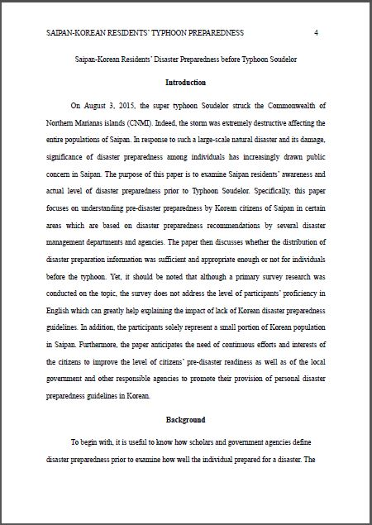
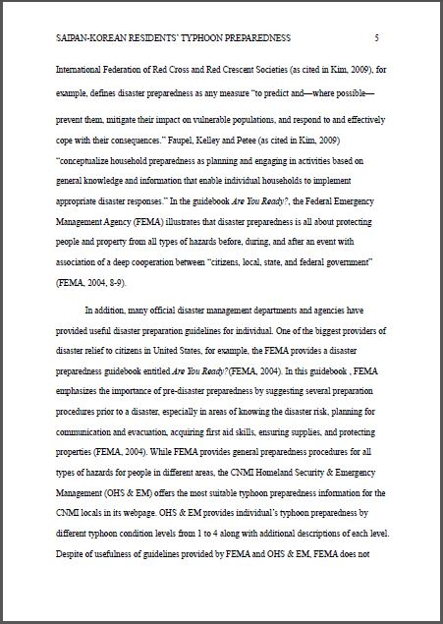
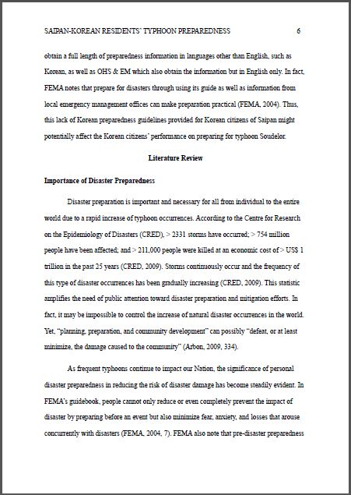
Final Research Report Draft

Slide 16
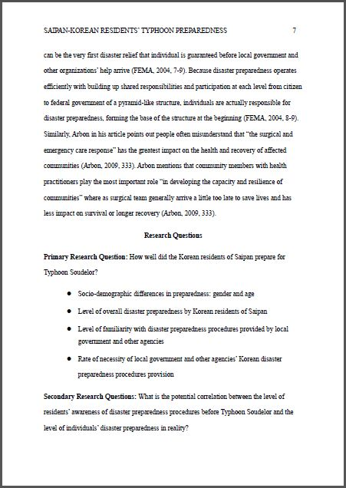
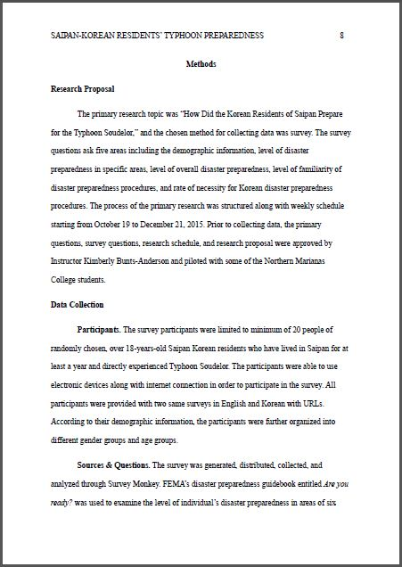
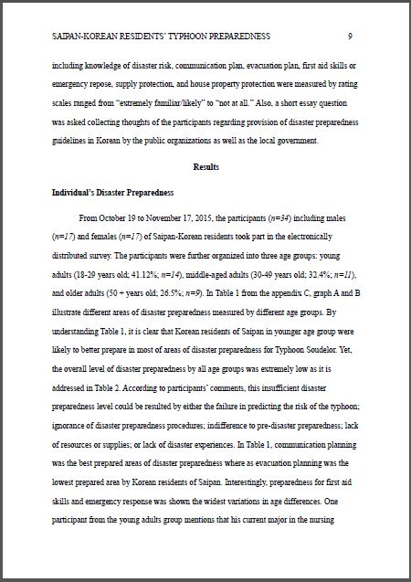
Final Research Report Draft

Slide 17
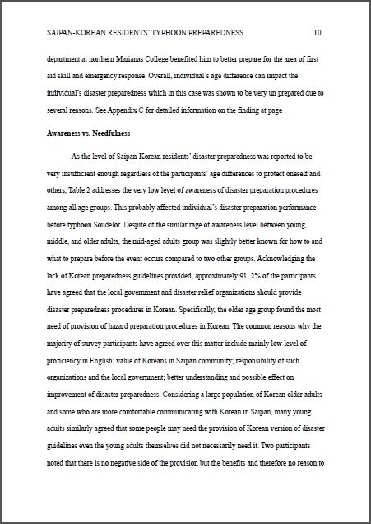
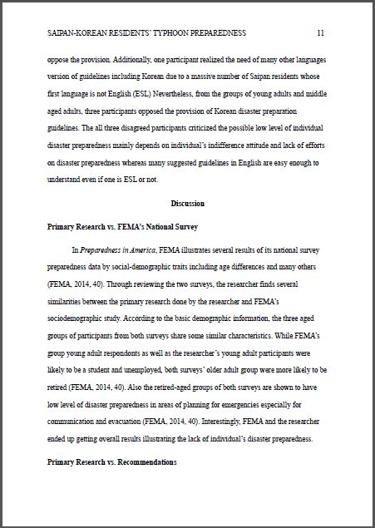
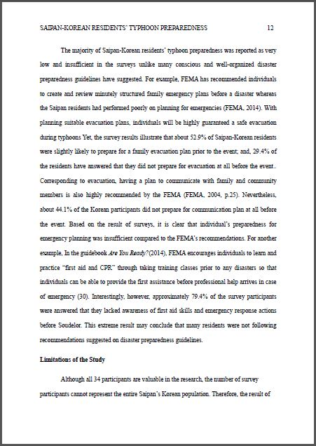
Final Research Report Draft

Slide 18
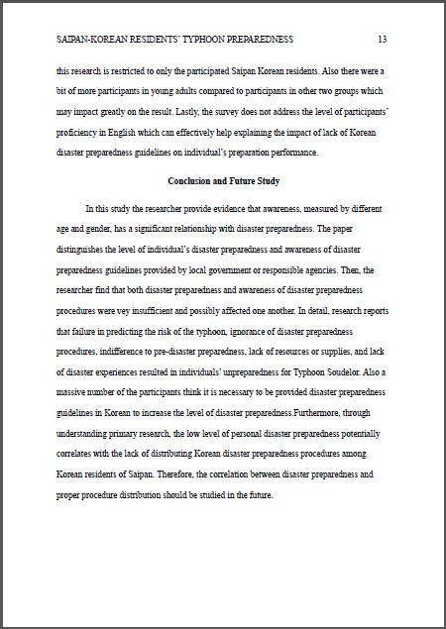
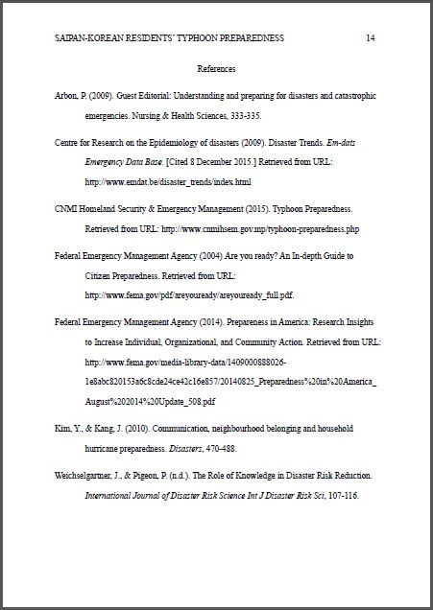
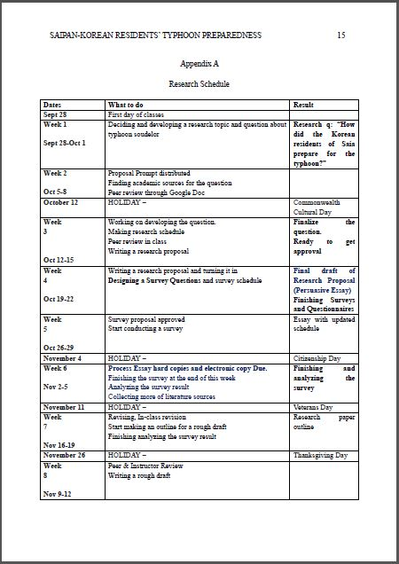
Final Research Report Draft

Slide 19
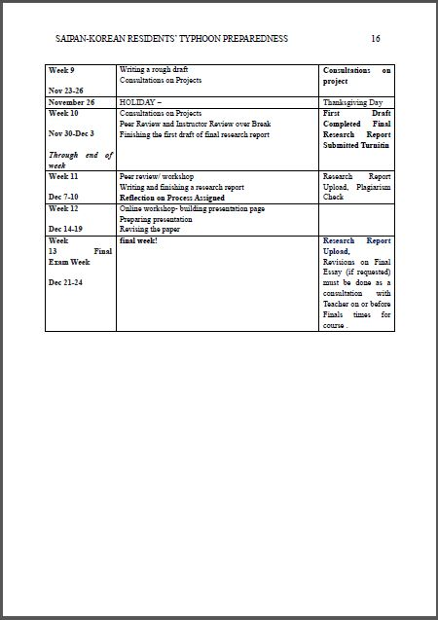
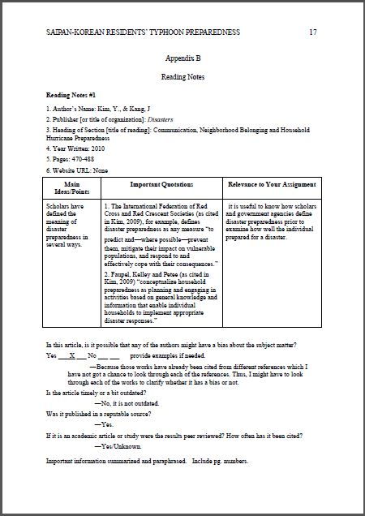
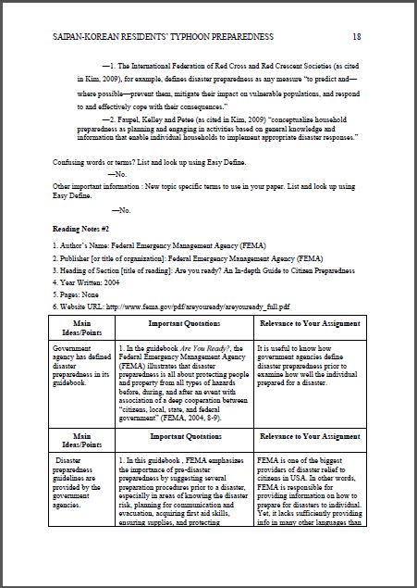
Final Research Report Draft

Slide 20
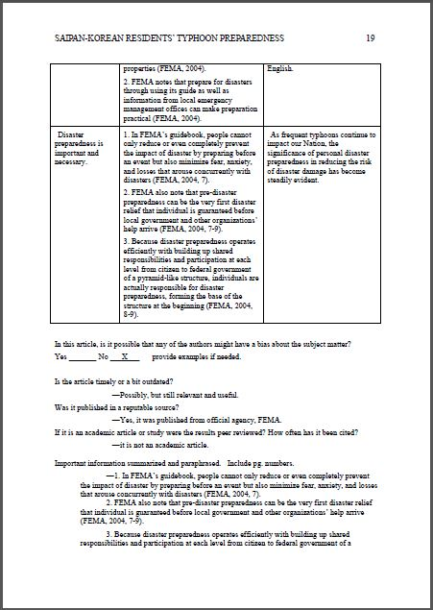
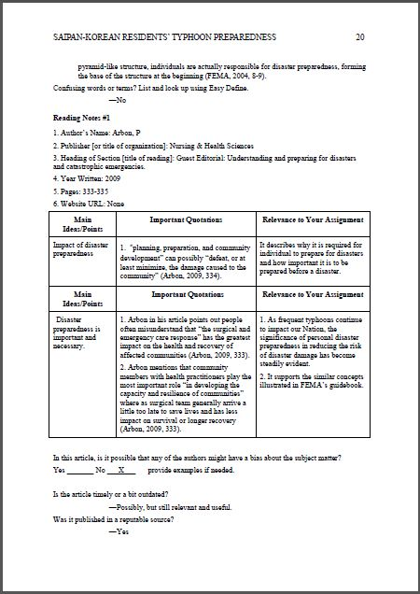
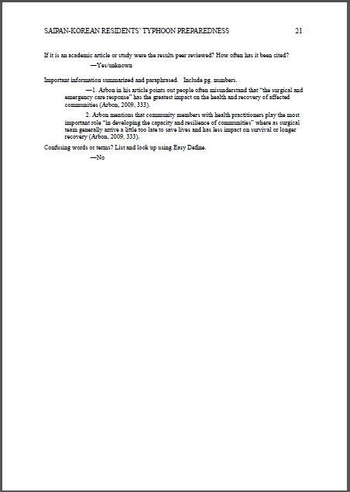
Final Research Report Draft

Slide 21
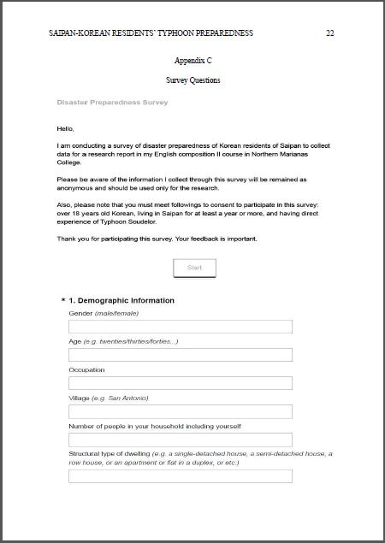
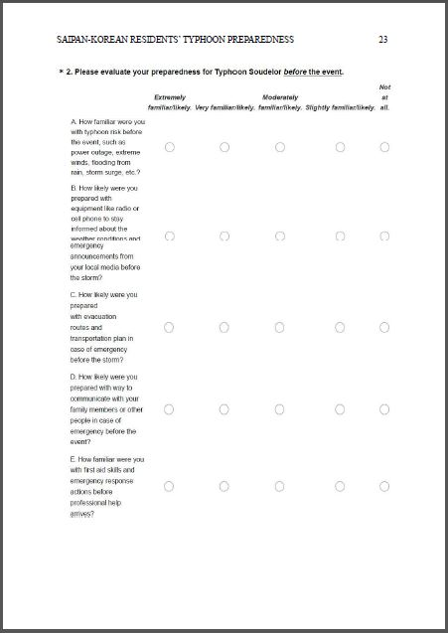
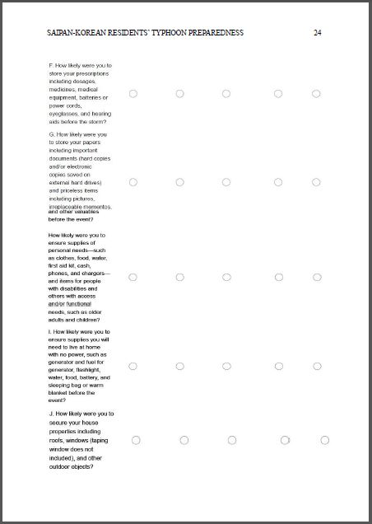
Final Research Report Draft

Slide 22
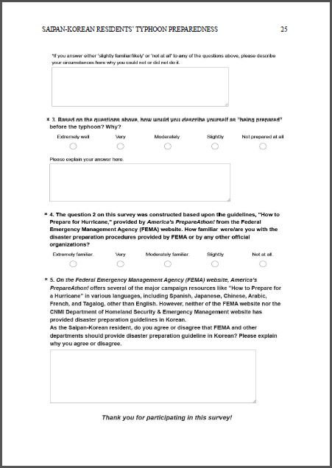
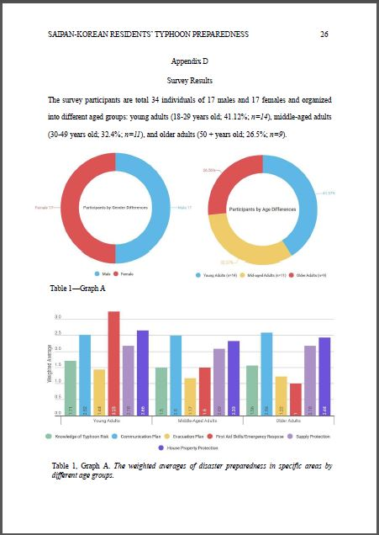
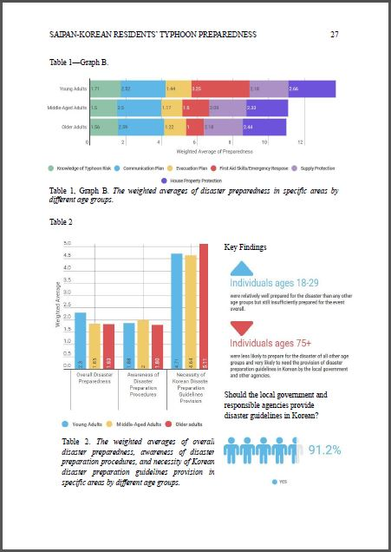
Final Research Report Draft

Slide 23
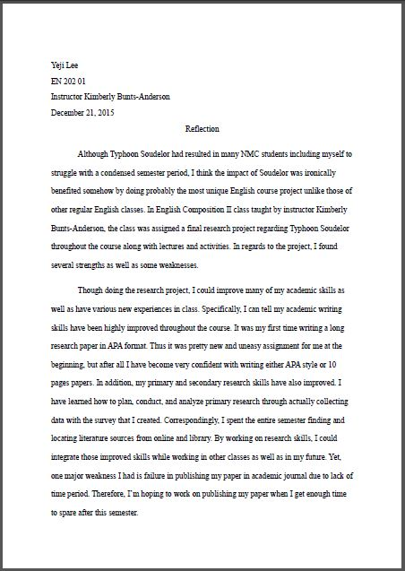
Reflection

Slide 24
-The End-

