Slide 1
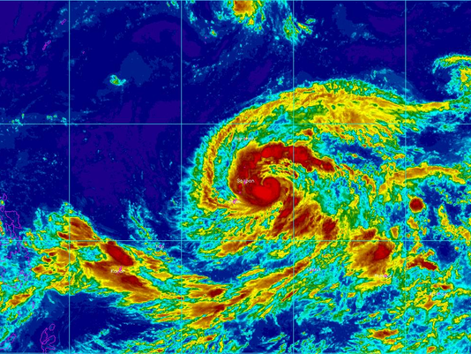
My English Research Portfolio
Government Aid Preparedness
Camille Joy Arrieta
Northern Marianas College
Dr. Kimberly Anderson
EN202-01

Slide 2
Primary Research Question
How the government prepared and distributed aid after typhoon Soudelor?
The government distributed aid by the help of federal assistance programs such as FEMA, NAP and American Red Cross and others.

Slide 3
Procedures of collecting data
Electronic Survey ( 11 Responses from Facebook) and Paper Survey (17 responses by NMC students)
Interviews ( FEMA, NAP, U.S citizens and Foreign Workers)

Slide 4
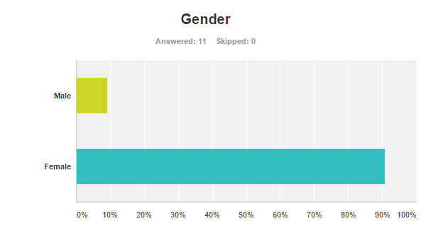
Electronic Survey Results
Out of the 11 people surveyed, most were female who accepted to take the questionnaire.

Slide 5
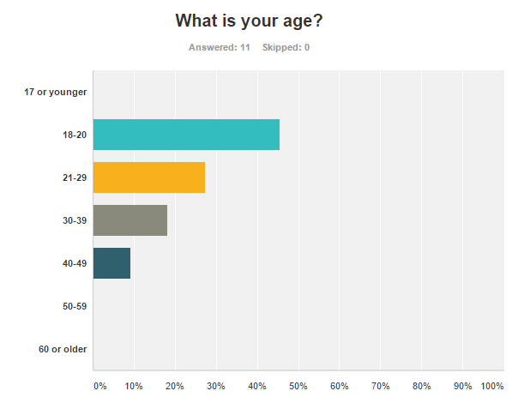

Slide 6
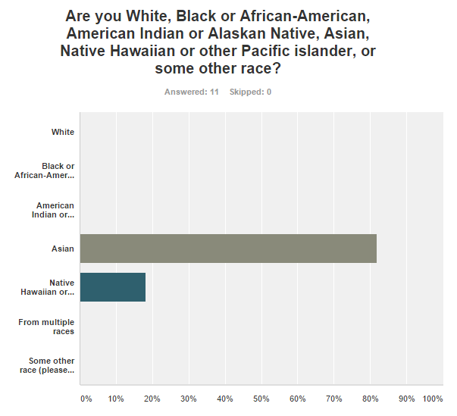
Survey Results

Slide 7
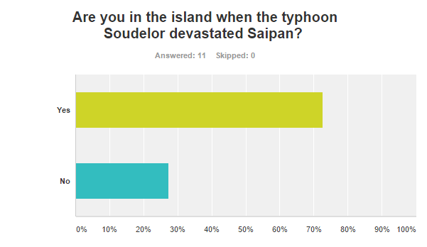
Electronic Survey Results

Slide 8
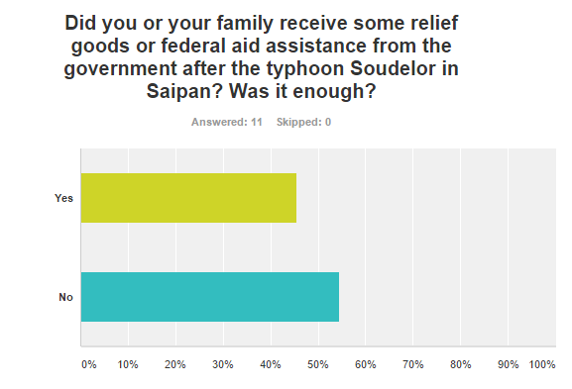

Slide 9
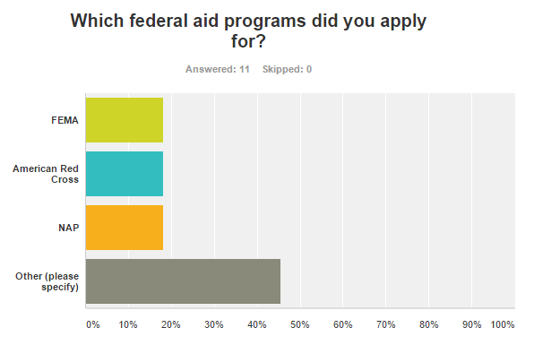

Slide 10
Paper Survey Results
# of people who received assistance. | # of people who did not received assistance but their relatives and friends does.
12 | 5
# of people who received federal aid said that the aid was enough. | # of people who recieved federal aid said that was not enough.
11 | 6
# of people said that the distribution of aid was fair. | # of people said that the distribution of aid was not fair. | # not sure
9 | 7 | 1

Slide 11
Secondary Questions:
FEMA ( Federal Emergency Management Agency)
1. How FEMA assisted those people who sought aid after the disaster? Was it through phone calls, emails or application form submissions? Which of these was the most useful? How did FEMA assisted people on Saipan?
2. FEMA did very well to help those typhoon Soudelor victims in the CNMI and had to travel from states to Saipan just to help. However some foreign workers were denied and not given a chance to get aid from FEMA while some foreign workers were accepted and given money for their damages? How did FEMA made their decisions? Did FEMA base assistance on salary or income of the person?
3. When FEMA went house to house, how did they know if the damages were caused by typhoon Soudelor or if people just making alibis.

Slide 12
NAP ( Nutrition Assistance Program)
1. Were there eligibility requirements to receive aid?
2. What were the strategies formulated to organize the release of aid?
3. How did NAP inform the public about their prepared aids?
4. How NAP assisted people on Saipan?

Slide 13
U.S. Citizens and Foreign Workers
1.Do you think aid that was given to you was enough?
2. Do you think federal assistance programs were fair and equally distributed the aid for everyone, most especially to foreign workers?
3.Was it hard to provide proof of your citizenship applying for aid?

Slide 14
References
Marquez, C. (2015, September 14). An open letter to President Obama. [Online] Retrieved from
http://www.saipantribune.com/index.php/an-open-letter-to-president-obama/.
Unheard No More (2015, October 23). Ashamed to be an American. [Online] Retrieved from
http://unheardnomore.blogspot.com/.
American Red Cross. (2015, August 06). Red Cross mobilizing relief supplies and volunteers to support Saipan. [Online] Retrieved from http://www.redcross.org/news/article/Red-ds-to Wildfires-Typhoon

Slide 15
Thank You and Happy Holidays ☺

