Slide 1
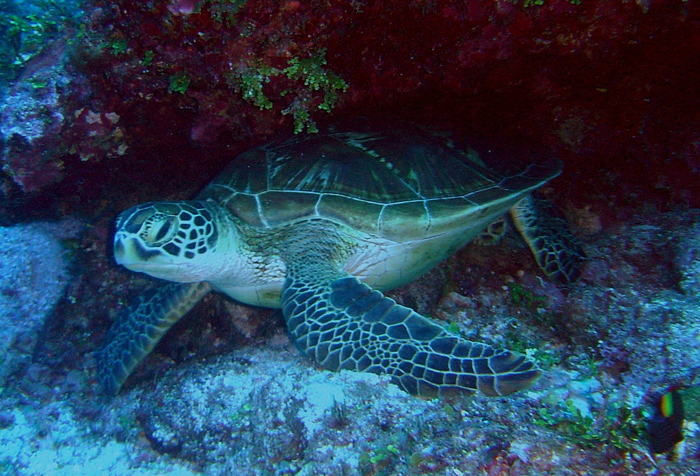
Endangered Local Animals of the CNMI
Rebekka King
EN 202
Propsal-Research

Slide 2
Introduction
Primary Question: Are the people of the CNMI aware of the endangered local animals?
Reason: The local animals are important because they are part our culture and they show our island in a unique way. I found this topic interesting because other animals in the world are being saved or protected so much, unlike the animals here in the CNMI; they deserve to be protected just like the others; they are living creatures too.

Slide 3
Tentative Schedules
RESEARCH SCHEDULE Sept. 3 – 11 Gather information of the cause of decrease of the local animals Sept. 12 Proposal Rough Draft #1 Due Sept. 15 – 19 Interview people who are aware of the endangered local animals Sept. 22 – 26 Do a pilot survey around neighborhoods and NMC Sept. 27 – 30 Gather all information | WRITING SCHEDULE Sept. 4 Start writing about what I learned and gathers so far Sept. 11 Add more to rough draft and make corrections Sept. 14 Fix Rough Draft #1

Slide 4
Tentative Schedules Cont.
RESEARCH SCHEDULE Sept. 3 – 11 Gather information of the cause of decrease of the local animals Sept. 12 Proposal Rough Draft #1 Due Sept. 15 – 19 Interview people who are aware of the endangered local animals Sept. 22 – 26 Do a pilot survey around neighborhoods and NMC | WRITING SCHEDULE Sept. 1 Start writing about what I learned and gathers so far Sept. 6 Add more to rough draft and make corrections Sept. 13 Fix Rough Draft #1 (final) Sept. 30 Start organizing literature Oct. 03 Organize methodology
Oct. 27 – 30 Gather all information | Oct. 11 Input all data collected Dec. 01 Finish final research paper

Slide 5
Primary & Secondary Questions
Primary Question:
Are the people of the CNMI aware of the endangered local animals?
Secondary Questions:
Who are the local animals?
How do they impact the CNMI?
What is the reason why they are endangered?
What can we do?

Slide 6
Methology
Interview
-age group 7-50
Survey
-15-20 people (survey print out or online)
Test
-show pictures to age group of 7-18
(aware of the local animals?)

Slide 7
Survey Results
Survey Held On (Oct 7 – Oct 29, 2016)
Resource : surveymonkey.com
Pilot survey: 7
Final survey: 34
Total Questions on Survey: 10
People Interviewed:
19 college students
10 high school students
5 young adults

Slide 8
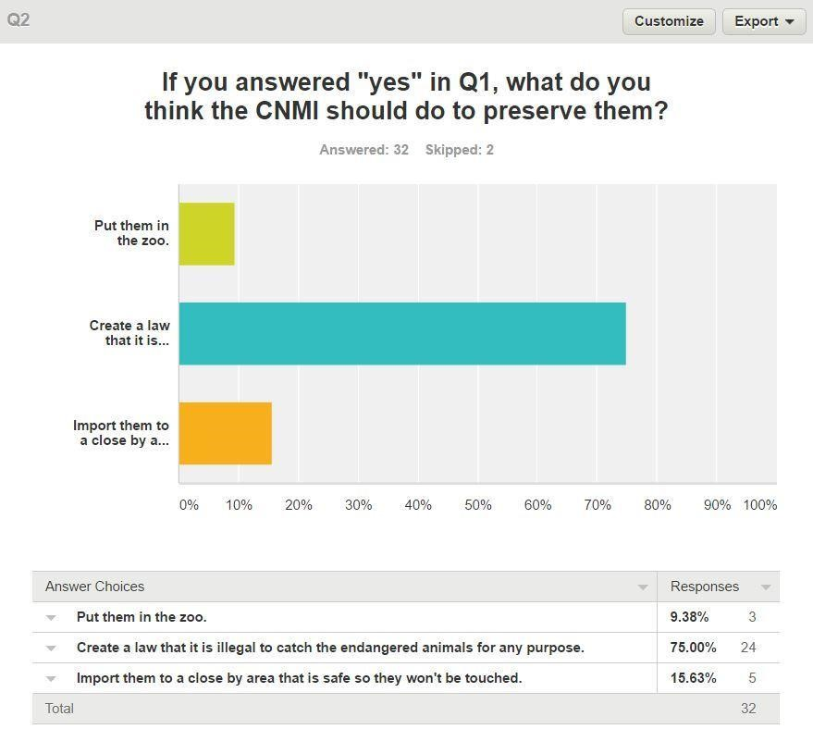
Survey Analysis
About 80% of the individuals stated that they are aware of the endangered local animals. . However, a total of 21% are not aware of them.
According to Question 1 (in the survey) it asked if individuals were aware of the endangered species here in the CNMI, when participants answered yes, it led to this question (photo)

Slide 9
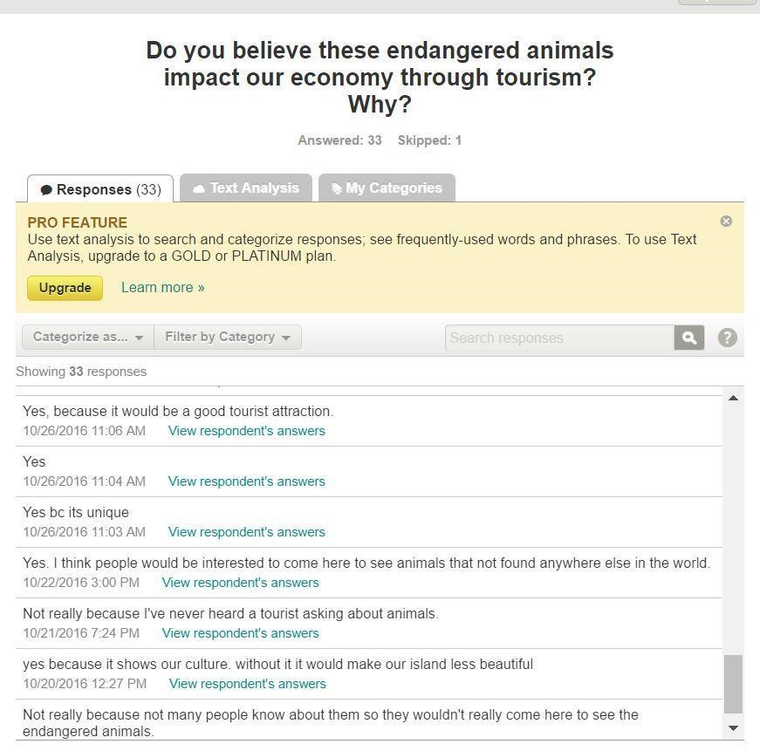
Survey Analysis Cont.
A large amount of 75% of the individuals seem to agree that these animals can be helped and save by creating a law that it is illegal to hunt for any purpose. Many also think that these animals are important for the next generation to see, except for one individual. What the student researcher seen most shocking is that 2 individuals think it is okay to let them get extinct.

Slide 10
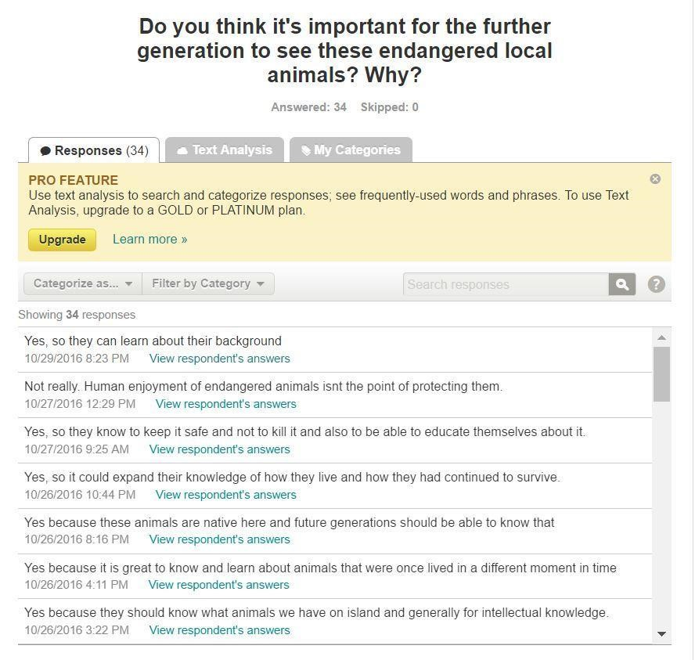
Survey Analysis Cont.
About 42% individuals think the reason these local animals are endangered because they are getting eaten or getting hunted for fun, 21% think it is global warming, 27% believes it is the life cycle, and 50% thinks it is all those reason.
The other result of 9% shows that people think they were not taken care of or protected.

Slide 11
Improvements for Others
Interview
Think of who is an expert in your field topic
Make an appointment (date & time)
Survey
Survey a fair amount of people in a certain age group for collecting data
Letters-to-Experts
Proofread your letter, ask for peer review
Follow-up on emails or letters you sent out
Send more emails to experts, even if you don’t get a response, it’s worth a try

Slide 12
Loses and Gains
Mistakes:
Not getting to plan ahead more effieciently
Lesson Learned:
I learned how to write in APA format
What we can do to save the animals
What the most of the people in the CNMI think of the animals

Slide 13
Thank you for your time!

