Slide 1
Final Research Presentation
By David Phan
EN202-01

Slide 2
Research Questions
Why is Saipan ranked 3rd in the world for type 2 diabetes (in relation to population)?
Why do people have such a blasé attitude towards diabetes?
What factors should be considered when concerning public health issues?

Slide 3
Literature
Hill, J., Nielsen, M., & Fox, M. H. (2013). “Understanding the Social Factors That Contribute to Diabetes: A Means to Informing Health Care and Social Policies for the Chronically Ill.” The Permanente Journal
Mai, R., & Hoffmann, S. (2015). How to Combat the Unhealthy = Tasty Intuition: The Influencing Role of Health Consciousness. Journal Of Public Policy & Marketing
Wilcox, K., & Prokopec, S. (2013). Tens, Hundreds or Thousands? How Nutritional Information Numerosity Nonconsciously Affects Unhealthy Food Choices. Advances In Consumer Research

Slide 4
Understanding Social Factors… (Hill et. al, 2013)
How to Combat the UTI… (Mai, Hoffmann; 2015)
Nutritional Information Numerosity (Wilcox, Prokopec; 2013)
Contributors to noncommunicable disease: low income, employment insecurity, low educational attainment, and poor living conditions.
patients that have difficulty meeting the prerequisites for healthy living due to lack of resources, such as affordable healthcare or nutritious foods, are more susceptible to diabetes than those who possess greater financial resources.
Basing policies on these nonmedical factors may lead to improved prevention and/or management of diabetes.
“Unhealthy= Tasty Intuition” (UTI). UTI refers to the idea that the healthiness of food is determined by its tastiness, implicating that healthier foods are inherently less enjoyable than unhealthy foods. This is a misconception that affects many at a subconscious level.
health consciousness diminishes belief in the UTI, and health-conscious consumers are less likely to subscribe to it.
health consciousness positively affects “cognitively shaped and inference-based evaluations (healthiness),” but the implicit evaluations (taste) cannot be nullified.
nutritional information found on canned products are ironically marked as a factor to adiposity (obesity) issues.
The numerosity (unit size) of an unhealthy food’s content can affect individual health perceptions.
False: Higher access to nutritional information equates to healthier living

Slide 5
Methods
Survey: 26 people
Interviews: 2 people (Ms. Lisa Lunde and NMC Nursing Department)
Letter to Expert: sent to six people; 1 response received from Dr. Khosrow Adeli
Survey, Interviews, Letters to Experts

Slide 6
Letter to Expert
Dr. Khosrow Adeli
1. Why do people continue to eat the way they do despite the risks of getting diabetes?
I think it is very difficult to change people’s dietary habits. Families tend to eat food based on many factors including tradition, heritage, culture, community, and food access/availability.
2. What has lead people to care less about their health?
Most people do care about their health but many develop a unhealthy lifestyle beginning in childhood likely arising from their family/home environment and the community they live in. Living healthy takes effort and significant time investment. Most people have very busy lives these days which leads to an unhealthy diet, lack of exercise, and other undesirable habits.
3. What can be done to foster population dietary change?
Best approach is to start teaching healthy habits to children beginning in early childhood (before age 5); by providing a health home environment, a healthy diet, and regular physical activity.

Slide 7
Interviews
Lisa Lunde, NMC Health Instructor (Interviewed on November 22, 2016) 5 questions asked
Questions revolved around the quality of diabetes education on island.
Her father has type 1 diabetes.
When she came to Saipan to teach, she was shocked to learn that Diabetes was a sort of “lifestyle.”
Commented that “habits,” formed by cultural influences, were often used as an excuse.
Believes that stronger family education should be prioritized so food choices and habits at home are better suited for health.
(Anonymous) Registered Nurse, NMC Nursing Department (Interviewed on November 23, 2016) 5 questions asked.
Questions revolved around the quality and availability of health services on island.
Clinics such as Hard Eye Clinic offer diabetes education but CHC is the island’s main source of comprehensive health care.
Thinks that there should be more effective methods to eradicate diseases rather than prolonging them.

Slide 8
Survey
The survey collected 26 responses in total (17 from the pilot version, 9 from the final version). Only the final version includes demographic information. As shown in the graph, participants were mostly Chamorro and Filipino. Ages ranged from 17-21 and all participants are currently schooling.

Slide 9
Question Types
Frequency | Variety | Awareness
How often do people eat? Too much? Too little? | What are people eating? Are they eating too much of the same thing? | Are people aware of their health? Are they capable of making informed health decisions?

Slide 10
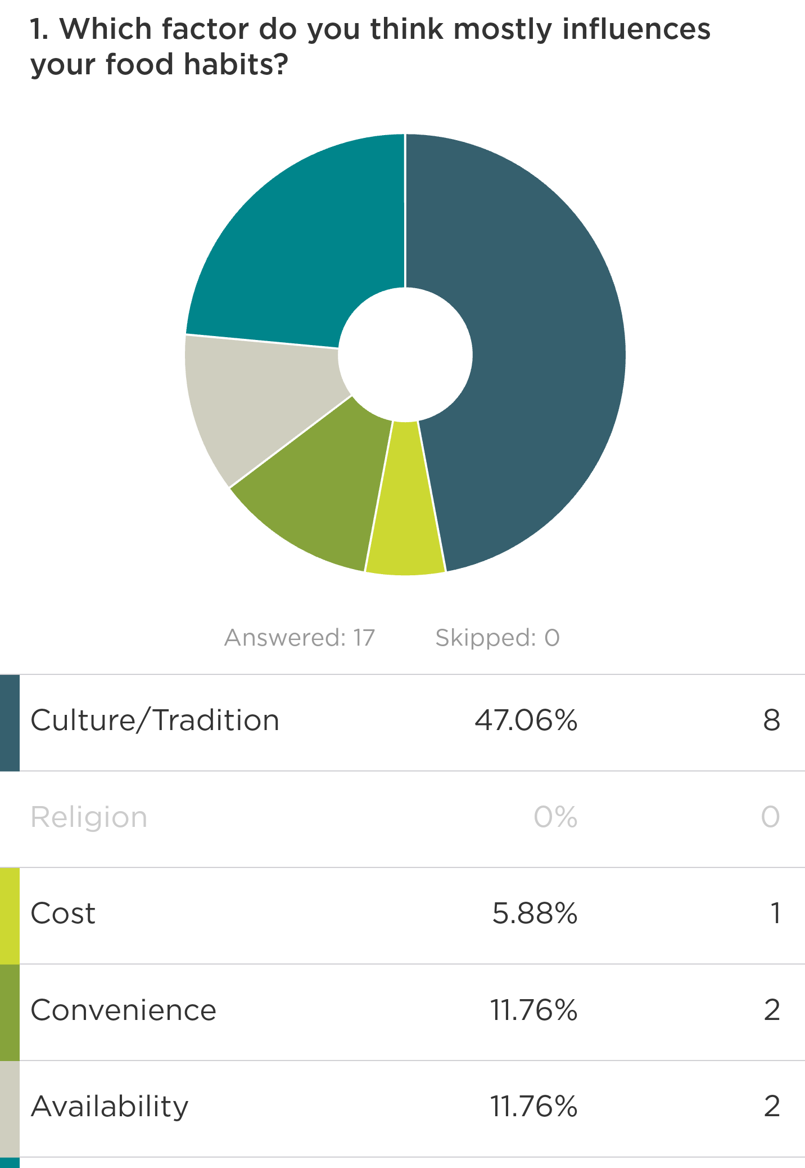
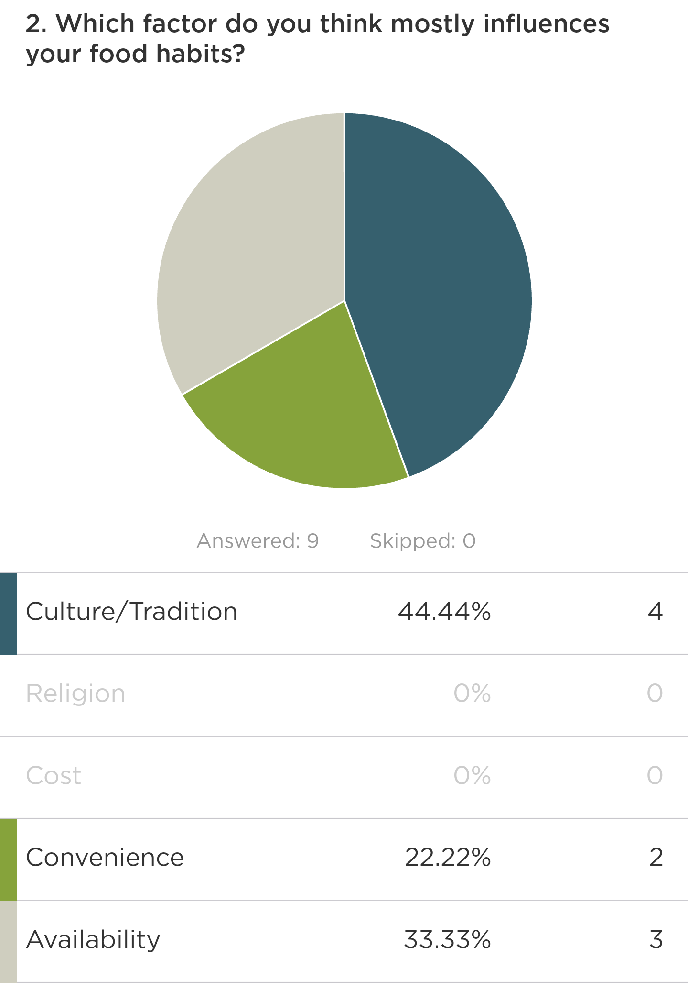
Results
Pilot
Final
Among the 5 factors that influence food choice (i.e cost, availability, etc.), “culture/tradition” was the answer chosen by 12 people, resulting in a 46% majority.

Slide 11
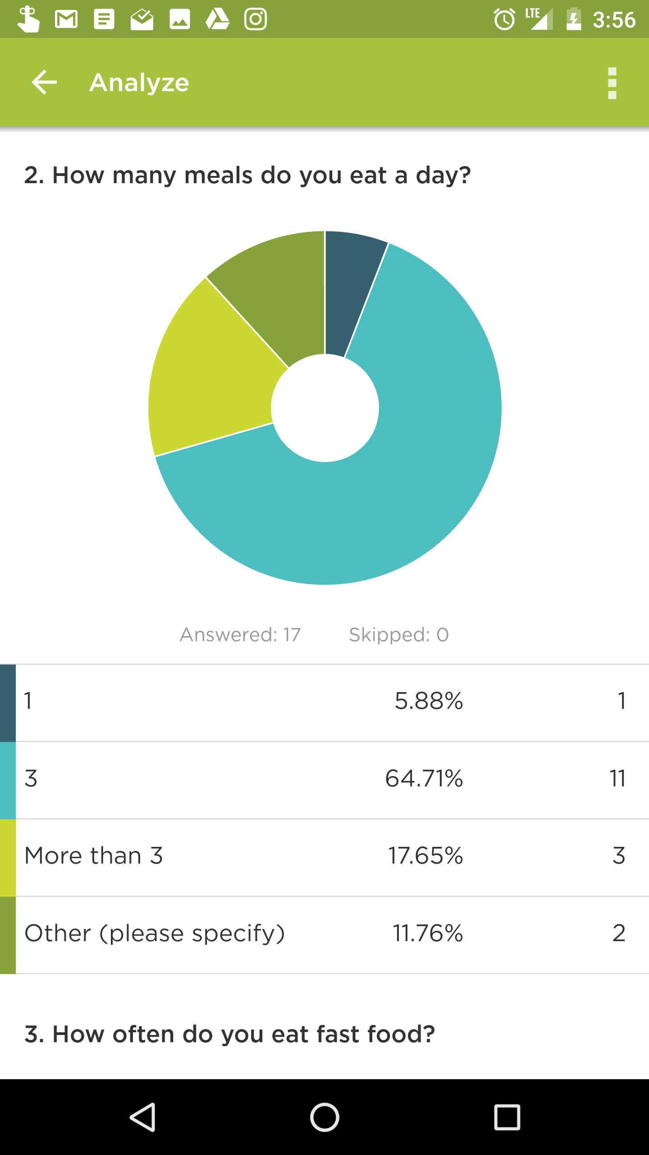
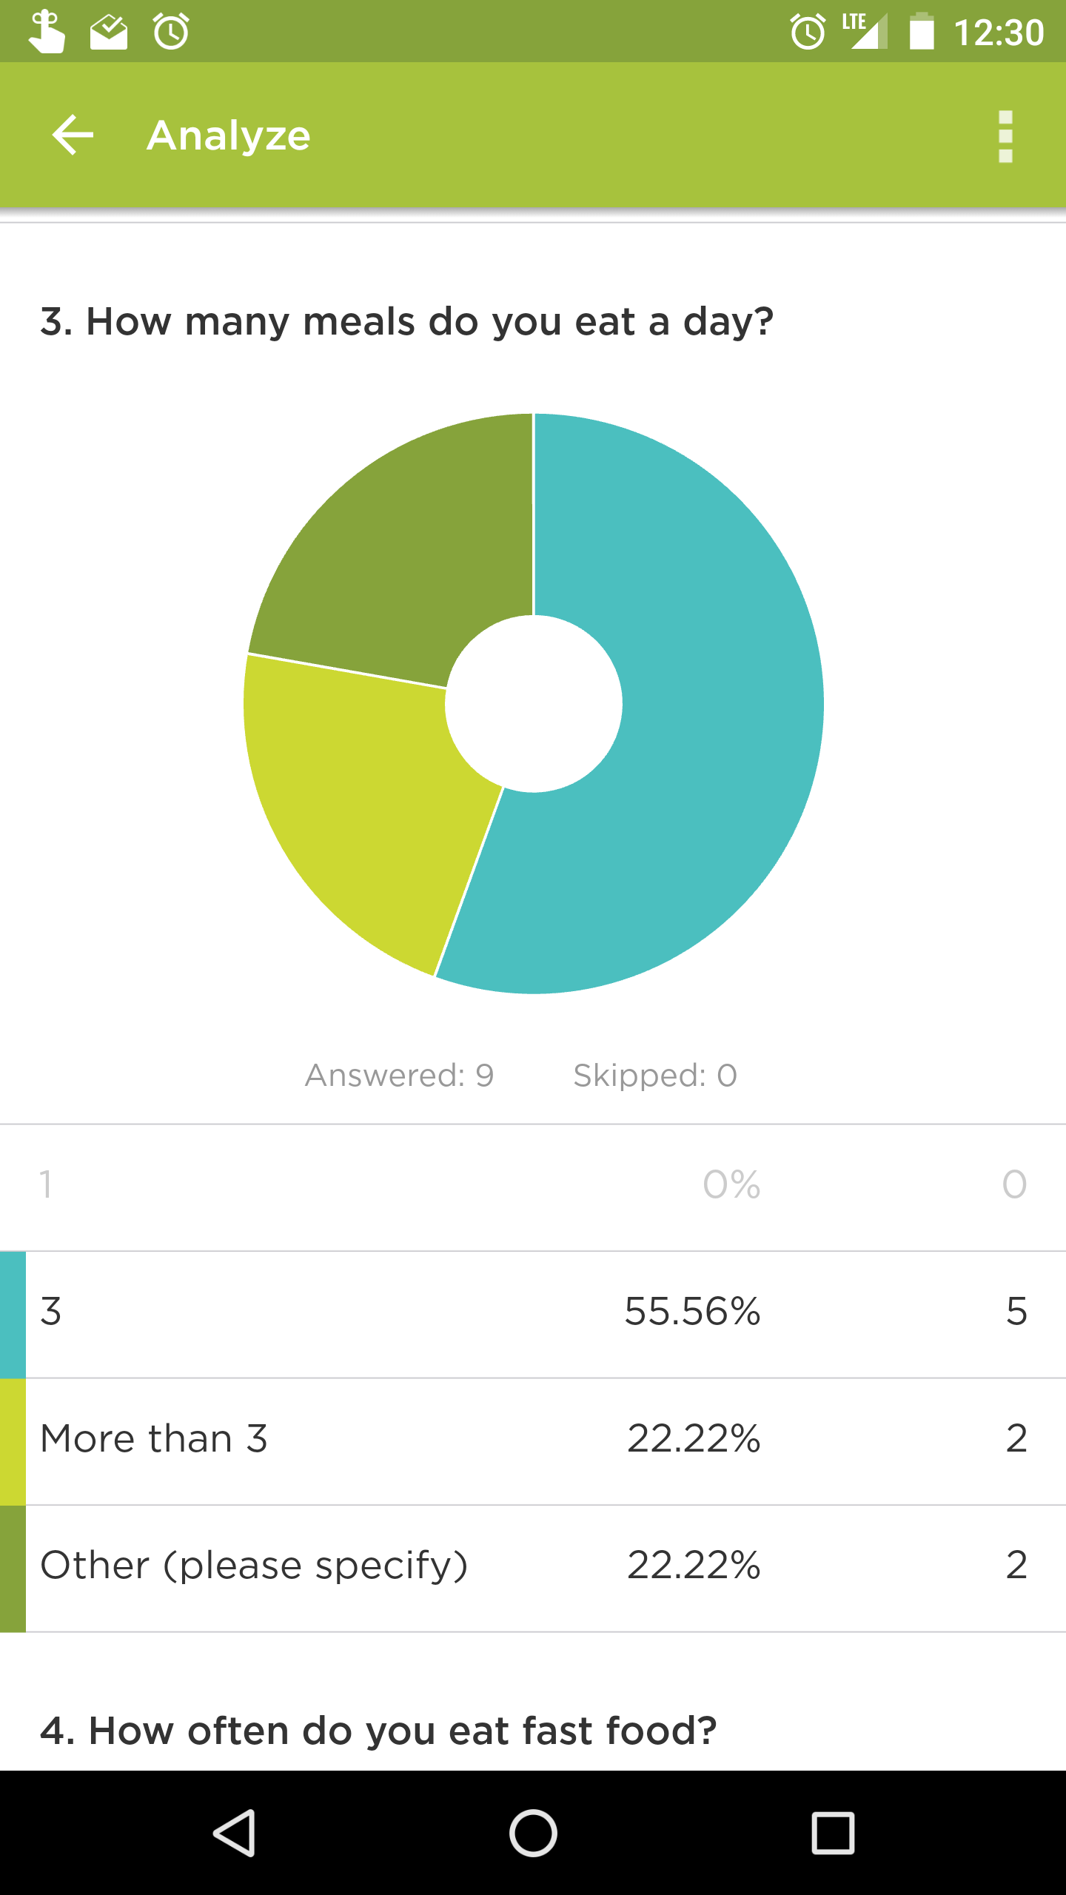
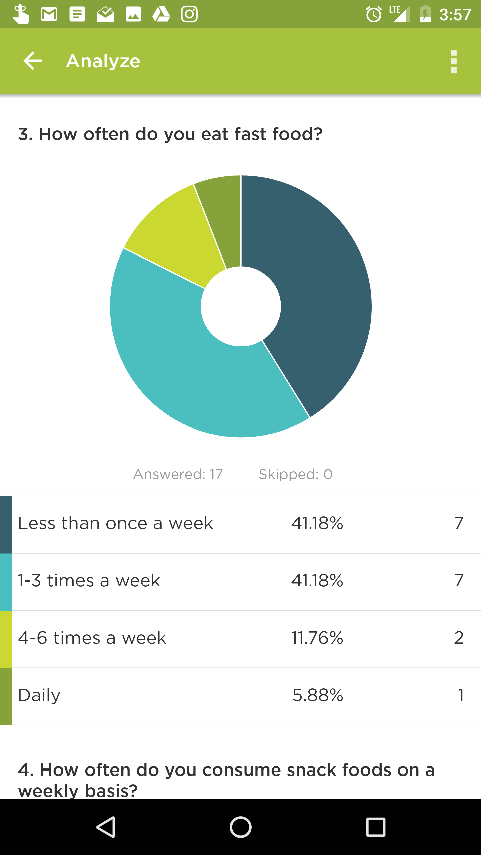
Results
Pilot
Final
people generally feed themselves at average frequencies (62% eat 3 times a day; 19% eat less and another 19% eat more than 3 times), and more than half of the survey participants eat fast food less than once a week.

Slide 12
The researcher’s hypothesis was rejected as he predicted that people would eat less or more than the ideal 3 times a day and that fast food consumption would be significantly higher; however, his prediction that social and traditional influences would be a dominant factor in most cases of health decisions was supported by the results of the first question and the information from the journal by Hill et. al (2013).

Slide 13
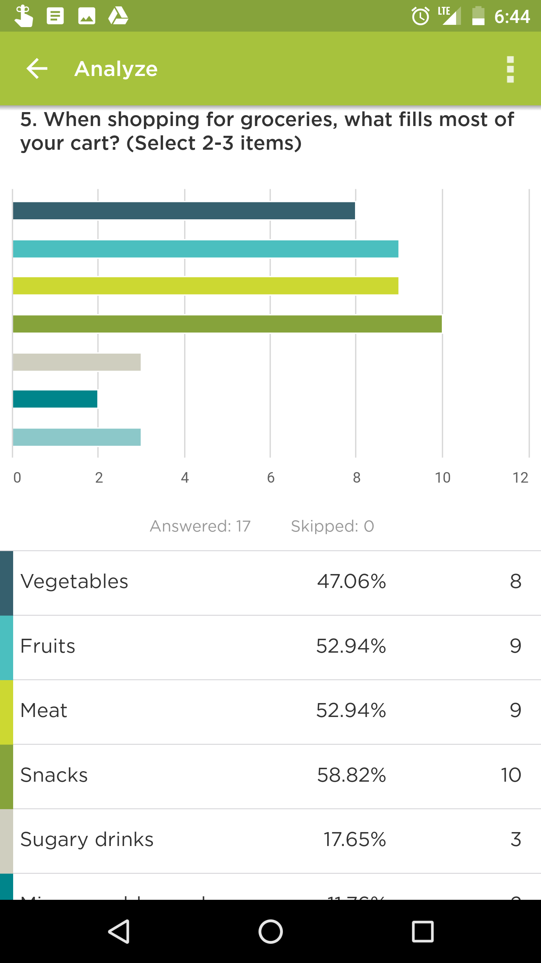
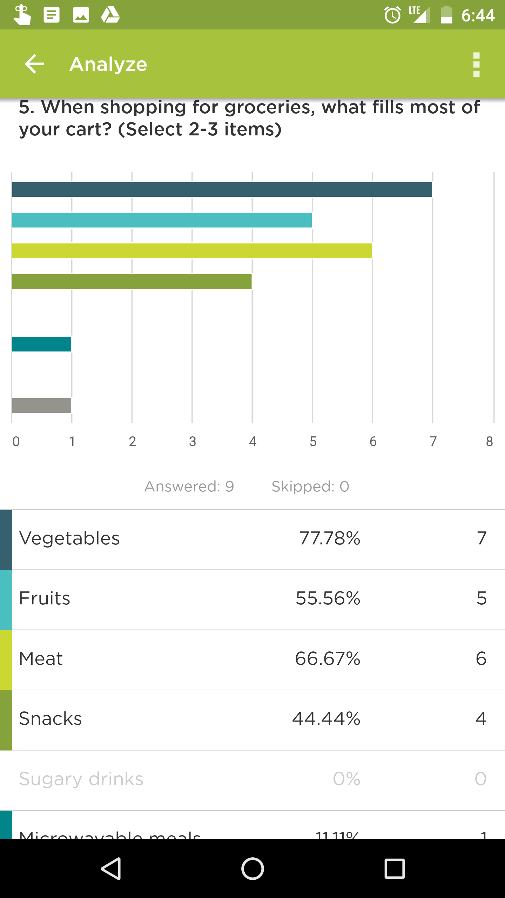
Results
Pilot
Final
To visualize the variety in people's diets, the survey asked its participants to select 2-3 items that mostly comprise their shopping practices (for example, they may select vegetables, fruits, and meat if they think their carts are mostly filled with those items whenever they shop for food).

Slide 14
While people have variety in their diets, as found in the survey, diabetes is still considered a widely-occurring disease; although, a larger, more diverse sample size could have returned different results. The literature by Mai and Hoffman (2015) that describes the effect of UTI (Unhealthy = Tasty Intuition) supports the findings of this unusual relationship between apparently healthy diets (displayed by the sample group) and high rates of diabetes on the island. While people are able to control several external factors, such as picking their food when shopping, they are still susceptible to unconsciously subscribing to sensory experiences when consuming food which is enabled by implicit processes.

Slide 15
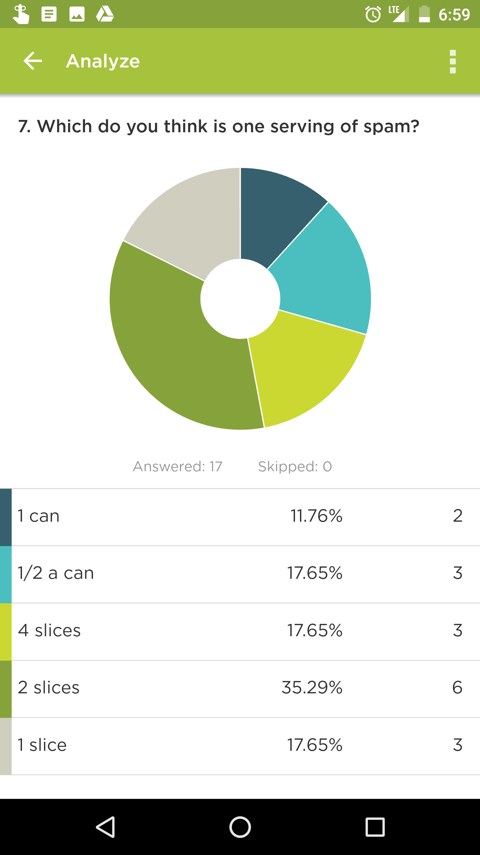
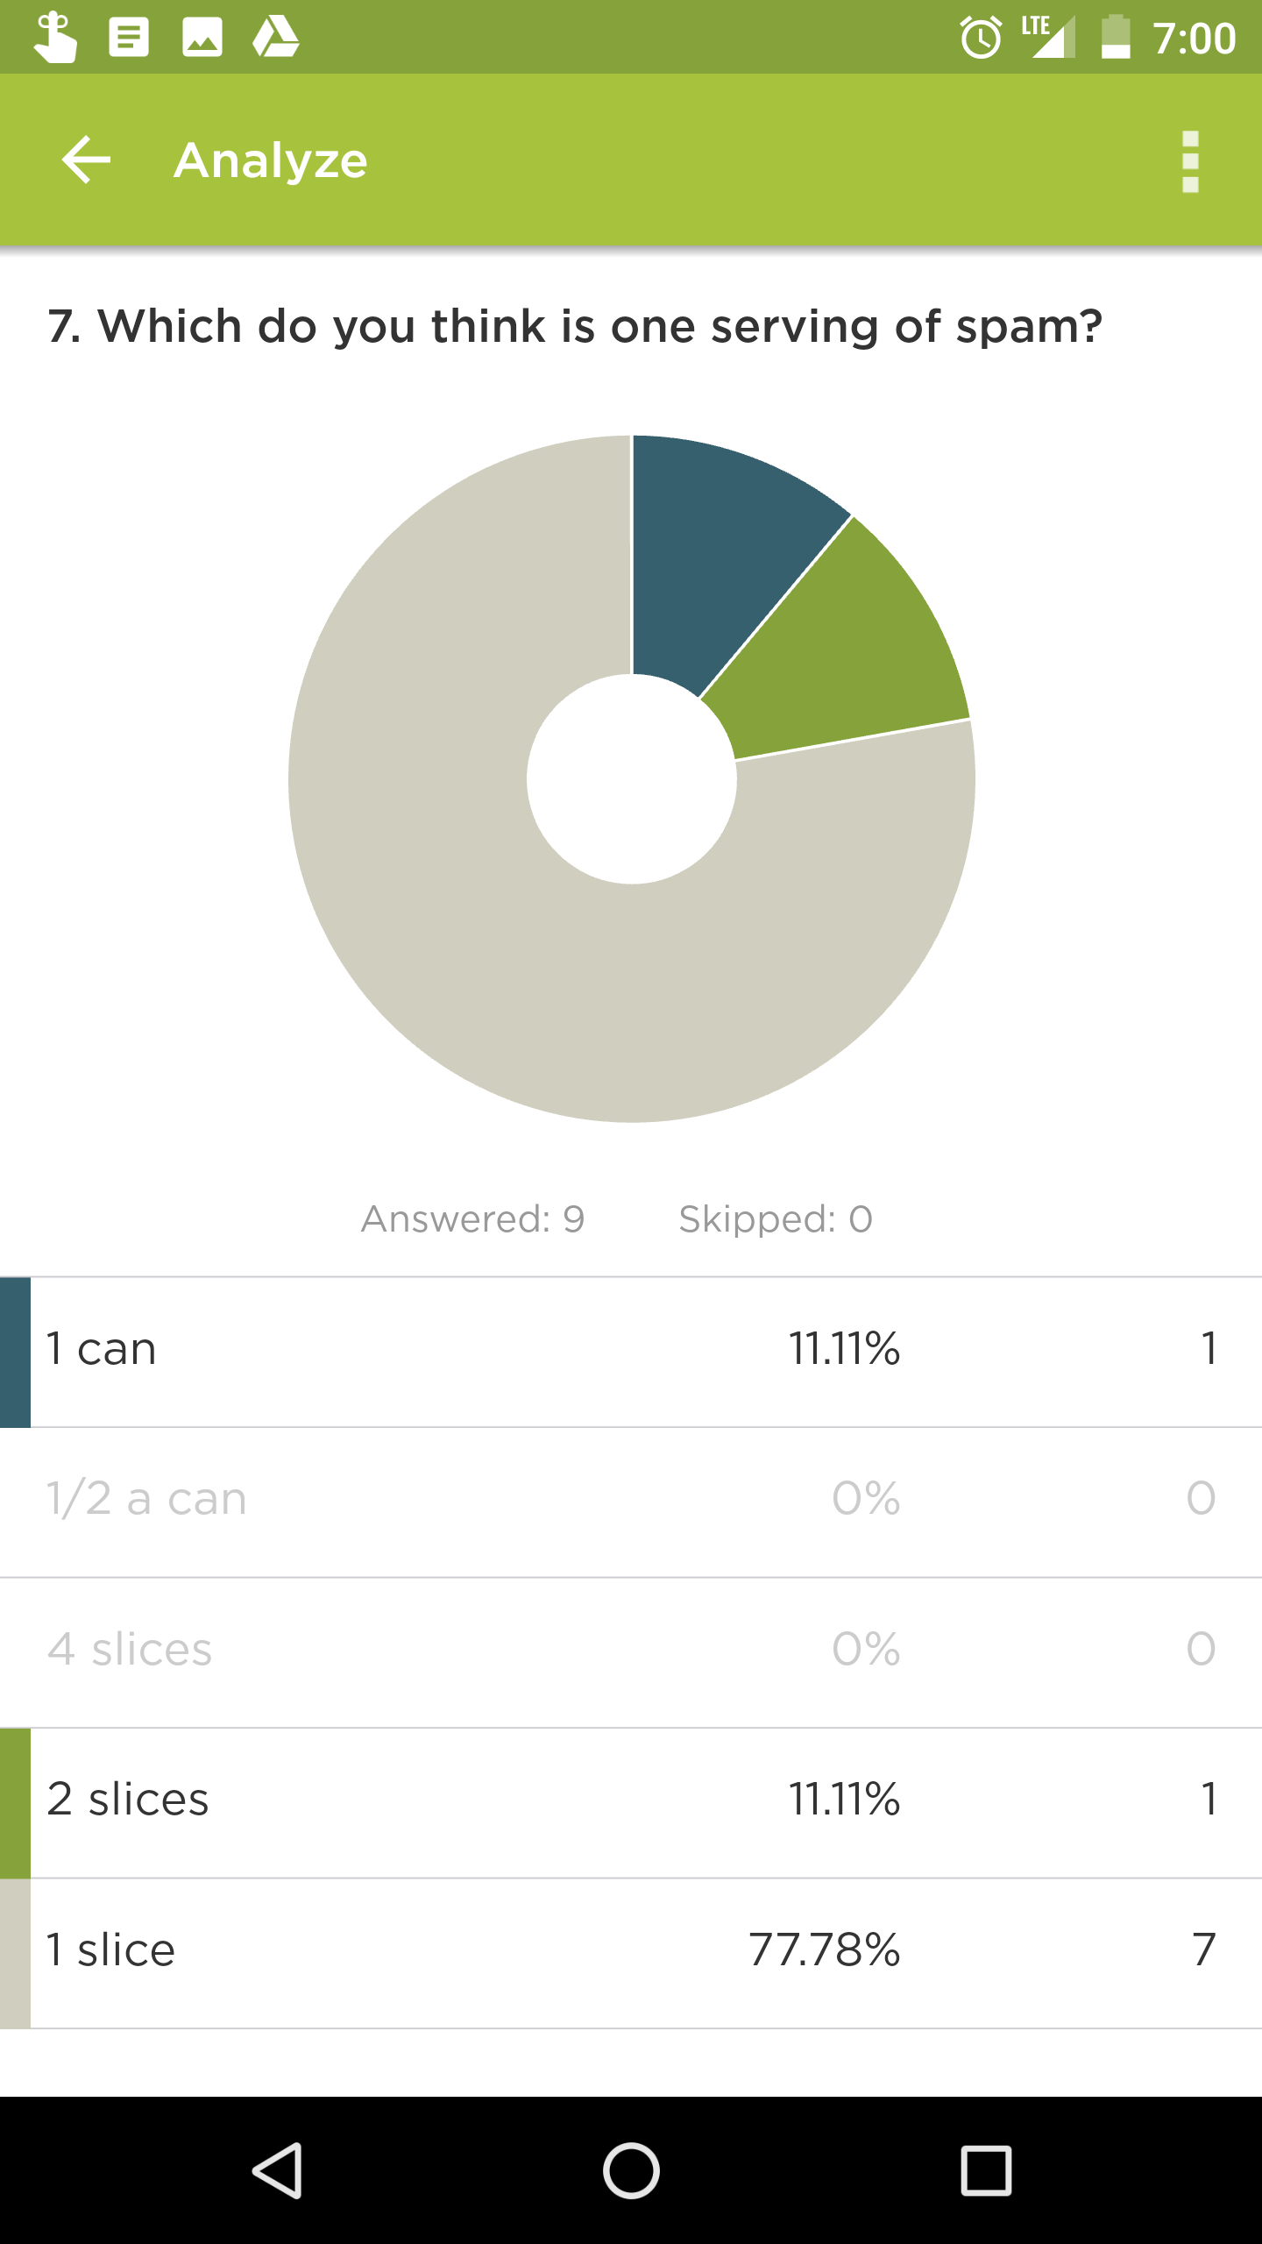
Results
Pilot
Final
To gauge health perception, the survey participants were presented different portion sizes of “spam” and were asked to determine which portion size most accurately represents one serving of the canned meat.

Slide 16
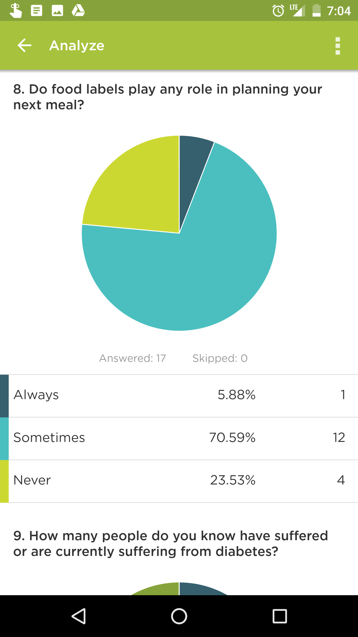
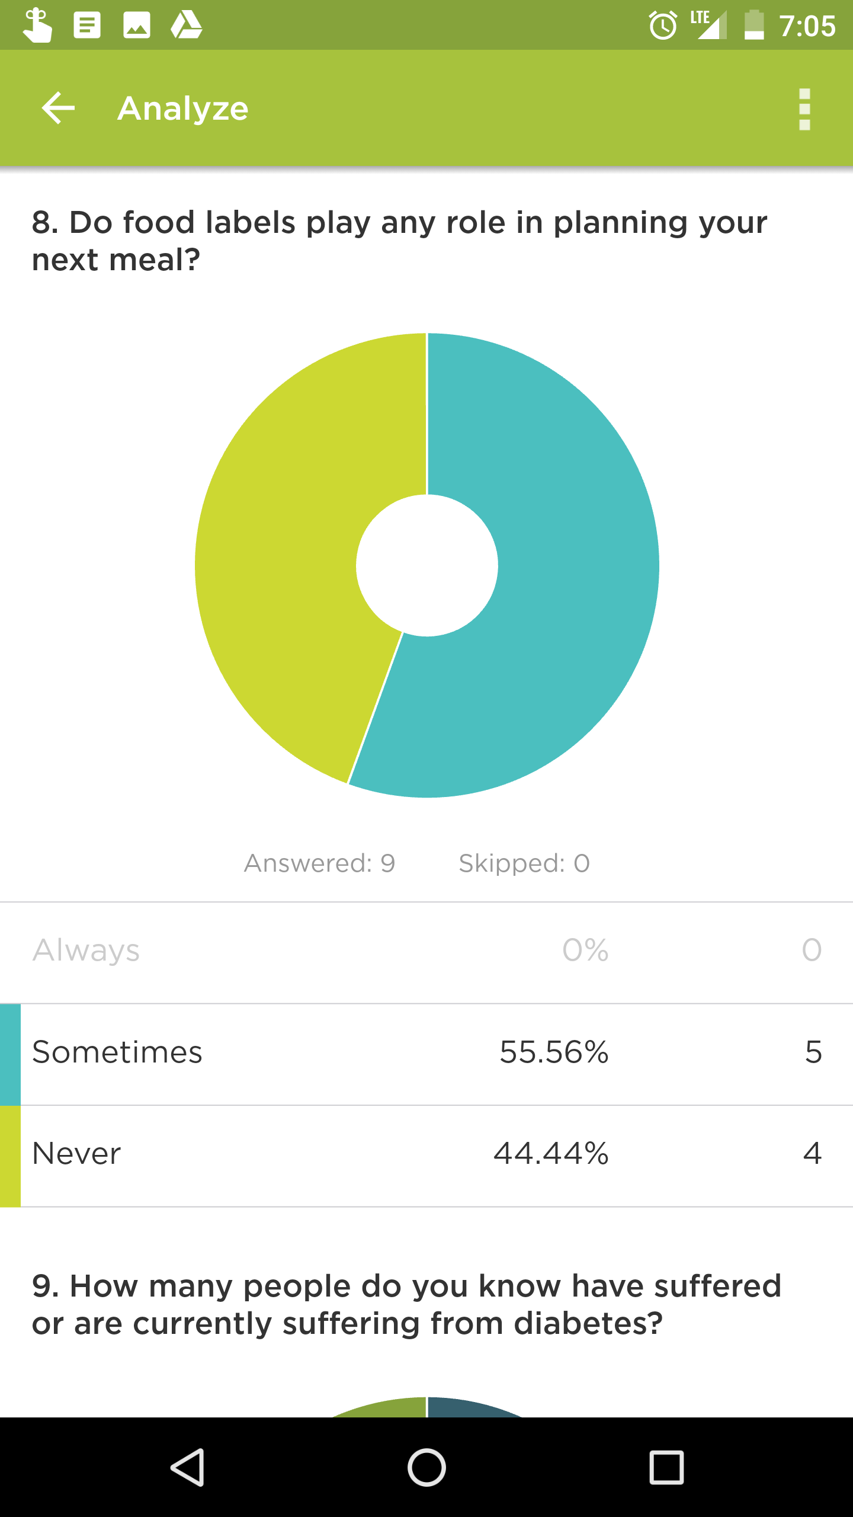
Results
Pilot
Final
The survey participants were then asked if whether or not they read food labels to assist in deciding what they want to eat next. Results show that 65% only read labels sometimes and 31% never read labels; a single person said that they always utilize labels when making food choices.
For those that read “sometimes,” there is no indication of how frequently they read labels.

Slide 17
These findings support the points made by UTI journal report as the survey takers demonstrate health consciousness and demote the healthiness of a product such as spam.
Furthermore, the group that never read labels can be described as consumers who are, “confronted with numbers in variety of different unit sizes,” (Wilcox, Prokopec; 2013) as well as those who are part of the group that only read labels sometimes
The findings suggest that the population of Saipan do not generally read labels, most likely because of the issue of the numerosity of nutritional information

Slide 18
81%
Of the survey participants know at least one person affected/has been affected by diabetes
33% know only one person, 48% know more than one but less than five, and 19% know more than five people.

Slide 19
Gather sources, first write up
More drafting, informal interviews
Peer review/edit
Week 1
Week 2
Week 3
Week 4
So on
Interviews, observations, data collecting
Repeat observation research, third draft. Refine, refine, refine

