Slide 1
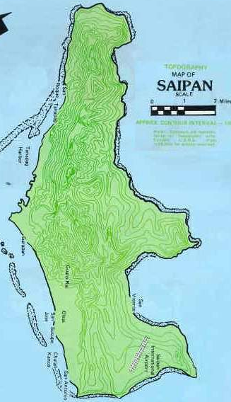
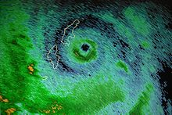
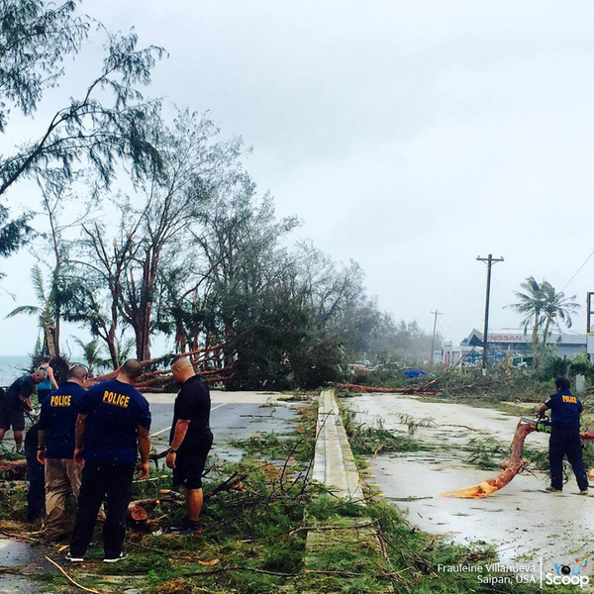
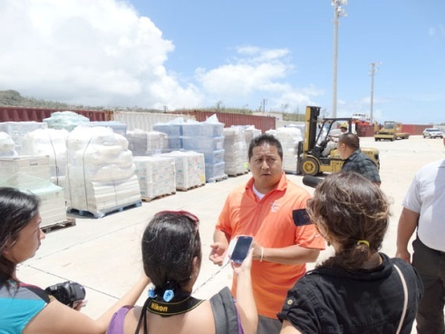
Final Research Report
Government Preparedness
English 202
Kimberly Bunts-Anderson
Elton Castro

Slide 2
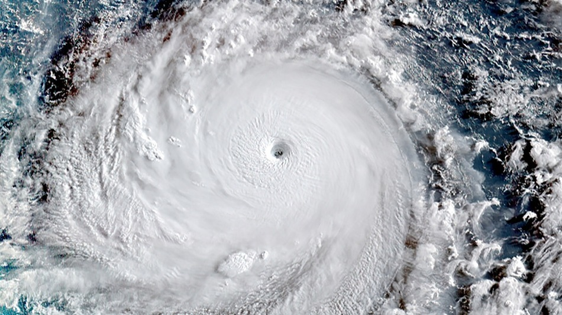
Background
On August 3rd 2015 Typhoon Soudelor hit Saipan.
President Obama declares state of disaster on August 5th 2015
National Weather Service Tiyan Guam gave out the wrong forecast, prior typhoon.
The typhoon was ruled out to be a category 3, then later classified as a category 4 tropical cyclone by the National Weather Service in Guam and the University of Guam-Water and Environmental Research Institute.
Soudelor is described as a “unique” small typhoon

Slide 3
Literature Review
In Saipan Tribune Soudelor was described as a unique small typhoon.
In one of the academic articles found, it states that Natural disturbances vary in size, strength, and frequency. The common type of natural disturbance to affect the CNMI is typhoons. According to ‘Ecosystems (1998) 1:511-523’ under ‘Factors influencing succession: Lessons from large, infrequent natural disturbances’ page 512, typhoons do not need to be large to be intense. In this case typhoon Soudelor wasn’t expected to increase its strength and this might be one of the key factors to why the residents of the C.N.M.I. weren’t prepared for it.

Slide 4
Research Question
Primary Research Question:
“How prepared was the government after typhoon Soudelor?”
Secondary Research Question:
“What is the statistical relationship between the government and the residents of the CNMI’s level of preparedness after typhoon Soudelor?”

Slide 5
Methods Used
Interview question for government officials/employees: Lt. governor “Ralph DLG Torres”, Mayor “David Apatang”, Parks and Rec: “Eddy Cabrera” director.
Interview questions focused on their opinions that asked them how things were done, could it have been done better, the hardships they faced, and overall were they prepared for this kind of disaster.
Created a survey using the website: https://www.surveymonkey.com/
Distributed the survey to my fellow peers and had it available online.
Questions asked were mostly short answered questions that required survey takers to further explain their feelings towards the questions

Slide 6
Findings

Slide 7
Key findings
The acting governor, Ralph DLG Torres stated that the government was absolutely not prepared for this disaster---The Mayor though, stated that he’s always prepared
Saipan received the wrong weather forecast
The government lacks heavy equipment that were needed for the clean up.
The acting governor Ralph DLG Torres said that the government will be more prepared if another disaster hits us in the future.
Lack of communication with government and residents of the CNMI caused an uproar with the gas stations.
The acting governor , Ralph DLG Torres states: The complains why government were gassing their own separate gas station, while having the community gas on separate gas stations, one of that was making sure that the government provides public safety, medical care, and the access to that. The hard part was communicating with our community letting them know that the government has to separate our duties as a government to prioritize those safeties to the community.

Slide 8
Conclusion and Future Study
Overall, the government admitted that they weren't prepared for typhoon Soudelor, however the lessons learned from typhoon Soudelor has created a better way of dealing with future natural disasters.
Future study…
-a survey that targeted all age groups would have greatly impacted the information

Slide 9
References
Ecosystems (1998), 1998 Springer-Verlag 1:511-523’ under ‘Factors influencing succession: Lessons from large, infrequent natural disturbances’ page 512 Retrieved: November 24, 2015 from: link.springer.com/article/10.1007/s100219900047#page-1
Ecosystems (2011) 14: 127-143, Typhoon Disturbance and Forest Dynamics: Lessons from a Northwest Pacific Subtropical Forest. 2010 Springer Science+Business Media, LLC. Chang, C., Liu, C., McMullen, C.,Lin, K., Wang, L.,Vadeboncour, M., Lin, S., Hamburg, T., Hsia,Y. Retrieved on: November 25, 2015, DOI:10.1007/s10021-010-9399-
Human cost of natual disasters (2015) centre for research on the epidemiology of disasters-CRED. Retreived: December 20, 2015 from: http://reliefweb.int/report/world/human-cost-natural-disasters-2015-global-perspective
Camacho, J. (2015, August 5). A day after typhoon soudelor. Saipan tribune [Saipan]. Retrieved from http://.saipantribune.com/index.php/a-day-after-typhoon-soudelor/
Press Release. (2015, August 3). Widespread damage from typhoon Soudelor. Saipan tribune[Saipan]. Retrieved from http://www.saipantribune.com/index.php/widespread-damage-from-typhoon-soudelor
SPNEditor. (2015, August 2). Breaking news. Saipan tribune [Saipan]. Retrieved from http://www.saipantribune.com/index.php/breaking-news-typhoon-soudelor-13w-2/
Villanueva-Dizon, F. S. (2015, October 7). Torres Soudelor unveiled issues in the CNMI.Saipan tribune [Saipan]. Retrieved from http://www.saipantribune.com/index.php/torres-soudelor-unveiled-issues-in-the-cnmi/
Villanueva, F. S. (2015, August 14). Soudelor damage consistent with a category 3 typboon.Saipan tribune [Saipan]. Retrieved from http://www.saipantribune.com/index.php/soudelor-damage-consistent-with-a-category-3-typhoon/
Pinaroc, J. D. (2015, August 6). Breaking news: Obama declares CNMI under state of disaster.Saipan tribune [Saipan]. Retrieved from http://www.saipantribune.com/index.php/obama-declares-cnmi-under-state-of-disaster/

