Slide 1
Findings and analysis
EN202-02
Research Portfolio
Aaron Paul V. Pamintuan
Dr. Kimberly Bunt-Anderson
Northern Marianas College

Slide 2
Findings

Slide 3
Findings

Slide 4
Findings

Slide 5
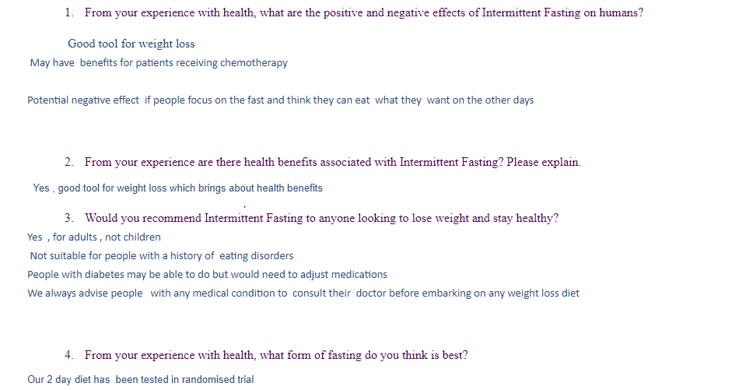
Findings

Slide 6
Analysis
Through this shorten course, the student researcher was able to complete his research report. By working in a timely manner he was able to collect viable data. This included academic literatures and interviews. After conducting and completing this research report, the student researcher have found that intermittent fasting is effective. It has proven to be beneficial in burning fat which leads to weight loss. Pamintuan also discovered that intermittent fasting is most effective when partaking in a physically active lifestyle and nutritious diet.

