Slide 2
Fortune telling
Speaker: Keisha Santos Class: CO210-02

Slide 3
About the cards
Suits
Spades = bad luck
Clubs = 50-50 good and bad luck
Diamonds = 30-70 bad and good luck
Hearts = Good luck
Conditions
NO gambling with cards
NO touching without permission

Slide 4
Types of readings

Slide 5
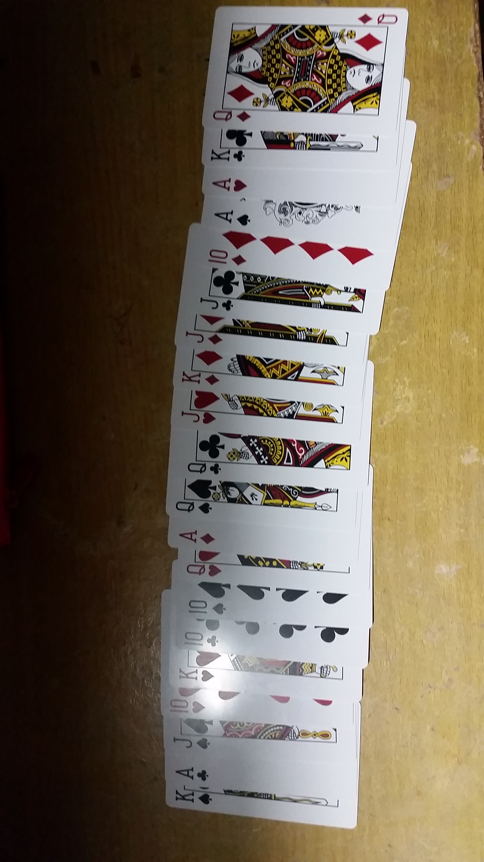
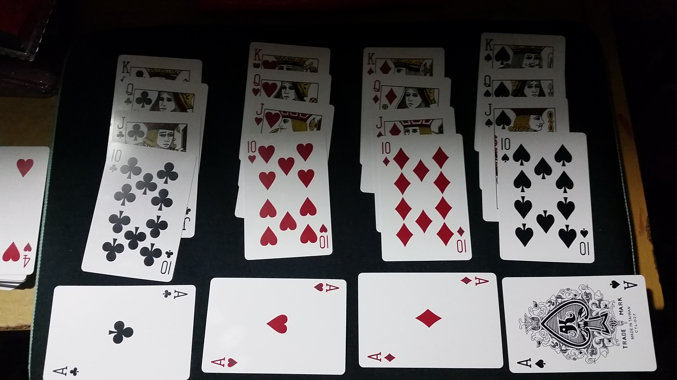
Relationship reading
Cards tell a story but uses a simple layout
Cards needed: Kings, Queens, Jacks, Tens and Aces
King’s, Queen’s, Jack’s, and 10’s
Doubles mean guarantee
Steps:
Teller shuffles the cards
The person taps amount of letters of the person’s name
EX. Keisha, person taps six times on the deck
Teller will continue reading

Slide 6
Situation deciding
Two cards
Helps seeing the fate of the decision made
Teller does not need to know situation
Steps:
Teller tells person to consider their situation and their decisions
Person picks two cards and holds one card on each hand
Teller tells person to base their decision’s result on card NOT FLIPPED

Slide 7
Actual card reading?
KEISHA, WHAT DO YOU MEAN?

Slide 8
Samples of card readings
Aces
Nines
Jacks
Hearts
The home, love friendship, joy the start of a romance. A love letter.
Diamonds
A ring or present of jewelry. News about money. A letter.
Clubs
Wealth, health, love and happiness. A letter concerning money.
Spades
Emotional conflict, obsession, death. Thing coming to an end.
Hearts
The wish card. Dreams come true.
Diamonds
Surprise with money. New business opportunities. Restlessness.
Clubs
Achievements. A new lover or admirer. Don’t be stubborn.
Spades
Bad luck in all things. Depression and low energy. Destruction, deaths. Extreme anxiety.
Hearts
A close friend or a good-natured, fair-haired youth.
Diamonds
A relative. A very fair-haired youth. Watch out for dishonesty or unreliability.
Clubs
A reliable friend. A dark-haired youth.
Spades
A well-meaning but immature and unreliable youth. A very dark-haired youth.

Slide 9
Let the cards do the talk
THANKS FOR LISTENING!

