Slide 1
Greetings in the Commonwealth of the Northern Mariana Islands
Nathan Hofschneider Ada

Slide 2
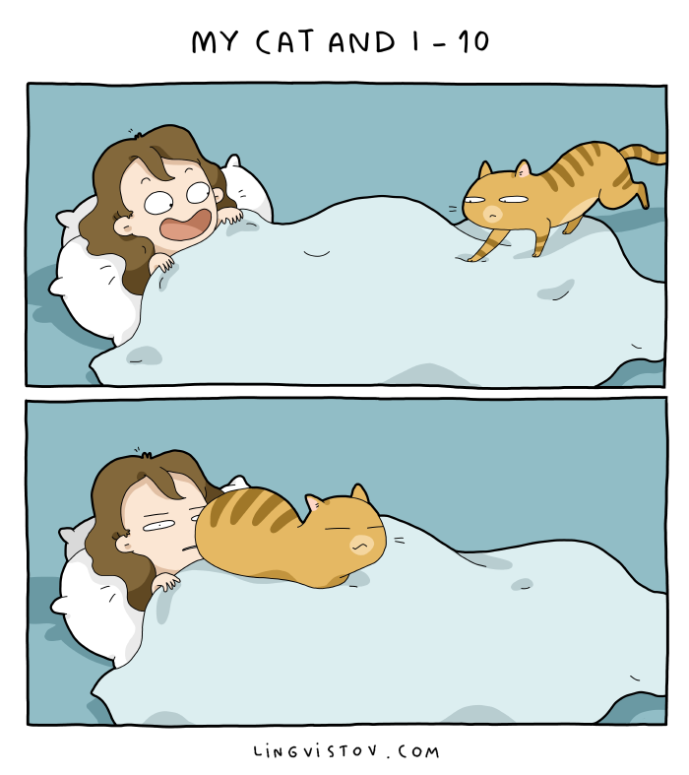
Greetings
a polite word or sign of welcome or recognition.
Determines a person’s perspective of you

Slide 3
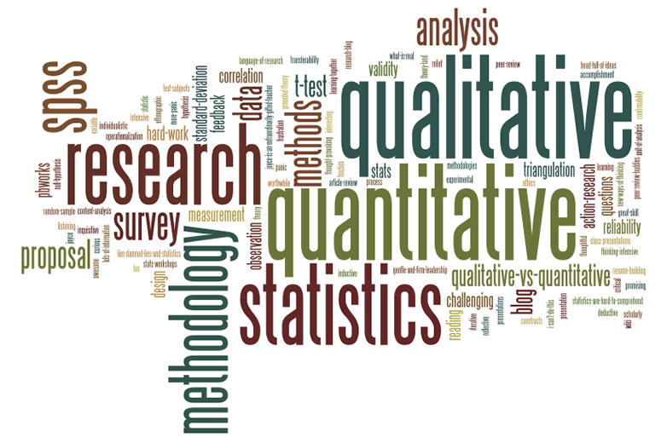
Methodology
Surveys
Observations
Interviews

Slide 4
Surveys
Manually and through Online
12 total
Demographics and opinionated questions
Saipan, Tinian and Rota

Slide 5
Observations
3 areas
Different settings
2 on Saipan
1 on Tinian

Slide 6
Thursday street market
Cultural event
4 days for on month
Multiple interactions
Most of the interactions were from afar

Slide 7
Stand sands Plaza
Shopping, entertainment and food
4 days for a month, Every Wednesday
Minimal interactions

Slide 8
Birthday Party !!
How gifts were given
One Day
Multiple interactions( children )

Slide 9
Interviews
“In your opinion what is greetings and why is it important?”
Similar definition
All the responses dealt with a positive outlook

Slide 10
Literature
6 total
Importance of greetings
Multiple greeting styles

Slide 11
Findings
Based of the interviews, surveys and observations conducted every person grabs an elder person’s hand place it on their forehead or on their nose.
People are more open to different types of greetings with friends than with relatives.
Don’t usually converse with random people unless the situation is somewhat Awkward

Slide 12
Conclusion
Open for further research
CNMI developed a unique style of greeting

