Slide 1
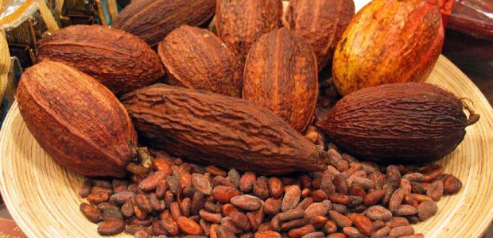
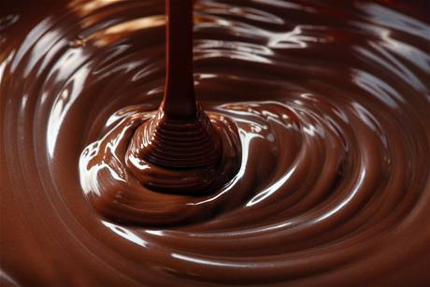
Having a Chocolate Factory on Saipan
Shirlene C. Laniyo’s Presentation
English Composition 101-07
Dr. Kimberly Bunts-Anderson

Slide 2
Survey
100% of the people I have surveyed agrees that Saipan should have a Chocolate Factory
100% says it will be a successful enterprise because it is something that people will love and it would be amazing to see how chocolate is made.
10 people chose that Garapan would be a best place for a chocolate factory. 2 out of 10 prefer that the Kagman is the best place for a chocolate factory because Kagman has better soil and plenty of water for the cocoa beans that needs to be harvest.

Slide 3
100% agree that the chocolate factory should be creative and make chocolate bars along with ice-creams and chocolate milk.
6-F 6-M (12 people surveyed)
Age: 19-47
Occupation: 4 student 8 work 10 parent

Slide 4
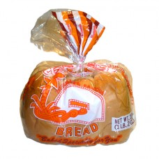
Interview with Juan “Pan” DLG. Herman’s Bakery
Interview with Juan “Pan” Deleon Guerrero
Date: November 25, 2013 Time: 10:30 am
To state: Juan Pan has limited knowledge about the chocolate industry.
With your business experience in the region do you believe a chocolate factory here on Saipan would be successful enterprise and beneficial to the community? Why or why not?
- It will be a successful enterprise if Saipan would have a chocolate factory especially for tourism. It should though have a proper planning, structure, you may want to start off small scale but do high end with a variety of doing your own shapes, name, product, and packing.

Slide 5
3) How would you go about choosing employees?
- It’s best to have employees that are experienced. So the experienced can teach those who are not as experienced as they are.
4) Would you attempt to grow supplies locally? If so, how would you train the farmers?
- For initial setup I would import and later would look into growing supplies locally as soon as research is a guarantee that cocoa beans can grow in Saipan. NMC CREES is highly recommended to be the people or company to seek about cocoa beans being harvest.

Slide 6
5) If you were to buy products from overseas where do you think you would import from and why?
- Best to look at countries that produces the most and the best cocoa beans. They may require the buyer to buy container loads and it may not be as cheap. Herman’s Bakery imports most of their chocolates from the US, Australia, and Thailand.
6)From a business stand point where do you think the first and second locations should be placed for maximum traffic?
- Duty Free. Best locations are places that are already set up. Garapan is a good place to have a Chocolate Factory so that you can have a parking ideal and so people can have walking access. Garapan is a tourism place.

Slide 7
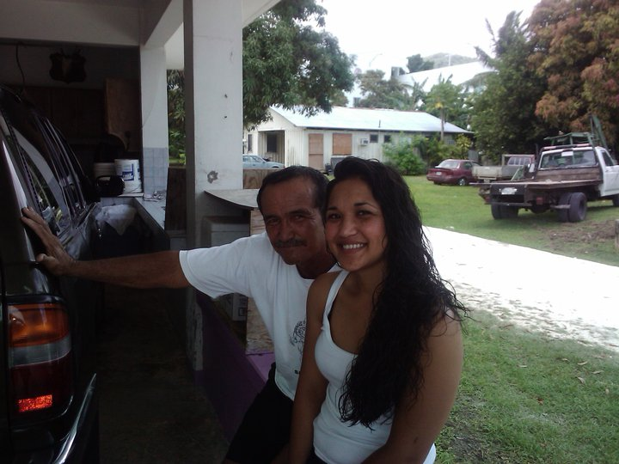
Interview with Archaeologist Mike Fleming
November 24, 2013
Time: 1:00 pm
Have you ever harvest/grow cocoa beans in your past or present time? If yes, was it a successful process? Please Explain.
- Yes, I have harvest cocoa beans in the past and it was successful. Planting a cocoa bean tree is like planting any tree, it’s no different. Just make sure it has good soil and always water it.
Where in Saipan would be best for growing/harvesting cocoa beans and why?
- As Teo area because the water supply is plentiful and the soil is also rich.

Slide 8
Where did you harvest your cocoa beans? & how many cocoa beans were harvested?
- I planted about 5 cocoa beans and it took 4-5 years to bare fruits. I’m not too sure but I think I had two Criollo cocoa beans that bare fruit in the color of white and purple. The three other cocoa bean plants that I harvested were purple and had smooth yellow pod in the inside and they are called Forastero.
According to my research: Harvesting occurs between 3-4 times weekly during the harvest season is it likely to be just the same when harvesting here on Saipan?
- Yes, but it depends at the kind of cocoa variety
Do you believe that Saipan would benefit if we were to grow/harvest cocoa beans? Why or why not?
- I have seen cocoa beans being grown in As Teo area and they seem to be doing well.

Slide 9
If you were to harvest/grow cocoa beans how would you go about it? What are your daily plans on harvesting cocoa beans?
-
Cocoa tree is like any regular tree. They grow best at Mr. Joe I. Pangelinan’s Farm. I would harvest the cocoa beans by first doing some soil testing then analyze the soil context then prepare and produce that soil for the growing cocoa plant. Honestly it maybe something to increase production and stable supply throughout the season or harvest.

Slide 10
About Chocolate ☺
1.Cocoa pods are the fruit of the cacao tree.
2.It takes a cocoa tree five years to produce its first COCOA BEANS (pods).
3.The peak growing period for a cocoa tree is a duration of 10 years.
4.Cocoa beans are called “cocoa” beans and not “cacao” beans because of a spelling mistake made by English importers in the 18th century when chocolate was becoming popular.
5.Cacao trees range from 13-26 feet tall. Sometimes reaching 32 feet.
6.Cocoa flowers can blossom on cacao trees all year around, however the flowers will die within 24 hours if not pollinated.

Slide 11
Process of harvesting cocoa beans
Fermenting 2. Drying & bagging 3. Winnowing
4. Roasting 5. Grinding 6. Pressing 7. Pressing
THE END ☺

