Slide 1
How can waste be minimize in the free meal program?
Nestor T. Tumaquip
EN 202/01-English Composition II
Insturctor: Professor Kimberly Bunts Anderson

Slide 2
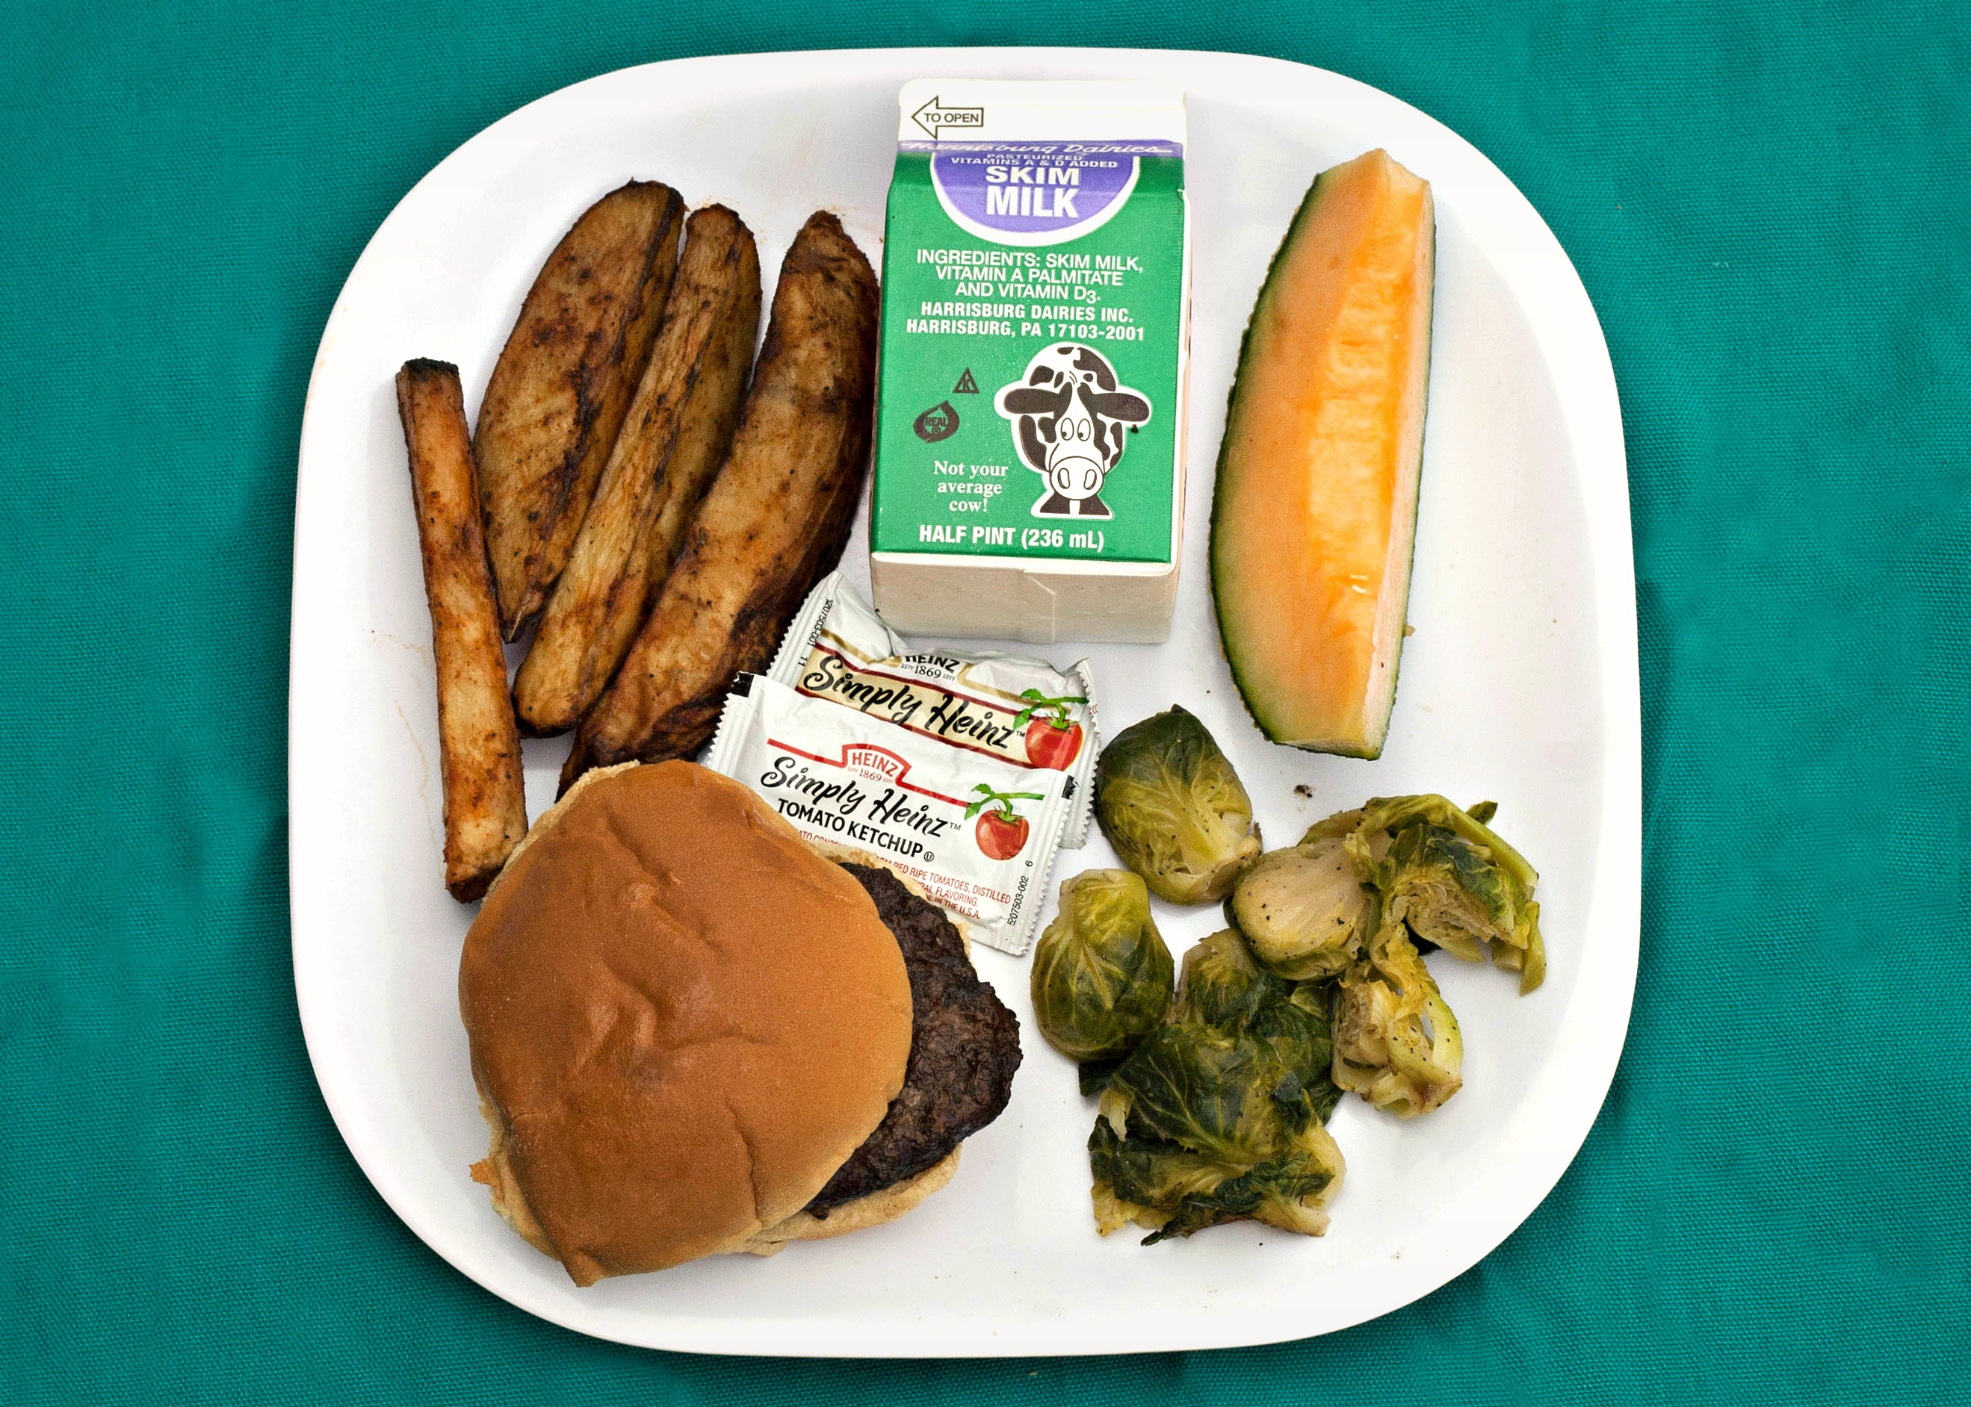
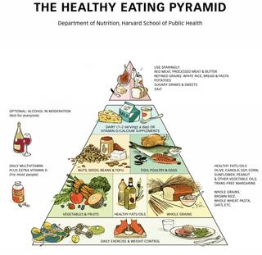
A study of food preferences in CNMI Public schools to northern marianas college student
This Photo by Unknown Author is licensed under CC BY-SA
This Photo by Unknown Author is licensed under CC BY-SA

Slide 3

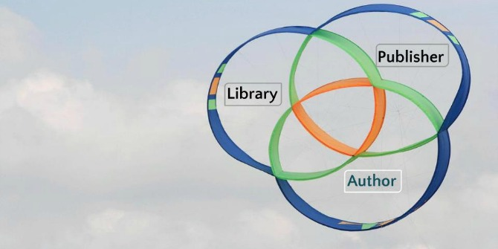
Literature as references for my studies of Public school free meal that are wasted
Academic : 4 sources
Non-Academic : 4 sources
This Photo by Unknown Author is licensed under CC BY-SA
This Photo by Unknown Author is licensed under CC BY

Slide 4
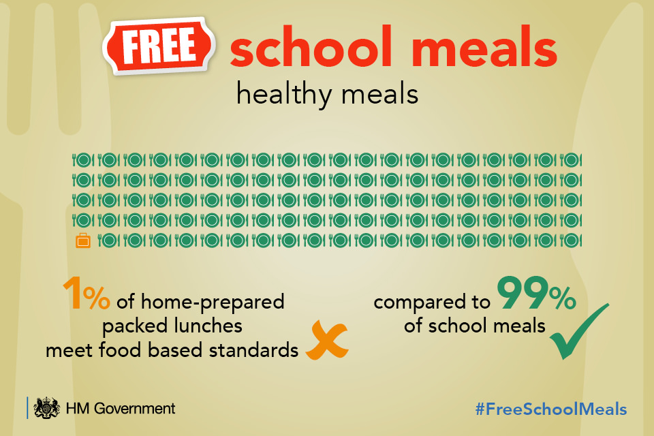
Methodology of survey from northern marianas college students (40 students)
This Photo by Unknown Author is licensed under CC BY-NC-ND

Slide 5
First Methodology by using survey from different public school
San Vicente School Elementary School
Dandan Middle School
Marianas High School
First Grade and Second Grade School Students.
Fourth and Fifth Grade School students
Sixth Grade Students
Seven Grade Students
Eight Grade Students
Nine Grade Students
Ten Grade Students
Twelve Grade Students

Slide 6
Second Methodology : interviews to three experts about free meal programs
Public School System/Child Nutrition Program
Public School System/Child Nutrition Program
Public School System/Child Nutrition Programs Vendors
Director Dale Robertson:
Direct contact of United States Federal Grants and CNMI Public School System.
Ms. Kaisa Anderson: Official and certified Nutritionist Public School System/Child Nutrition Program
Kalayaan Catering
Barny’s Catering
LSG Catering

Slide 7
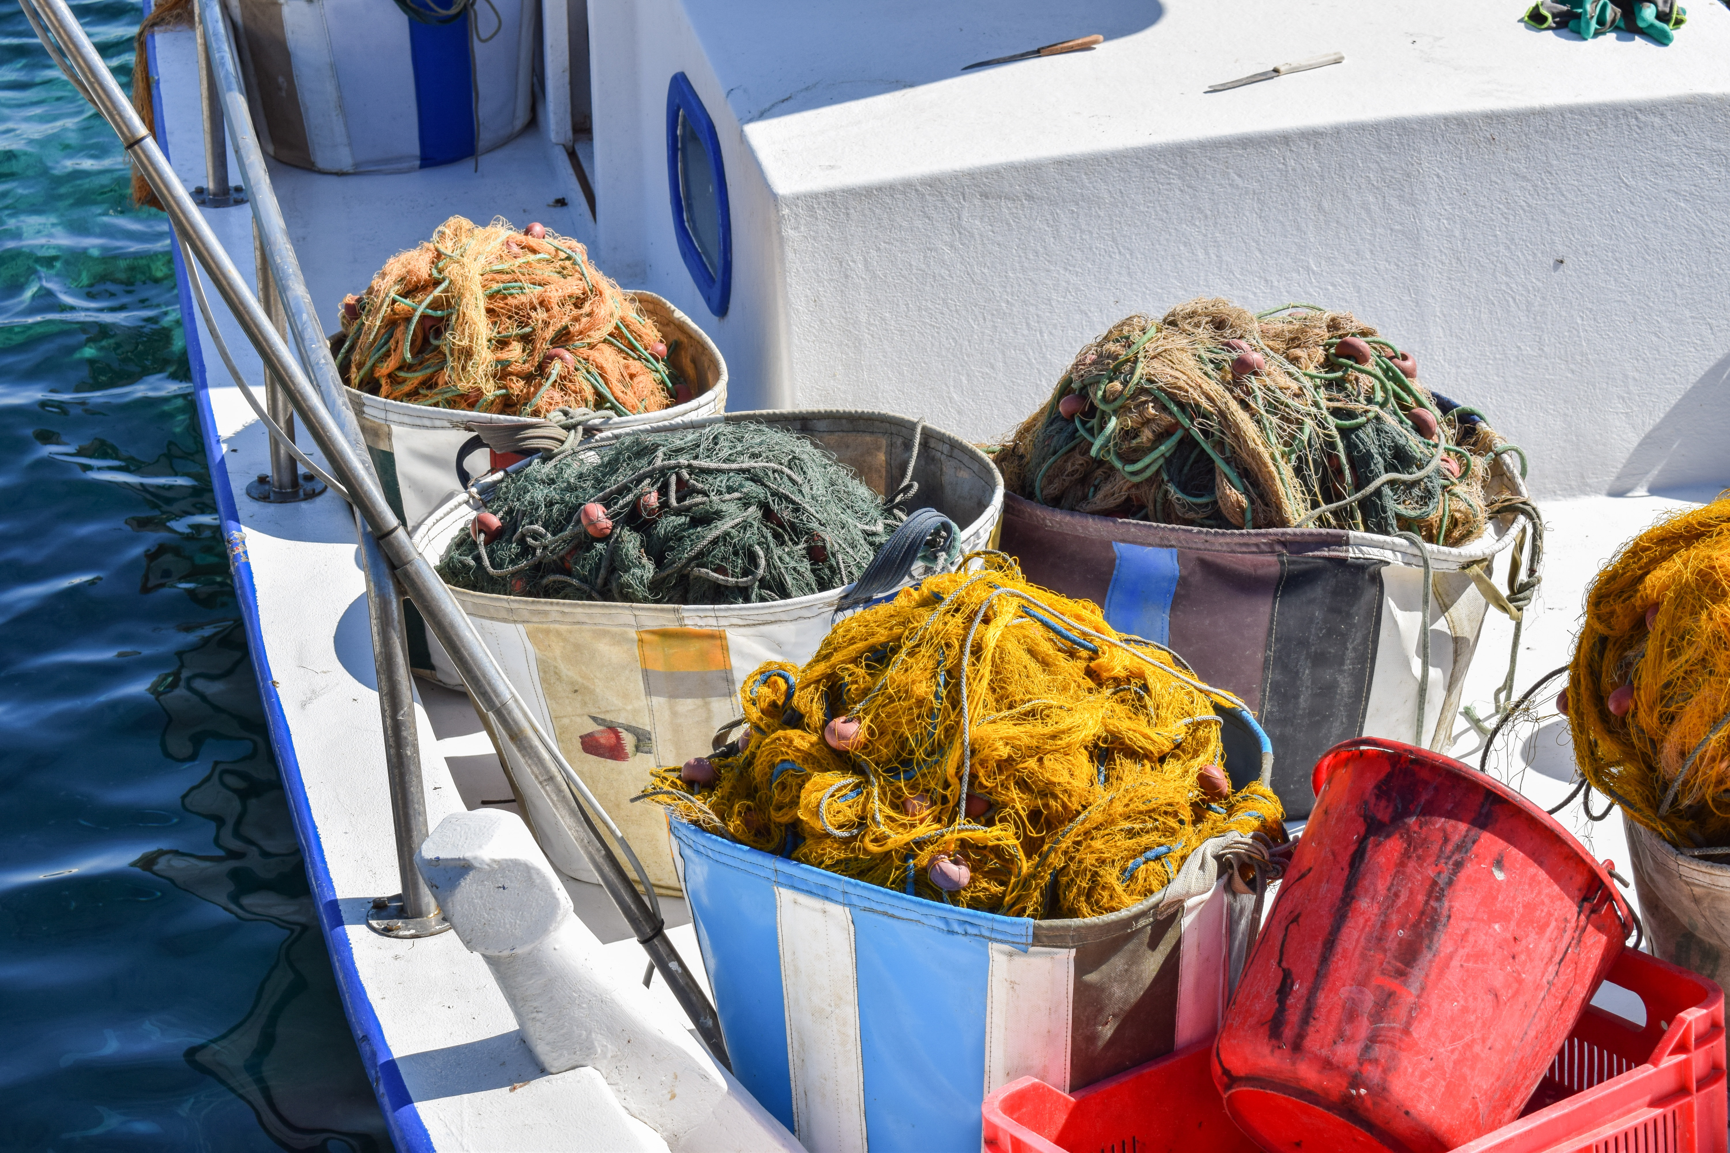
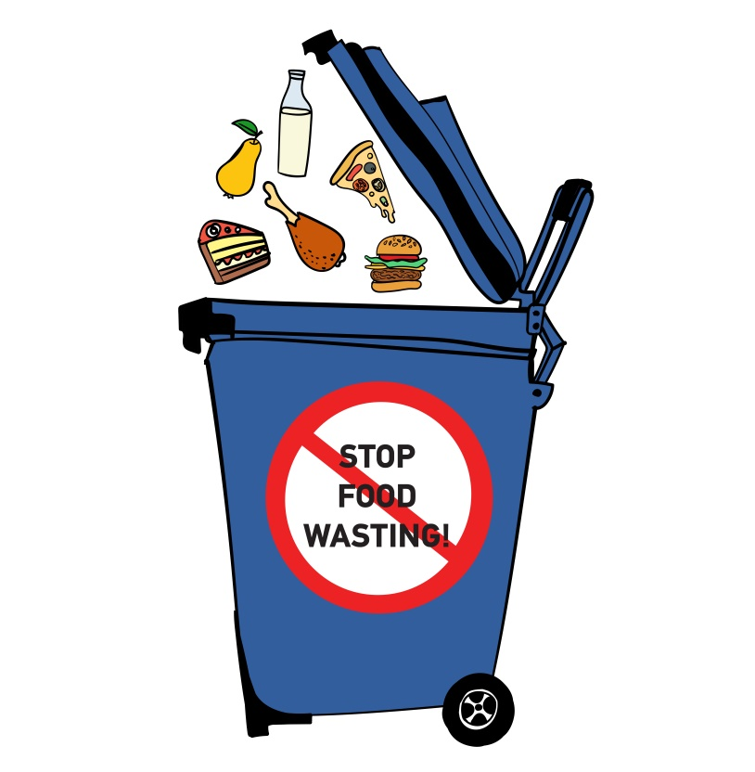
Third methodology : write to two of academic authors about their study of waste foods from free meal program.
This Photo by Unknown Author is licensed under CC BY-NC

Slide 8

Schedule to finish my essay project
Sept. 24-30 Week 6. Revising essay 2 hard copy for peer feedback/instructor feedback due.
Oct. 1-7 Week 7. Essay FD2 due essay 3 literature review drafting.
Oct. 8-14 Week 8. Essay 3 due for peer/instructor feedback.
Oct. 15-21 Week 9. Essay FD3 due process essay starting.
Oct. 22-28 Week 10. Essay revising/consultations.
Oct. 29- Nov. 4 Week 11. Process essay due/consultation essay FD4 due.
This Photo by Unknown Author is licensed under CC BY-SA

Slide 9
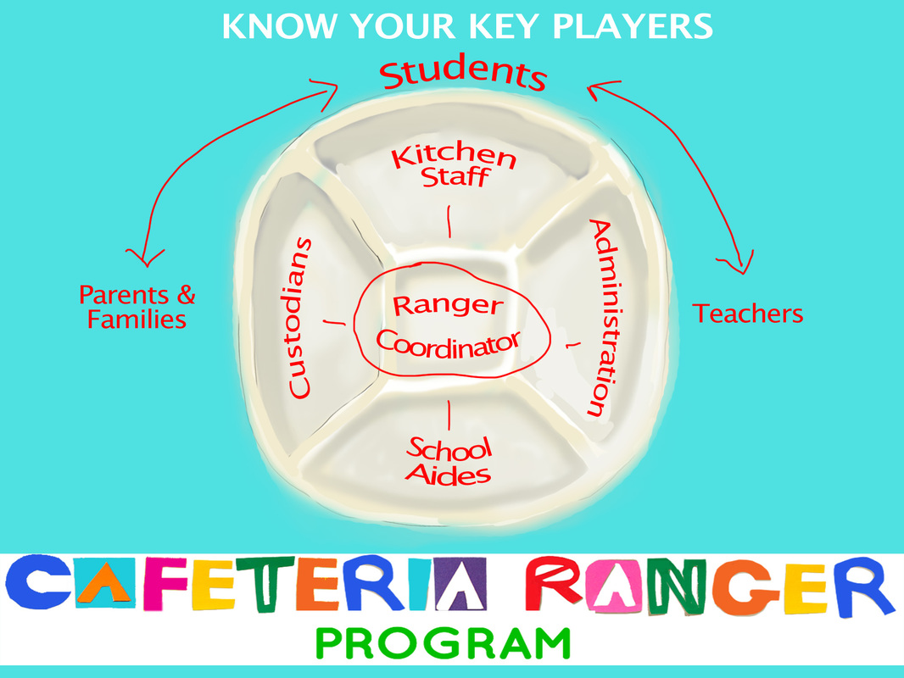
Conclusion: Base on information and collecting of all data, this proposal should be approved because it involves our students who is our future leaders in our beloved island of commonwealth of northern mariana islands..
This Photo by Unknown Author is licensed under CC BY-NC-SA

Slide 10

In closing
This Photo by Unknown Author is licensed under CC BY-SA
This Photo by Unknown Author is licensed under CC BY-SA

