Slide 1
Impacts of Genetic Organism Modified(in food and drinks)
Mary Joy G. Laquian

Slide 2
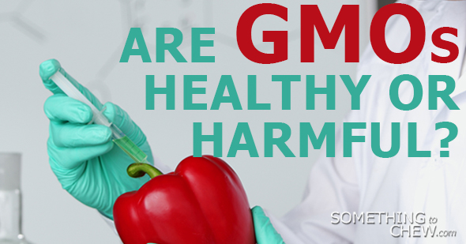
Can biotechnology like GMOs improved nutrition? or will harm the health of the people who will ingest it?
Research Topic:
Impacts of GMOs in food and beers
This Photo by Unknown Author is licensed under CC BY-SA

Slide 3
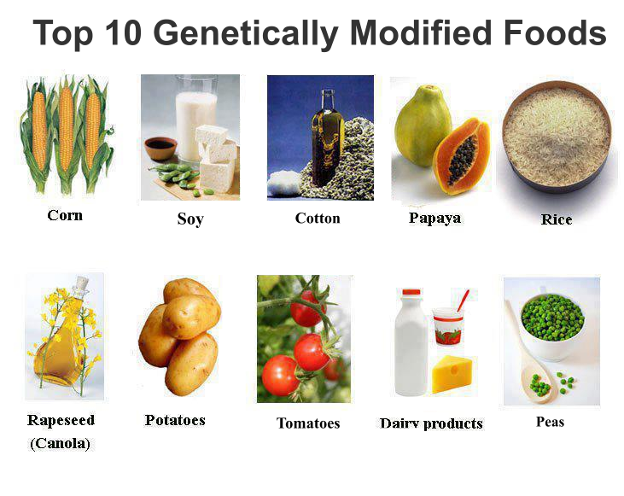
What is Genetic Modified Organism?
A genetically modified organism (GMO) is an organism whose genetic material has been altered using genetic engineering techniques. Organisms that have been genetically modified include micro-organisms such as bacteria and yeast, insects, plants, fish, and mammals. GMOs are the source of genetically modified foods, and are also widely used in scientific research and to produce goods other than food.
This Photo by Unknown Author is licensed under CC BY-NC

Slide 4
Background of Research
According to the Adoption of Genetically Engineered Crops in the U.S, “In recent years, Genetic Modified Organisms (GMOs) have been replaced our food with genetically altered food, which might have badly affected human health”. (India Attacks Genetically Engineered Crops, 2010).
GMOs is a form of scientific farming where crops are injected by chemicals to produce and to increase size of crops. However, for some crop management they are beneficial it is a technique used to improved crops and food quality in a more efficient way.

Slide 5
Purpose
To tackle and to learn more about GMOs (new information)
The impacts of GMOs (negatively) in the health

Slide 6
Research Questions:
- Primary Questions:
What are Impacts of GMOs? In food and drinks?
Secondary Questions: (Informal Interview)
Are you familiar with Genetic Modified Organisms?
Do you have any allergies? Food, drink, or medicine?
Do you drink beer often? Why or why not?
Are you aware that some of the beer ingredients has GMOs in it?
What do you prefer beers in can, bottle, draft beer or local brewing?
What are reason of the possible harmful effects of GMOs? In food and drinks?

Slide 7
Secondary Questions: (Survey monkey)
Age?
20-24
25-32
33-37
others specify
Gender?
Male
Female
How familiar are you with the term Genetic Modified Organisms?
Very familiar
Somewhat familiar
Not familiar
Had never heard the term
How much have you heard about GMOs (In classes, on TV, on the internet?
A lot of information
Some information
Never heard about Genetic Modified

Slide 8
If you have heard of GMOs before, what you do think of the effects that might cause in our health?
Do you think the public has enough information about with food and drinks are now genetically modified?
Yes
No
Do you have any allergies? Food, drinks or Medicine? If beer, why do you think you have allergies with it?
What reactions do your body do when your allergies strike?
How often do you drink beer?
What kind of beer do you prefer to drink?
Canned beer/bottled beer
Draft beer
Local brewed beer
Do you think that GMOs will be a big issue in the CNMI? Why or why not?

Slide 9
Research Objectives:
To identify the some effects of GMOs in the health
To identify how does people get allergies in beers?

Slide 10
Literature Review:
Triggers Allergies
Antibiotic Resistance
Increased Toxicity

Slide 11
Triggers Allergies
Why?
Allergic reactions in humans occur when a normally harmless protein enters the body and stimulates an immune response.
If the new protein in a Genetic modified plant comes from a source that is know to cause allergies in humans or a source that has never been consumed as human food, the concern that the protein could cause an immune response in humans.
For instance, some genetic modified food is one of the ingredient of this specific beer you drink that is why your body is experiencing allergic reaction.

Slide 12
Antibiotic Resistance
Why?
- Biotechnologists use antibiotic resistance genes as selectable markers when inserting new genes into plants.
There is concern that bacteria living in the guts of humans and animals could pick up an antibiotic resistance gene from a GM plant before the DNA becomes completely digested
By attaching the desired gene to an antibiotic resistance gene the new GM plant can be tested by growing it in a solution containing the corresponding antibiotic. If the plant survives scientists know that it has taken up the antibiotic resistance gene along with the desired gene.

Slide 13
Increased Toxicity
Why?
Most plants produce substances that are toxic to humans. Most of the plants that humans consume produce toxins at levels low enough that they do not produce any opposing health effects.
There is concern that inserting an exotic gene into a plant could cause it to produce toxins at higher levels that could be dangerous to humans. This could happen through the process of inserting the gene into the plant. If other genes in the plant become damaged during the insertion process it could cause the plant to alter its production of toxins.

Slide 14
Research instrument:
Yes or No question to separate people who knows or do not know about GMos or GMfs
Example:
1. Are you familiar with Genetic Modified Organisms?
2. Do you think the public has enough information about with food and drinks are now genetically modified?
3. Do you think Genetic Modified Organisms is a serious issue in the CNMI?

Slide 15
Ask and interview some Local Brewer: Yes or No
Do you know what is Genetic Modified Organisms is?
Do you use Genetic Modified Organisms as an ingredients of your beer? Why?
3. Do you sell those products in the Island?

Slide 16
Data Collection:
The survey will take 5-7 minutes to complete.
A short informal interview will commerce after to explore their understanding, views, experiences and beliefs.
Quantitative Data Collection method will be used to provide a deeper understanding.

Slide 28
Data Analysis
Will draw the independent and dependent variables of the study.
- Compile all the answers from the questionnaire, survey and interview

Slide 29
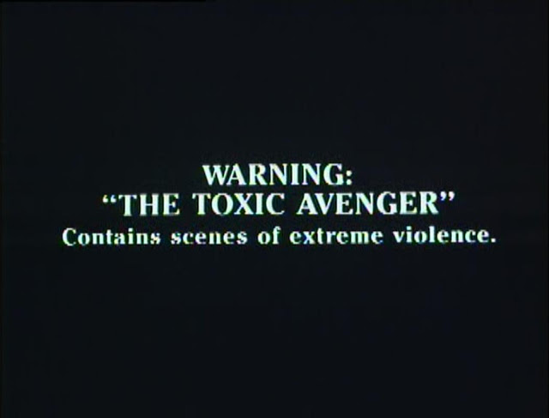
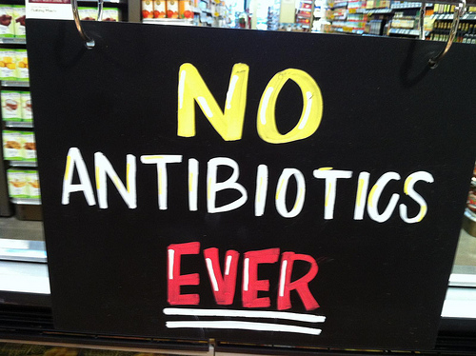
Conclusion:
Allergies, increased toxicity, antibiotic resistance are the possible harmful effects of GMOs n a persons health as you consume it.
This Photo by Unknown Author is licensed under CC BY-SA
This Photo by Unknown Author is licensed under CC BY-NC-SA
This Photo by Unknown Author is licensed under CC BY-NC-ND
This Photo by Unknown Author is licensed under CC BY-NC-ND
This Photo by Unknown Author is licensed under CC BY-SA
This Photo by Unknown Author is licensed under CC BY

