Slide 1
How to Jump higher?
CO210 – 05
Demonstrative Speech
Cheonsu Kim

Slide 2
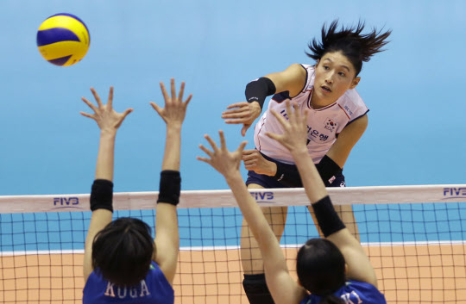
Benefit of jumping higher
Notes:
Explain where, when, and why higher jump is good.
Jumping Higher Shows Your Athleticism

Slide 3
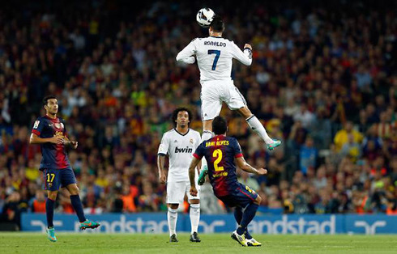
Benefit of jumping higher
Notes:
Like their strength and agility.
They will Get More Playing Time because they will be able to get more points on offense and block the point on defense.

Slide 4
The Big 3 of Jumping
STRENGTH
Overcoming resistance
QUICKNESS
How fast you move
TECHNIQUE
Coordination the movement
Notes:
Here is a big three categories to become a better jumper. First one is strength to overcome resistance. Second is quickness how fast you move. Last is technique coordination the movement. All of these three is very important, but presentation time is limited so I will only talk about strength part.

Slide 5
Misconception
If people were weighted down, they will become a higher jumper.
If people who are really strong, they will become a higher jumper.
Notes:
Here is first misconception on the next slide.

Slide 6
Misconception
Notes:
If you were weighed down, not only your fat are reduced but also your muscles. So if you can jump 20 inch right now, you can jump less than 20 inch when you lose your weight.

Slide 7
Misconception
Notes:
Except when you did a proper diet. Proper diet is lose the fat not a muscles. So here is a key, you need to become strong at your body weight. And here is a second misconception on a next slide. Do you think that ~

Slide 8
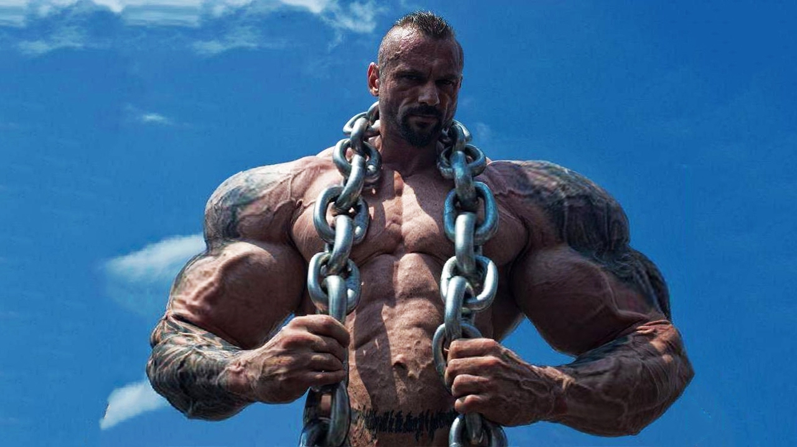
Body-builder

Slide 9
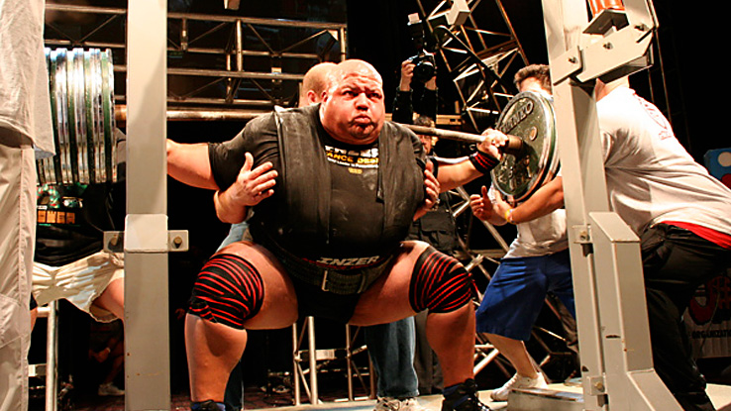
Power-lifter
Notes:
Can jump high? Probably not. As I already mention about relative strength, you need to be strong at your bodyweight. Here is a short video to show what relative strength.

Slide 12
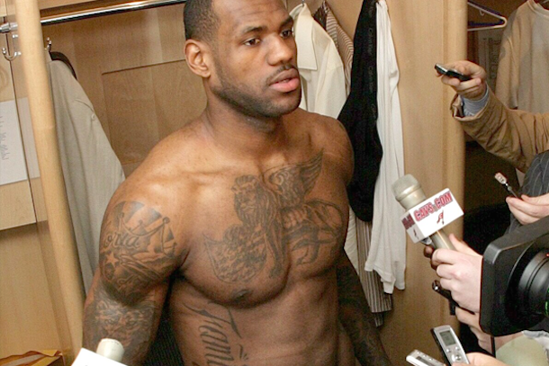
Notes:
That strong at there bodyweight but their body is not looks like a bodybuilders or power-lifters. These guys can jump more than 38 inches.

Slide 13
Questions
Notes:
So here is a questions.
How to train?

Slide 14
Types of Muscle
Notes:
Here is two types of runner. Training anaerobic endurance is marathoner, and training explosive power is sprinter. It is easy to guess who can jump higher.

Slide 15
Types of Muscle
Notes:
Here is 2 types of muscles. It is three but type 2 a and b is similar types of muscle.

Slide 16
Types of Muscle
Notes:
Here’s type 1 muscle fibers. When they train this they will get a high stamina because they use oxygen when they training. They need to work out long time.

Slide 17
Types of Muscle
Notes:
Here is type 2. when they training they need to use a lot of energy in one time. They do not need to work out a long time but need to more recover times.

Slide 18
Types of Muscle
Notes:
Here is differences when they train. Left is how much they need to use energy and bottom is muscle recovery.

Slide 19
Types of Muscle
Notes:
Normally people have half of each muscle fibers. You can choose either side depending on what you want to be

Slide 20
How to train
Training the right kind of strength
Notes:
So how to train type two muscles? They need to training the right kind of strength.

Slide 21
How to train
Notes:
It means do not work out a long times. If you do squat 30 min, dead-lift 30 min, box jump 30 min, and etc… you already pace yourself because when you do over-training, you will train your anaerobic endurance.

Slide 22
How to train
Notes:
I already mention that when you training you need to work with high resistance and velocity in short times. So when you work out in one set you have to do less than 8 and proper rest time between the sets.

Slide 23
How to train
Notes:
Strength without quickness, you cannot jump higher. We are not a power-lifter or bodybuilder. So when you train, you need to move the weight as fast as possible. We don’t jump slowly. When jumpers jump, they will pop it up their body with short amount of time.

Slide 24
Summarize
Notes:
If you work out with jumping low in 100 times, they will work out anaerobic endurance. If they jump as hard as possible 1-5 times, they train explosive strength.

Slide 25
Summarize
Notes:
so when they work out with high resistance and velocity. It means work out as strong as you possible and as fast as you possible. Also there some rules when you train type 2 muscles.

Slide 26
Summarize
Notes:
So when you train, you need to work out strength and quickness because here is a formula that explosion is come from strength times quickness. And when you work out these, you can probability be like this.

Slide 27
Questions

