Slide 1
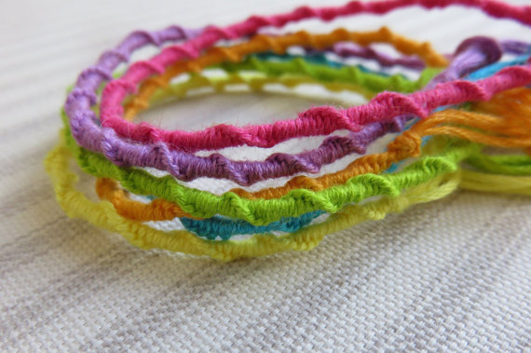
How to make a Spiral Friendship Bracelet
By: Julia Yasuda

Slide 2
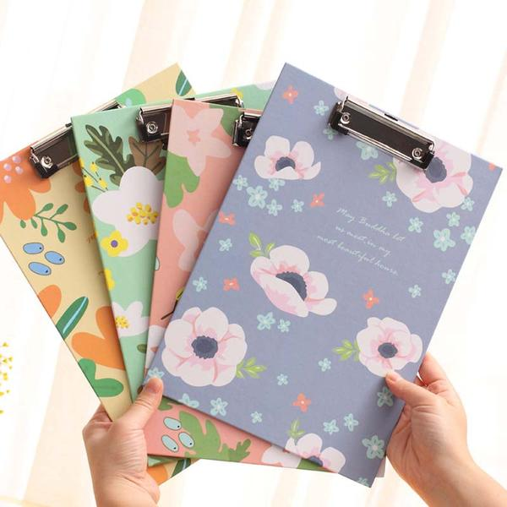
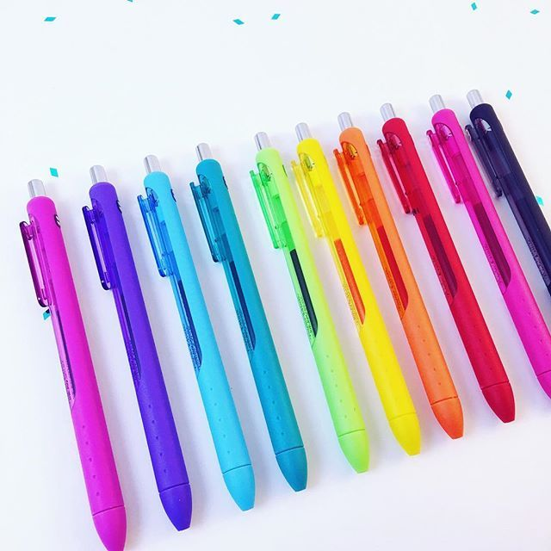
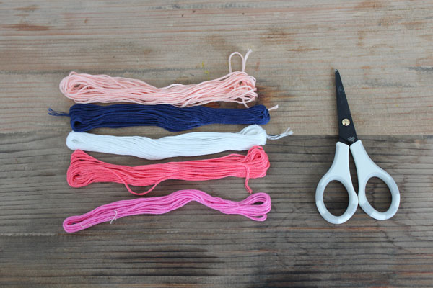
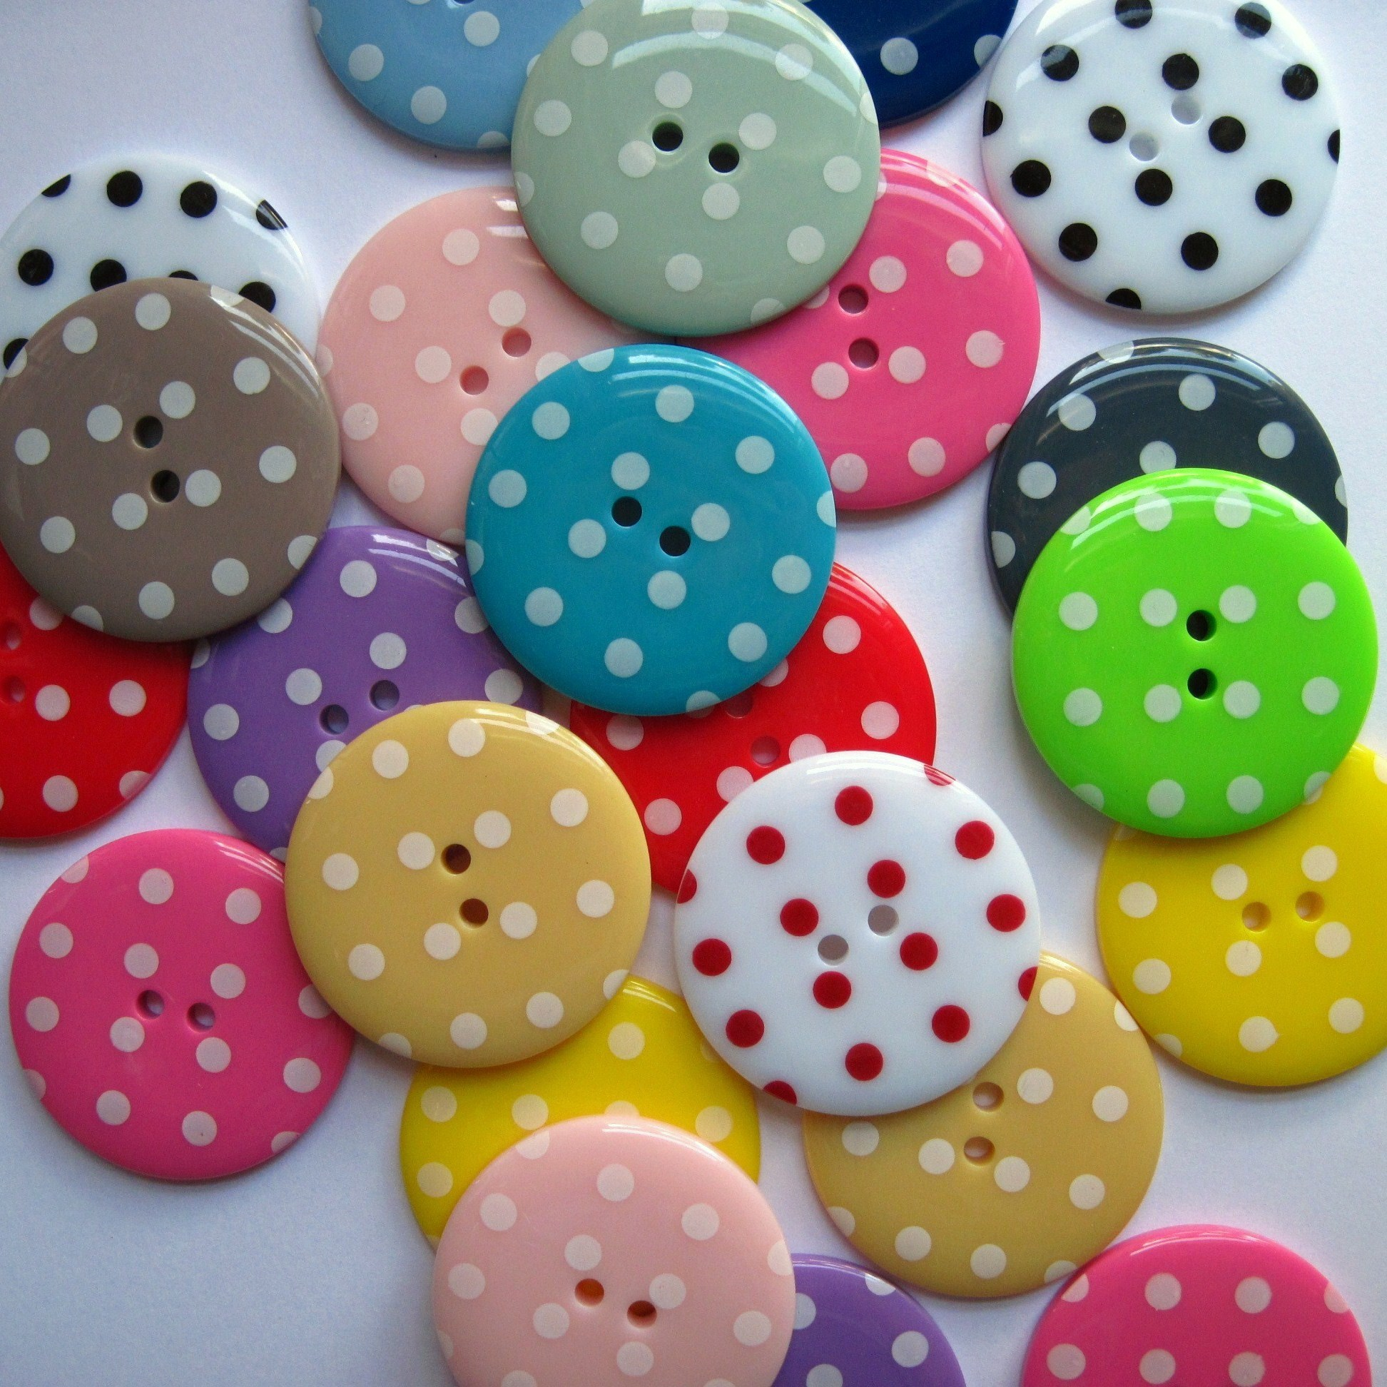
Materials
Embroidery Thread
Scissors
Pen OR Clipboard
Buttons (Optional)

Slide 3
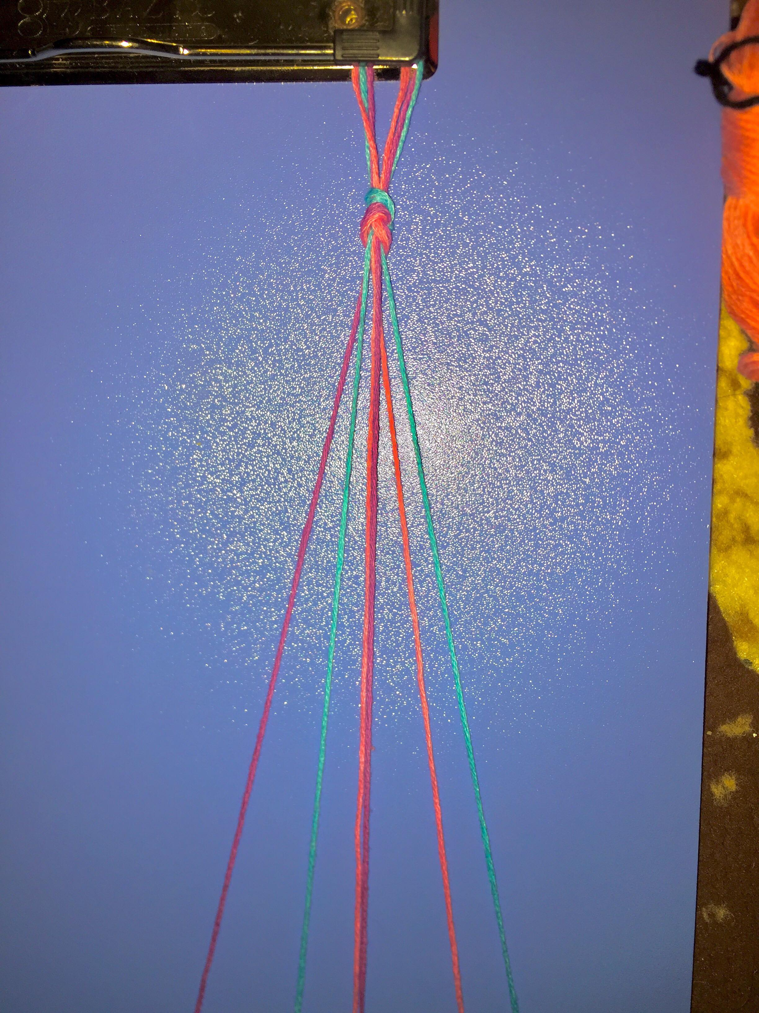
Step 1:
Choose your colors
Measure your wrist, double this length
and add three more inches
Make it in half & knot near the end
Choose your first color

Slide 4
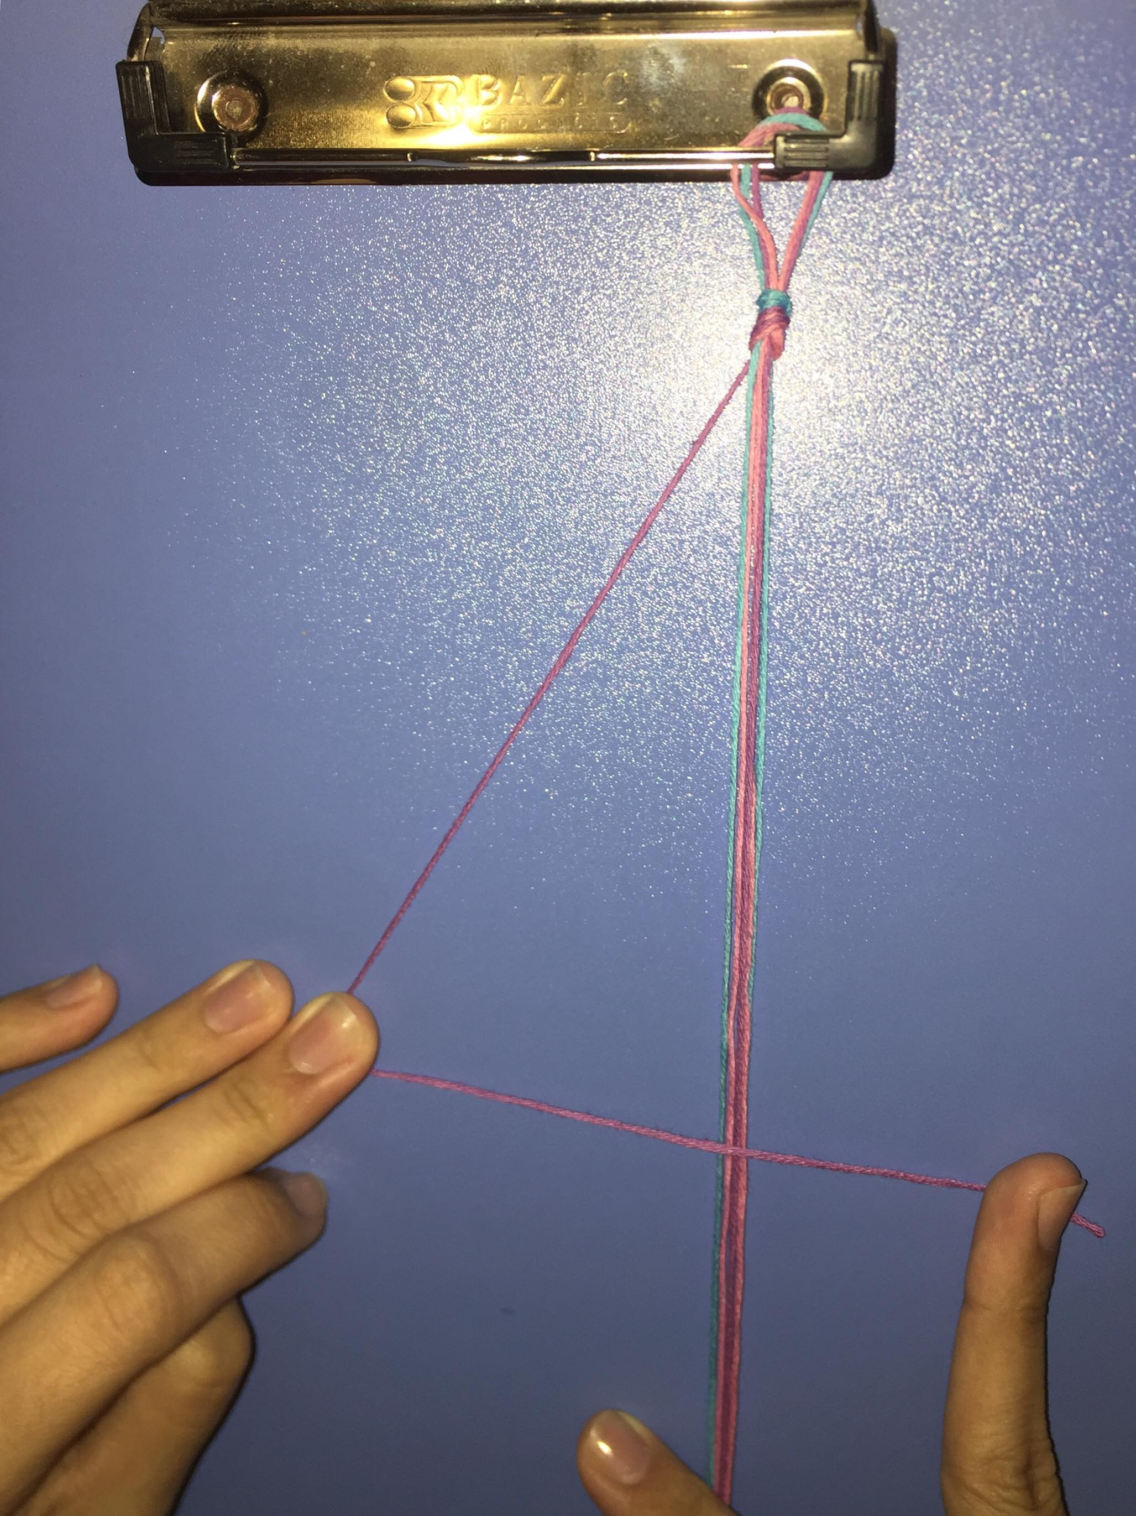
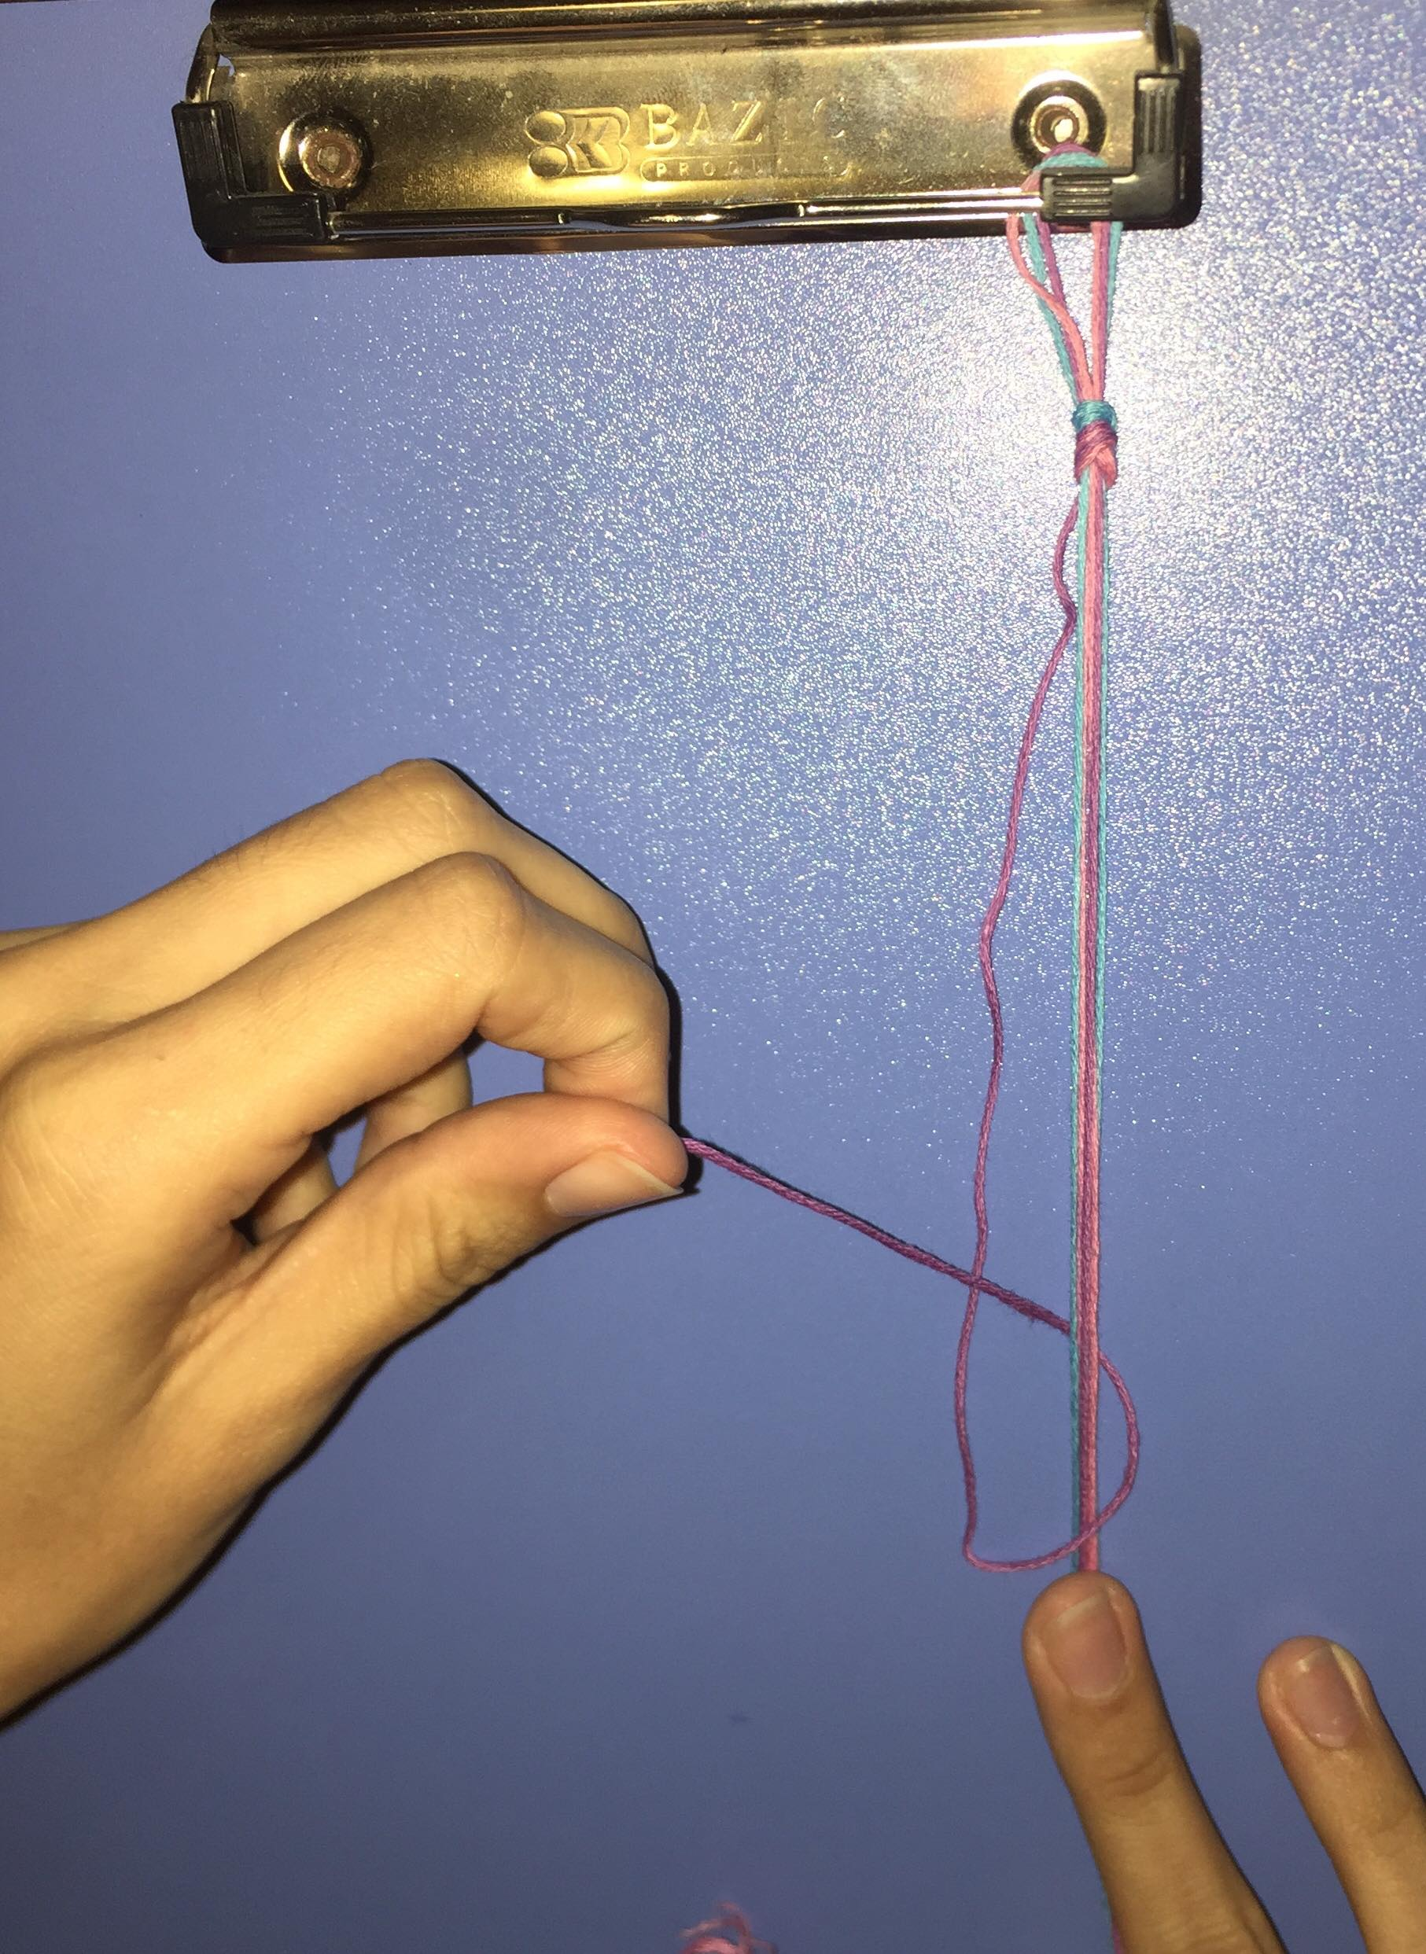
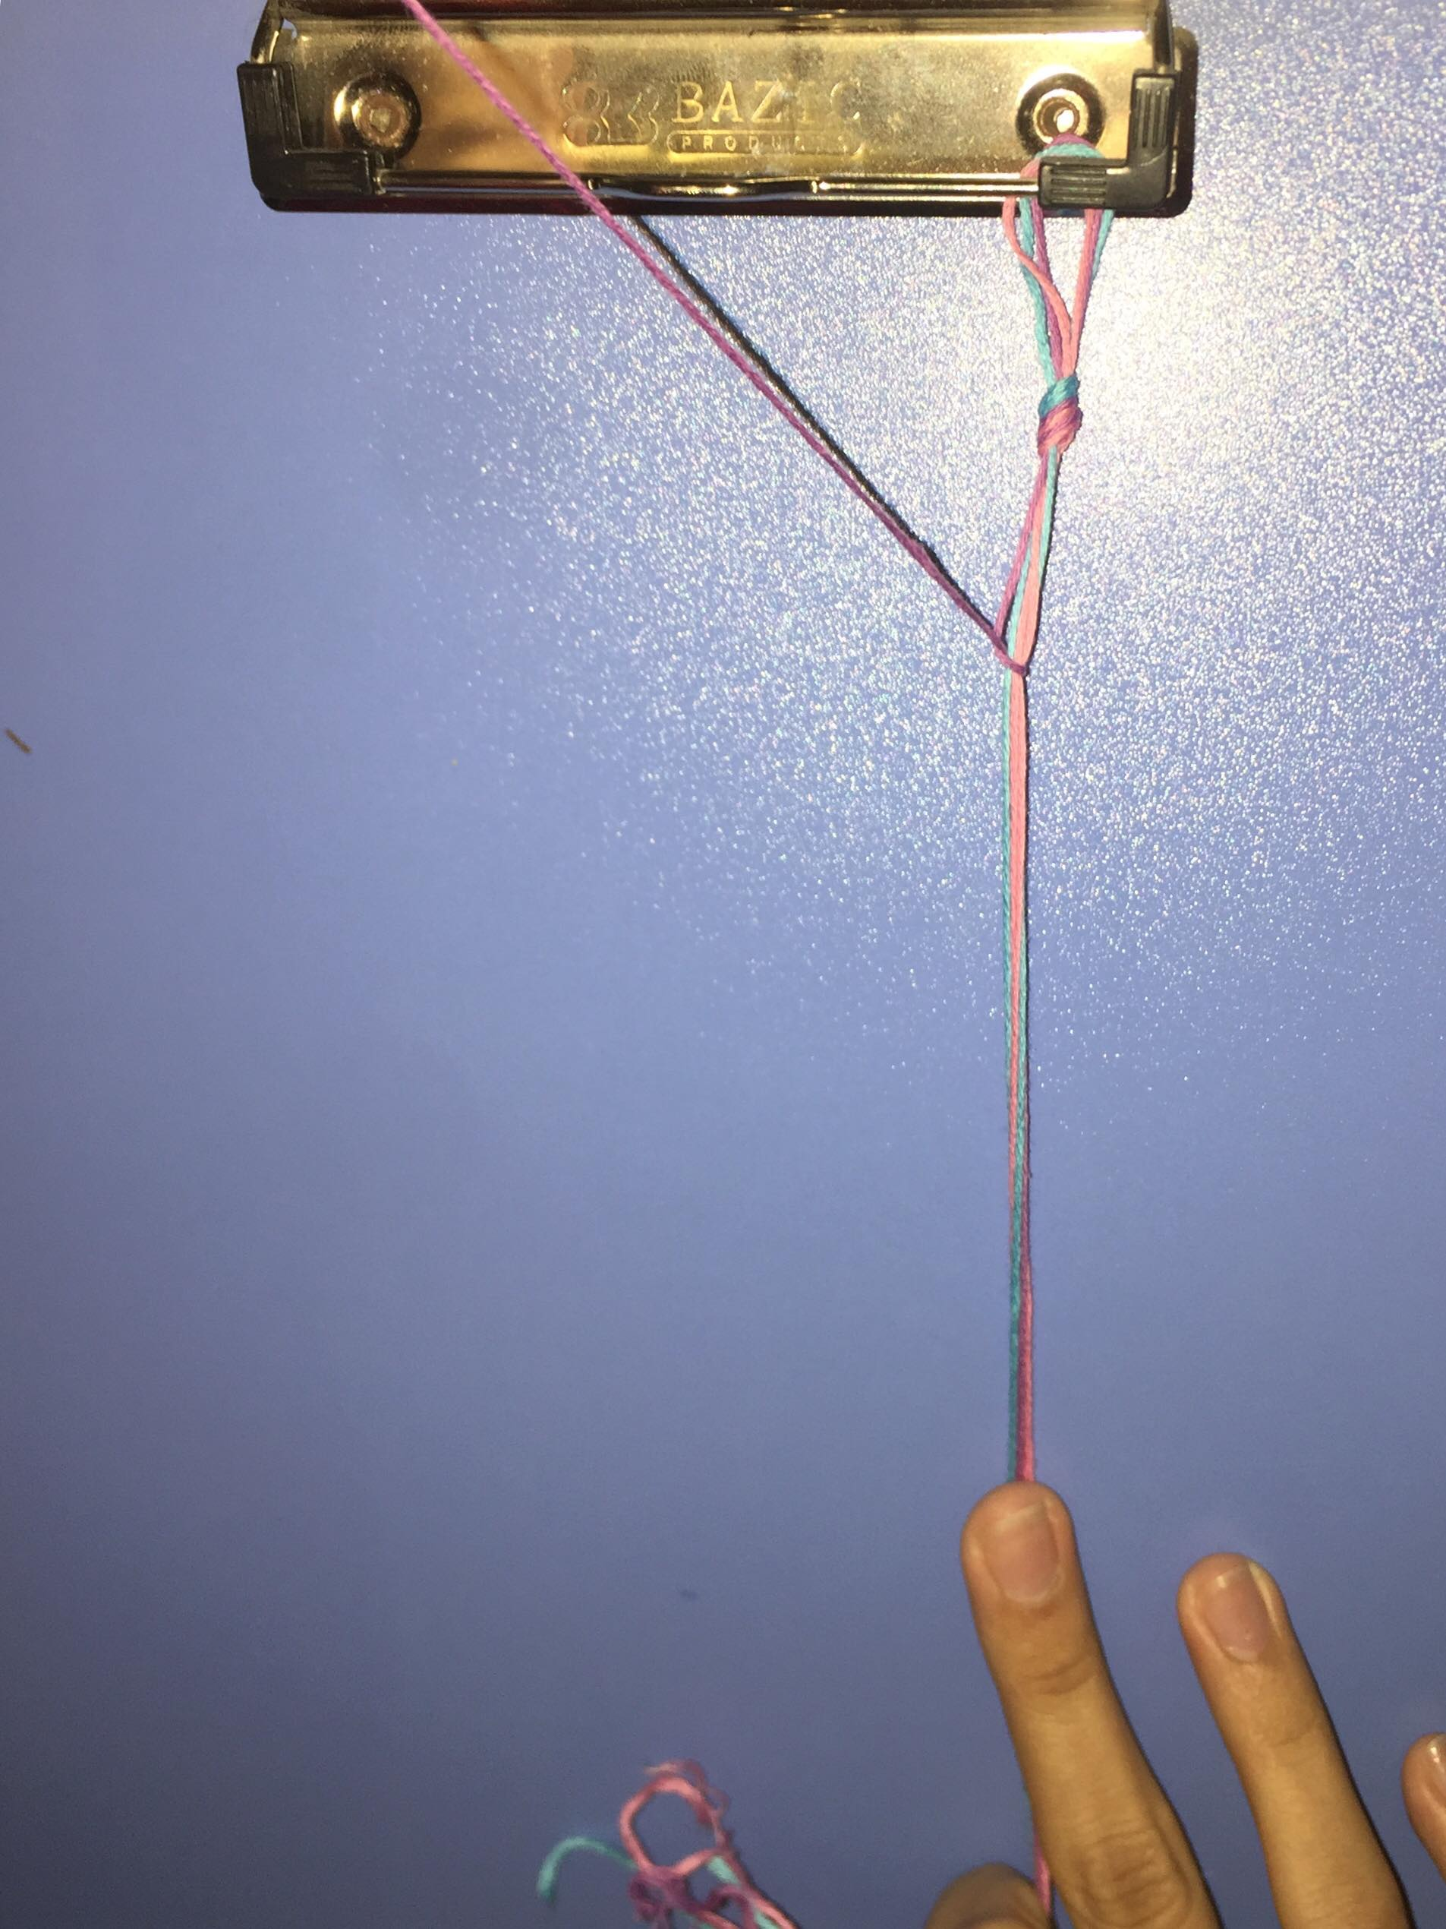
Step 2:
Cross your first color over the two colors
Tuck it under the two colors and pull
Repeat about 7-15 times
How big do you want the color section to be?

Slide 5
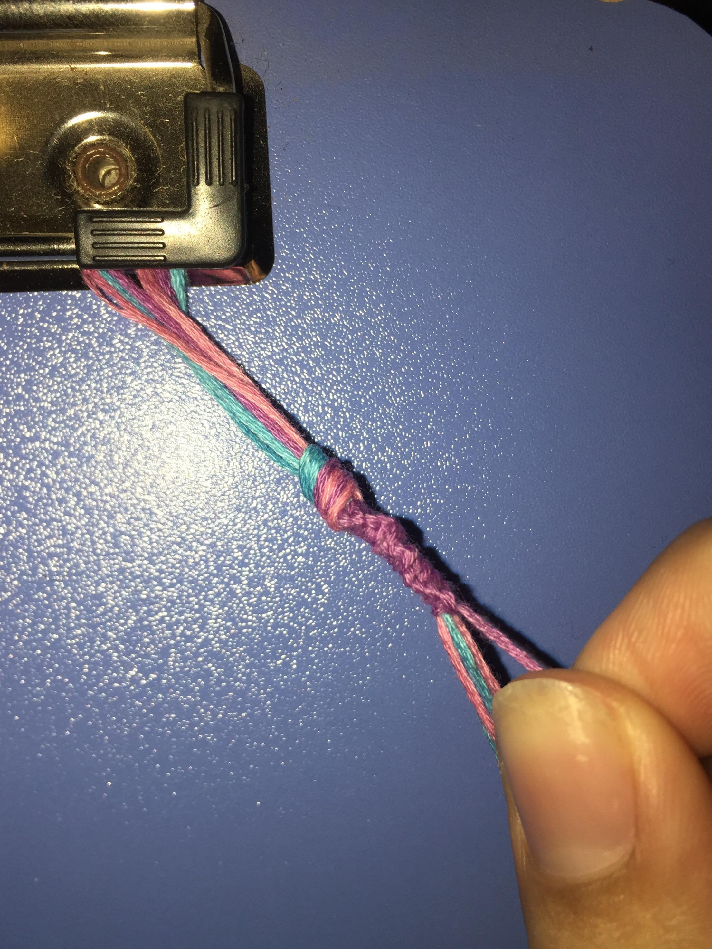
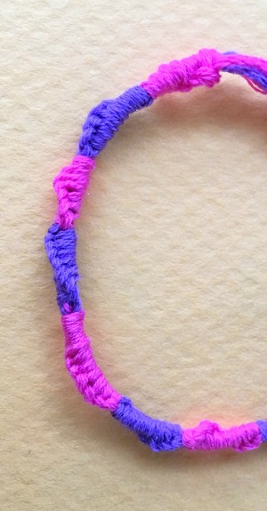
Step 3:
You will see the “spiral”
Decide on your second color
Repeat
Decide on your third color
Repeat

Slide 6
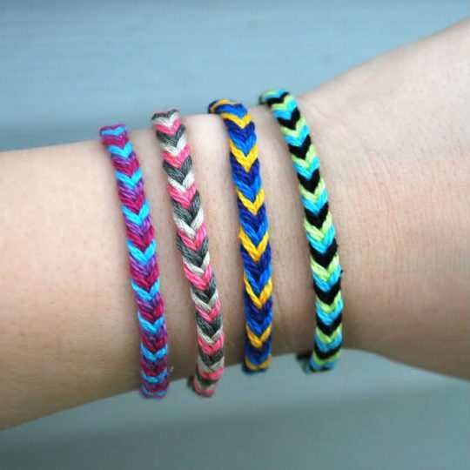
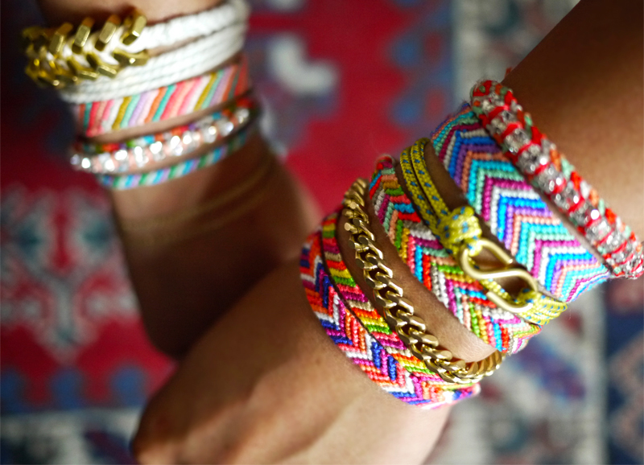
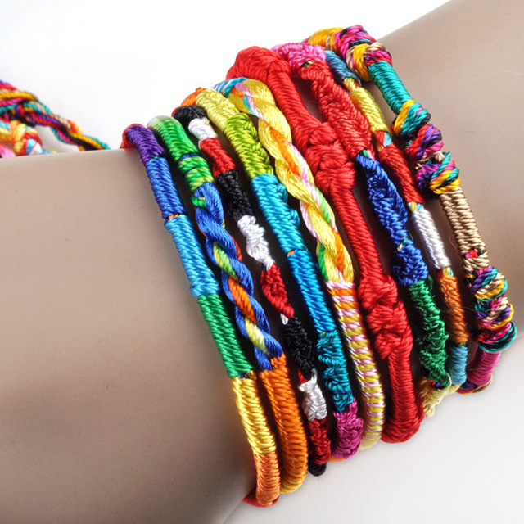
Friendship Bracelets
YoU aRe StUcK wItH mE fOrEvEr!!1!!1!!

