Slide 1
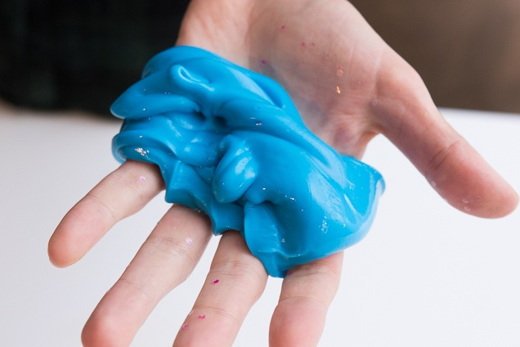
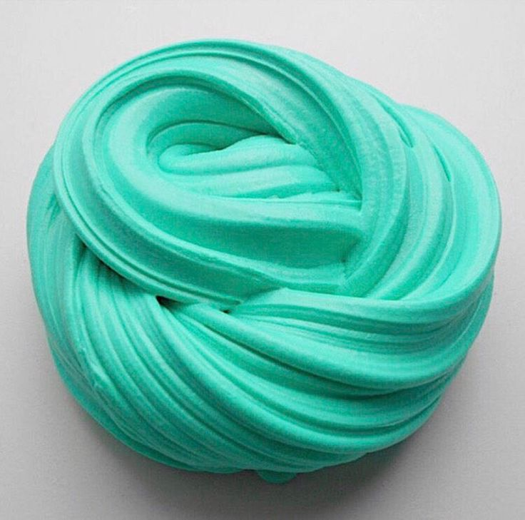
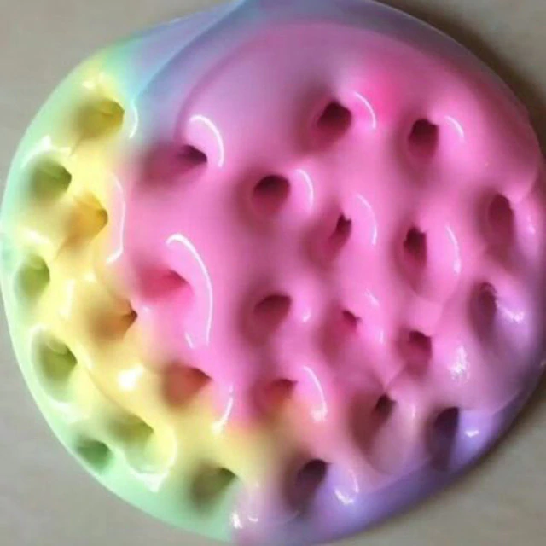
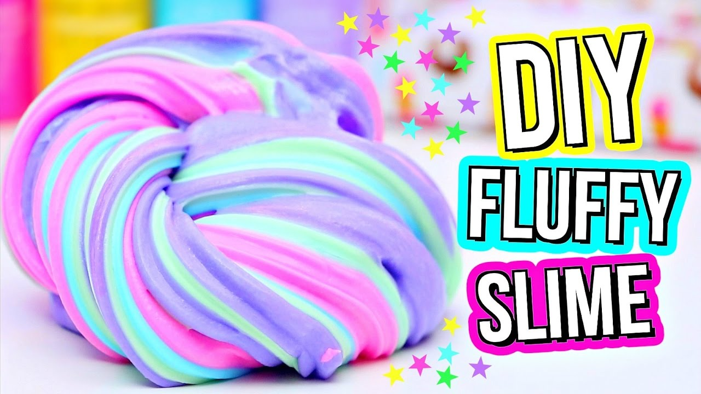
How to make DIY Slime
Catherine Diaz

Slide 2
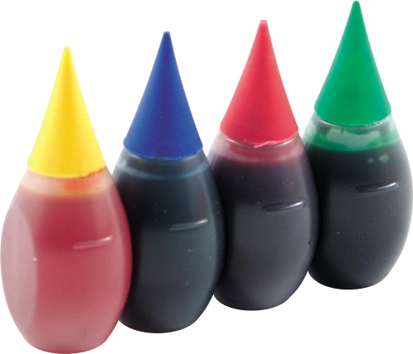
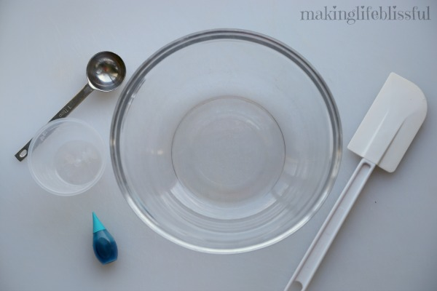
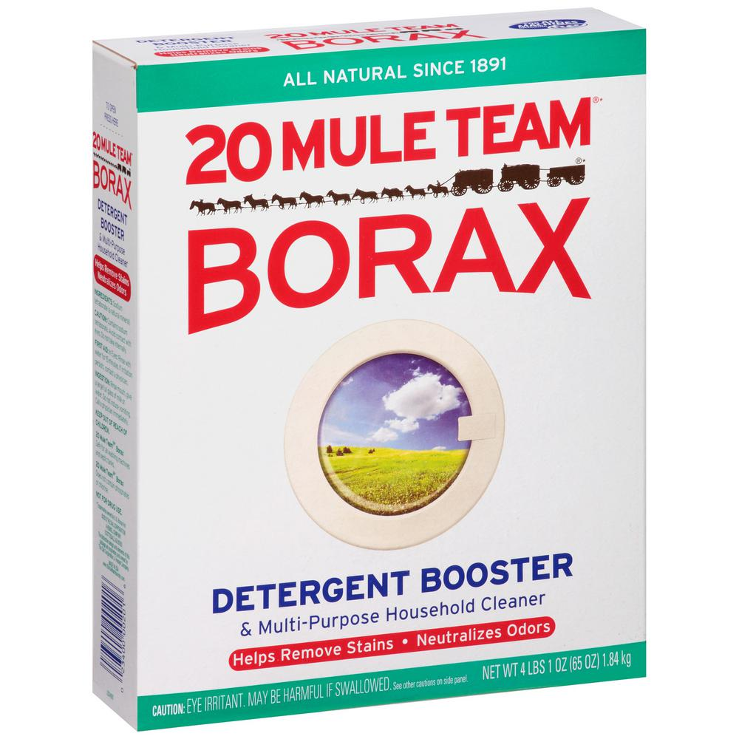
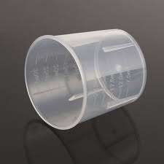
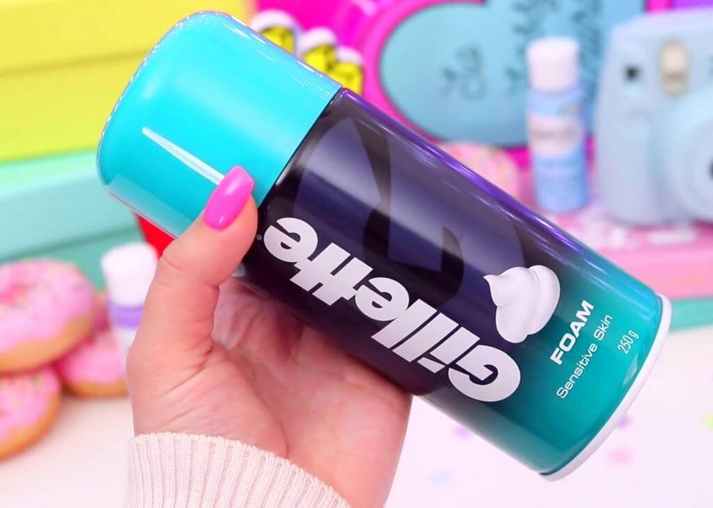
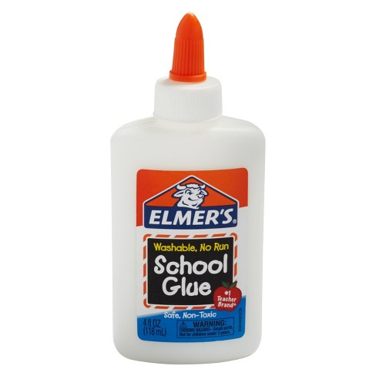
MATERIALS/
INGREDIENTS NEEDED:
Mixing Bowl
Cups
Spoon
Glue (clear/white)
Water
Shaving cream (optional)
Food coloring (optional)
Borax
Alternative= Contact lens solution
Laundry detergent

Slide 3
STEP 1: PREPARE
PREPARE ALL materials and ingredients

Slide 4
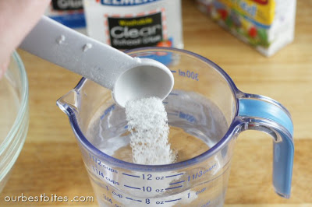
STEP 2: MEASUREMENTS
MEASURE amount of borax to water to make BORAX SOLUTION
Equal parts glue and water
1 cup shaving cream

Slide 5
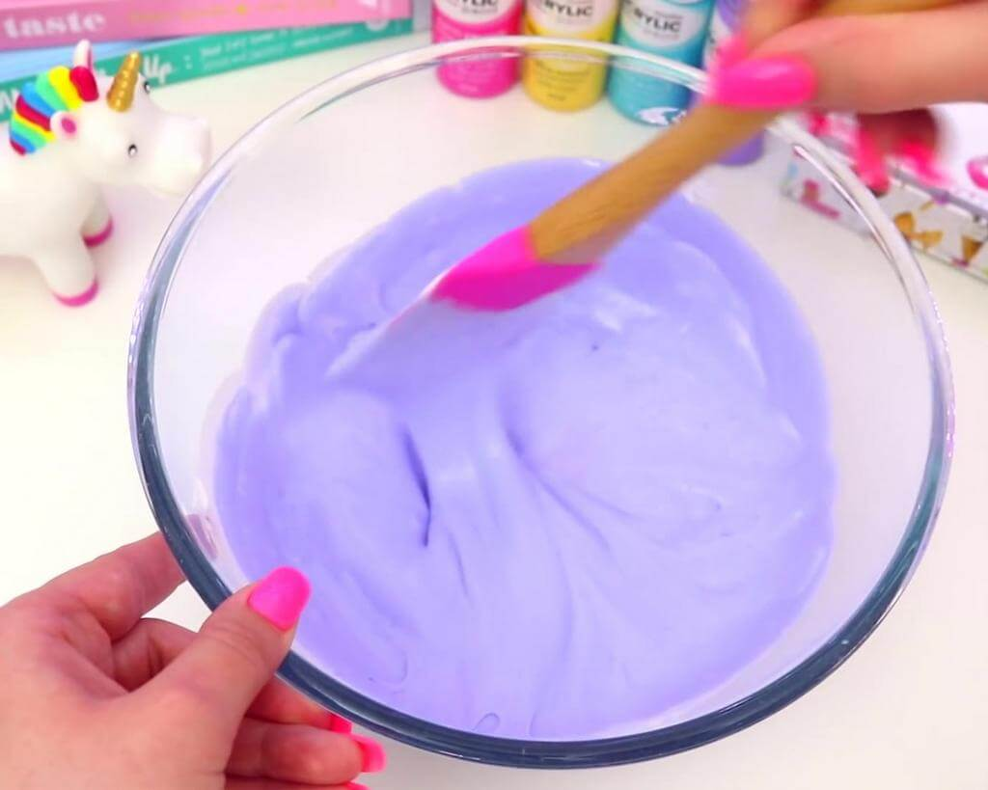
STEP 3: COMBINE & MIX
COMBINE
Equal parts glue and water, food coloring, 1 cup shaving cream into mixing bowl
MIX until smooth consistency (it should not be too thick nor too thin)
ADD 1 spoon of borax solution at a time while mixing
Notice: The mixture starts to thicken and stick together in one form

Slide 6
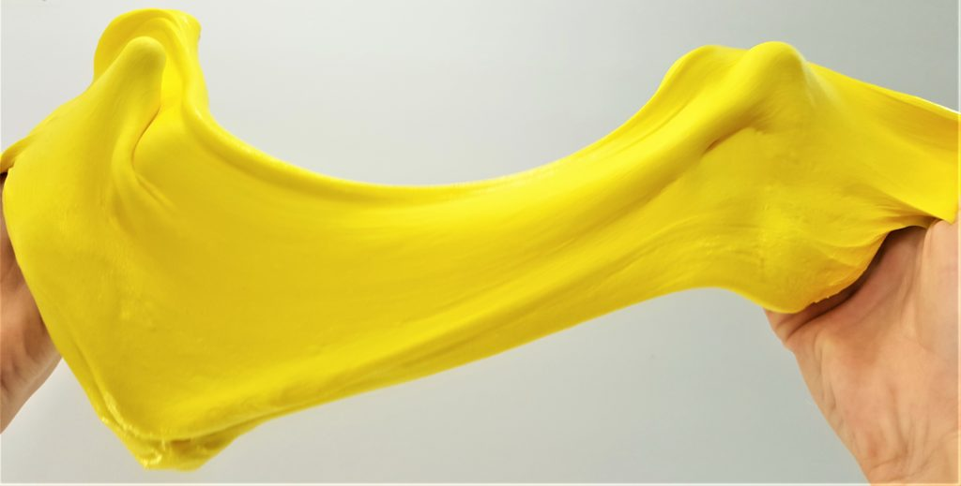
STEP 4: KNEAD & STRETCH
Use hands to knead & stretch in order for slime to set

Slide 7
Ingredients/materials:
Water
Glue
Borax
Shaving cream
Food coloring
Bowl
Spoon
Cups
STEPS:
PREPARE
MEASURE
COMBINE
KNEAD

Slide 8
QUIZ
Name at least 3 ingredients that were used
Name at least 2 materials used
What were the alternatives for Borax?
What ingredient makes the slime fluffy?

Slide 9
THANK YOU!
Any questions/comments?

