Slide 1
How to make YUBUCHOBAP
Sohee Yu
Co210-04
Dr. Bunts-Anderson

Slide 2
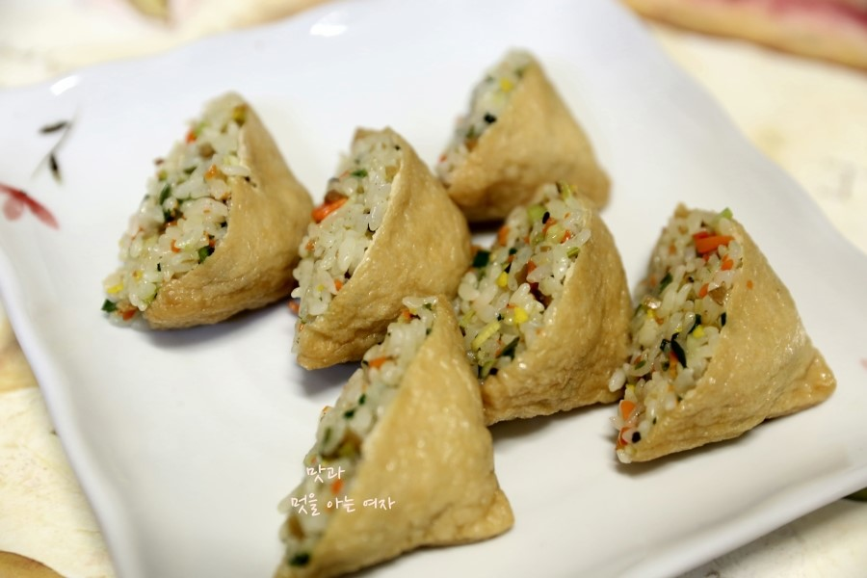
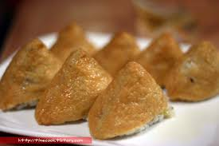
What is the YUBUCHOBAP?
Fried tofu sushi

Slide 3
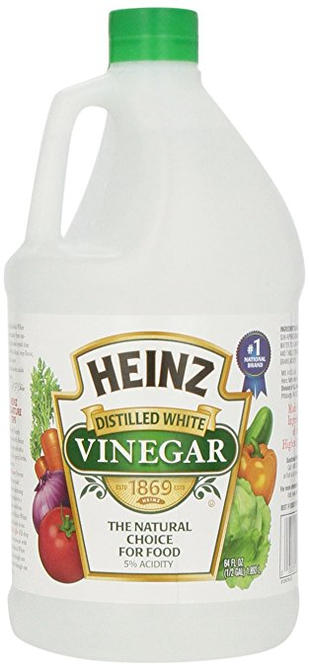
Step 1
Mix the sauce and rice
½ spoon
2 spoons
3 spoons

Slide 4
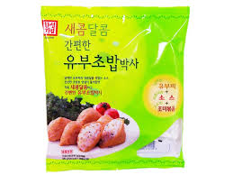
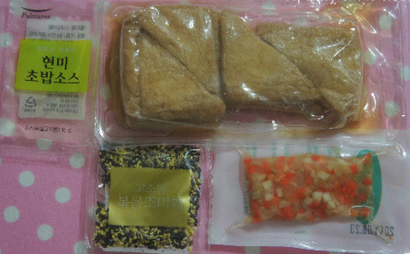
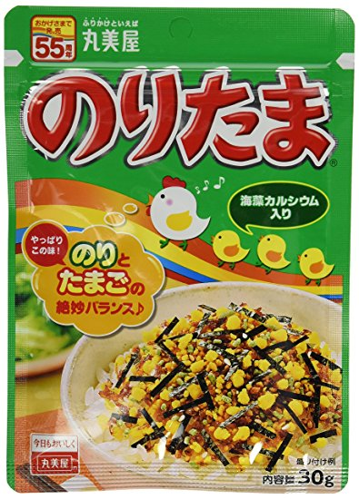
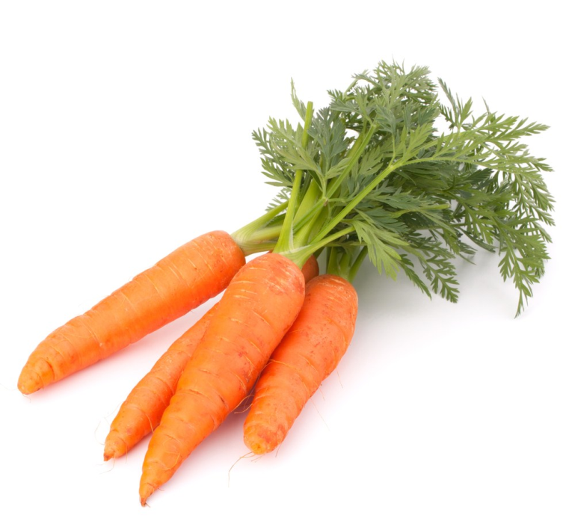
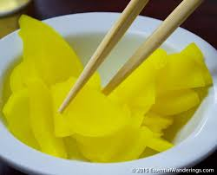
Step 2
Add Carrots, Pickled radish, and Furikake

Slide 5
Step 3
Fill tofu with seasoned rice inside

Slide 6
Works Cited
http://es.memegenerator.net/instance/59258497/stifler-party-lets-do-it-together
https://item.rakuten.co.jp/e-godai/4902820101126/
https://www.bukalapak.com/p/food/minuman/c4k8hq-jual-chongga-radish-danmuji-acar-lobak-kuning-import-korea
http://patatietpatata.org/produit/carottes-nouvelles-la-botte/

Slide 7
Thank You

