Slide 1
How to perform a Kickflip
By: Alfredo Q. Guevarra Jr.

Slide 2
Today you’ll be learning how to perform a kickflip on a skateboard.
Kickflip is on of the basic flip tricks starting out and is a base of different variations of tricks.

Slide 3
Equipment:
Proper shoes and comfortable clothing
Skateboard
May be purchased online or at our local shop, Borderline.

Slide 4
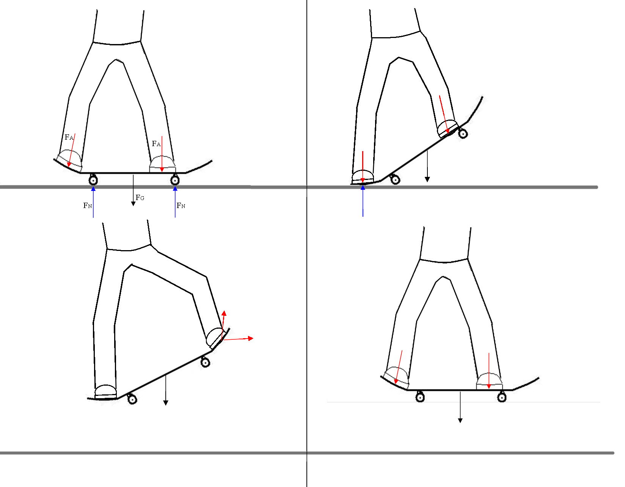
Before performing a kickflip, you must first learn how to do the “Ollie”

Slide 5
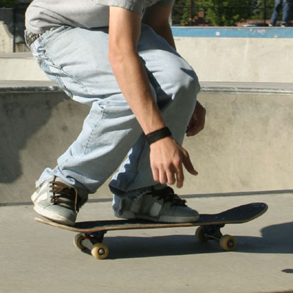
Step 1:
Position yourself as you would performing an Ollie and bend at the knees.

Slide 6
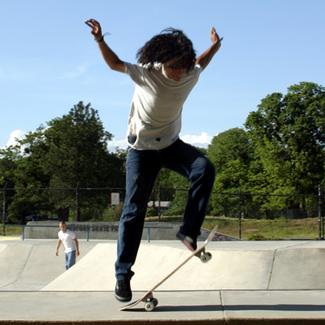
Step 2:
With your back foot, slam down on the tail and extend upwards.

Slide 7
Step 3:
Glide your front foot up the board as you elevate and flick out to the corner of the board.

Slide 8
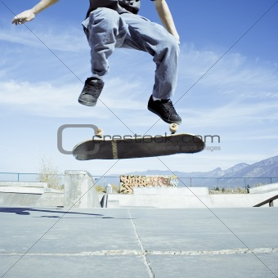
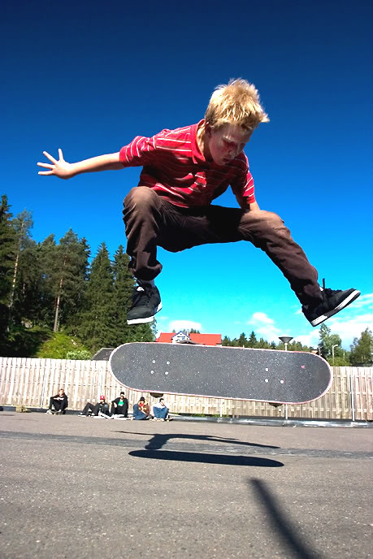
Step 4:
Allow the board to make a full rotation before making contact with the board again.

Slide 9
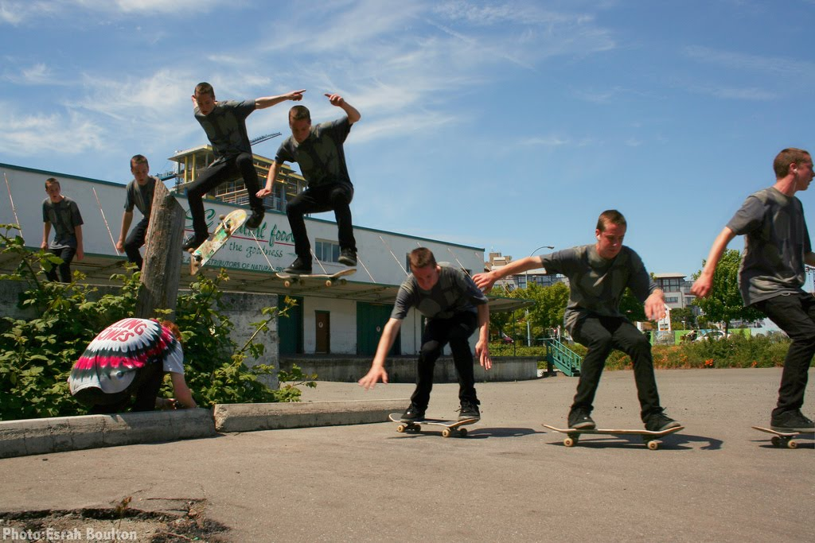
Step 5:
When you see the grip tape, extend your legs to make contact with the board and bend your knees once you touch back down onto the pavement to absorb the shock.

Slide 10
Recap
Bend down
Slam tail down and extend upwards
Flick on the corner of the board
Catch and land

Slide 11
What is a kickflip?
A basic beginner flip trick which is the base of many trick variations

