Slide 1
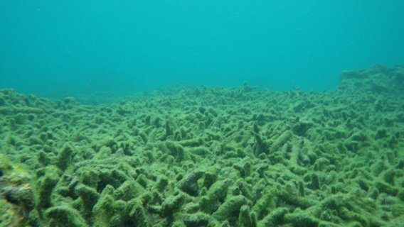
The Effect of Typhoons on Coral Reefs
Jerric Conde Fall 2018
September 25, 2018 Dr. Bunts-Anderson
EN101-06

Slide 2
Importance
There are too much typhoons going on in the Pacific.
How are our coral reefs affected?
What could happen to us if there was a potential tsunami?

Slide 3
Any sources?
Have collected four (4) academic and four (4) non-academic sources.
Other information will be collected through my data collection methods.

Slide 4
Data Collection
Three Methods
Survey (40 NMC Students)
Interview w/ 5 NMC Students
Interview with the Bureau of Environmental & Coastal Quality

Slide 5
Planned Data Collection & Analysis Schedule
Data Collection
Date | Method
October 1 to October 7 | Survey w/ 40 NMC Students
October 8 to October 14 | Interviews w/ 5 NMC Students
October 22 to October 28 | Interviews w/ BECQ

Slide 6
Planned Data Collection & Analysis Schedule
Reading, Analyzing, & Writing
October 29 to November 27

Slide 7
Why should it be approved?
Increase awareness
Find ways we can help protect our coral reefs

