Slide 1
Intermittent Fasting
EN202-02
Research Portfolio
Aaron Paul V. Pamintuan
Dr. Kimberly Bunt-Anderson
Northern Marianas College

Slide 2
Table of Contents
Abstract
Schedule
Brainstorm Process
Findings
Reading Notes
Reflection
Final Research Report

Slide 3
Abstract
A student of Northern Marianas College located in Saipan, CNMI expresses an original 3 month study highlighting the practice of Intermittent Fasting in one’s lifestyle. Pamintuan wanted to inform the readers of the weight loss benefits associated with Intermittent Fasting while highlighting the different experiences from a variety of people with it. He had conducted a variety of methods to gather data. This includes handing out surveys, and conducting interviews and questionnaires. Through the data gathered over a 4 week period, Pamintuan have found that most people are not aware or are not practicing Intermittent Fasting. Although most people do not practice or are aware of Intermittent Fasting, people that did partake in Intermittent Fasting experienced results of weight loss while participating in a physically active lifestyle. The study is important because although not much people are aware of Intermittent Fasting, while being physically active, it quantitatively illustrates the weight loss benefits of incorporating Intermittent Fasting in one’s lifestyle.

Slide 4
Schedule
April 2 - 14 | April 15 - 19 | April 20 - 26 | April 29 - May 3 | May 13 - 17 | May 6 - 10
Decide on Research Topic Finding the best choice for topic based on the CNMI. | Background Essay Chose topic already and complete Essay 1 | Persuasive Research Proposal After completing Essay 1, start on Essay 2 and submit | Pilot Survey Submission & Essay 2 Work on survey rough draft | Final Survey Submission Fix pilot survey and submit as final survey | Process Essay Submission Complete Essay 3 and submit

Slide 5
Schedule
May 13 - 17 | May 20 - 24 | May 27 - 31 | June 3 - 7 | June 10 - 14 | June 14 - 17
Letters to Expert Look for experts to interview and get data from | Essay 4 Submission Complete descriptive essay and submit | Final Report & Portfolio Brainstorm Make outline for final report and portfolio | Begin Final Report &Portfolio Time to gather all data and start working on Final Report and Portfolio | Final Research Report Finalize Final Research Report and submit | Research Portfolio & Weebly Site Time to work on Portfolio on Weebly. Complete before the Final Exams

Slide 6
Brainstorm Process
Healthy Lifestyle
Diet
Physically active
Exercise
Complete Nutrition
Healthy Diet
Intermittent Fasting

Slide 7
Findings

Slide 8
Findings

Slide 9
Findings

Slide 10
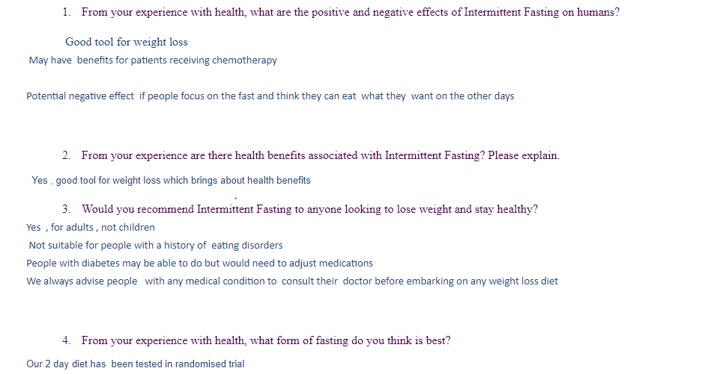
Findings

Slide 11
Reading Notes

Slide 12
Reading Notes

Slide 13
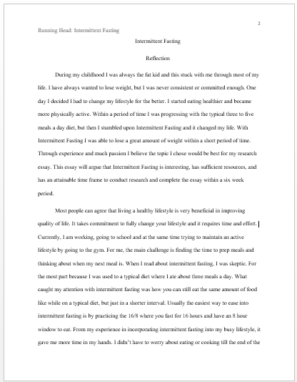
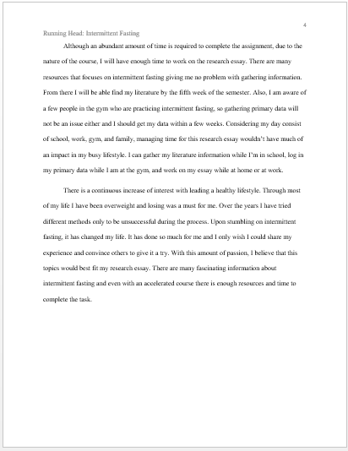
Reflection

Slide 14
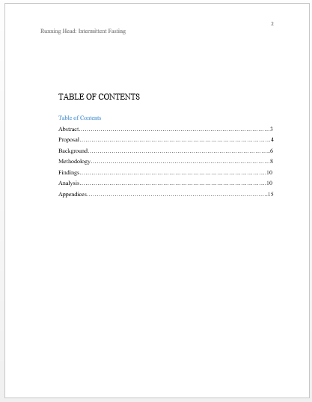
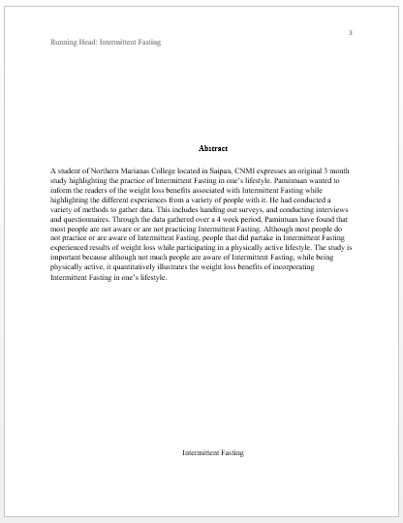
Final Report

Slide 15
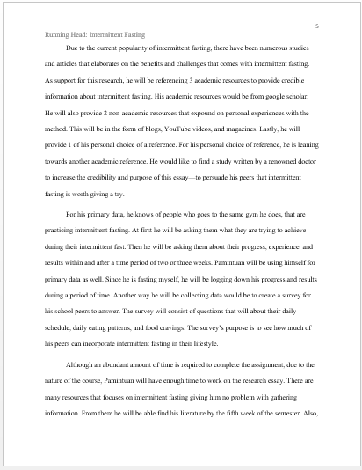
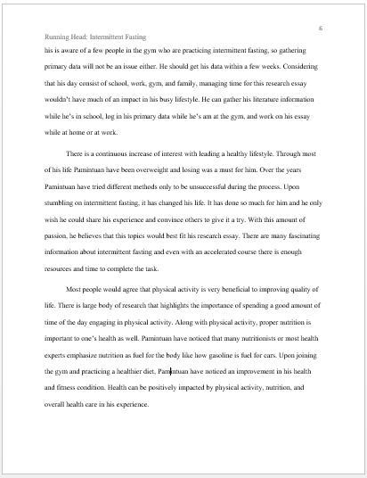
Final Report

Slide 16
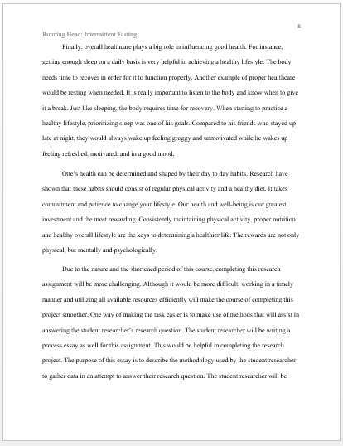
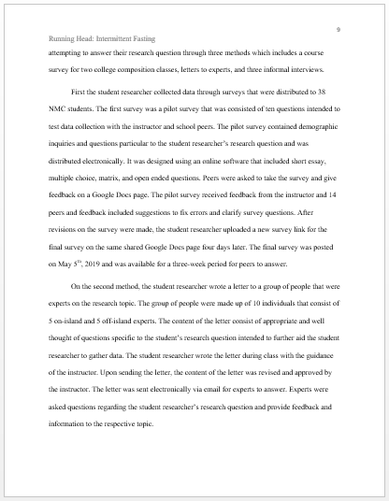
Final Report

Slide 17
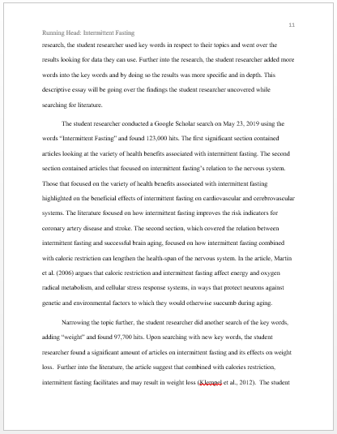
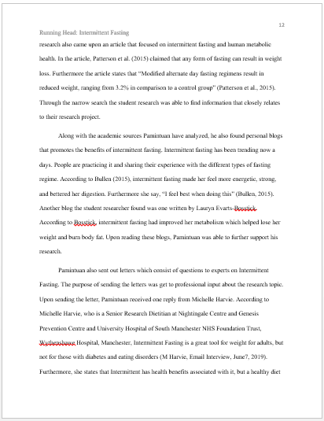
Final Report

Slide 18
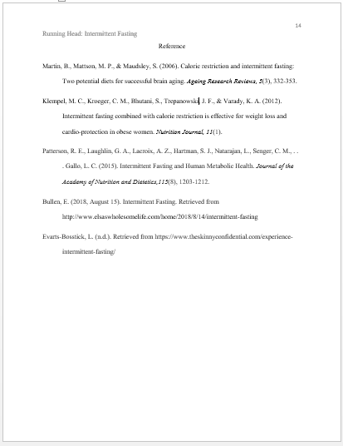
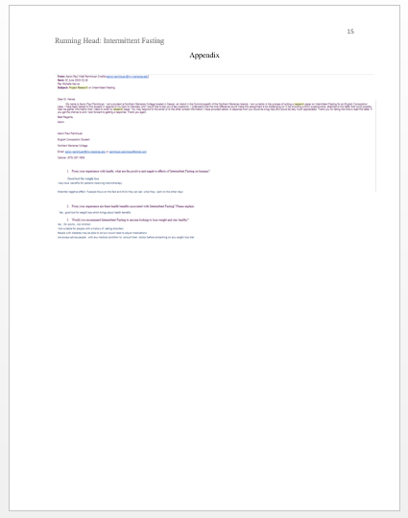
Final Report

