Slide 1
Internet Effects on Education
By: Kim Alvarado

Slide 2
Introduction
The internet is a great tool in providing people with entertainment, knowledge, news, and anything we can think of. With the growth of technology and the internet it can be a helpful resource in our day to day school lives. It can also be over relied on and over shadow original book and journal articles. Students need to know how to manage themselves from distractions and work.

Slide 3
Methodology
Surveys were giving out to Saipan Southern High School students and Northern Marianas College Students.
High School Students (50 male, 50 female, age range: 16 – 20 years old)
NMC students (30 female, 30 male, age range 18 – 22 years old)

Slide 4
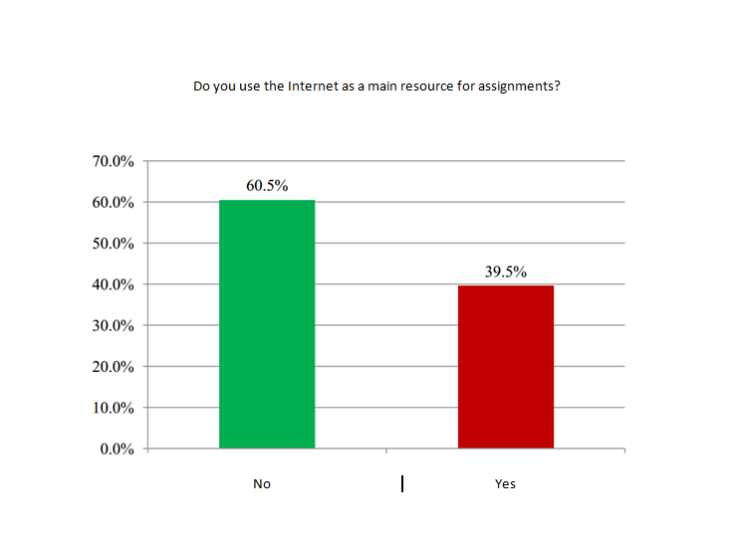
Results
NMC Students

Slide 5
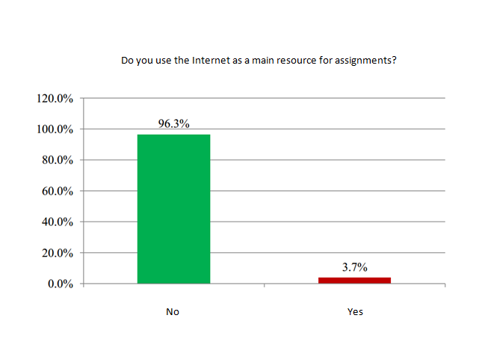
Results
High School Students

Slide 6
Discussion
Encourage parent’s kids and teacher’s students to use internet resources for assigned work.
Use of Social Network (Facebook, Twitter, Instagram, etc.) as tool for helping out each other out. Whether it is sharing information, pictures, ideas, to asking help when it is needed.
The Public School System in the CNMI is implementing further use of technology involving computer and internet use. This being said, teachers should teach their students how to gather information online.

Slide 7
Conclusion
The internet has great access to better help student’s education. This being said, some parent’s and teacher’s see the World Wide Web as a wall that prevents students from learning. As it is filled with social networking, games, entertainment sites, distractions, and almost anything random that would possibly affect their work ethic. Access to free online college courses is a big step to higher education. The internet is not the basis of student’s downfall on their education, yet it could possibly be the climb to higher education. The internet is a privilege given to everyone; it only takes diligence and determination.

Slide 8
References
Carr, N. (July 2011) The Shallows. City, State: Atlantic Books.
Badke, W. (2011, June) Why Do Students Procrastinate? Retrieved from http://www.evolllution.com/opinions/why-do-students-procrastinate/
Jeffries, D. (2013, March) is technology and the internet reducing pupils’ attention spans? Retrieved from http://www.theguardian.com/teacher-network/teacher- blog/2013/mar/11/technology-internet-pupil-attention-teaching
Anderson, K. (2012) Internet Use Among College Students: An Exploratory Study. Journal of American College Health, Vol 50, No. 1 pp. 21 – 26
Wanajak, K. (2011, June) Internet Use and the Impact on Secondary School Students in Chiang Mai, Thailand. n/a, pp. 1 – 163
Jelski, D. (2012, January) A Free College Education For All. Retrieved from http://www.forbes.com/sites/ccap/2012/01/19/a-free-college-education-for-all/
McGill, T. (2014) The Internet and Higher Education. n/a Vol 22, pp. 24 – 36
Yoon, โดย (2012) Why did Bill Gates drop out of Harvard? n/a p. 1

