Slide 1
Juicing

Slide 2
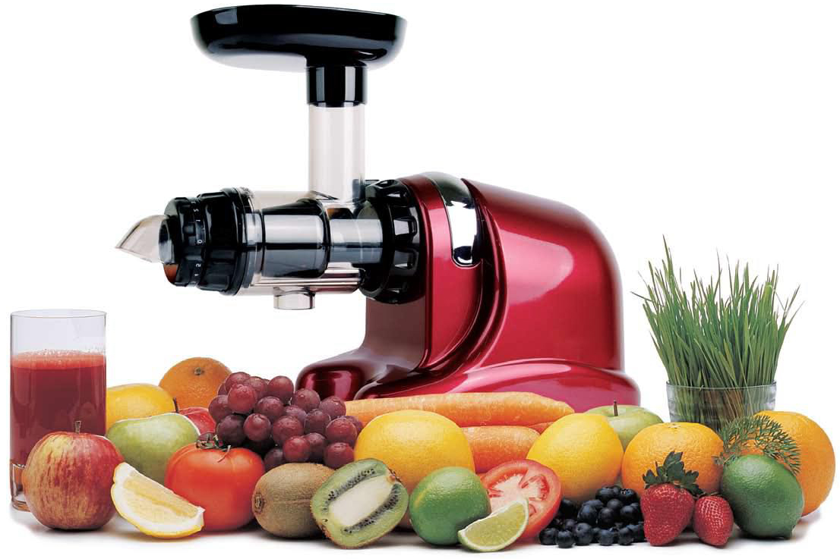
What is Juicing?
Juicing is the grinding of fruits and vegetables with industrial machine.

Slide 3
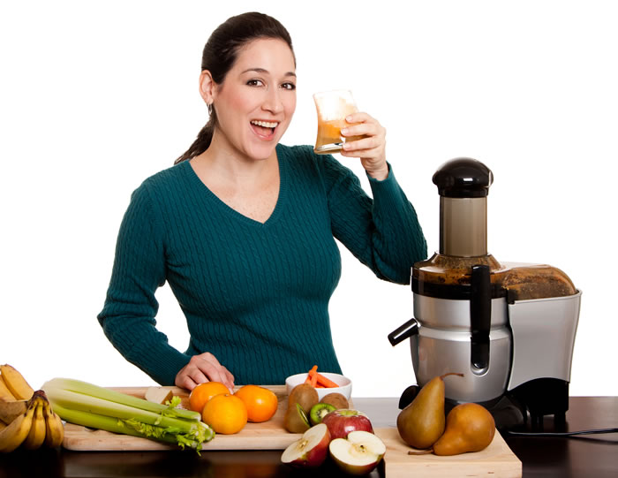
Why Juicing?
A family member of mine suffered from rheumatoid arthritis, a type of autoimmune disease.
People claimed that juicing may correct an autoimmune disease.
I want to find out whether juicing could cure autoimmune diseases.

Slide 4
Primary & Secondary Question
Primary Research Question: Is juicing healthier than eating whole fruits and vegetables?
Secondary Research Question: Can juicing cure health problems?

Slide 5
Juicing vs. Eating Fruits and Vegetables
JUICING
Removes most of the fiber from vegetables; makes juice less nutritious.
Adding the pulp back into the juice will provide a small amount of fiber.
Easier to digest.
Fun way to get nutrients if you dislike fruits and vegetables.
Quickly develops harmful bacteria, if not consumed right away.
EATING whole fruits and vegetables
Hard to fit in all of the recommended servings of vegetables.
Not everyone likes to eat fruits and vegetables.
Whole vegetables provide more nutrients overall.

Slide 6
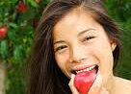
Eating whole fruits & vegetables is healthier than juicing.
-Almost 100% of the original nutrient quanti ty ends up in the pulp, which juicers discard.
- Excessive juice intake can be dangerous for people with diabetes because juice is a concentrated source of calories, primarily sugar.

Slide 7
Can juicing cure health problems?
Based on research, juicing will not cure health problems (autoimmune diseases) in general, but will help people relieve and manage their sickness.
Joe Cross, the man behind “Fat, Sick, and Nearly Dead”, a documentary on Netflix , claimed that juicing helped him mange his sickness. It did not cure his sickness, but it did help him manage his sickness.

Slide 8
Research
Internet (blogs, social media sites, health and wellness websites)
Interviewed 2 family members that are juicers
Read “Juicing for Life”, written by 2 nutritionists.
Pilot Survey

Slide 9
Ongoing Debate
Dr. Frank Shallenberger believes that juicing for a four to six weeks period may begin the process of detoxification. He believes that detoxification could remove all toxicity in a person’s body.
There is hope.
It is not easy and quick to heal an autoimmune disease which is the reason why doctors say it is incurable.

Slide 10
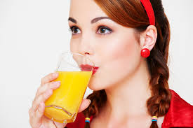
What I learned about Juicing
Juicing is a great alternative for people who dislike eating fruits and vegetables.
It cannot cure an autoimmune disease, but it can help people to manage their sickness.
Eating whole fruits and vegetables is more recommended by health nutritionists, despite the ongoing debate.

Slide 11
What I learned about Academic Writing
Proper format for APA
Emphasis on APA citations
Conduct research for research papers

Slide 12
General
Others
APA is not easy.
I would like to get used to writing in APA format.
I need work on my writing in general. It is a skill I have yet to master.
Although doctors say juicing cannot cure an autoimmune disease, a family member of mine was cured. She was suffering from an autoimmune disease since the age of 7. She is now 19.

