Slide 1
Make the World a Better Place
By: Bryce Maratita

Slide 2
How to make the world a better place?

Slide 3
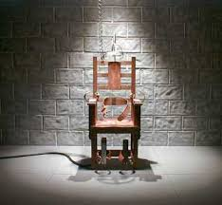
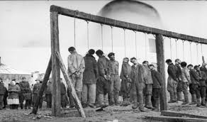
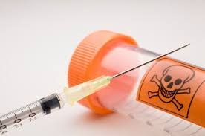
Capital Punishment
A.k.a Death Penalty

Slide 4
Death Penalty
Also called Capital Punishment
Indicted when a Capital Offense occurs

Slide 5
Types of Capital Offense
Murder
Unlawful killing of a human being
Espionage
Spying to obtain political or military
information

Slide 6
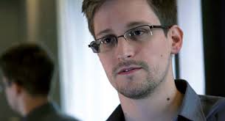
Treason
Betraying one’s country, overthrow
government or kill sovereign.

Slide 7
Reasons why Death Penalty should be implemented
Retribution
“Eye for an Eye”
Provides Justice for victims family
Criminals would fear our criminal justice system
Lower crime rates
Cost of execution vs imprisonment

Slide 8
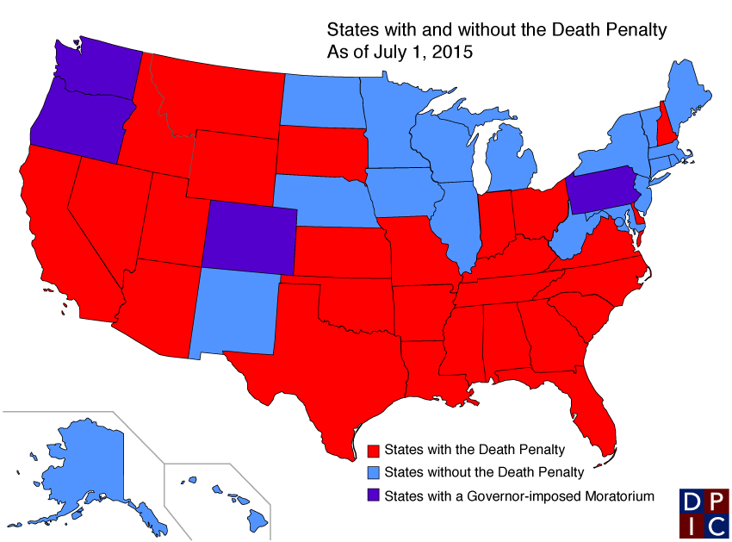
States that allow and do not allow Death Penalty
31 States with Death Penalty
19 States without Death
Penalty

Slide 9
Conclusion
We must declare to all citizens that if you are willing to ruin a life/lives, you are willing to give up your own.
“ Eye for an eye”

Slide 10
Resources
“States with and Without Death Penalty” .Death Penalty Information Center. 7 May 2016. <http://www.deathpenaltyinfo.org>
“Should the Death Penalty be Allowed?” . ProCon.org. 3 March 2014. <http://www.deathpenalty.procon.org>
Hayworth,Michael. “ 5 Reasons people think the world need Death Penalty”. Amnesty International. <http://www.amnesty.org.au>

