Slide 1
Marijuana vendors in the CNMI

Slide 2
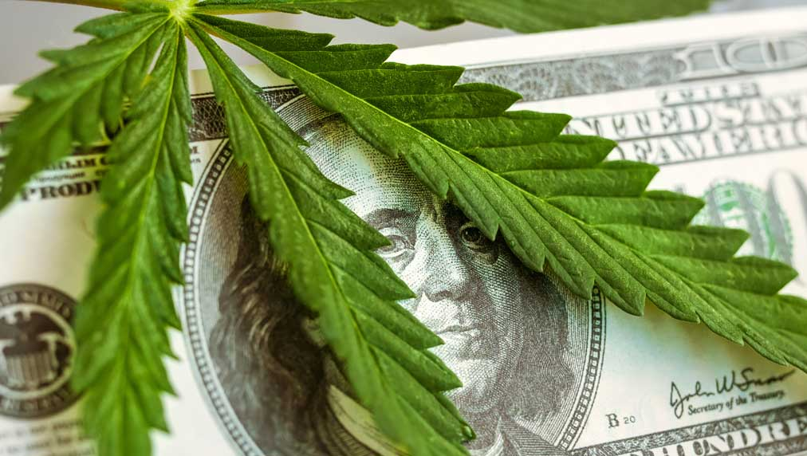
WHY IS THIS TOPIC IMPORTANT?
Majority of the people in Saipan want to smoke or have marijuana without going to jail.
Legalizing marijuana has been the “talk of the town” for a while now.
Everyone smokes it but doesn’t really know what it does besides getting you high and hungry.

Slide 3
HOW ARE YOU FINDING YOUR RESOURCES
With 4 academic resources:
Geiger-Oneto, S., & Simkins, T. (2017). A Social Identity Perspective on the Legalization of Marijuana in the United States: The Relative Importance of Status Insecurity and Group Membership. AMA Marketing & Public Policy Academic Conference Proceedings, 27, 28. Retrieved from http://search.ebscohost.com/login.aspx?direct=true&db=buh&AN=126288427&site=ehost-live
Greg Allen. (2014). Entrepreneurs Buzzing Over Medical Marijuana In Florida. All Things Considered (NPR). Retrieved from http://search.ebscohost.com/login.aspx?direct=true&db=n5h&AN=6XN201406162116&site=ehost-live
Shuman, J., Hill, K. P., Saxon, A. J., & Levin, F. R. (2015). Controversies in Marijuana Legalization. MD Conference Express, 15(11), 12–14. https://doi.org/10.1177/1559897715593535
SUSAN HAIGH - Associated Press. (2016). Advocates hoping to keep pot legalization issue alive. AP Regional State Report - Connecticut. Associated Press DBA Press Association. Retrieved from http://search.ebscohost.com/login.aspx?direct=true&db=n5h&AN=AP20f1ec499aa94f79995989faea273c7e&site=ehost-live

Slide 4
…Continue…
And 4 non-academic resources:
N.A (N.A) Production Process. Retrieved from https://www.cannimed.ca/pages/cannimed-production-process
Morris, C. (2018, April 20). Colorado Was the First State to Legalize Marijuana. Now Its Governor Won't Rule Out Recriminalizing It. Retreieved from http://fortune.com/2018/04/20/colorado-marijuana-legalization-law-governor-hickenlooper/
Perez, J. (2018, September 21). Breaking News: NMI legalizes pot. Saipan Tribune. Retrieved from https://www.saipantribune.com/.

Slide 5
….Continue
Others would will be found with surveys, observations, and more research.

Slide 6
HOW IS DATA BEING COLLECTED
Surveying at least 40 NMC students
Interviewing or asking at least 3 experts/professionals.
More research

Slide 7
SCHEDULE
Data Colleting | September 20 –October 28
Analyze
Read
Write

Slide 8
WHY SHOULD THIS TOPIC BE APPROVED
Besides being a very good topic, because there are a lot of pot smokers out there who just smoke because they think its cool.
This topic would give useful knowledge upon the marijuana users and non-users.

