Slide 1
Military Training in the CNMI
Darsha Camacho

Slide 2
U.S. Occupied extensive areas in the CNMI
2/3 of Tinian
Entire island of Farallon De Medinilla

Slide 3
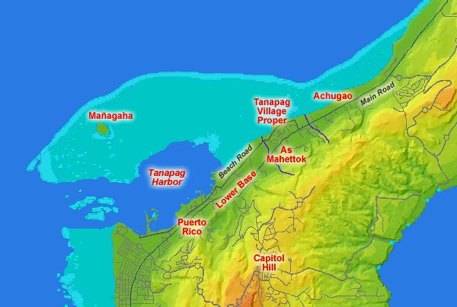
Cont..
Around Tanapag harbor on Saipan

Slide 4
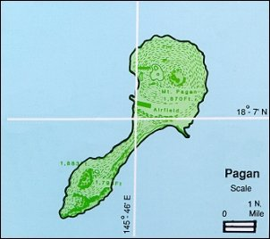
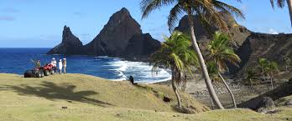
The Department of Defense proposed a military buildup on Tinian and Pagan

Slide 5
Live Fire Exercises in the CNMI by the Number
6,000 – The number of explosive bombs per year that the MITT authorizes for No’os (FDM) under the MITT. Previously, the number was 2,150 per year. This is a 300 percent increase in bombing.
6,880,860 – The number of field artillery, shells, mortars, rockets, and grenades projected to hit Tinian and Pagan over 60 years (based on Draft CJMT EIS estimate of 114,681 per year for 20 and 15 weeks of live-fire for Tinian and Pagan respectively).
10,596,000 – The number of bombs up to 1,000 lbs to be dropped on Tinian and Pagan over 60 years (based on Draft CJMT EIS estimates of 176,600 air-delivered munitions per year for 20 and 15 weeks of live-fire for Tinian and Pagan respectively).
295,538,580 – The number of small arms munitions up to .50 caliber to be shot on Tinian and Pagan over 60 years (based on Draft CJMT EIS estimate of 4,925,643 per year for 20 and 15 weeks of live-fire for Tinian and Pagan respectively).
20 and 15 – The number of weeks per year of live-fire exercises planned for Tinian and Pagan respectively. These levels will probably increase to 45 and 40 weeks respectively. During exercises the military has jurisdictional control of the sea and airspace around these islands and non-military travel will be severely restricted.

Slide 6
Effects

Slide 7
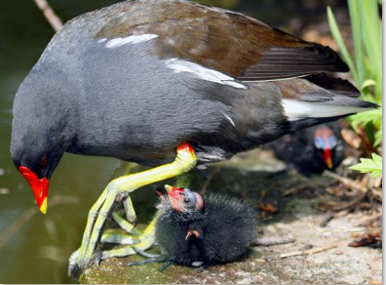
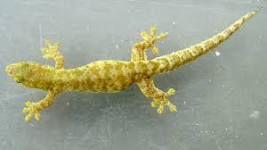
Endangered Species

Slide 8
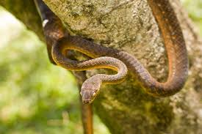

Slide 9
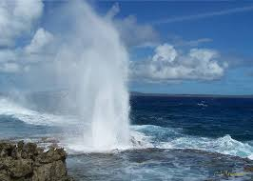
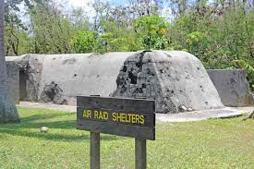
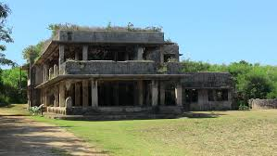
Tourism

Slide 12
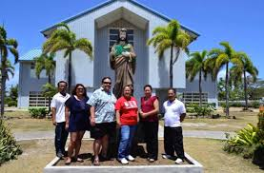
Noise Pollution

Slide 14
THANK YOU!

