Slide 1
How to:
Make a Misanga Bracelet
Cindy Alo
CO210-04
Dr. K. Bunts-Anderson

Slide 2
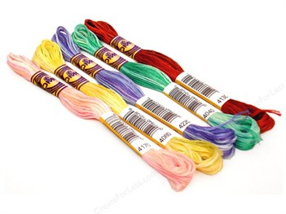
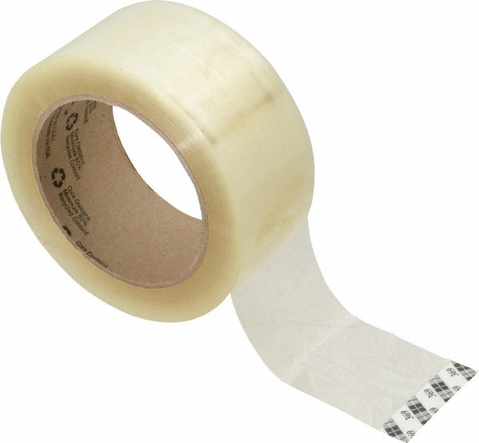
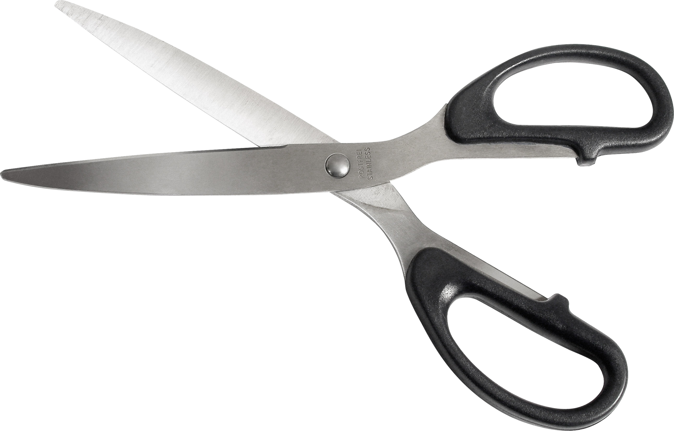
Materials you would need:
Thick thread, embroidery floss, or something similar,
Any color you’d like.
Scissors,
Tape,
Ruler/measuring tape.

Slide 3
Steps to create: preparation
Cut thread to about 40 inches long,
Fold all the thread in half,
Knot the folded ends and tape down on a flat surface,
Braid the two colors about an inch down.

Slide 4
Steps to create: knotting the thread
“Mother and son” system: the “mother” ALWAYS being the first string from the left and the “sons” ALWAYS being the rest of the strings,
Take the “mother” and tie a knot down its “son” twice,
Tie the knot by taking the “mother” string in our right and the “son” string in your left - make a number 4 and bring string into the hole and create a knot.
MUST do Step 3 TWICE for EACH string

Slide 5
Steps to create: finishing touches
Continue knotting until you have about 2 inches left of untied string,
Close off knotted part of the bracelet by tying the strings to a close,
Braid the string an inch down and tie a final closing knot,
MAKE A WISH!!!! ..as you tie the bracelet onto your wrist.

