Slide 1
My 30-day Challenge
Lose eight pounds, four stages a week, two pounds a week.
BY FRANK

Slide 2
I will pay attention to drinking more water. Drinking water can promote blood circulation and accelerate the metabolism of the body. And drinking more water can also increase satiety and reduce food intake.

Slide 3
I will pay attention to regular work and rest, go to bed early and get up early. I like to stay up late, usually wake up late in the morning, so I often miss breakfast. In the following lunch, I tend to overeat, resulting in overnutrition and body fat.

Slide 4
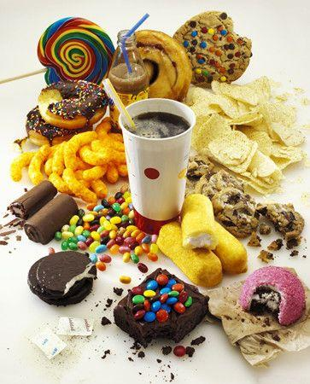
I must control your mouth. Don't eat junk food with high calories. If I really want to eat, Iwill eat fruit and drink boiled water.

Slide 5
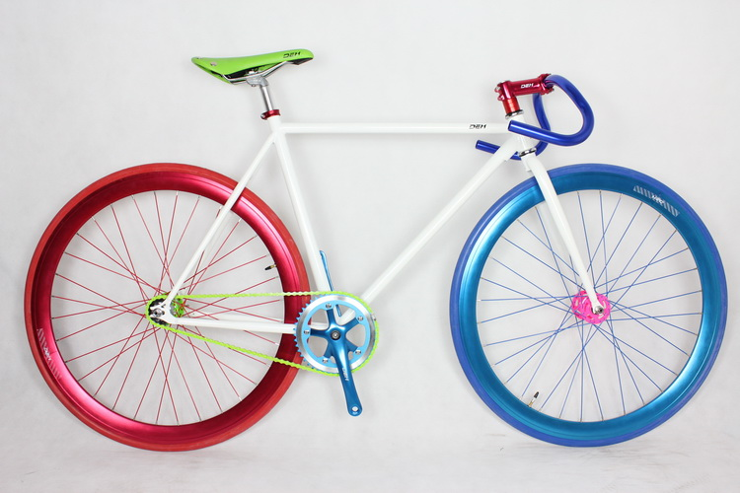
Keep running. Running is a great weight loss exercise. It consumes a lot of calories, but you need to keep running for 30 minutes every day.
Cycling is also a good exercise to lose weight, and compared with running, when I ride a bicycle, I ride on the seat, so it is easier to ride a bicycle than running, insist on a longer time, the effect will be better.

