Slide 1
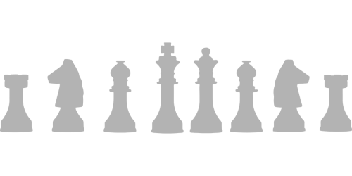
My 30-Day Challenge: Learn to Play Chess
By Sybil Kate Meriveles

Slide 2
30-Day Chess Challenge
In thirty days, I will learn to play basic chess. I will acquire effective gameplay strategies along the way.

Slide 3
Why I Chose This Challenge
A few years ago - when I was in the Philippines - I played a short game of chess with my cousin. Unlike myself, he took chess training from a professional chess player, which meant that he won all chess rounds against me. His quick movements during the game inspired me to learn basic chess. Because of my schedule, I was unable to do it, so I will take this 30-day challenge project as an opportunity to become a beginner in chess.

Slide 4
Goal for the Challenge
My goal for this challenge is to enhance my critical thinking. Most of my courses require critical thinking. Unfortunately, I'm weak in this strategy of thinking - I'm more of a creative thinker. Thus, by the end of this challenge, I hope to apply my improved critical thinking skills to my studies.

Slide 5
What Measurements Will I Take as a Starting Point?
In this challenge, I intend to maintain flexibility in my progress. To achieve this, I will schedule certain days to practice chess offline or online. I can access multiple websites that offer to teach basic chess online. Whenever I'm offline, I can also play (offline) chess games.

Slide 6
How Will I Journal My Methods to Collect Data?
To collect data, I will journal my performances in my chess practices and include short reflections about them. I will record them in two locations: OneDrive and in my College Success notebook. Afterward, I will compare every collected data to determine my progress and my chances of reaching my goal.

Slide 7
Conclusion
In brief, my 30-day challenge is to learn how to play basic chess. My cousin in the Philippines inspired me to do this, and I know that I'll gain critical thinking from this experience. I need to be flexible to complete this challenge, so I will set practice dates. Lastly, I will - also - record what I learned and my progress throughout the challenge. After I finish this challenge, I hope to apply the skills that I acquired - especially critical thinking - in my academic courses.

Slide 8
Credits
Image Source
https://www.needpix.com/photo/853876/bishop-chess-game-king-knight-pawn-pieces-play-queen

