Slide 1
MY 30 DAYS CHALLENGE PROPOSAL IMPROVE MY WELLNESS
By Guoyan(Helen) Sui
BE111-ON2
Kimberly Bunts-Anderson

Slide 2
BACKGROUND
Healthy problem
Doctor diagnose: High Blood Pressure-140 mgh
Easy to have a cold (flu):low immunity
Obesity : Height/160cm; Weight/65Kg

Slide 3
Goals
Reduce Blood Pressure to 130 mgh
Improve body immunity
Lose weight ( Challenge to reduce 2 KG)

Slide 4
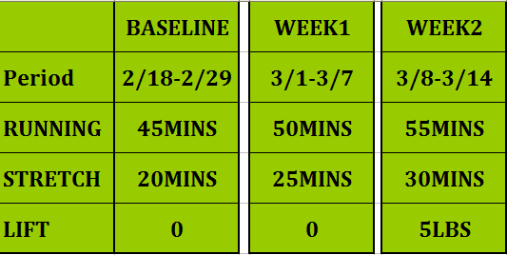
PROPOSAL

Slide 5
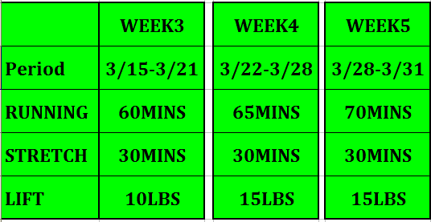
PROPOSAL CONTINUE…...

Slide 6
CHALLENGE-PRACTICE
Pictures...
Waiting update
Videos...
Waiting update

Slide 7
Results
Reduce Blood Pressure ...waiting update
Body immunity...waiting update
Lose weight ...waiting update

