Slide 1
My
E-Portfolio
Davian Atalig
Northern Marianas College
EN101-06
Dr.Kimberly Bunts-Anderson

Slide 2
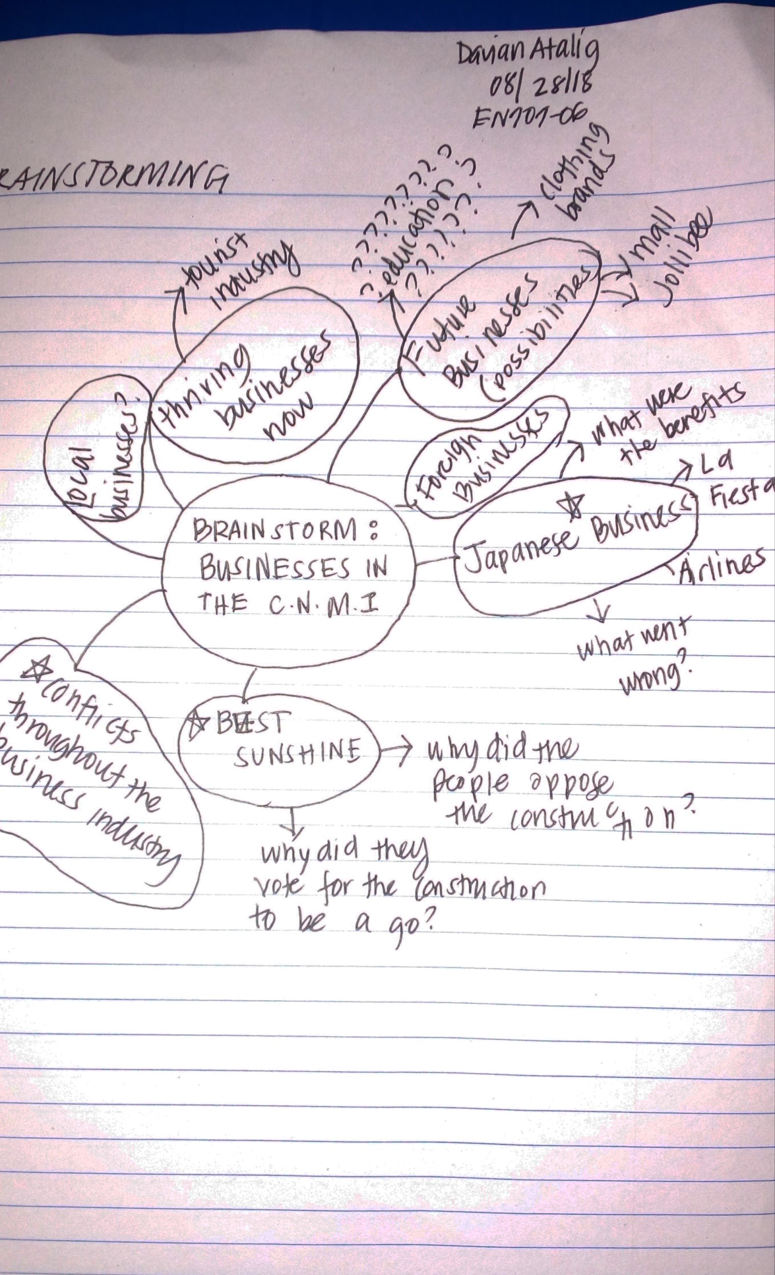
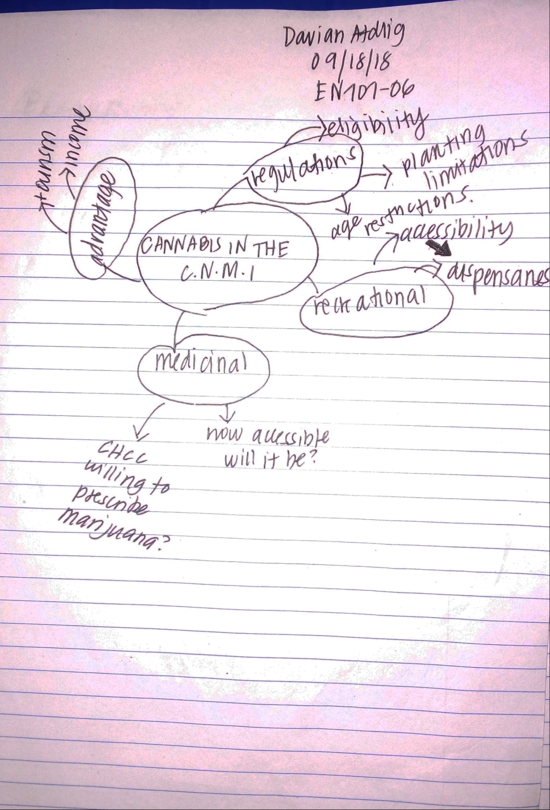
Brainstorms
Essay1: Businesses Through TIme
Research Essay:
Cannabis in the C.N.M.I

Slide 3
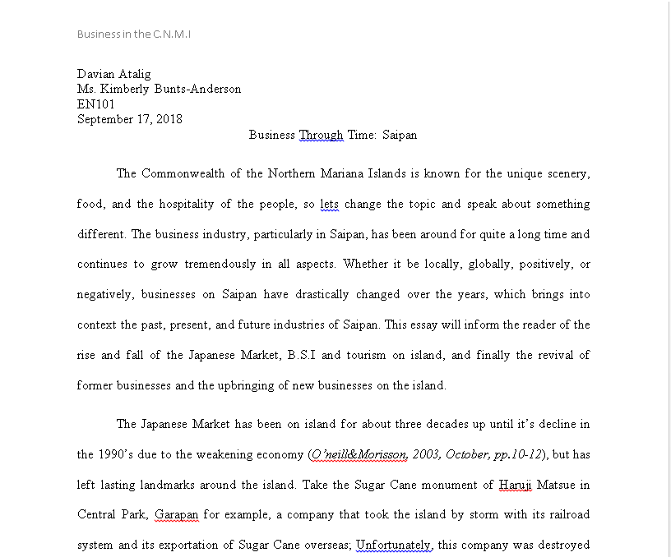
Businesses in C.N.M.I (Past, Present, Future)
Essay 1: Business Through Time
Link:
https://docs.google.com/document/d/1F_brqTkarQLApbC7XcHLQWtDEV0pbSeBpsglYQ43l38/edit?usp=sharing
-must use NMC email to access document

Slide 4
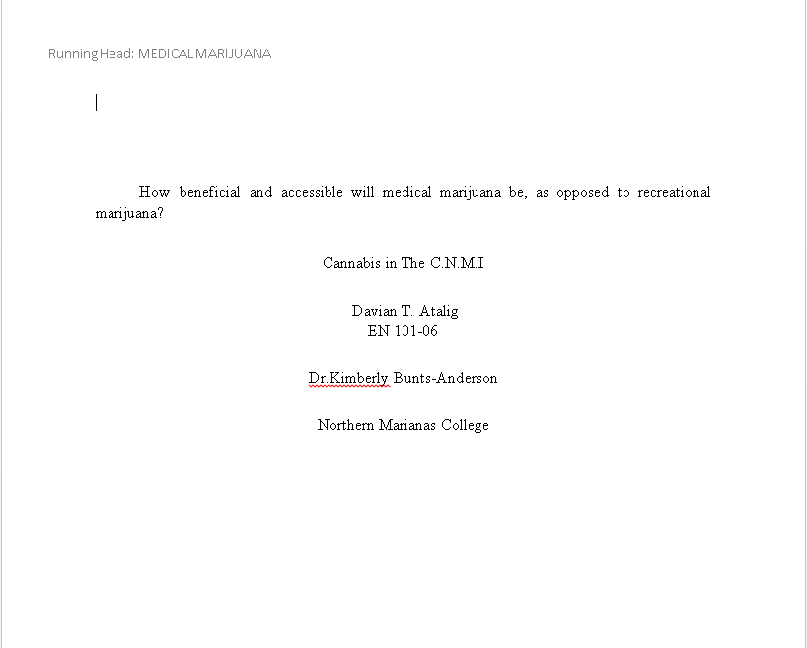
Proposal Essay/ Research & Writing Schedule
Link:
https://docs.google.com/document/d/1SXPAze2dGF2kTywNxuwIEPUwjhZ6I_Ovnqt-oN0w2gs/edit?usp=sharing
Must use NMC email to view document

Slide 5
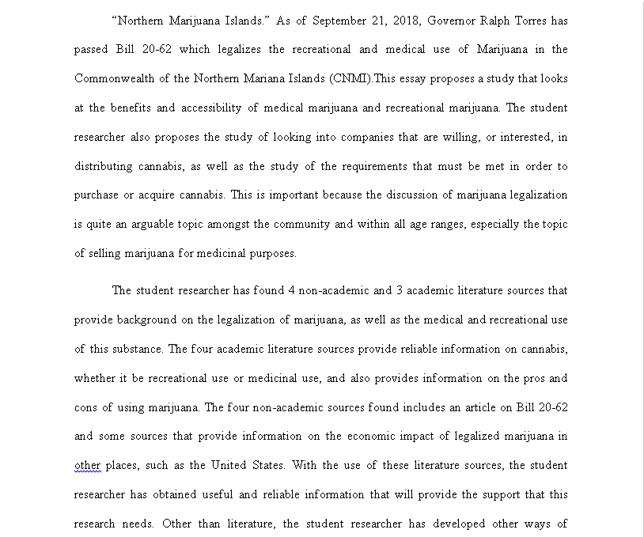
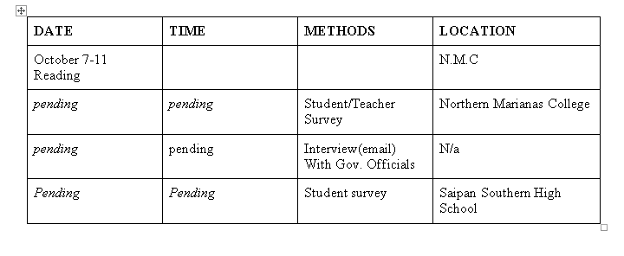

Slide 6
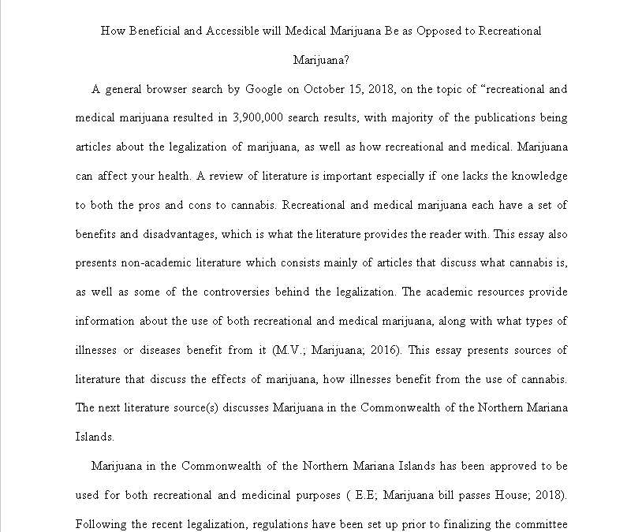
Essay 3: Literature Review Essay
Link: https://docs.google.com/document/d/1oezovLP9xpw0Wfvm9C5NNI9qCMHq4p4bNKBEBDmvc7Q/edit?usp=sharing
Must use NMC email to view document

Slide 7
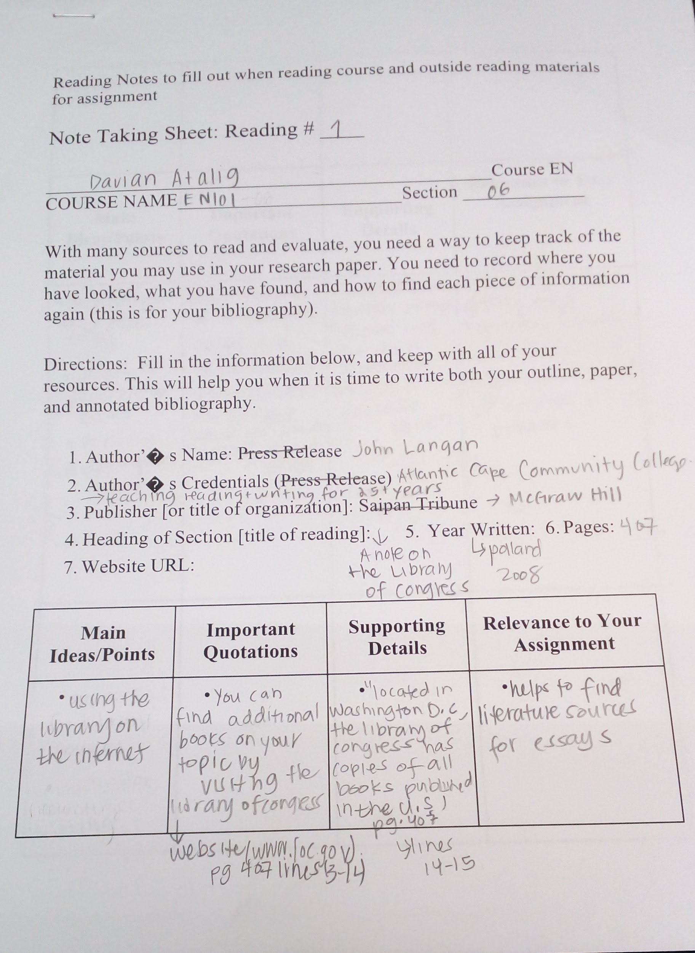
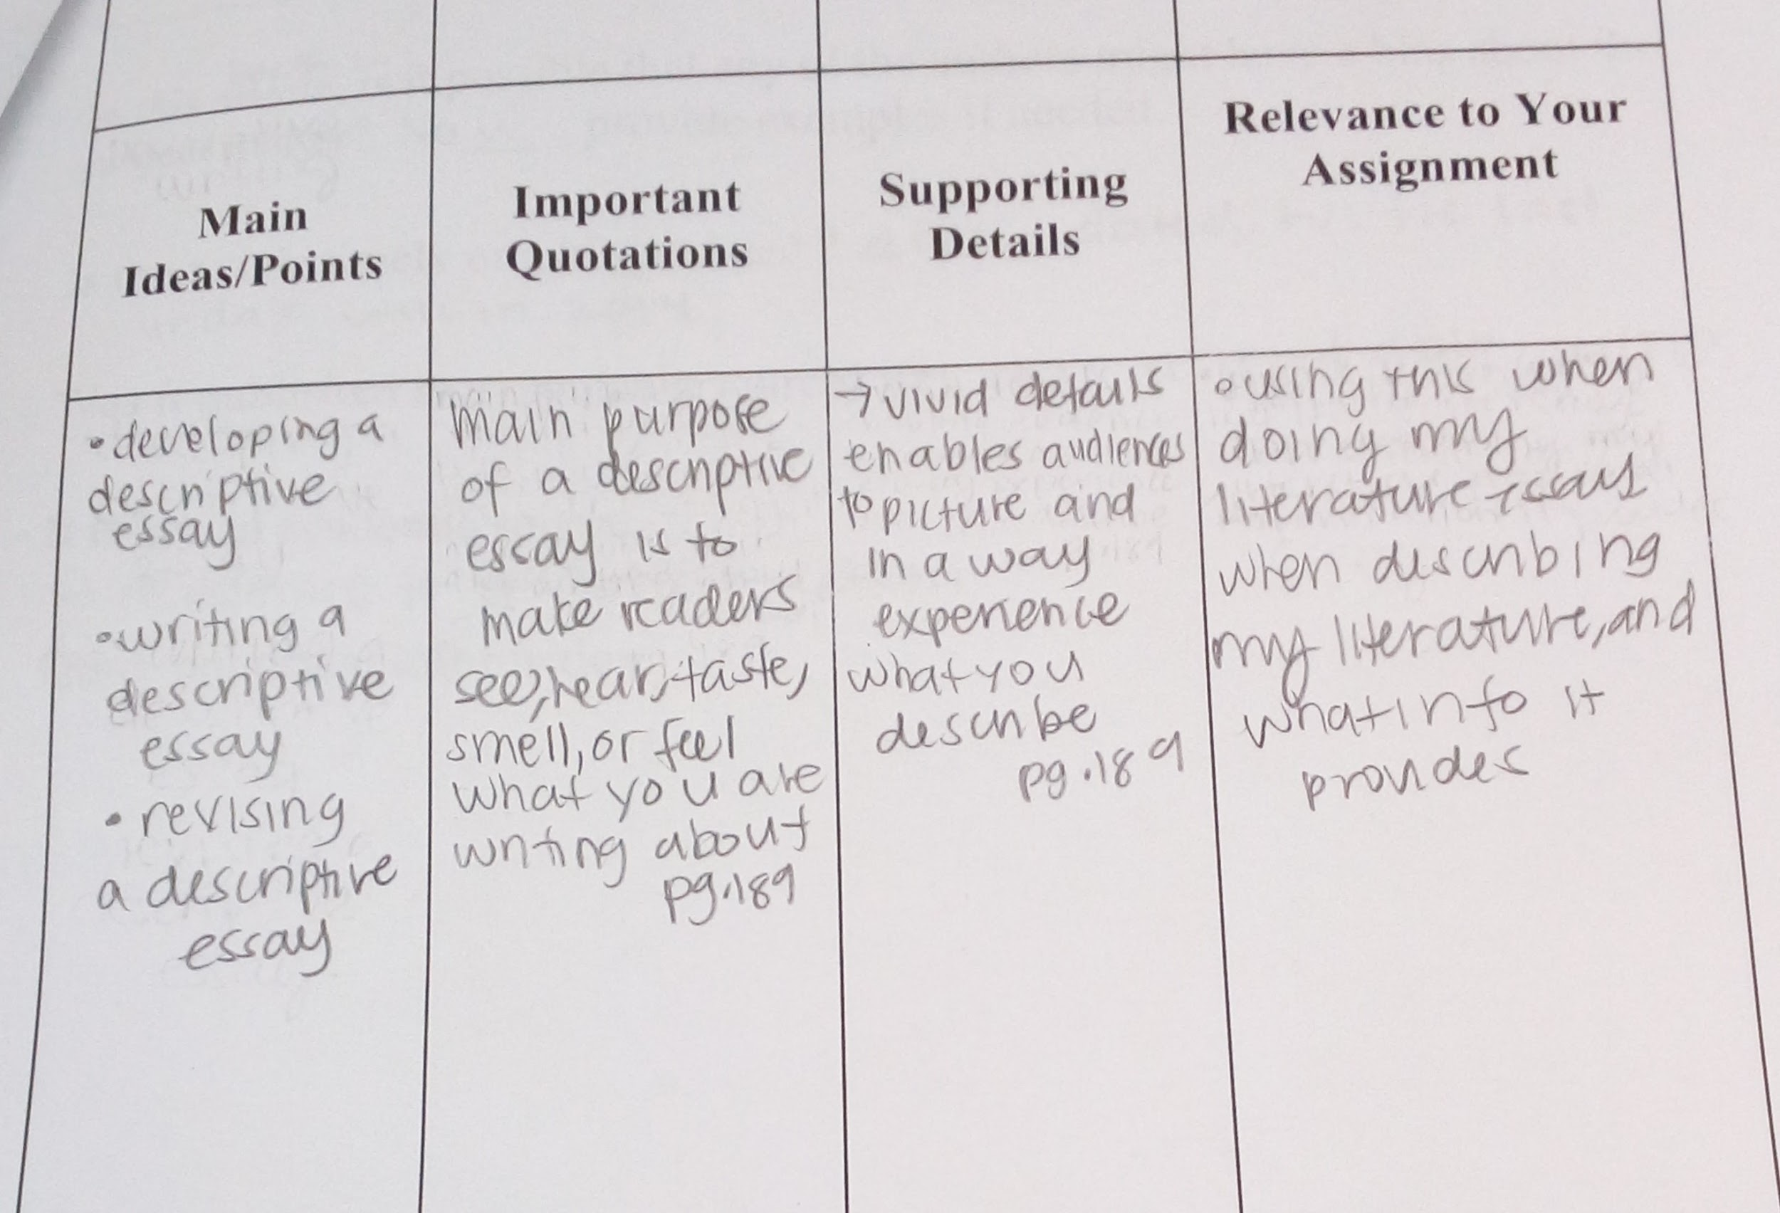
Reading Notes

Slide 8
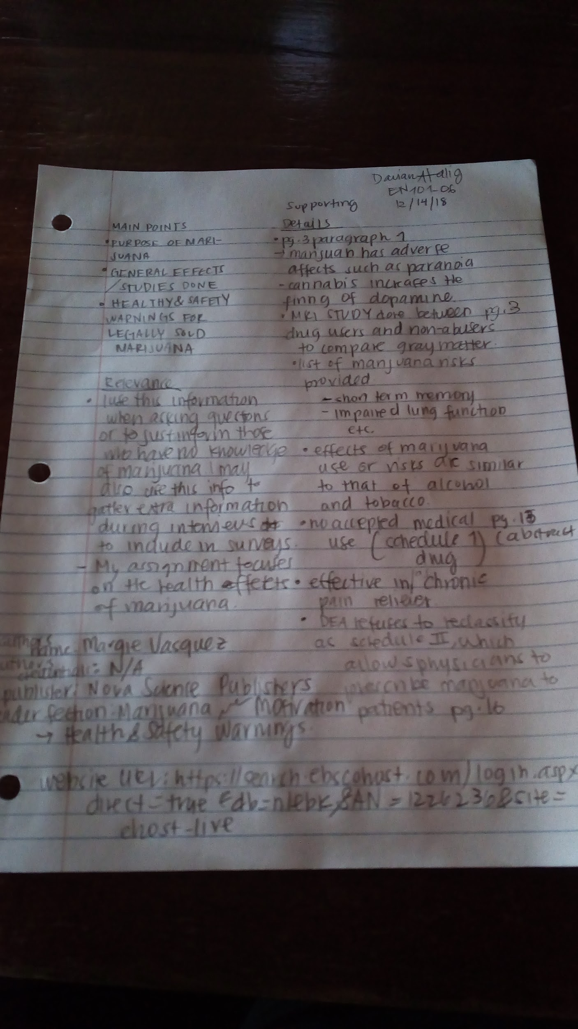
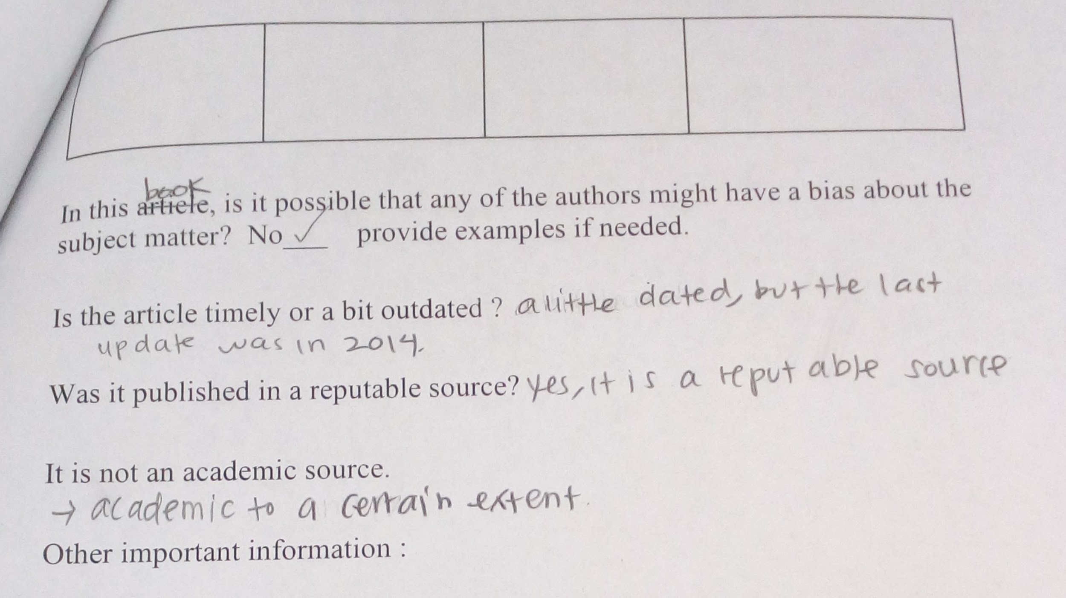

Slide 9
Hyperlink of All Sources
● O’Neill, M.E., & Morrison, C.E (2003, October)
Commonwealth of the Northern Mariana Islands Economic Report, pp.10-12
● Torres, F.D. (2017, March 22).
Worker killed at IPI construction site.
Retrieved from https://www.saipantribune.com/index/php/worker-killed-ipi-construction-site
● Campbell, M., & Wei, D. (2017, April,9
o Retrieved from https://www.bloomberg.com/amp/news/articles/2017-04-10/human-smuggling-money-laundering-probes-surround-saipan-casino
● A Historical Portrait of Haruji Matsue
o Retrieved from http://www.sugarking.org/hmFrame.html
● CLYDE HABERMAN, Special to the New York Times. (1985, November 25). JAPAN RECLAIMS SAIPAN; THIS TIME TO MAKE MONEY.
o Retrieved from https://www.nytimes.com/1985/11/25/world/japan-reclaims-saipan-this-time-to-make-money.html
● U. (2016, April 10). Abandoned La Fiesta Mall.
o Retrieved from https://www.atlasobscura.com/places/abandoned-la-fiesta-mall
● Camacho, J. D. (2004, September 5). The truth behind the La Fiesta deal.
o Retrieved from https://www.saipantribune.com/index.php/a0737b63-1dfb-11e4-aedf-250bc8c9958e/
● N. A. (2009, January 26). Jollibee to close in Feb. Retrieved from https://www.saipantribune.com/index.php/b3271073-1dfb-11e4-aedf-250bc8c9958e/

Slide 10
Hyperlink continuation…...
Bridgeman, M. B., & Abazia, D. T. (2018, August 17). Medicinal Cannabis: History, Pharmacology, And Implications for the Acute Care Setting. Retrieved from https://www.ptcommunity.com/journal/article/full/2017/3/180/medicinal-cannabis-history-pharmacology-and-implications-acute-care
Encinares, E. (2018, August 08). Marijuana bill passes House. Retrieved from https://www.saipantribune.com/index.php/marijuana-bill-passes-house/
Volkow, N. D., Baler, R. D., Compton, W. M., & Weiss, S. R. (2014, June 05). Adverse Health Effects of Marijuana Use. Retrieved from https://www.ncbi.nlm.nih.gov/pmc/articles/PMC4827335/

Slide 11
Hyperlink
Grinspoon, P. (2018, January 09). Medical marijuana. Retrieved from https://www.health.harvard.edu/blog/medical-marijuana-2018011513085
National Institute on Drug Abuse. (n.d.). Marijuana as Medicine. Retrieved from https://www.drugabuse.gov/publications/drugfacts/marijuana-medicine
What is Recreational Marijuana? - Definition from Maxyield. (n.d.). Retrieved October 3, 2018, from https://www.maximumyield.com/definition/4370/recreational-marijuana
Vasquez, M. (2016). Marijuana : Medical Uses, Regulations and Legal Issues. Hauppauge, New York: Nova Science Publishers, Inc. Retrieved from http://search.ebscohost.com/login.aspx?direct=true&db=nlebk&AN=1226236&site=ehost-live

