Slide 1
Computers in regard to NMC learning?
James CHUA

Slide 2
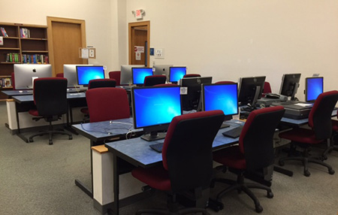
Process
Collecting Data, a student researcher planned to have plan on have 40 NMC student take an online survey in surveys monkey. I only received 12/40 responder in survery monkey. The student researcher was not able to collect data enough data, because student, teacher, and counselor are not available time to interview during the cause of Typhoon Yutu. The student researcher should compare their academic resource.

Slide 3
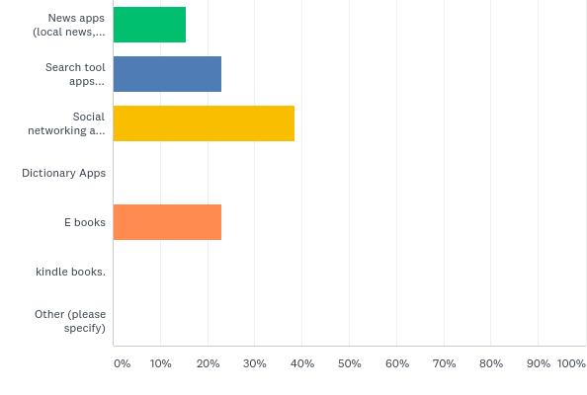
Finding 15.38% News apps (local news, national headlines, technology announcements, etc.) 23% Search tool apps (directions,) phone numbers, recipes, etc.) 38.46% Social networking apps (location check-ins, friend status updates, etc. 23.08% E books

Slide 4
Analysis
After collecting all my data through electronic surveys online. In my research data most of the student have a access to school computers during their lab ours finish up their homework assignments and research projects. I found one responder wrote this,It makes research easier and word processing and designing presentations easier as well. Overall it helps consolidate tasks and helps the learning process.
Most of the student said using a computer benefits their learning on a computers.

Slide 5
Literature source
Free computer classes back at public library
Non academic souces
Free computer classes back at public library
https://www.saipantribune.com/index.php/bddbfb53-1dfb-11e4-aedf-250bc8c9958e/
Why we need computer network.
http://www.omnisecu.com/basic-networking/why-we-need-computer-network.php
Critical Inquiry in a Text-Based Environment: Computer Conferencing in Higher Education
Information Technology
https://www.marianas.edu/content.php?id=223
https://www.sciencedirect.com/science/article/pii/S1096751600000166

