Slide 1
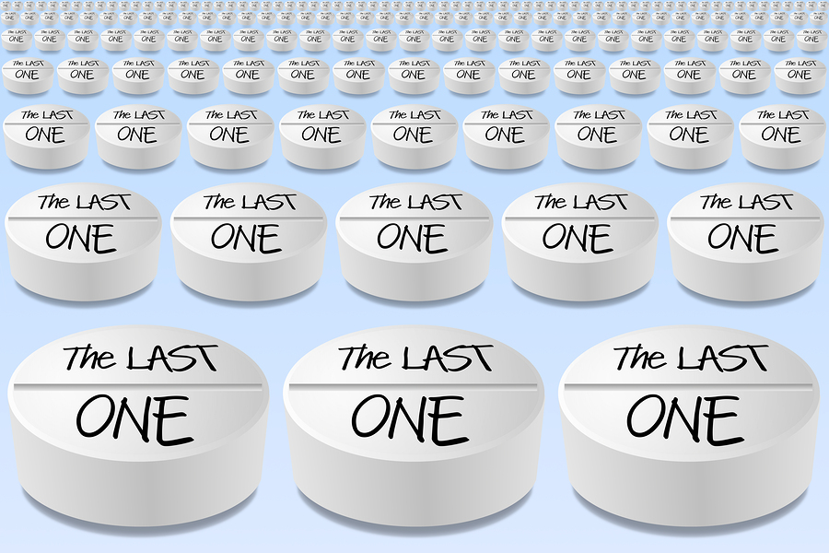
Opiate Addiction
Opiate Addiction

Slide 2
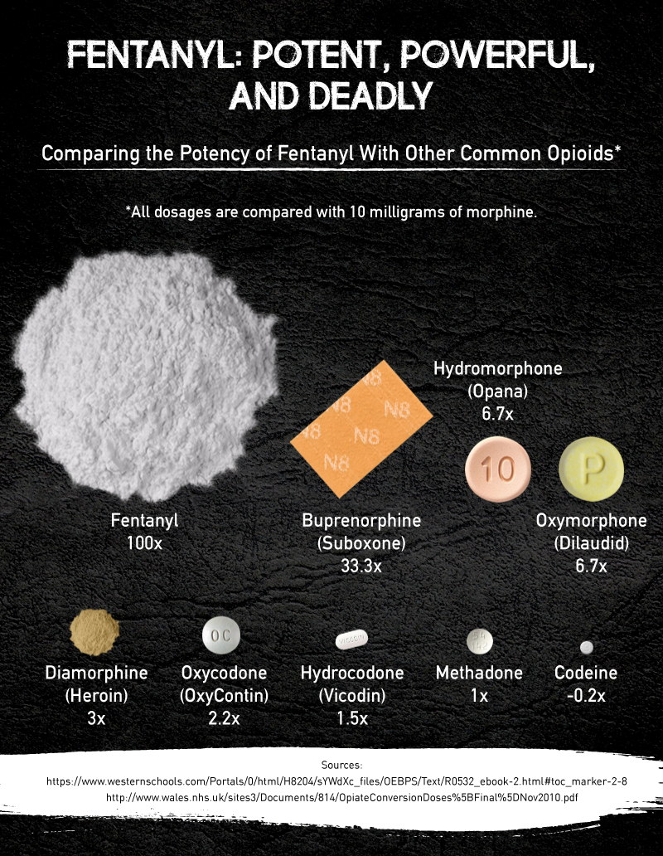

Slide 3
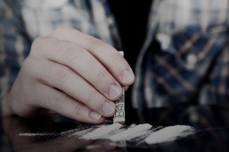
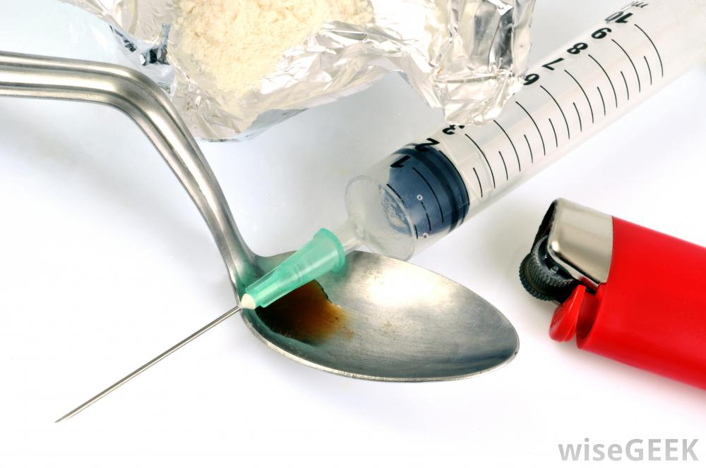

Slide 5
Reference
“The American Fentanyl Epidemic.” Heroin.com, heroin.net/think/the-american-fentanyl-epidemic/.
Google Images, Google, www.google.com/imghp
“Opiate Abuse.” DrugAbuse.com, 25 May 2017, drugabuse.com/library/opiate-abuse/.
Journal, Elephant, et al. “America’s Addiction to the War on Drugs: Stories from People who have Been There.” Elephant Journal, Elephant journal, www.elephantjournal.com/2017/09/americas-addiction-to-the-war-on-drugs/.
“Ex-Convict found using opiates, gambling at poker arcade.” Saipan News, Headlines, Events, Ads | Saipan Tribune, 17 May 2015, www.saipantribune.com/index.php/ex-convict-found-using-opiates-gambling-at-poker-arcade/.
“Non-Profit corp. seeks to open CNMI's first drug and alcohol rehab center.” Saipan News, Headlines, Events, Ads | Saipan Tribune, Saipantribune, 7 Aug. 2016, www.saipantribune.com/index.php/non-profit-corp-seeks-open-cnmis-first-drug-alcohol-rehab-center/.

