Slide 1
My Research Portfolio
Evangeline Babauta
ENON101 Fall
Dr.Bunts

Slide 2
Its all about present problems
Brainstorming
Criteria
Something applicable to the CNMI
Effects the public
Finding a topic I have personal interest in
Can I create a whole project on it ?
Can I have enough time to conduct my own experiments?

Slide 3
What is my topic?
Self love. Self Worth.
Are we persuaded by the media on how to think of our selves?
As the problem of self image continues to grow, researchers continue to look for answers.
This particular issue has been heavy on my mind, ever since I was young.
I decided to conduct a research project on something personal to me, that is a prominent worldly issue.
Our concept of “beauty.”

Slide 4
Research Proposal
By conducting surveys and interviews, I could gather my own statistics.
By contacting experts I was able to receive primary professional input.
**wrote research proposal**
This is the next step after brainstorming, starting to create

Slide 5
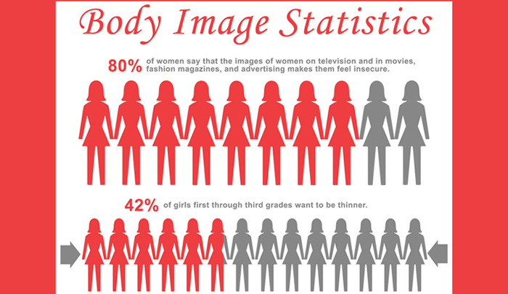
Gathering Data
As a researcher is SO important to gather your OWN statistics!
Survey Monkey and in person interviews are excellent forms of primary sourcing!
Single out your variables
Eliminate them
Gather 100% accurate results!

Slide 6
Your Sources Are Your Credit
Sourcing literature
Providing credentials
Have various sorts of resources!
See if you can relate information from your own findings
You MUST cite every source you use
APA formatting

Slide 7
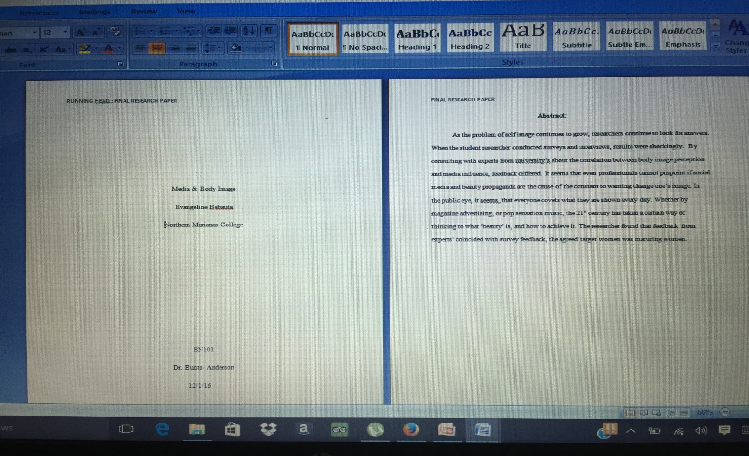
Review, Rewrite, and Report.
After collecting all of my work, in chronological order- I wrote my paper. Re-writing is always necessary, researching is adjusting as you go… When I finished and finalized I reported my work to Dr. Bunts.

Slide 8
THE END
Thank you!
And good luck with your projects!

