Slide 1
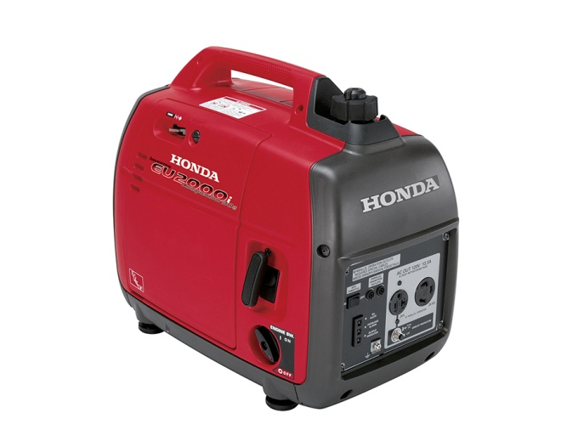
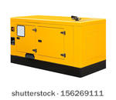
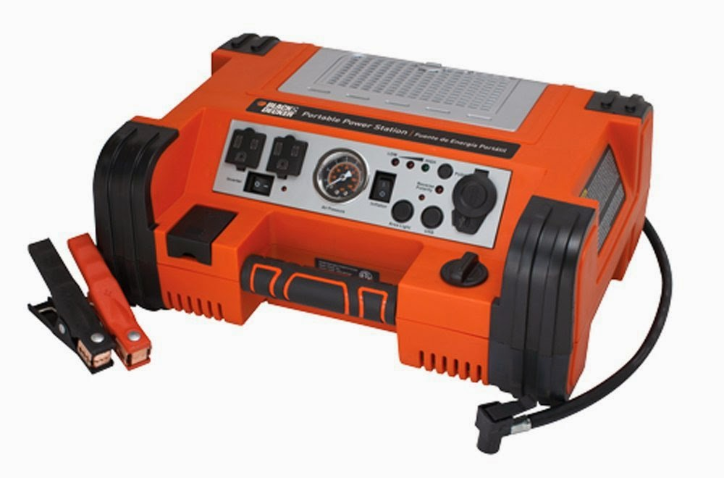
THE EFFECTIVENESS OF GENERATORS AFTER TYPHOON SOUDELOR ON SAIPAN
By: Michelle Lizama

Slide 2
Primary question
How effective was the use of generators on water pumps to restore water in homes after Typhoon Soudelor?
Secondary research question
What was the most difficult about not having water restoration for 3 months?
What were the strategies used to collect water for families?

Slide 3
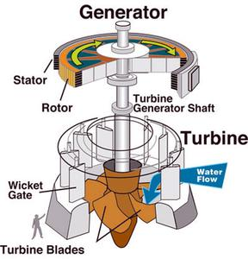
Collecting Data
Surveys:
Northern Marianas College Students:
Ages 18 and above
Questionnaires:
Ace Hardware Workers(Susupe & Gualo rai)
-Kim (Susupe)
-Loyce (Gualo rai)
Observations:
North & south sides of the island

Slide 4
Findings on surveys
Surveys were conducted on Northern Marianas College Students on the island of Saipan, and were only recorded by students of the ages 18 and above. Male and female.
35 NMC students took the survey
19 males, 16 females
28 out of 35 surveyed students used generators after Typhoon Soudelor

Slide 5
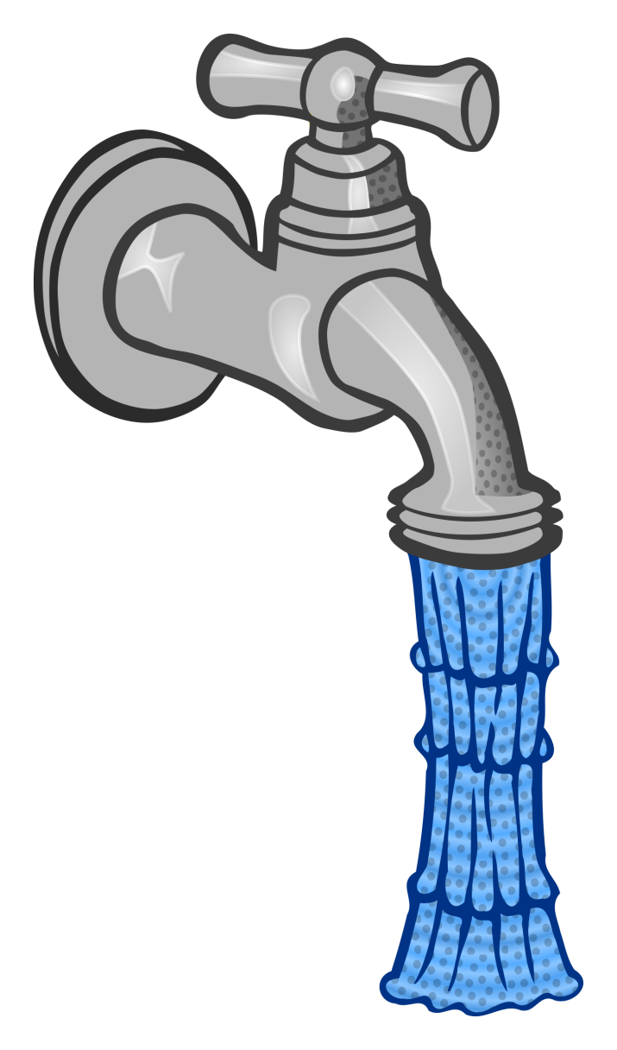
Findings on surveys
The government had provided generators used on water pumps around the island to restore water in homes
Majority of surveyed students have water and power restoration
1 out of 35 students does not have power or restoration.
Majority of surveyed students agreed that the generators on water pumps were affective in their homes
Some surveyed students did not benefit from generators used on water pumps

Slide 6
Findings on Questionnaires
Kim from Ace Hardware Susupe
“ Receiving shipments of generators did not take too long, generators were available after Typhoon Soudelor, and majority of generators were sold.
Loyce from Ace Hardware Gualo rai
“There were generators available after Typhoon Soudelor”

Slide 7
Findings on Observations
Some parts of the north had generators still being used on water pumps for water restoration in homes
There were not much generators being used for water pumps in the south part of the island.

Slide 8
Findings on Observations
Not the whole island has water restoration
There are some people on the island that still have no power or water.

Slide 9
Learning outcomes
It is very difficult and stressful for the people on the island that did not have water or power.
Generators on water pumps were affective for most homes on the island, and aided most people.
Generators used on water pumps were a great idea.

Slide 10
Suggestions on researching more on the topic:
Further interview individual Northern Marianas college students.
Interview families that aided from generators used on water pumps and families that did not benefit from the generators.
Conduct more surveys on more students

