Slide 1
Impact of typhoon soudelor on san vicente homeowners
By: Radbert Solomon
English 202
Dr. anderson

Slide 2
Reseach questions
What were the types of damage incurred after Typhoon Souldelor?
Did you receive any assistance or aid?
What were the agencies that assisted you?
How helpful were these agencies?
Were these agencies federally funded , private entities or government?

Slide 3
Methodology and data
Interviews –Consited of a questionnaire of sixteen question
Observations-observed and noted damages to homes, cars, and front lawn

Slide 4
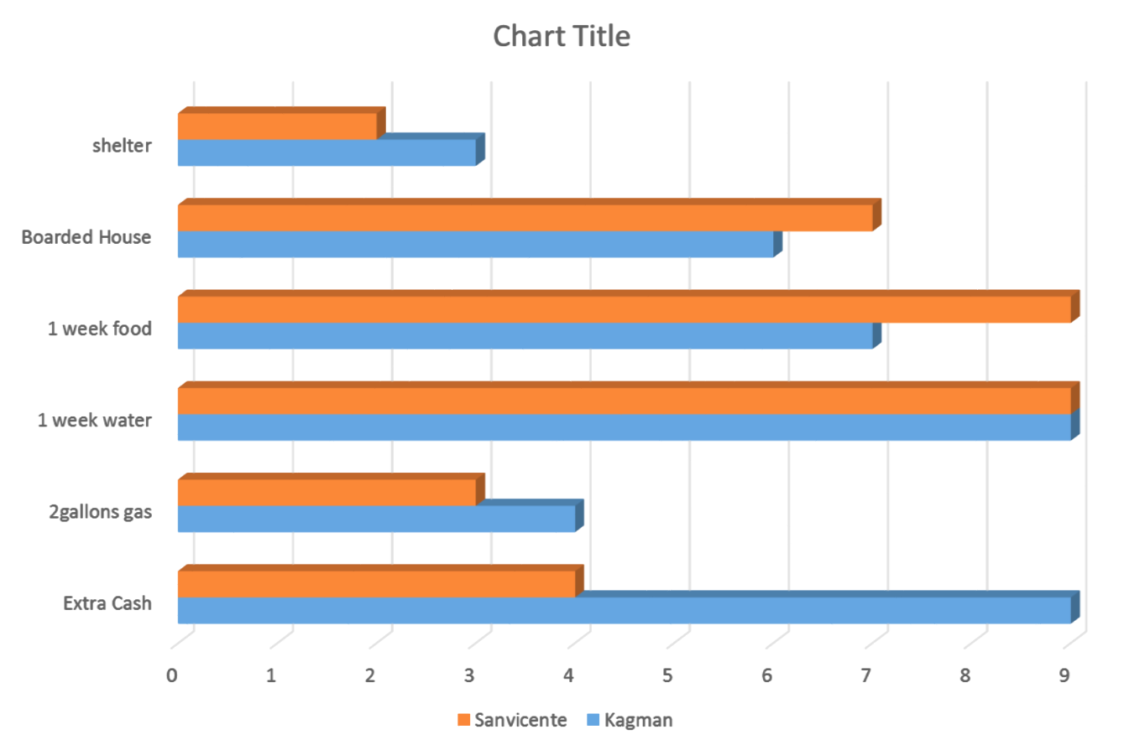

Slide 5
Interview Questions
What were the types of damage incurred after Typhoon Souldelor?
Did you receive any assistance or aid?
What were the agencies that assisted you?
How helpful were these agencies?
Were these agencies federally funded , private entities or government?
What types of other agency or assistance would you prefer?
How helpful were these agencies?
How long did it take you to avail these services?
What documents were requested from these agencies?
Was money or food (aid) provided and was it enough to sustain your household?
Would you avail to utilize these assistance program in case another disaster strikes?
What recommendations do you have to better benefit your household and/or the community?
Was the services you received, if any, quick?
What were the requirements to apply for these services?
What were the negative experiences you learned from this experience?
What were the positive experiences you gained from this experience?

Slide 6
Findings
Nine out of ten interviewees said FEMA (see appendix A, question 13) felt that the process was very slow because they understood that everybody on the island needed assistance.
They mostly felt the waiting process after registering was even more depressing because other areas of Saipan were in worse situations as opposed to the San Vicente area.
Nine out of ten residents ages 19-66 had qualified for the NAP assistance (food stamp coupons) while the remaining person whose age 16 did not qualify because she receives food stamp on a monthly basis as opposed to the others who do not.

Slide 7
LITERATURE REVIEW
‘In Camacho’s et al.’s (2015) article on “A day after Typhoon Soudelor, It is stated that many people who resided in lower San Vicente had retreated to shelters at San Vicente School. Parked at San Vicente Elementary School, children are playing on the basketball court, while adults mingle around the cafeteria. Tables are laid out with people’s belongings. Others are eating and talking. A baby cries, the mother takes the baby out to get it to stop. Another mother is washing dishes outside of the cafeteria. It looks like there are about 40 people inside the shelter. The shelter watchers or volunteers are using radio to communicate (Camacho et al., 2015)

Slide 8
references
Camacho, Jason. (2015). Saipan Tribune. A day after Typhoon Soudelor,1-2
Tran, Phong., Shaw, Rajib (2012). Community, Environment, and Disaster Risk Management. Bingley, U.K.:Emerald Book Serials and Monographs.Camacho Jayson,(2015). Saipan Tribube. I have yet to receive aid from FEMA, Pages 1-2.
Chin, Oliver. P. (2009). Flood Damage Management. New York: Nova Science Publishers.

