Slide 1
The effects of cleaning chemicals on health
EN 202-01
Michael F. Alovera
Instructor Dr.Kimberly Bunts-Anderson

Slide 2
Background
Cleaning products are used daily in different environments, both indoors and outdoors.
However, household and cleaning products often include harmful chemicals that can cause health-related problems.
Some of these short-term health effects are:
headaches, migraines, nausea, dizziness, and many more.
Commonly used cleaning products are disinfectants, odorants, detergents and much more.

Slide 3
Primary Research questions:
Do cleaning products have an impact on the quality of health on the users?
What are some health-issues that occur when using cleaning products?

Slide 4
Methodology
Survey
data was collected based on questions revolving around the participants’ demographics, association with several types of cleaning products, and health issues that occurred when using these product types.
Quantitative data collection method was primarily used.
The survey had a total of 36 participants which consisted of 23 females (63.9%), 12 males (33.3%), and 1 preferred not to say his/her gender (2.8%).
Most of the participants were between the ages of 35 to 39 (33.3%).
Literature review
When googling “Cleaning products and adverse health effects” about 257,000,000 results show; which tells us that that this topic has been conduct before. Relevant academic resources within the last 10 years have been collected, and used for the research study.

Slide 5
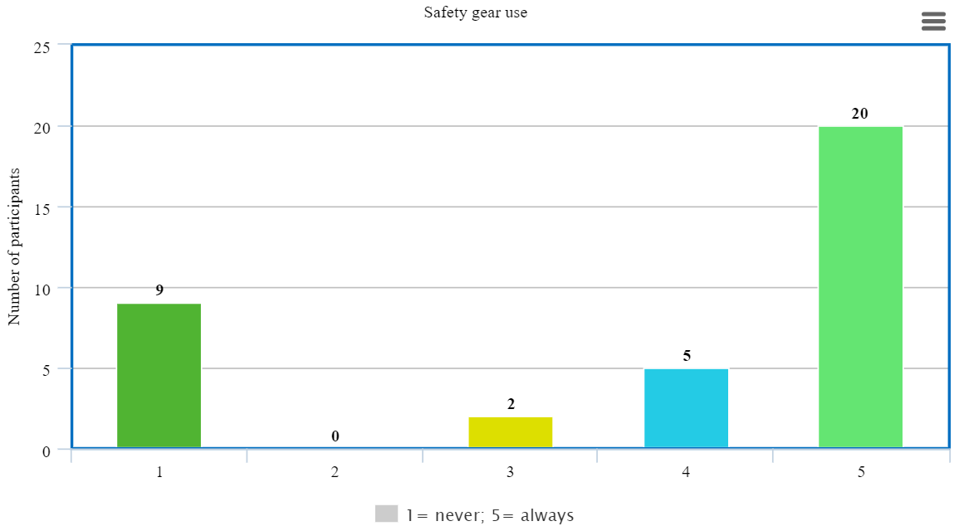
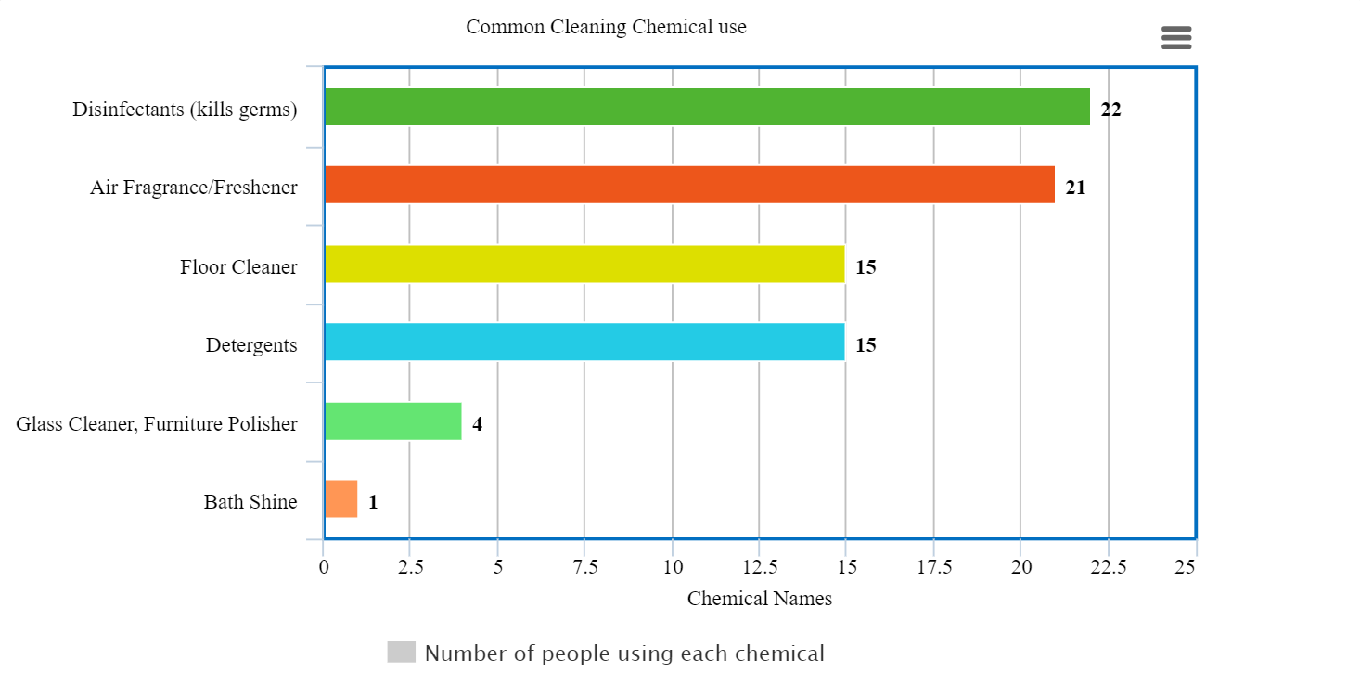
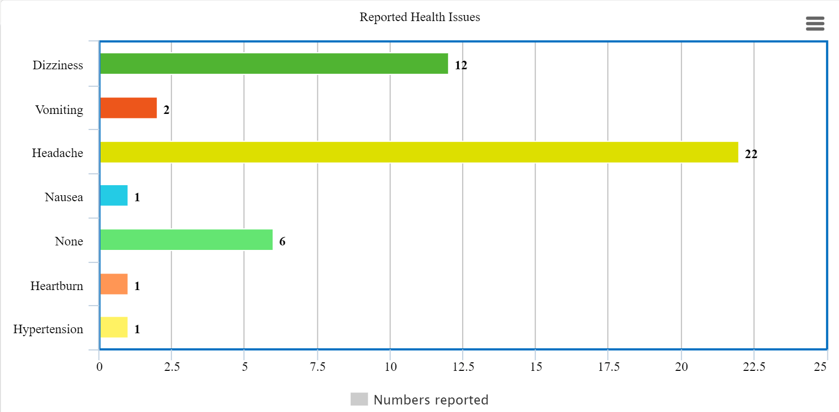
Results of survey

Slide 7
Conclusion/Findings
This study suggests that being exposed to cleaning chemicals has a negative impact to the quality of health
Although the study’s limitations precluded the authors from making stronger predictions between cleaning products, many participants reported having health issues such as dizziness, vomiting, headache, and nausea.
Despite the use of safety gear and following safety rules on the use of cleaning agents, the negative impact to quality of health still exist.

Slide 8
Study limitations
The knowledge of the specific composition of the products, amount used, and length of exposure are still rather limited; in several cases it has not been possible to obtain detailed information on the chemistry of the products. Also, questions in the survey should have used whole numbers, rather than ranges, to ensure a more concise and precise data collection.

Slide 9
Thank you see you soon ☺

