Slide 1
The Negative Effects of Climate Change

Slide 2
Research Questions
Primary Question
What are the negative effects of Climate Change?
Secondary Question
How will rising sea levels affect the earth?
Will hurricanes/typhoons be stronger?
* The information used to answer these research questions were from surveys, interviews, and research.

Slide 3
Research
Survey
10 Questions
35 NMC Students
Interviews
3 Questions
10 Experts

Slide 4
Survey
10 Questions
35 NMC Students
Questions ranged from demographics to opinion-based questions.
*

Slide 5
Survey Questions
Gender
Age
Do you know what climate change is?
What do you know about Climate Change?
Do you think climate change is caused by human activities?
Name different environmental issues that are caused by human activities.
Do you think our government is looking for solutions to help the environment?
Do you think the rising sea levels pose a problem to our islands?
Name different ways we could help the environment.
How important is the environment to you?

Slide 6
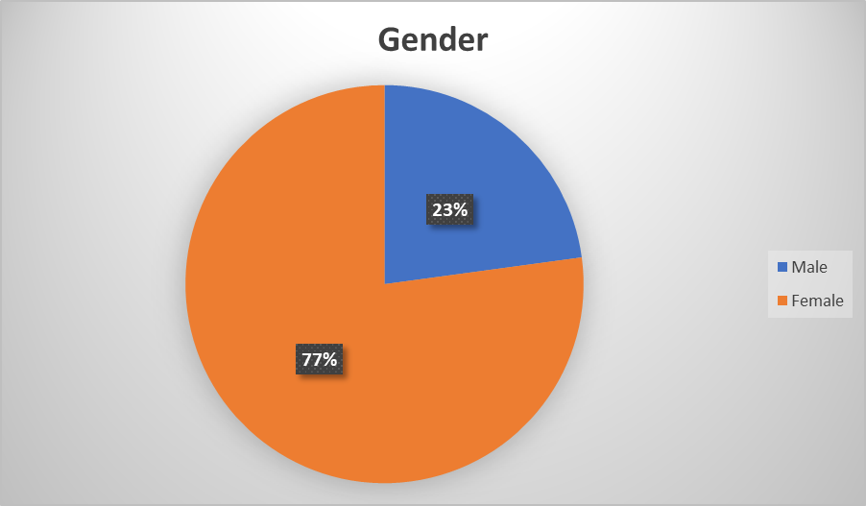
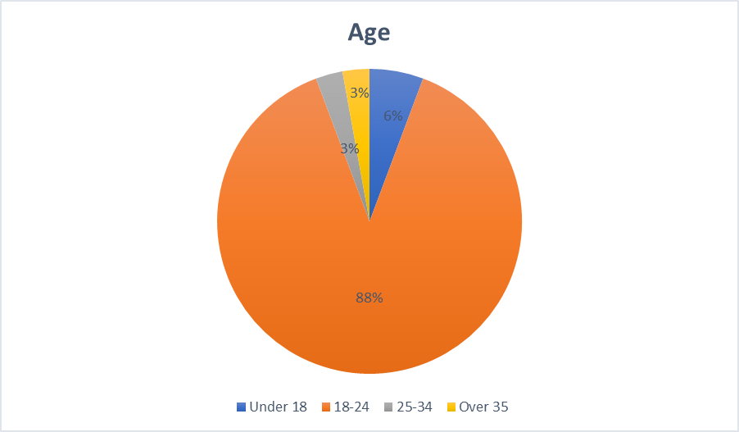
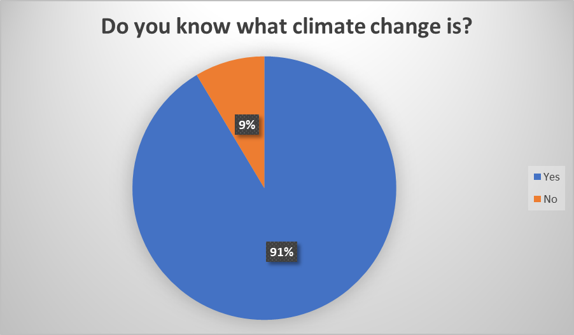
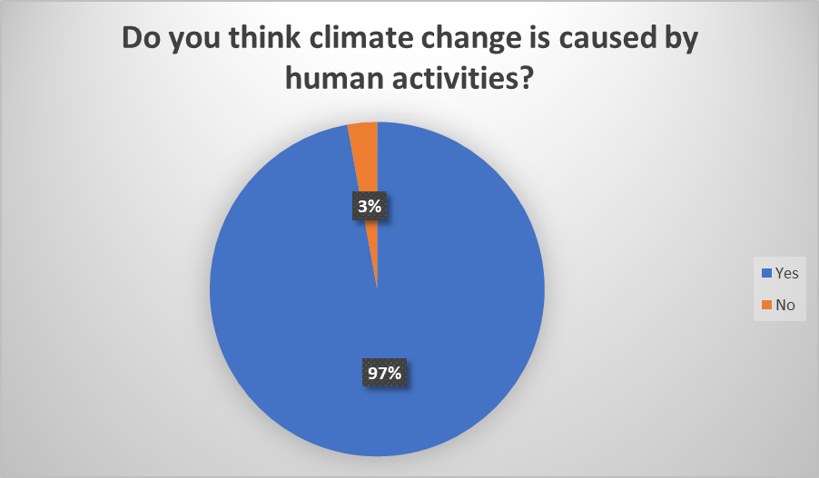
Survey Results

Slide 7
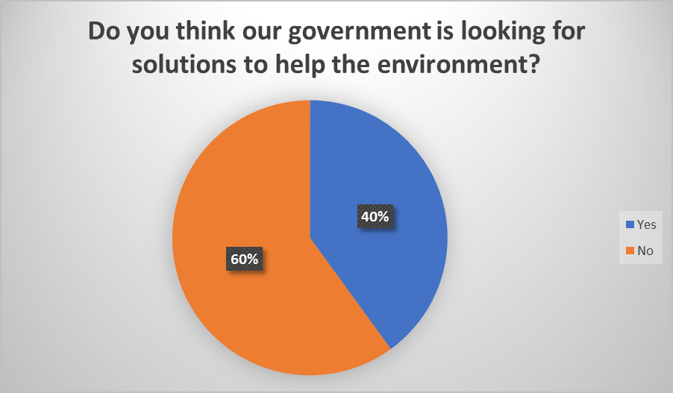
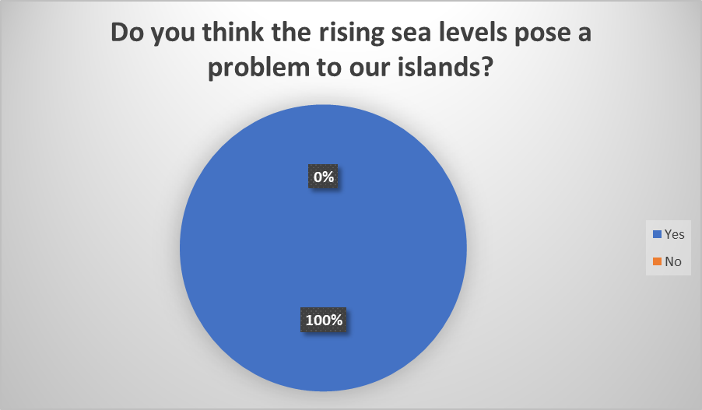
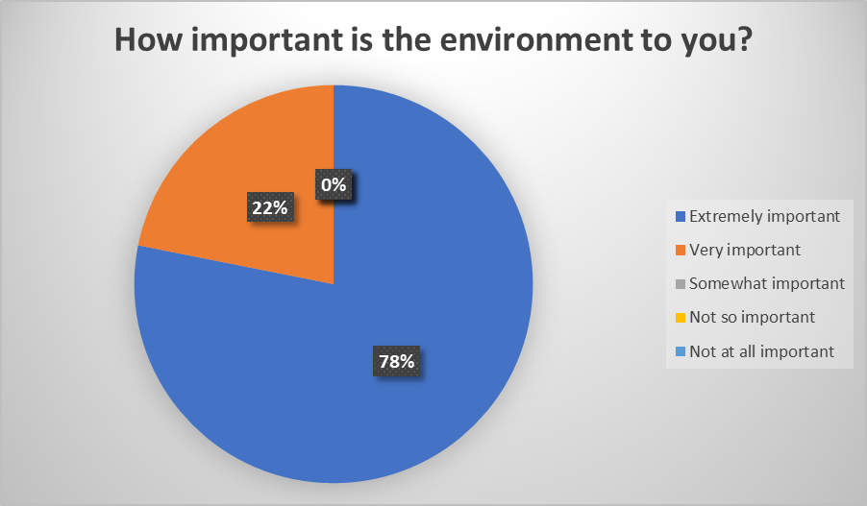

Slide 8
Expert - Questionnaire
3 Questions
10 Experts
Questions were answered with personal experiences

Slide 9
Expert - Questionnaire
What does the word Climate Change mean to you?
What impacts will climate change have in the future?
Is there a way to fight climate change?

Slide 10
Findings
Results were found through research, interviews, and surveys.
The negative effects of climate change are
Rising sea levels
Rising temperatures
Increase in illness
Hurricanes/Typhoons will become stronger
Rising sea levels will affect the earth by destroying homes near the shores.

Slide 11
Strengths & Weaknesses
Strengths
So many information
Research data will be a lot
Weaknesses
Unorganized research data
Too much data online, which means a lot of untrusted sites

Slide 12
What could’ve been done instead?
Interview people at an earlier date
Create stronger survey questions
Distribute surveys to more students
Proofread all essays by peers and mentors

Slide 13
What did I learn?
I learned more about the dangers of climate change, and the damages it will cause the world if it is not dealt with now.
Climate change can be affected by pollution and deforestation

Slide 14
Organization
I organized my report in order from
Introduction
Research questions
Methodology
Analysis
Conclusion
I think I did well on the Introduction and Methodology part. If I would do something differently, it would be my analysis. I want to find new ways to gather information and make it all connect together.

Slide 15
Future
In the future, I would like to learn more about climate change effects on the human health. I think learning about the human health is important because so we can learn how to prevent sickness. In the future, I would like to work on my writing skills. I believe that I improved on my writing skills, but I want to get better at it. The most interesting thing about climate change is that in order to slow it down, we all need to work together to stop it.

