Slide 1
BULLYING
Raelani Iglecias
EN101 ON01 Spring 2017
Dr. Kimberly Bunts-Anderson

Slide 2
Research Questions:
Primary Question: How does bullying affect the CNMI?
Secondary Questions:
Why do not students speak up when they are bullied?
What can be done to prevent bullying?

Slide 3
SCHEDULE:
Research Question = FEBRUARY 2017
Research Proposal = FEBRUARY 2017
Pilot Survey Proposal = FEBRUARY/MARCH 2017
Conducting interviews = MARCH/APRIL 2017
Process essay = MARCH 2017
Final essay = APRIL/MAY 2017

Slide 4
PILOT SURVEY QUESTIONS:
What is your gender?
What is your age?
What is your nationality?
Have you ever been bullied?
If yes, what type of category?
How often have you tried to help another person who was being bullied?
How do you think teachers, students, etc. can prevent bullying?
What do you think is the result of bullying?
What do you think is the main reason of bullying in the CNMI?
On a scale of 1-10, how would you rate bullying in the CNMI?

Slide 6
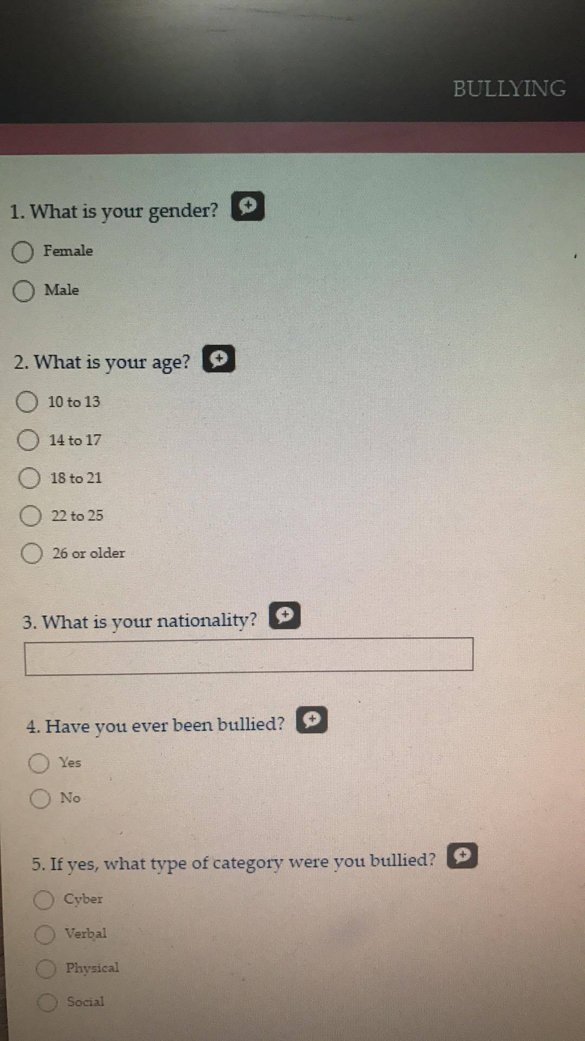
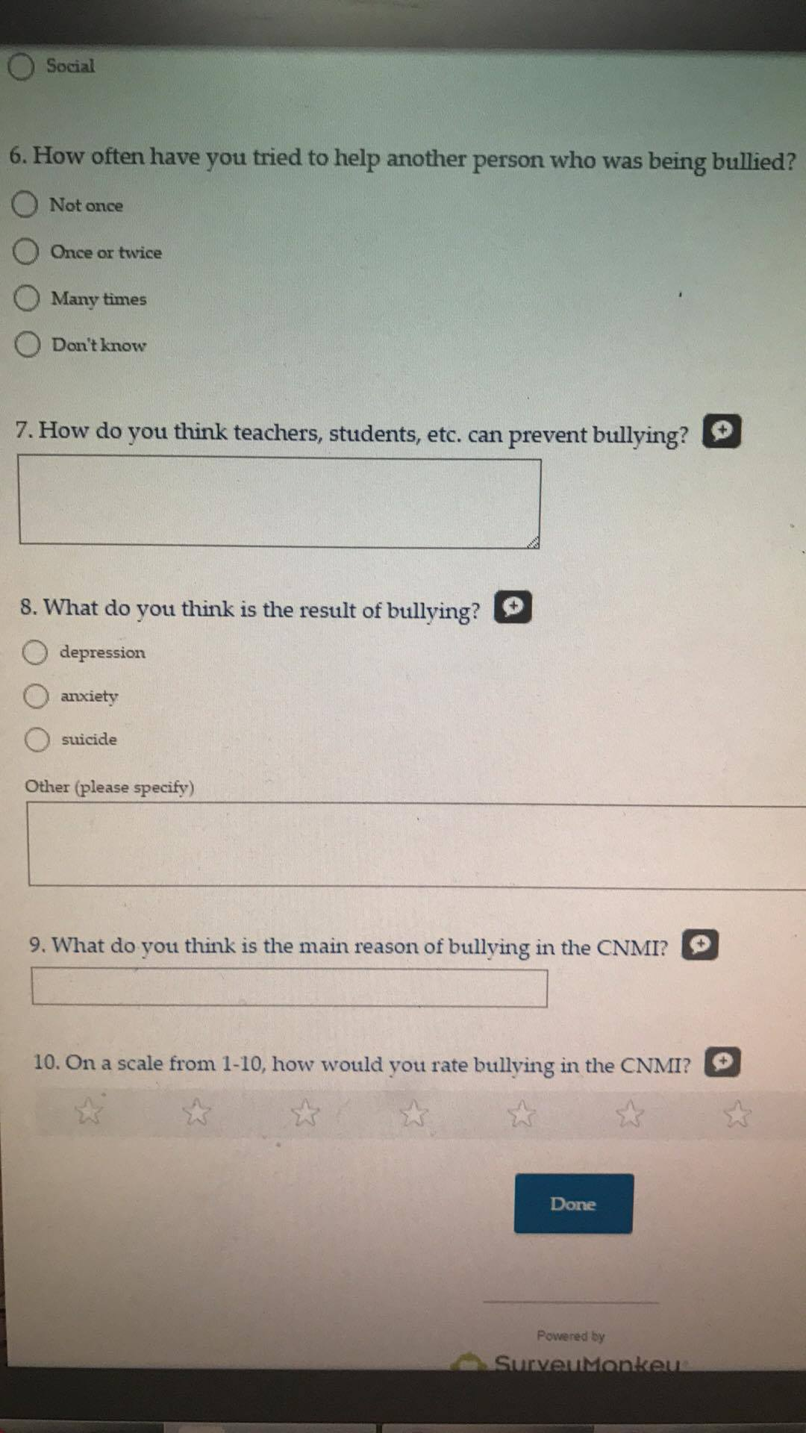

Slide 8
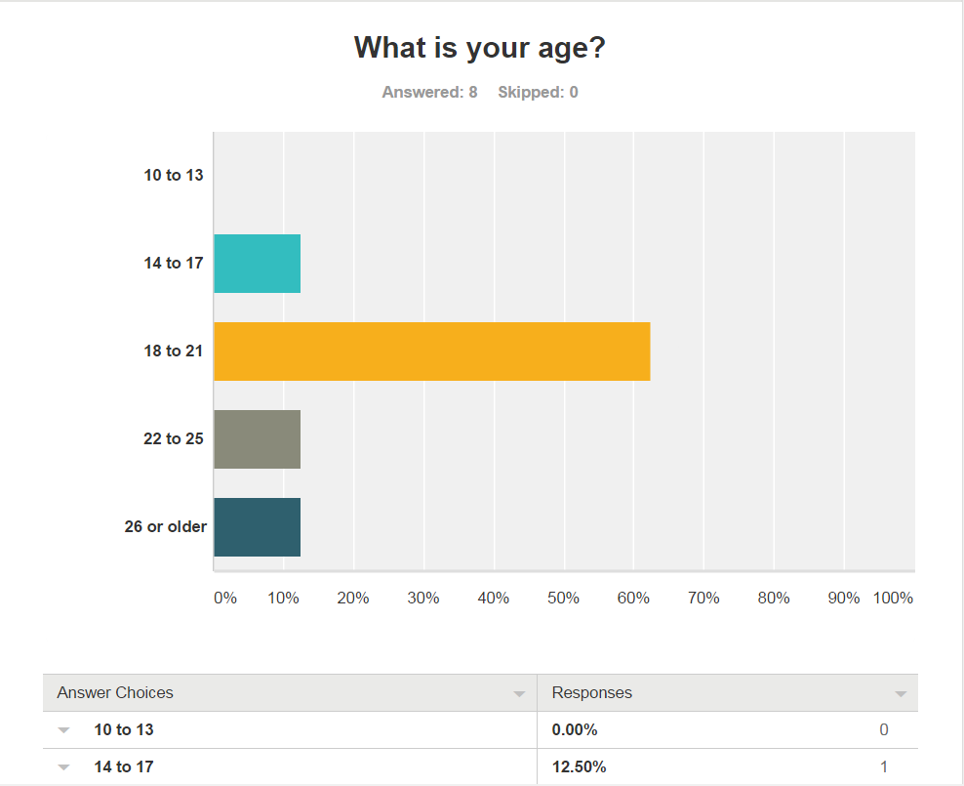

Slide 9
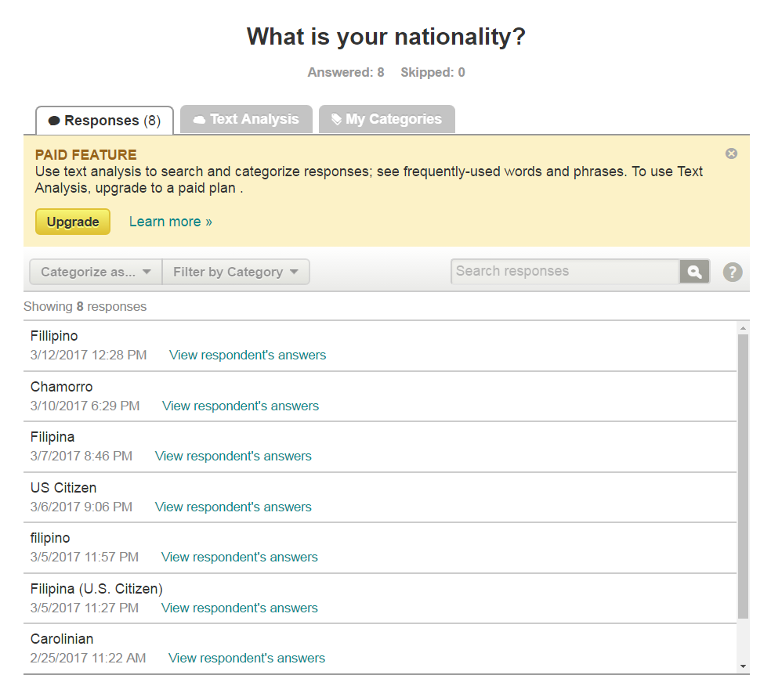

Slide 10
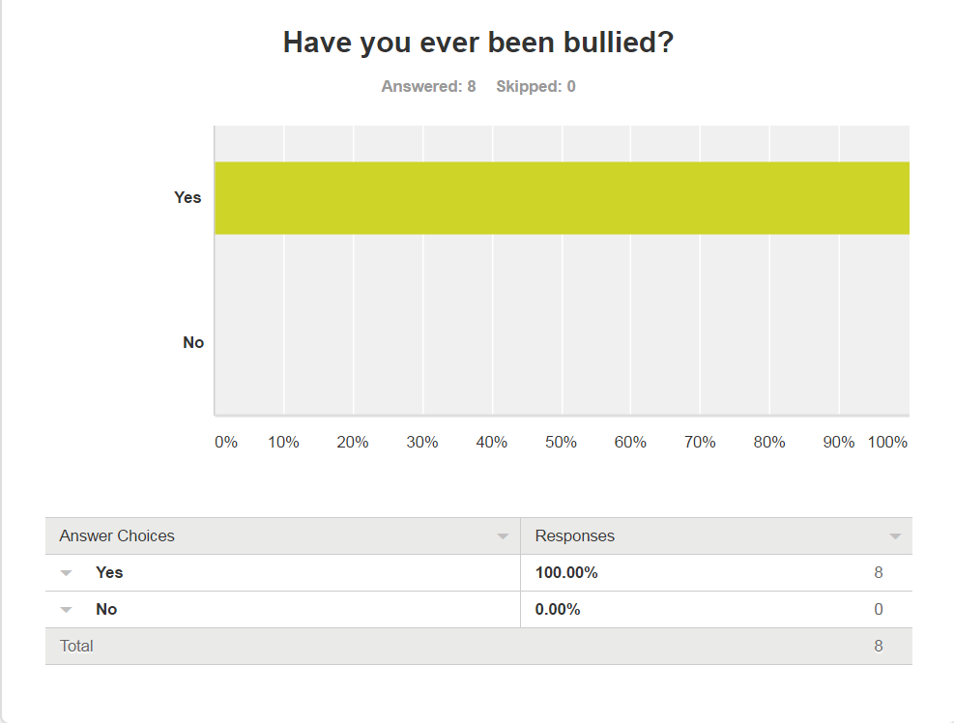

Slide 11
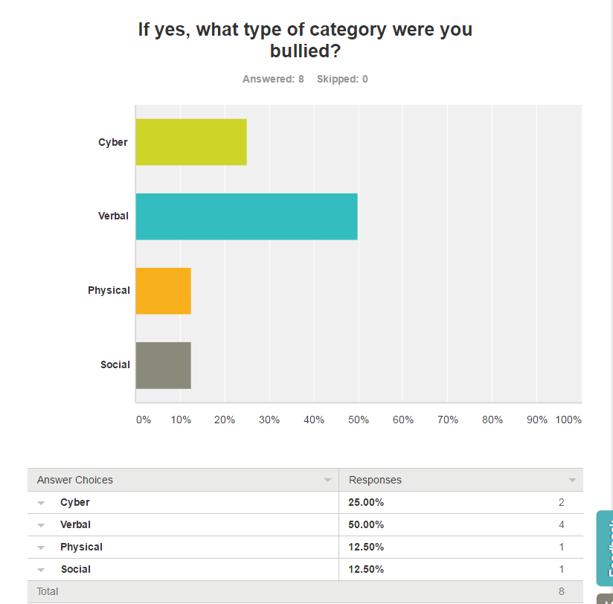

Slide 12
