Slide 1
30 Day Challenge Reading to sleep
By: Thomas Benavente
BE111 ON01 Fall 2020

Slide 2
30 Day challenge goal: reading to sleep
What: Shutting down all electronic devices before desired reading time and reading for at least 30 minutes before sleeping
Phone and laptop will be charging during dinner time to prevent overcharging
Books used will alternate every night

Slide 3
30 Day challenge goal: reading to sleep
When: Start Date- September 28,2020 End Date: October 27,2020
Why
Create a better sleeping schedule
Improve vocabulary and context history

Slide 4
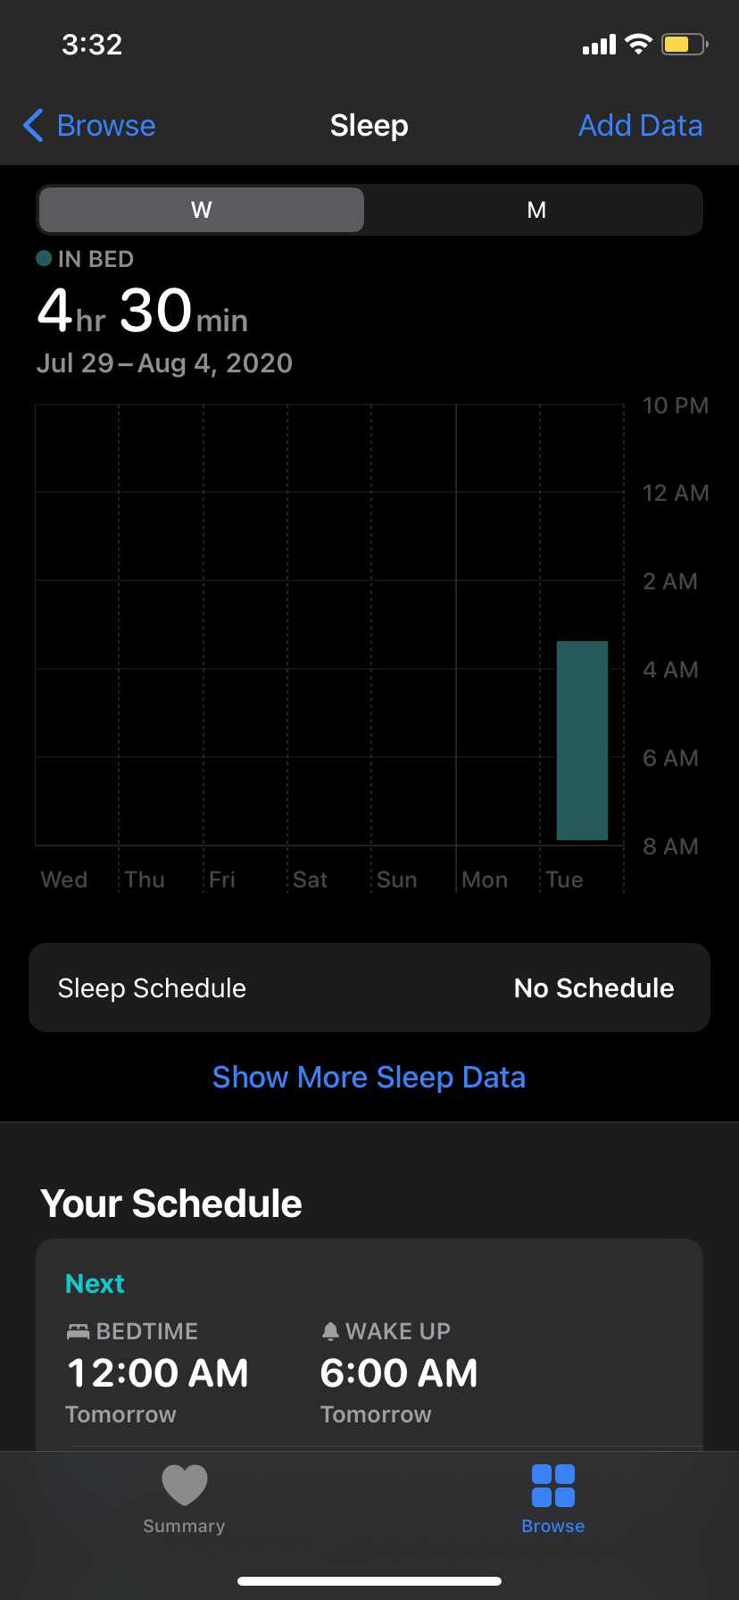
30 Day challenge goal: reading to sleep
How
Measurements: Sleep Times Logging, Paragraph Length
Journaling: Book Section Daily Summary, In-Bed Logging
Goal Assessments: Journal Logins, Sleep Browser in iOS Health, Peer Review
Materials: Textbook and Novel, Composition Book and Pencil/Pen, Watch or Clock
Where: In bedroom
Who: Myself

Slide 5
30 Day challenge goal: reading to sleep
Unforeseen Obstacles
Fatigue from recreational activities
Lack of Interest in book(s)
Family Hangouts
Inability to sleep
Intended Solutions
Relax and talk with friends before coming home
Choose different books in similar genres
Catch up with cousins or grandparents
Read more of the book

Slide 6
30 Day challenge goal: reading to sleep
See you in 30 days! ☺

