Slide 1
EN202-ON01
Presentation 2
Halia Taisacan
Northern Marianas College

Slide 2
Research Questions
How has technology affected the lives of the disabled/impaired?
In what ways can the CNMI improve to help accommodate persons of disability/impairment?

Slide 3
Process
For this research, the student researcher chose to create a survey consisting of 10 questions. That survey was then sent to roughly 40 NMC students. Along with the survey, the student researcher was able to send out letters to 10 experts in that field as well as collect data through articles and journals. Of the 40 possible respondents, 11 participated in the survey and only 1 of the 10 experts responded to the letter.

Slide 4
Methodology
The student researcher created a 10 question survey consisting of demographic questions, questions of opinions, and questions pertaining to the research. A link was then uploaded to a shared google document for participants to respond. Along with the survey was the response of the expert. Only one of then 11 experts provided a response. The expert was provided three questions and provided an opinion. Journals, studies, and articles were then reviewed for potential supporting information.

Slide 5
Analysis
Of the 40 possible respondents available on the google document, only 11 people participated in the survey. There were 4 males and 7 females ranging from ages 18-26. Out of the 11 respondents, only 5 said “no” when asked if they or someone they know requires an assisted device on a daily basis. The respondents that said “yes” to that question listed devices such as wheelchairs, canes, and hearing aids.

Slide 6
Analysis cont.
As for the letters to experts, the student researcher was only able to get a response from one expert out of the ten possible choices. This expert is a Special Education Coordinator for the Public School System in the CNMI. The expert deals with persons of disabilities in the school system and has experience in the field under research.

Slide 7
Findings
In the pages to follow are samples of findings collected through the research. Within the three photos are the following questions: “Do you or anyone you know rely on any kind of assisted devices on a daily basis?”, “Would you recommend the CNMI’s Call-A-Ride program for people with disabilities?”, and lastly, “How can technology within the CNMI improve to better accommodate people with disability?”. These are all questions in the survey taken by 11 NMC students. There are responses showing that majority of the devices used are wheelchairs, canes, and hearing aids. IN addition, it goes to show that 8 of 11 individuals would recommend the Call-A-Ride program. In response to how the CNMI can improve to accommodate the disabled, one opinion really stands out. The respondent stated that communication is what is most important. When a disabled individual has a source of instantaneous contact, they can receive the help they need in a more efficient manner.

Slide 8
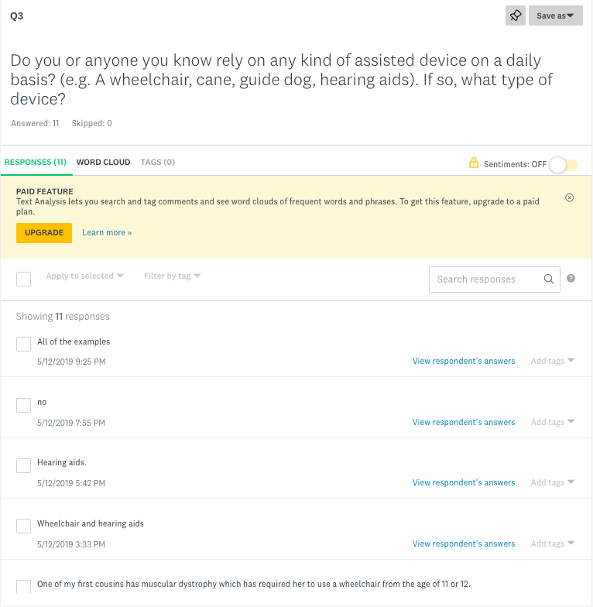
Findings

Slide 9
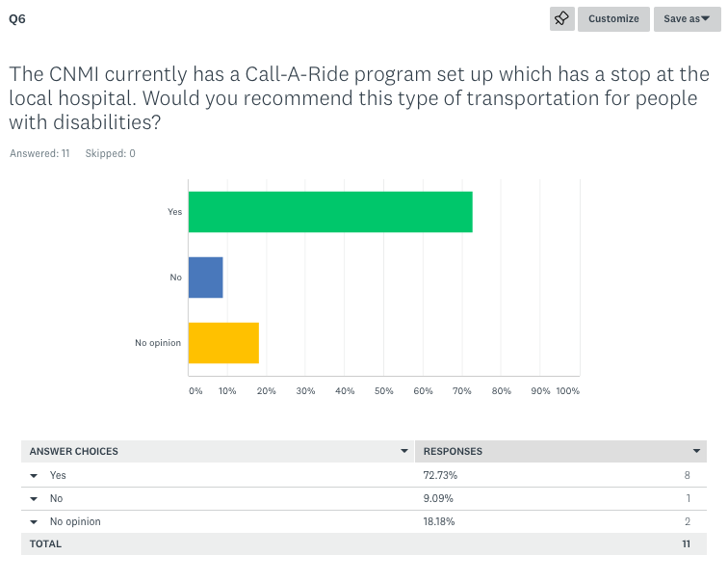
Findings

Slide 10
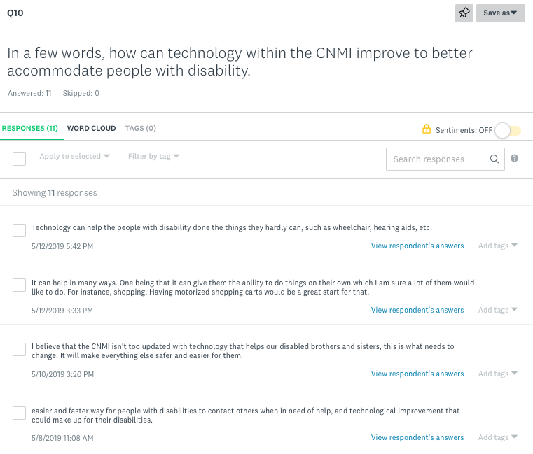
Findings

Slide 11
Conclusion
Technology can come in many different forms. Before the start of this research paper, the student researcher often thought of technology in a technical sense. However, throughout the months of research it is clear that technology has improved in countless ways. The development of wheelchairs and motorized shopping carts are two of the many technological advances. Without touching on the subject of technological devices, it is clear that any one of these options can severely impact a person with disabilities/impairments. It can help to bring the world closer and prove to be useful for simple daily activities. The technological revolution happening in todays society can provide voices for the non-verbal and acceptance in society.

Slide 12
About this research project
Both the research and survey answered the questions: How has technology affected the lives of the disabled/impaired? As well as, how can the CNMI improve to help accommodate the disabled/impaired? Throughout the research there were many, many, weaknesses and also strengths. A way the research could have been better prepared is if I had used my time wisely. Thankful for the process in the class that allowed me to work on the paper for the whole semester, but there are still some flaws. A major flaw was the lack of research available to me. A strength I might add is the structure of the course. Had this course not been laid out in this way, this research paper would have taken a completely different route.

Slide 13
About this research project
I learned many things while completing this research. One thing I never noticed was technology’s integration of the disabled. I knew of the features available of mobile devices but I didn’t know the extent of it. I am amazed of how the leaders in companies have seen this issue and took initiative. Although I would like to do many things differently, I have to be happy with what I have produced. I wish I had managed my time more wisely, but I am content with how I got things done. In the future, I would like to learn more about the disabled in the CNMI, in my research I didn’t really touch on the subject completely, and I would like to further explore it.

