Slide 1
Final Presentation
Marc Christian A. Venus
EN202 – ON01

Slide 2
Topic
Focusing on Sports-related injuries and concussions
  What are the causes behind these?
  What are possible solutions?

Slide 3
Research Questions
What are the causes of injuries and concussions?
Are regulations the primary reason behind this?
Could mismatches in sports be the reason behind this as well?
Is the general public aware of this issue?

Slide 4
Concussion
Traumatic Brain Injury (TBI)
Affects brain function.
Caused by blows to the head.
Fairly common in contact sports.

Slide 5
Sporting Mismatches
1997: Rugby match ends with a kid with a broken elbow.
Takes 8 years to reach court
Issues about regulating not regulating size ratio, instead of age.

Slide 6
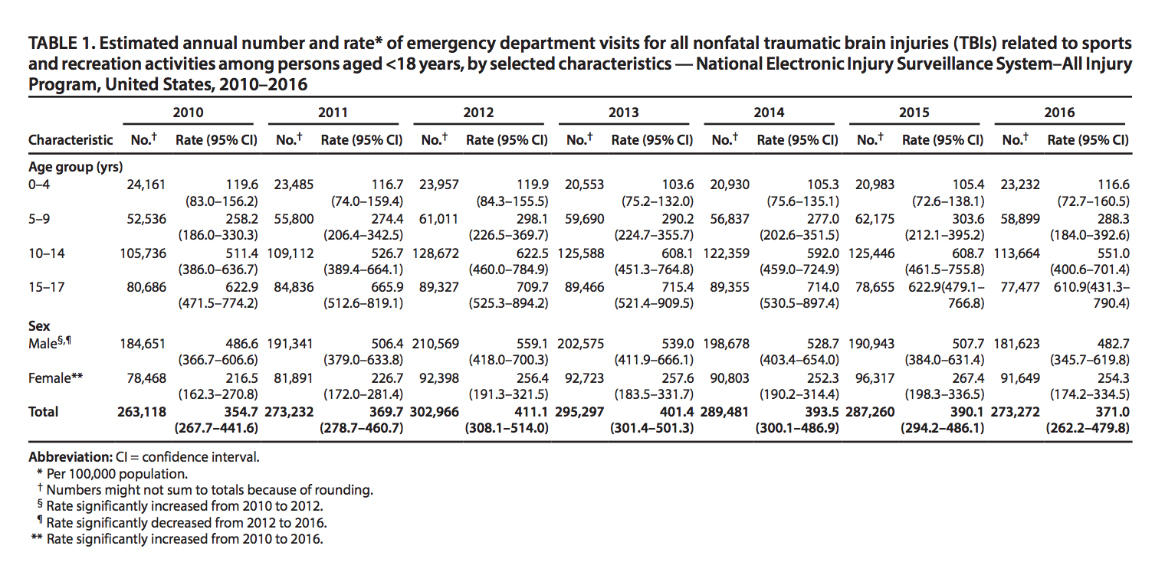

Slide 7
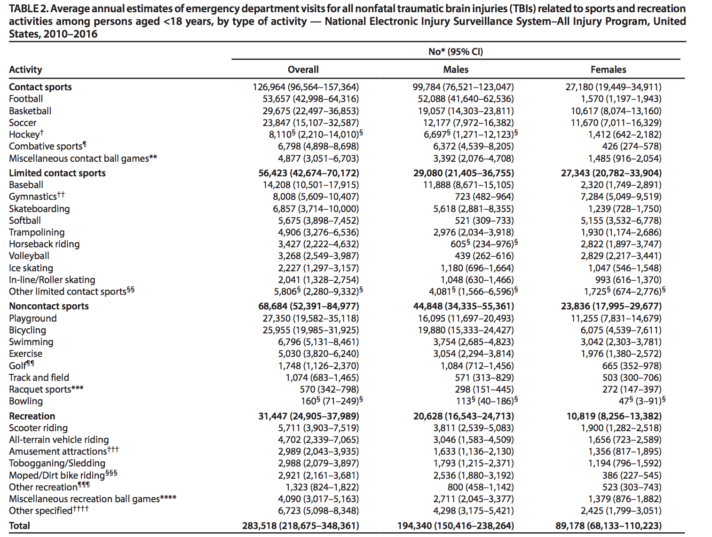

Slide 8
Survey
41 Individuals from NMC surveyed
10 Questions

Slide 9
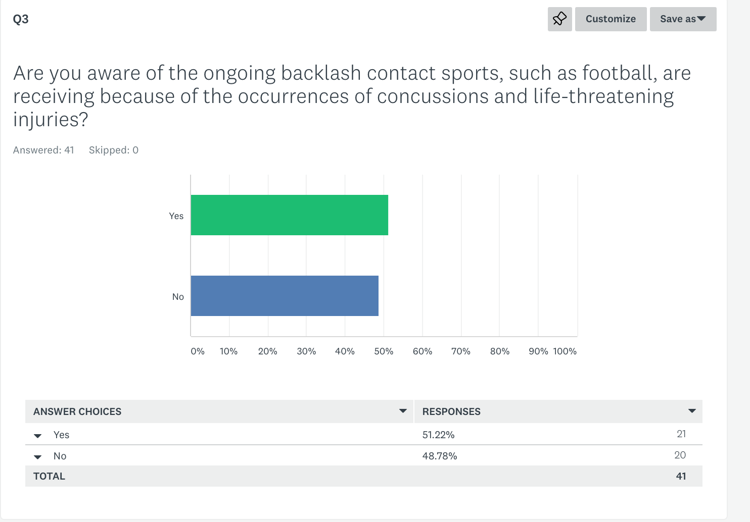
Notes:
I decided to focus on this question because of the importance of the issue. As someone, who watched Concussion, it seems like people should be aware about it since the movie itself was a commercial hit.

Slide 10
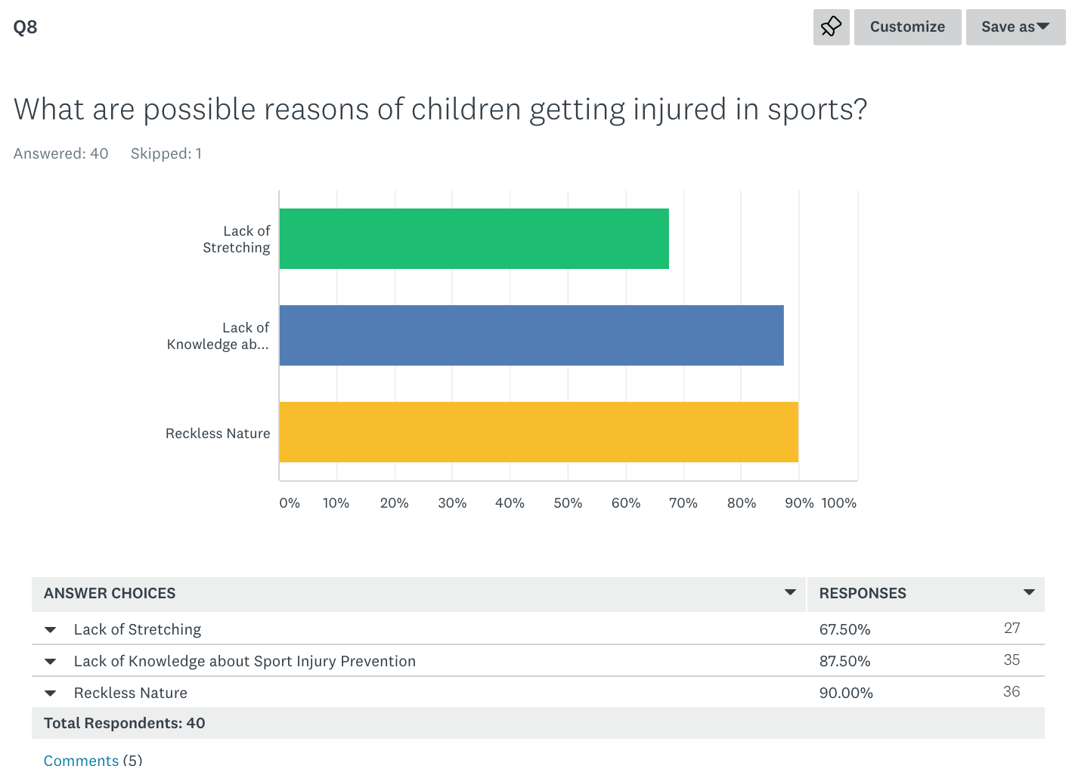
Notes:
I focused on this question as well because I wanted to see if given generalized reasons, would the surveyors usually choose and not think outside the box? As you can see there are 5 comments. The most important out of the 5 was the response of Rule Breaking, I tried to focus on tackling the idea of regulations being the primary issue and that it can’t be helped that incidental contact.

Slide 11
Expert Opinions
5 Questions (Focusing on either concussions/injuries)
Sent 10 (5 Physicians & 5 Neurologists)
Dr. Jeff Bazarian
Notes:
Bazarian was the only doctor that responded. He gave pretty interesting responses such as the side effects of concussions: Migrainous headaches, vestibular dysfunction (postural stability and visual tracking), insomnia, mood changes (anxiety and depression), cognitive dysfunction (memory and attention), near vision problems (accommodation and convergence insufficiencies); Some dysfunctions occur when concussions occur. Play by the rules.

Slide 12
Strengths
Was able to find generalized answers for questions.
Directly point out the probable causes behind the issue.
Straight to the point.

Slide 13
Weaknesses
Topic was a little too broad.
Survey was good, but could have been better.
Paper felt jumbled up and could have been organized a little better.

Slide 14
Resources
https://www.mayoclinic.org/diseases-conditions/concussion/symptoms-causes/syc-20355594
https://files.eric.ed.gov/fulltext/ED568918.pdf
https://www.thestar.com/opinion.commentary/2015/21/10/dont-let-fear-Concussions-ruin-sports-for-kids.html
https://www.abc.net.au/new/2016-04-01/concussions-fears-junior-spark-panic-researchers/7293676
https://www.tacklesmartsports.com/why-fear-of-concussions-shouldn’t-keep-your-kids-out-of-sports/

