Slide 1
30 Day Challenge
Joseph Cing

Slide 2
Overview
So this challenge is about helping me to become healthier and to help my back become stronger. Back in 2018 after Typhoon Yutu, I had back pain for the past few months due to my work because I work at a hardware store. So I have tried so many methods to get rid of my back pain such as pain killers, massages, and laying down on the floor and none of them work. Until now, my back pain is still here.

Slide 3
I was then referred to Saipan to be seen by a physical therapist. The therapist told me that my lower back bone was crooked and told me that the pain isn’t going to go away. He gave me exercises to do to lessen the pain. (Here I am being treated at the hospital.)

Slide 4
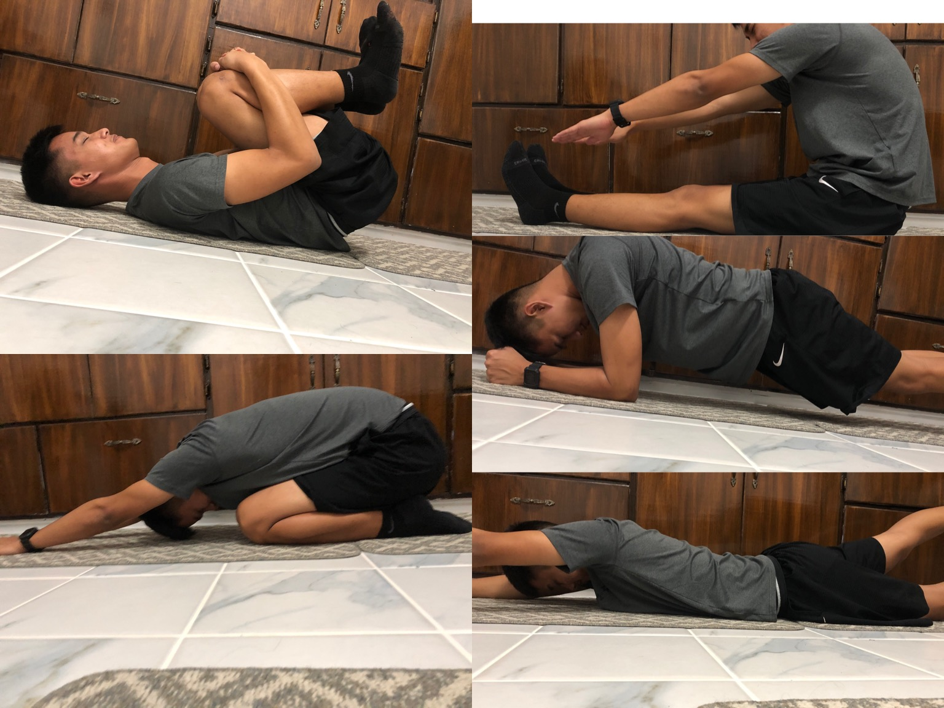
Beginning of the Month
On the first day of March, I was not used to the exercises that the therapist has showed me because I was stubborn to not do it and thought I could hack the pain. It was really a challenge to keep my body fit because my body was dead, like I didn’t want to do it. . But as the days went by, my body started to get used to it and I was back to exercising and it was helping my back pain go away.

Slide 5
End of the Month
As the end of the month came, my body and back started to become better. My back pain wasn’t there anymore, my body was becoming fit, and I had healthier eating habits. This challenge was to help me to continue exercising and to keep my back in total shape. I am still continuing on with my exercises and if I haven’t done this challenge, I would think that my back would be in pain and I wouldn’t be in shape.

Slide 6
30 Day Challenge Calendar

