Slide 1
Presentation II
EN202-ON01
Yukiko N. Kintol

Slide 2
Research Questions
Primary
How will the legalization of recreational marijuana affect our economy?
Secondary Questions
What are other benefits of the legalization of recreational marijuana?
How will the legalization of marijuana affect the well being of others?
Will the legalization of marijuana negatively

Slide 3
Survey Questions
Survey Questions:
Race, age and gender?
Do you support the legalization of recreational marijuana?
Do you support the legalization of medicinal marijuana?
Have you ever traveled or been to any country/state where recreational marijuana has been legalized? If so, how was your experience
Do you think that the legalization of recreational marijuana will affect the economy? If so explain
Have you ever smoked/consumed marijuana? If so, how often.
If marijuana was legalized would you smoke/consume marijuana?
Would marijuana affect the well-being of others? If so, explain.
What other things might marijuana affect?
Do you trust that the government will safely regulate the usage/market of marijuana?

Slide 4
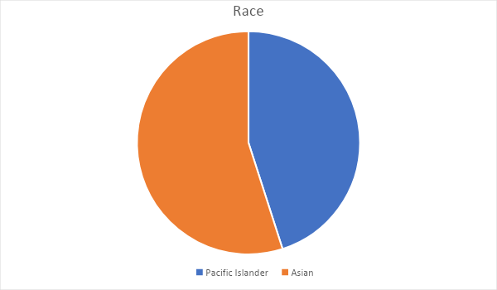
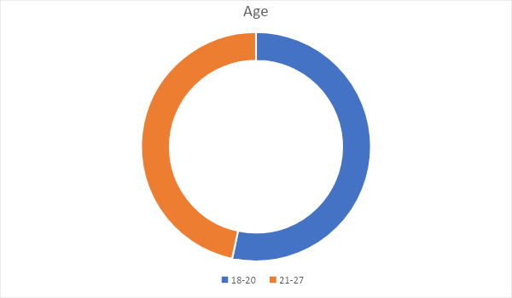
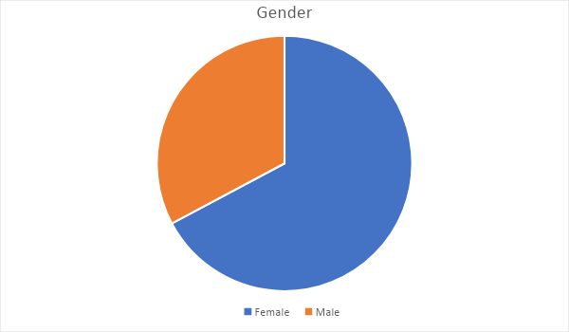
Survey Outcomes

Slide 5
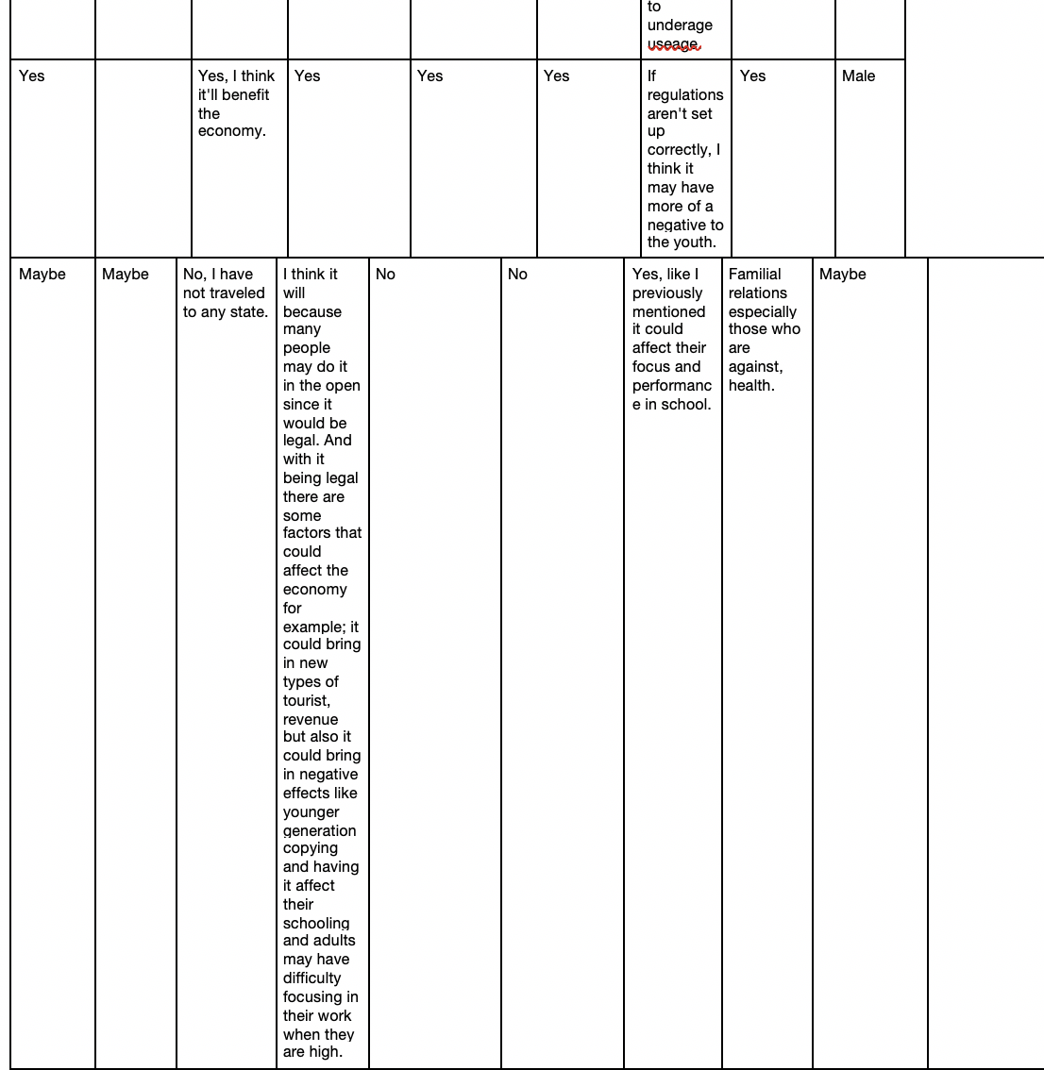
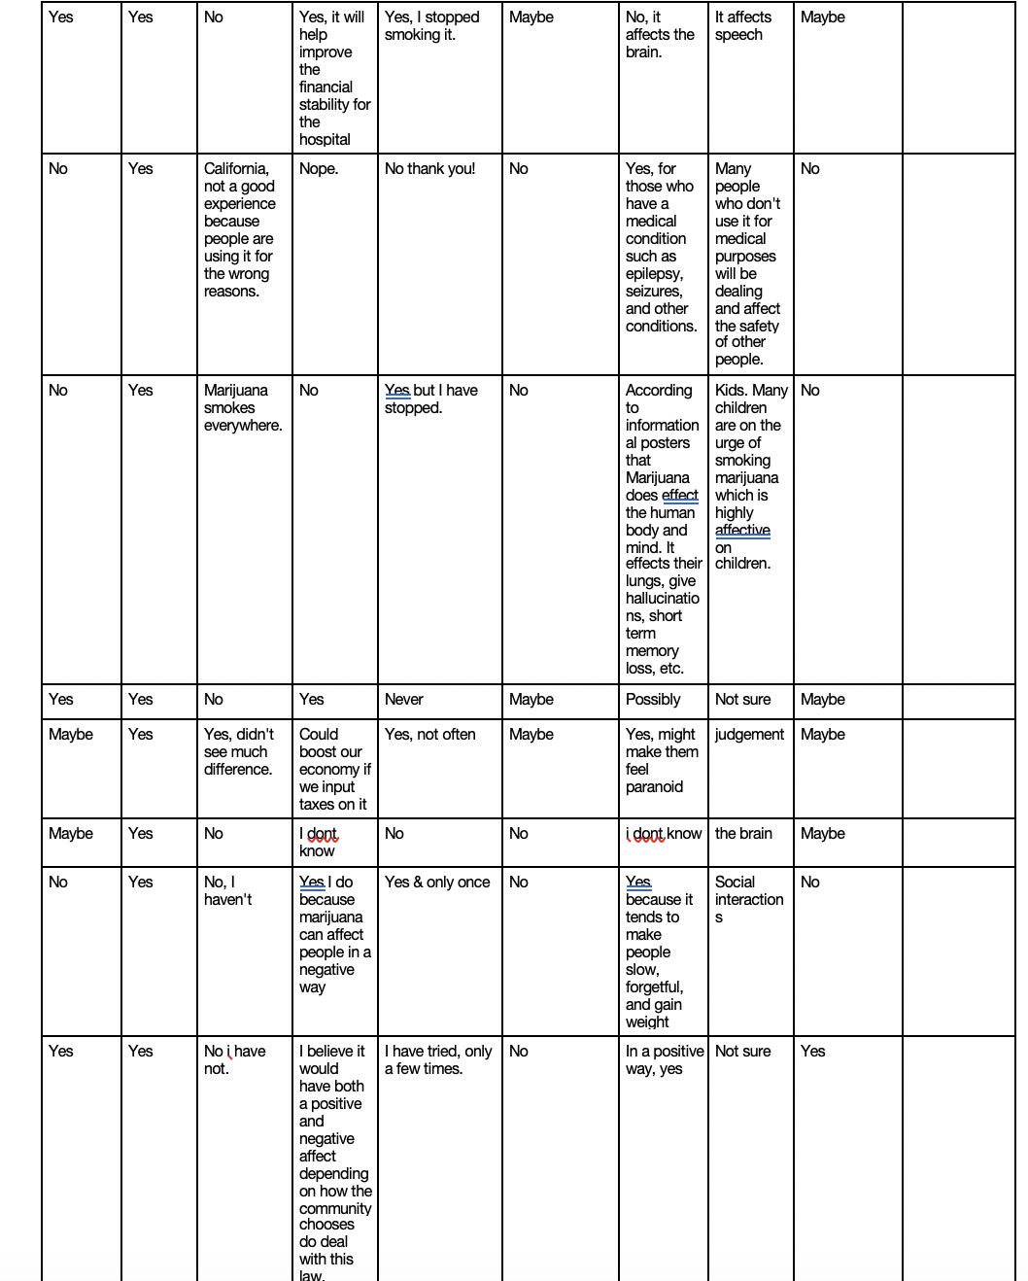
Responses

Slide 6
Interview Questions
What is your occupation?
Age & Gender
What are your thoughts on the legalization of recreational marijuana
Are you familiar with the effects that the legalization of recreational marijuana has?
What are some other opinions you have.

Slide 7
Expert Email
Dear Congressman Tom,
I am a student at the Northern Marianas College, and it is required that we write a research paper. My topic is the effects of the legalizations of recreational marijuana on the economy, I have noticed you are a part of the finance committee in the state of Colorado and finance deals a lot with the economy and I am writing this letter to request for an interview with you VIA Skype or you can simply reply to the questions I have for you; Does the legalization of recreational marijuana increase employment rates, does tourists rate increase, what are some benefits, some negative impacts, etc. If you are unable to skype kindly let me know and I will send you a list of questions that I have prepared.
The message above was the first email sent out. Later, nine more emails were sent.

Slide 8
Literature Sources
Hajizadeh, Mohammed. (2016). Legalizing and regulating marijuana in Canada: review of potential economic, social and health impacts. International journal of health policy and management, 5(8), 543.
Evans, D. (2013). The economic impacts of marijuana legalization.
Kang, S. K., O’Leary, J., & Miller, J. (2016). From forbidden fruit to the goose that lays golden eggs: Marijuana tourism in Colorado. SAGE Open, 6(4), 2158244016679213.
Joffe, A., & Yancy, W. S. (2004). Legalization of marijuana: potential impact on youth. Pediatrics, 113(6), e632-e638.
Shepard, E. M., & Blackley, P. R. (2007). The impact of marijuana law enforcement in an economic model of crime. Journal of Drug Issues, 37(2), 403-424.

Slide 9
Strengths & Weaknesses
Strengths
Able to manage time wisely
A lot of literature resources available
An issue that is happening here in the Marianas.
Weaknesses
People feel like it is a sensitive subject and are not open to share all details.

Slide 10
Methodologies
Survey
Interview
Emails to experts
Observations

Slide 11
The Legalization of Recreational Marijuana
As the legalization of recreational marijuana is near here in the CNMI this research report was very informative because it gives readers information needed.
But there are some effects, both negative and positive that may happen but if the CNMI legislature and the Cannabis Commission regulate Marijuana carefully things will run smoothly.
I learned information regarding effects of the legalization of recreational marijuana which include; higher accident rates, DUI rates higher, homelessness and more.

Slide 12
Future Plans
To share my research report to anyone interested in gaining information on the effects of the legalization of recreational marijuana may have here in the CNMI. I may share this research report to family, friends, classmates, coworkers, or even elected officials. It is important that people of the CNMI are aware of the facts presented as the legalization of recreational marijuana is near.

Slide 13
A few years after the legalization of recreational marijuana here in the CNMI, I want to look back at this research report and compare it to any statistics provided by the CNMI government and just look at how the CNMI has been affected by the legalization of recreational marijuana.

