Slide 1
Attraction and its factors
Russ Dequito
EN202-02
Dr.Kimberly Bunts-Anderson

Slide 2
Research Questions
1.Why do some people find it difficult to talk to someone they find attractive?
2.What factors affect attraction and how do these factors affect a person?

Slide 3
Methodology
Surveys
-Pilot
-Final
Interviews
-4 individuals
Letters to Experts
-No responses

Slide 4
Findings
Factors: Proximity, Familiarity, Propinquity
More Factors: Physical, Psychological, Behavioral
Personal Factors: Shyness, Cultural Background, Age, Past or present relationships, experiences.

Slide 5
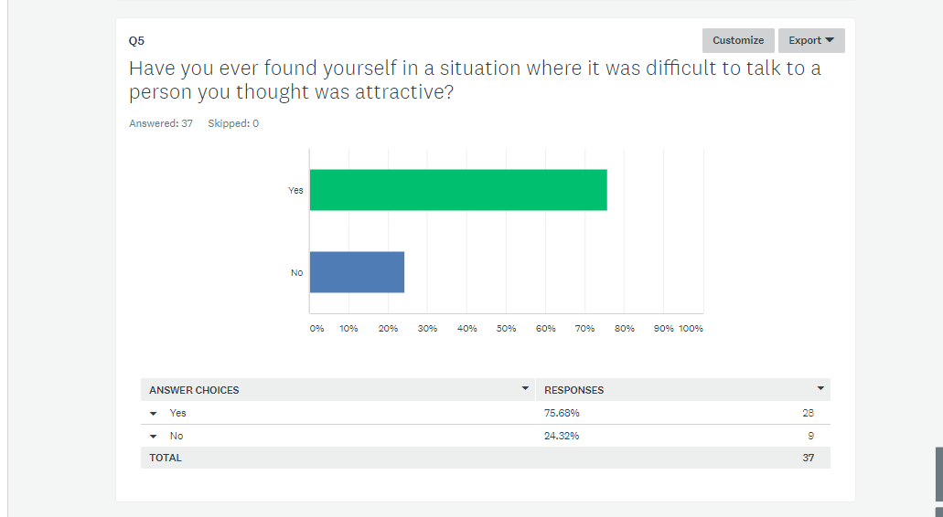
Findings Cont

Slide 6
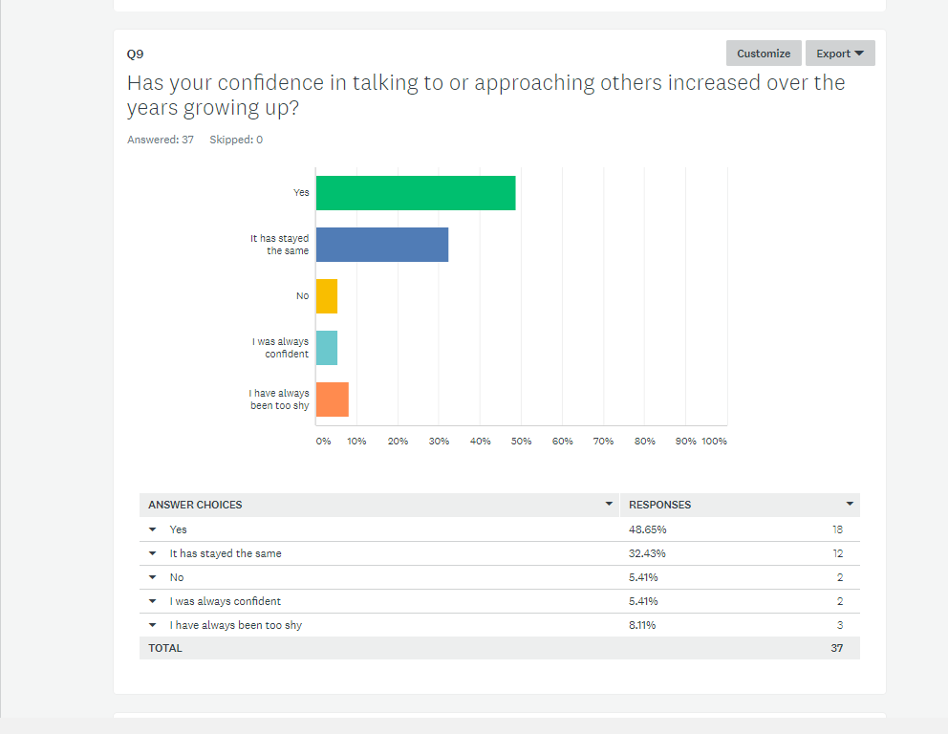
Findings Cont

Slide 7
Interview Findings
Important Notes
3rd Interviewee

Slide 8
Conclusion
Attraction and factors of difficulty all vary from person to person.
It can easily be observed or seen when doing interviews with people or giving out surveys and gathering the results.

Slide 9
Please read my report for more information

