Slide 1
Marie Doris Rioux- Materne Northern Marianas College EN 202-01 Dr. Kimberly Bunts-Anderson Final course presentation
March 16, 2019

Slide 2
NMC and WORKFORCE Study was conducted between August 2018 and March 2019.
Research question:
Has the opening of the NMC’s School of Business Impacted the Local Workforce of the CNMI?

Slide 3
Method to answer the research question:
Finding literature review (academic and non-academic)
A pilot survey of ten multiple choice questions was randomly distributed to 35 NMC students . Out of those, 8 men and 15 women replied.
Letters on the topic were sent to three different experts off island (out of three, only one responded)
An interview was conducted with a student majoring in Business Management at NMC

Slide 4
Interview with expert off island
Daniel Bocash
Occupation: Senior Vice President
Ascentium Capital
Texas
Method of Interview: via Email
Number of Questions Asked: 6
Types of Questions Asked: open-ended
Response Time: Email was sent on October 2018.

Slide 5
What was not successful
I had difficulties reaching experts on island due to the impact of Typhoon Yutu on Saipan.

Slide 6
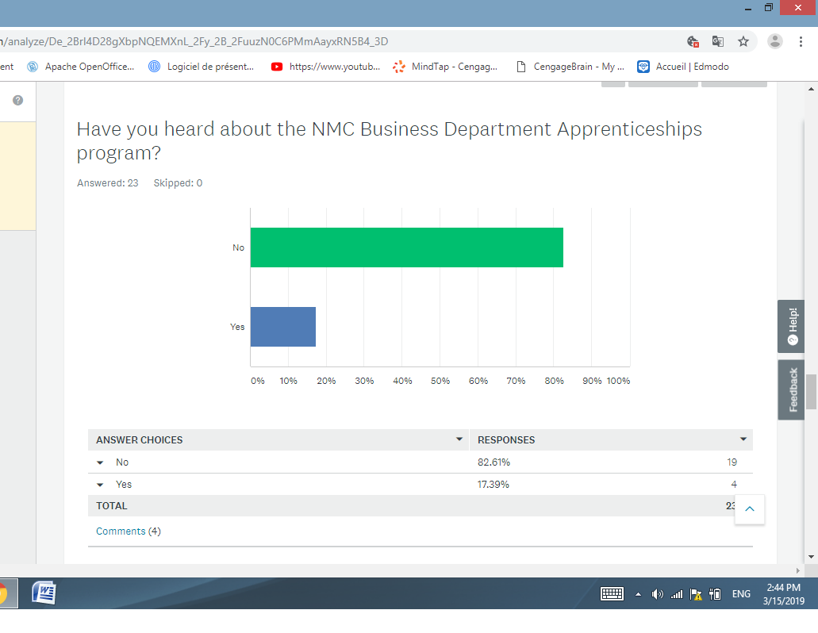
DATA FROM THE PILOT SURVEY
Out of the 23 participants:
5 were majoring in business studies
-6 in education
82 % of the participants not heard of the NMC Business Department Apprenticeship program

Slide 7
Findings
Interestingly, only the six education majors expressed an intention of staying on Saipan to work in the future.
The School of Business is fairy new and still has room to grow and to improve.
Most people lose their jobs not because of what they don’t know or did wrong -It’s how they get along with peers and managers.

