Slide 1
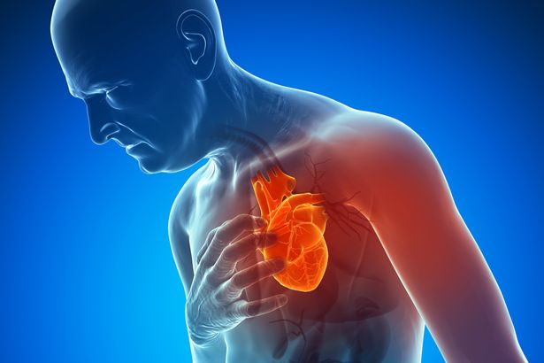
Heart Attacks in the CNMI including the U.S Janna Estrada Atalig PRESENTATION I
Importance of chosen topic: Because of many deaths that involve non-communicable diseases, heart attacks became a worldwide problem due to the fact that it has become a silent killer. Heart attacks are hard to overcome, especially when it comes to seeing loved ones suffer which is life-changing. People who are aware of this type of disease can learn the importance of never encountering it. There is always a better way to stay away than to experience the pain that heart attacks can bring to a family.
Primary causes of Heart Attacks in the CNMI
Difference in age or gender of Heart Attacks
Importance of preventing Heart Attacks

Slide 2
Primary Question: What are the primary causes of heart attacks in the CNMI?
Plan/Objective:
Collect more information from people who has suffered from heart attacks. Being able to use gather sources like this would be a great way to have more knowledge about the topic that I’ve chosen.
Research more online from online newspapers and try to get more facts on the causes of heart attacks.
Gather important booklets/readings and focus on the topic to obtain information that is relevant to the essay

Slide 3
Secondary Question: What are the differences in age or gender reported in the CNMI or the U.S.?
Plan/Objective:
Research on the age/gender differences that is based on the CNMI/U.S.
Obtain more information on the triggers of heart attacks.
Look for more information by interviewing people who encountered a heart attack and find out their thoughts in the gender differences between men or women.

Slide 4
3rd research Question: Why is the prevention on heart attacks important in the CNMI?
Plan/Objective:
Conduct more research on the prevention on heart attacks.
Get background information on what people think that can prevent heart attacks.
Figure out if children can be prone to experiencing a heart attack and see whether or not that is why prevention is important.

Slide 5
PLAN FOR GATHERING MORE DETAILS OF THE QUESTIONS:
Primary sources:
Get in contact with someone who has suffered from a heart attack
Doctors/nurses who know more about heart attacks
Statistics/data that relates to heart attacks in the CNMI
Secondary Sources:
Online Articles
Hospital Pamphlets

Slide 6
Scheduled Dates:
January 22-28 |  | Choosing a research topic
January 29- February 04 |  | Decision of topic and Organizing of research
February 5-11 | Primary/Secondary Research: Newspapers, Online Sources, Pamphlets /Social Interactions | Brainstorming and Outline/Persuasive Draft Essay to be submitted and finalized
February 7-9 |  | Submission of assignments on research and focusing on data
February 10-11 | Writing Schedule/Tentative Writing Schedule | Revisions of Final Essay
February 12-15 |  | Research Report Submission

Slide 7
Conclusion:
Heart attacks are one of the leading cause of deaths ever to happen in the CNMI. Many deaths that involve a non-communicable disease like heart attacks became a worldwide problem because it has become a silent killer. Heart attacks are hard to overcome, especially when it comes to seeing loved ones suffer which becomes life-changing. In addition, people who are aware of this type of disease can learn the importance of never encountering it and can finally see the truth of what simple ways there are to prevent it. There is always a better way to stay away than to experience the pain that heart attacks can bring to a family or to the people. Some individuals might not want to take this up to date and seek awareness for this illness, but when the time comes and they unexpectedly experience the pain a heart attack causes, the people are not safe. So, what will the people of the CNMI do? Will they continue to care or not? Will they finally take the time to see what benefits they can have by trying?

