Slide 1
The CNMI CWs:
The Process to It All
Tiara Babauta
EN101-06
Dr. Kimberly Bunts-Anderson

Slide 2
Research Questions
Primary Question:
Does the Marianas have enough experienced workers to fill the necessary spaces when the CWs leave?
Secondary Questions:
How can we continue the work within the absence of the CWs?
Do we prioritize our locals more than our foreigners?
If the CWs do leave, will this better the CNMI or will this slowly increase more issues that have already taken place?

Slide 3
So, here's how I figured out how to actually get my answers...
The CNMI and
the CWs
Start on a schedule of when to get certain things done.
Find 5 experts and write them letters along with a questionnaire.
Create a pilot and final survey to be disseminated to students at NMC.
Interviews with experts
Meetings with Ed Propst and Governor Torres.
Locate sources, both academic and non-academic.
Disseminate them to students at NMC.
Use search engines such as Google Scholar & EBSCO.
Found sources from news articles, journal entries, and government reports.

Slide 4
About the surveys
I created two surveys: a pilot and a final.
Each survey was given to students at NMC via email. Students were allowed to answer how they please, and giving their own open-minded answers. They were mainly Chamorro or filipino, where many of them were not children of contract workers. Most of them had agreed upon an extension, while others remained neutral. They almost all agreed upon the lack of local workers that the CNMI has. And lastly, the all stated what needs to be done in the workforce to actually make a better employment impact in the Marianas.

Slide 5
What was on the surveys?
Pilot Survey:
Multiple choice, where the percentage of each question was high.
80, and majority were both Chamorro and Filipino. The rest consisted of different nationalities.
Of those ethnicities, almost all were not children of contract workers.
Most chose to be mutual about the situation but others had believed that there was a lack of workers.
Other individuals chose to say that we do need these workers and their time here is very critical.

Slide 6
What was on the surveys?
This survey was distributed to a total of 123 people. Again, majority were either Chamorro and Filipino who were not children of contract workers. From questions 5 to 10 were for people to agree or disagree, it goes to show that the Marianas desperately needs these CWs. However, from questions 11 to 17, were more for opinionated answers and if the Marianas can allow for the locals to gain training, so that when an extension does not occur, we can thrive.

Slide 7
What questions are asked to the experts?
Two questions were unable to be answered due to a certain policy.
The expert’s assistant emailed me other sources that I could use in attempting to answer these questions.

Slide 8
What questions are asked to the experts?
When emailing this to the experts, I had no issues. They were both very helpful and actually wanted me the overall repost of my essay.

Slide 9
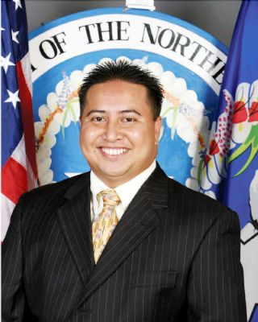
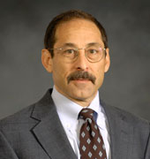
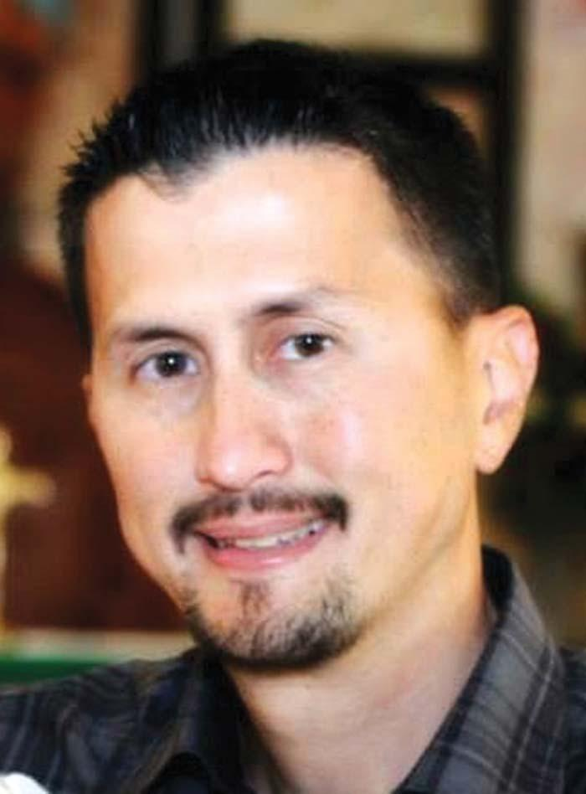
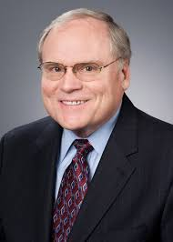
Who are the experts though?
Honorable Ralph DLG Torres
Representative Edwin K. Propst
Mr. David Gootnick
Dr. Oliver Richard
Emil Friberg Jr. was the individual who answer my questions in the absence of Mr. Gootnick and Dr. Richard.
---------------->

Slide 10
So,what's the literature?
The reading notes depicted show what was found when locating sources. As seen, most of the information was from a new article by Sarah Perez and the Government Accountability Office.

Slide 11
Identify the Difficulties
Strengths
People of the CNMI were very active in the topic
Most actually gave me tips on what I could add to my research.
There was a ton of background information every time I located a source.
Weaknesses
Most sources were repetitive.
More experts could have been found, but most were not interested in explaining more about the issue from an outside view.
Literature sources were mainly non-academic sources, barely enough academic sources.
Sources barely gave me answers to what I needed, so I had to change my question.

Slide 12
what was learned? What was felt?
I actually felt glad that I attempted to conduct this research. I learned that we, the locals and foreigners, both what the Marianas to thrive. In order fo that to happen, we need to work together and our locals must find a way to train to the same advancement as the foreigners. I learned that the unemployment rate could be at the number one in the nation, if we find a way to raise the numbers.

Slide 13
Future Plans on Topic
Regardless of how interesting the topic was, I do not plan on research further. However, I do plan to review the updates on the topic every now and then. I do hope that the Marianas drastically changes, in a good way!

Slide 14
Suggestions?
Be sure to have more than five experts.
READ the literature, you could find out more the I did.
Talk to people, ask them these questions, you never know they could actually answer the questions that you have.
If all else fails, PICK ANOTHER TOPIC!!!

