Slide 1
Library vs. Internet
By: Ivan Santos
EN202-02
Northern Marianas College

Slide 2
Research Questions
Primary Question: For retrieving sources, is it better to use the library or the internet?
Secondary Questions: Which is more accessible? Which provides more, valid, information?

Slide 3
Sources
Academic Journal
Academic Journal
Website Article
Academic Journal
Textbook
Textbook
Interview
Textbook

Slide 4
Schedule
October 1-10 | Brainstorm & Gather research questions
October 10-15 | Start introduction
October 15-31 | Group answers and start on body & Survey people
November 1-10 | Add survey as support & Revise
November 10-20 | Interview and question experts
November 21-December 10 | Finalize and Revise Research Essay, Work on eportfolio, and prepare presentation.

Slide 5
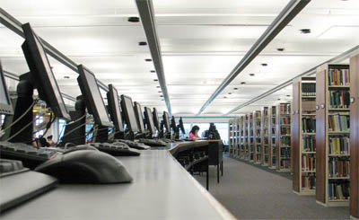
Status Quo
We are moving into a technological era.
In almost every institution, there are computers.
The world depends on the internet.
But, we still have libraries.
We still have libraries because it provides the most trusted information.

Slide 6
Library
The library provides the most published sources such as textbooks, non-fictional books, academic journals, etc.
This is an advantage for people who research because the time they use to research does not deal with looking for true information.

Slide 7
Internet
Latest Information
Most Popular Information
Faster Access
Helps you find articles related to the topic
With these advantages, people will have great chances of having the latest information.

Slide 8
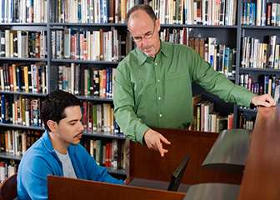
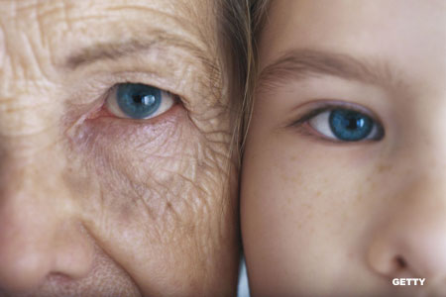
Differences
In fact, older generations prefer using the library for research.
Libraries have only hard-copied sources which may be old and take a while to replace and update.
Libraries have staff that can help you with your research.
Besides the library, books can be found anywhere in the world.
The library can be used for studying.
Younger generations prefer using the internet for research and other reasons.
Internet articles may be false, therefore you can’t trust everything you find.
You use the internet on your own
In order to use the internet, a device is needed.
Internet places are not suited for studying

Slide 9
Interest/Argument
Helped me develop better writing skills
Taught me how to use the library which provided me with the best sources for research
I also found out about the databases online
It improved my communication skills
As we are moving into a technological era, people are using the internet more than the library which is causing students to misunderstand the significance library.

Slide 10
