Slide 1
Social Networking Addiction
My English Research Portfolio
Joanna Bea
Northern Marianas College
EN 202-02

Slide 2
Project: Social Networking Addiction
Section One
Preparation Documents
Brainstorm
Proposal
Outline
Research Paper

Slide 3
Brainstorm
Three Research Topics/Questions
“Why does young people get affected so much by social media?”
“How can social media be an escape from the real world?”
“Is there really something happening to your heart when you’re ‘heart-broken’?”

Slide 4
Brainstorm
Choosing a Topic
Social Media
Education
Politics
3 topics choices
Are there sources available online and outside help?
Is there any existing studies?
Is it possible to be completed at a given time?

Slide 5
Brainstorm
Chosen Research topic:
Social Networking Addiction
Primary Research Question
“When social networking becomes an addiction?”
Secondary Research Question
What are the reasons or motivations for Social Networking Sites usage?
Does Saipan have a lower or higher risk of social networking addiction?

Slide 6
Research Proposal
My Research Proposal
Introduction
Research Question
Literature Review
Reference
Research Methodology
Tentative Schedule
Conclusion

Slide 7
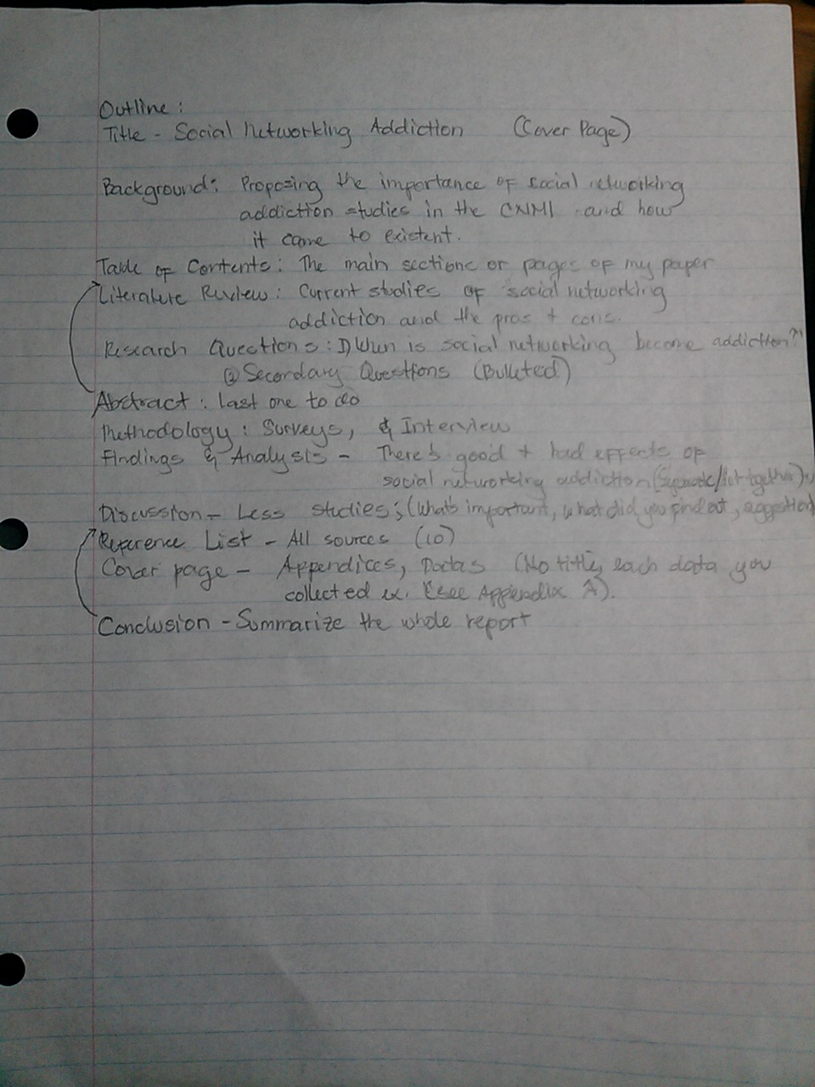
Portfolio Outline & Literature Sources

Slide 8
My English Research Portfolio
Topic: Social Networking Addiction
Research Portfolio
Abstract 3
Introduction 4
Background 4
Literature Review 6
Research Questions 7
Primary Research Question 7
Secondary Research Questions 7
Methodology 7
Pilot Study 7
Second Pilot Study 7
Interview and Questionnaire 8
Findings 9
Discussion 10
Conclusion 11
References 12
Appendices 15-24

Slide 9
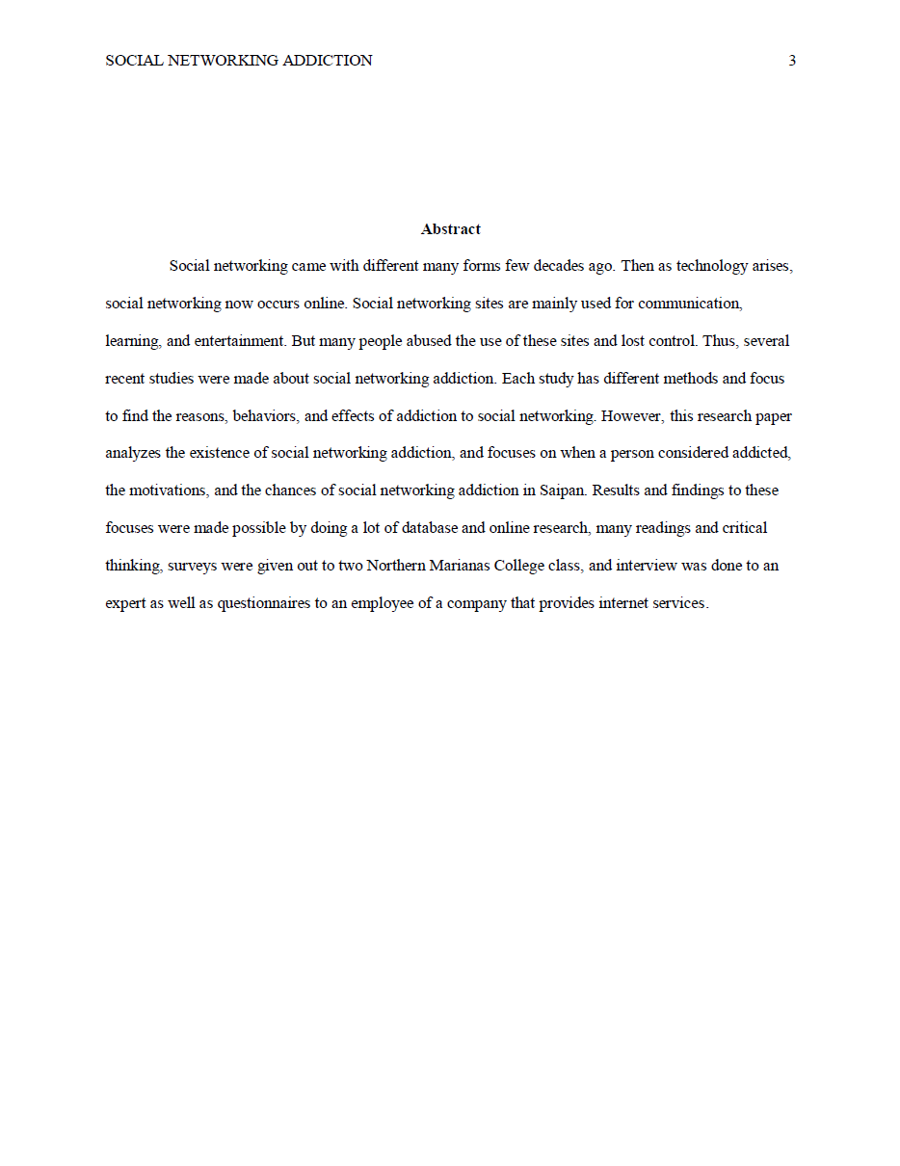
Cover Page, Table of Contents, Abstract

Slide 10
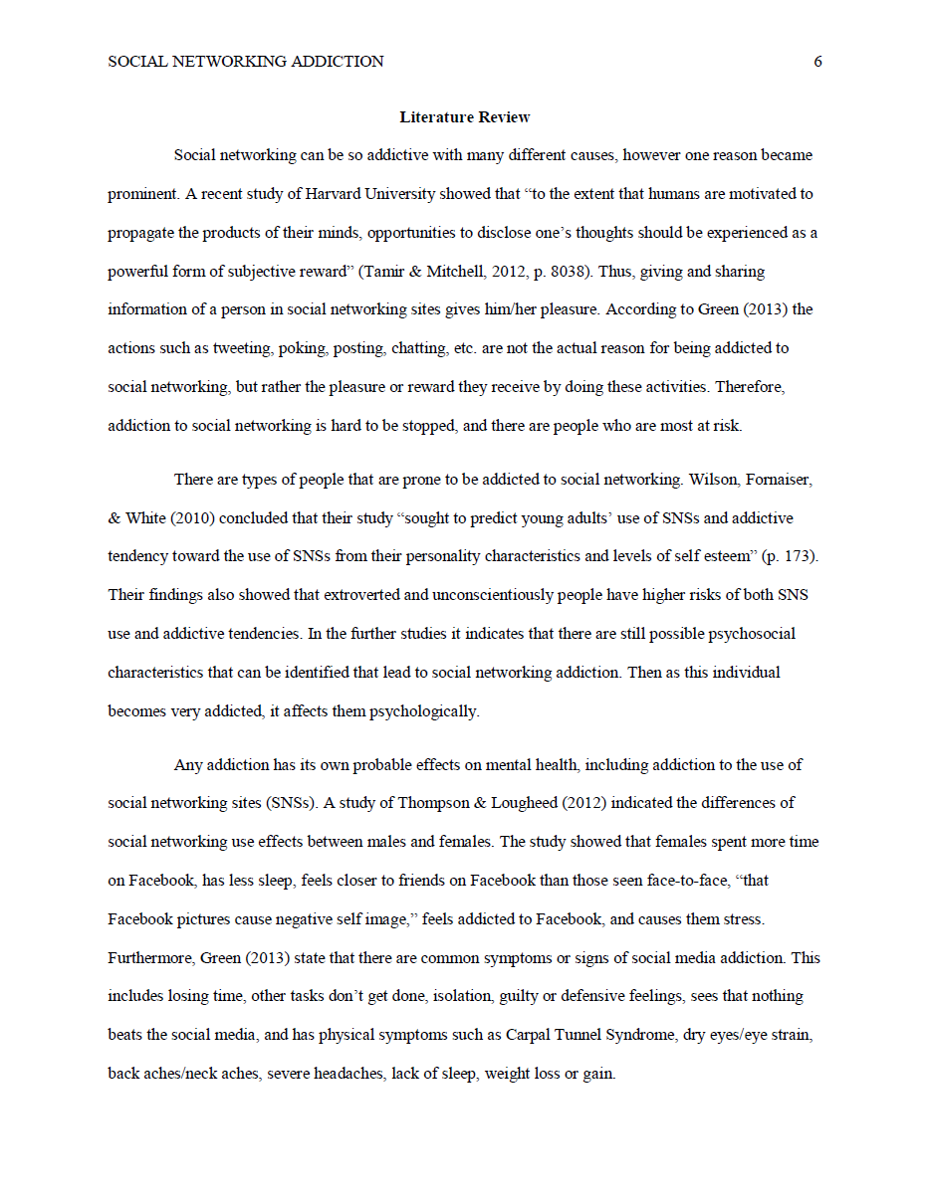
Intro, Background, Literature Review

Slide 11
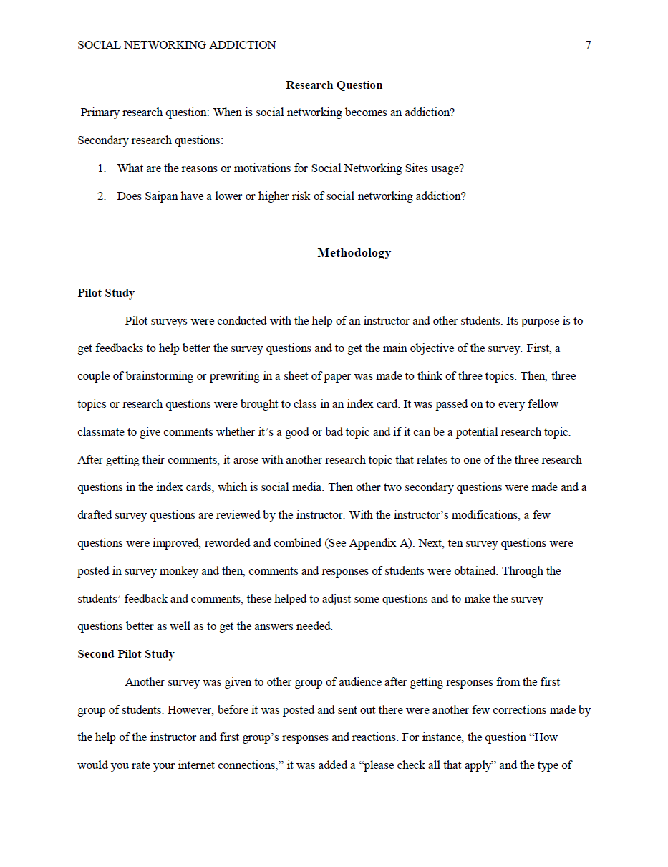
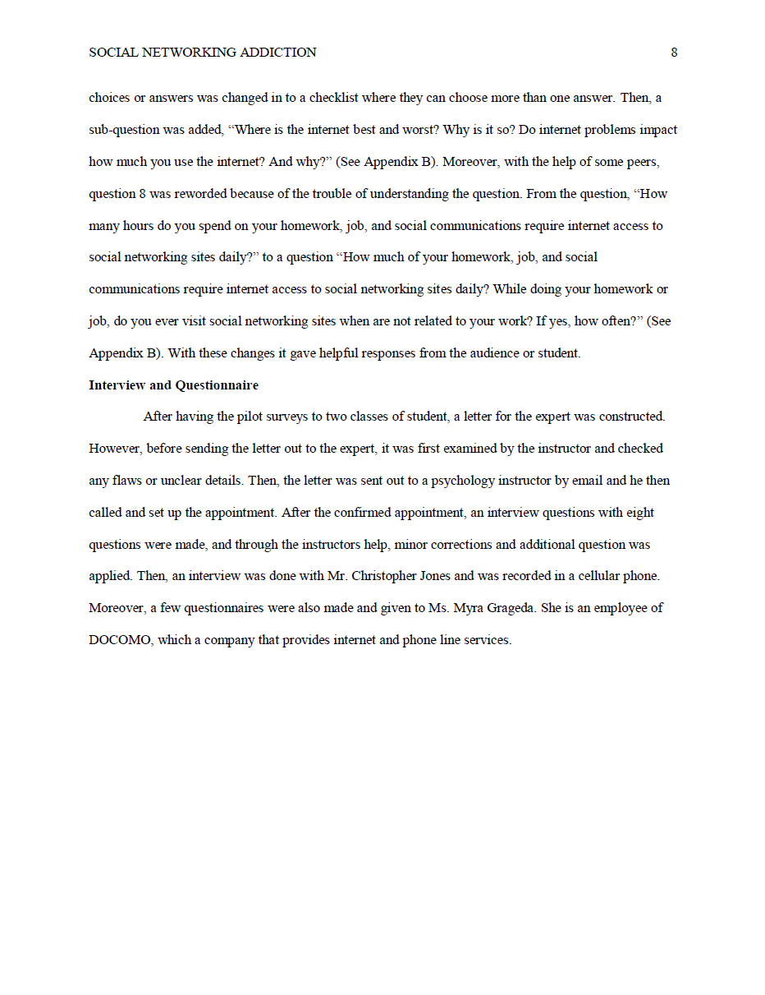
Research Questions, Methodology, Findings

Slide 12
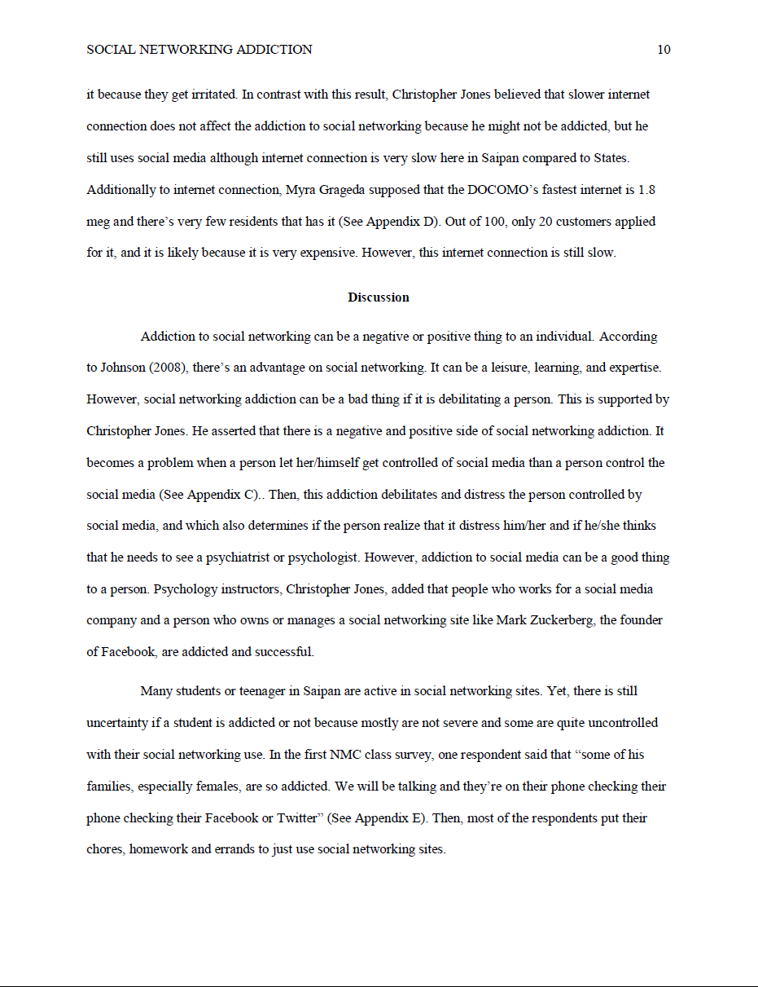
Discussion, Conclusion, Reference

Slide 13
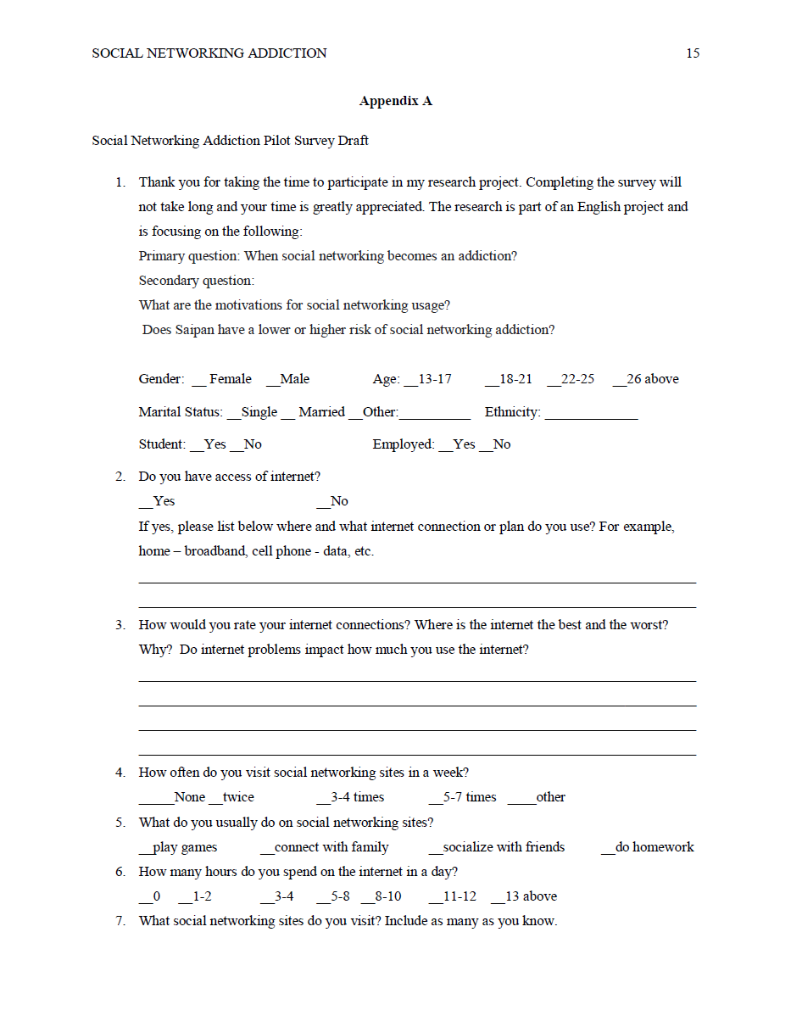
Reference, Appendices(Cover Page), Appendix A

Slide 14
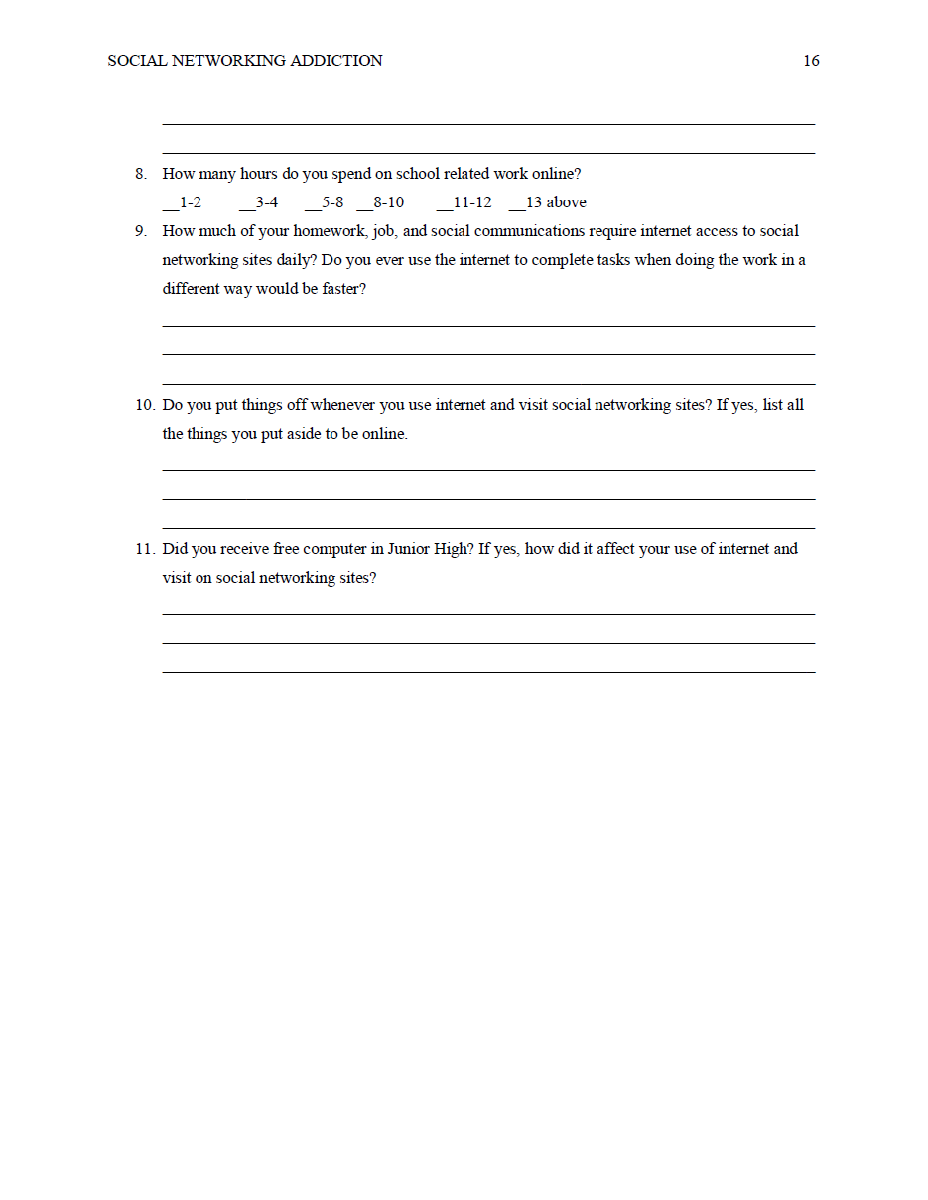
Appendix A & B

Slide 15
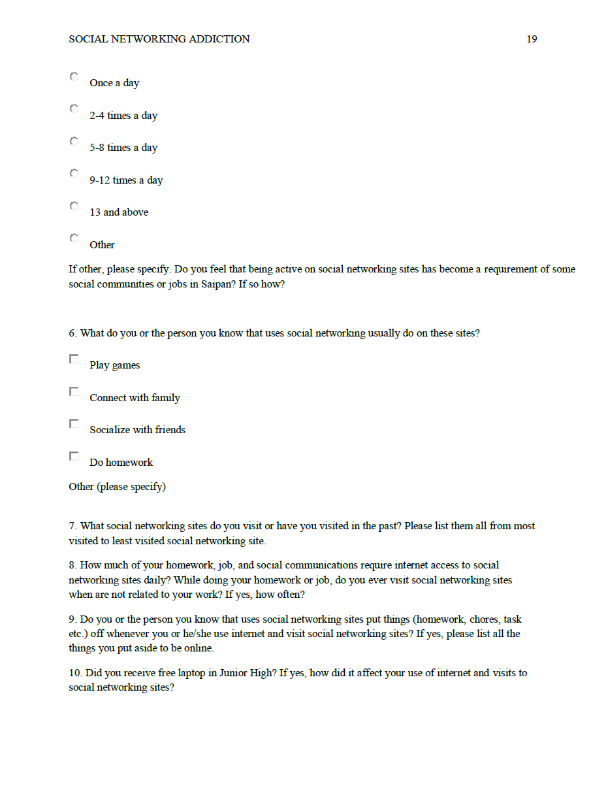
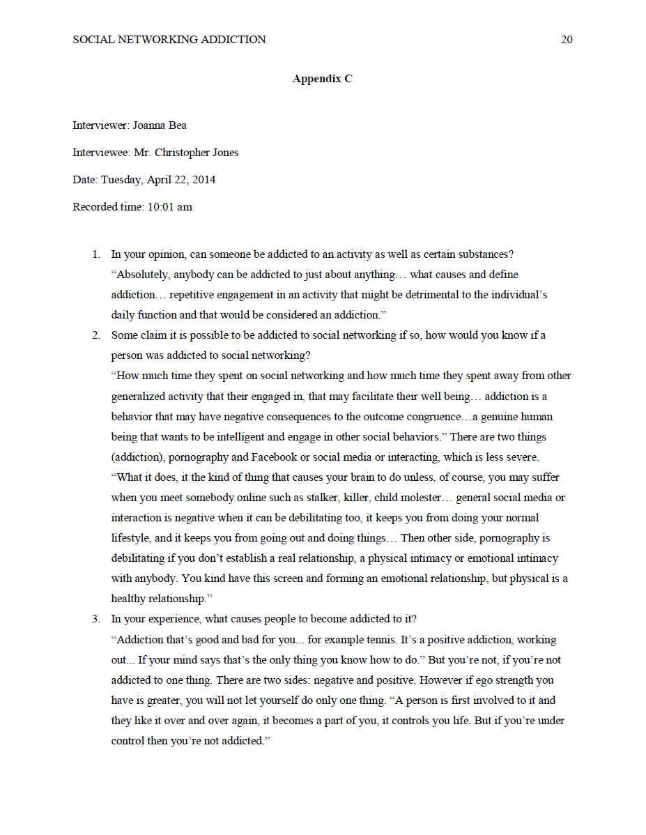
Appendix B & C

Slide 16
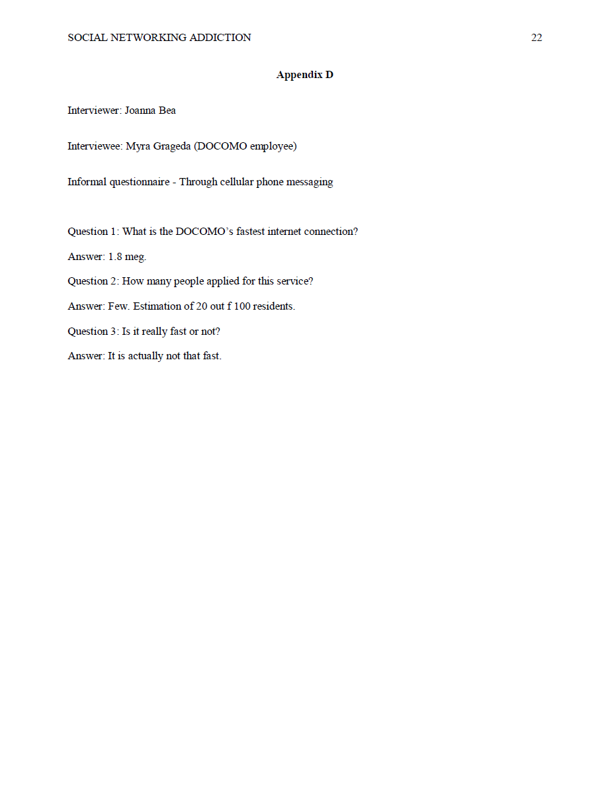
Appendix D & E

Slide 17
The End

